Slide 1
Outline
Module 3: Understanding Data
2.1 What is Data?
2.1.1 Types of Data
2.1.2 Data Storage and Representation
2.2 Big Data Analytics and Types of Analytics
2.3 Big Data Analysis Framework
2.3.1 Data Collection
2.3.2 Data Preprocessing
2.4 Descriptive Statistics
2.5 Univariate Data Analysis and Visualization
2.5.1 Data Visualization
2.5.2 Central Tendency
2.5.3 Dispersion
2.5.4 Shape
2.5.5 Special Univariate Plots

Slide 2
Module 2: Understanding Data
What is Data:
  Data refers to raw facts, figures, or information collected for analysis, interpretation and decision-making.
      It can be in any form — numbers, text, images, audio, video, or sensor readings.
      Available is different data sources like flat files, databases or data warehouse.
      Small data: Data collected, integrated and processed by small scale computer.
      Big Data: refers to extremely large and complex data sets that traditional data processing tools cannot handle efficiently. It comes from various sources like:
              Social media (posts, likes, shares)
              Sensors and IoT devices
              Online transactions
              Emails and digital communication
              Health records, GPS data, etc.

Slide 3
Module 2: Understanding Data
Elements of Big Data:
  Big Data is characterized by 6Vs
Element | Description | Example
1. Volume | The amount of data generated every second is massive.(PB, EB, 1 exabyte is 1million terabytes) | YouTube uploads 500+ hours of video per minute.
2. Velocity | The speed at which new data is generated and processed. | Stock market data, live tweets, or sensor data streaming in real time.
3. Variety | Data comes in multiple formats | Form(text, video, audio) Function( human conversation, transaction) source of data(social media, multimodel data)
4. Veracity | Conformity to facts, truthfulness, believability & confidence in data. | Free of Fake news, duplicate entries, missing values.
5. Value | The usefulness of data — converting raw data into insights or business benefits. | Using customer data to predict buying behavior.
6. Validity | Accuracy of data required as needed for given problem | Data types as per field

Slide 4
Module 2: Understanding Data
Types of Data: In Big data there are 3 kinds of data
Type | Description | Examples
Structured Data | Organized in rows and columns, easily stored and processed in databases. | Excel sheets, SQL databases (e.g., student records, sales data)
Unstructured Data | No fixed format; difficult to store in traditional databases.(estimated 80%) | Images, videos, emails, social media posts/blogs
Semi-structured Data | Has some structure but not strictly organized. | JSON, XML files, log files, HTML pages
Structured data frequently encountered in Machine Learning
Record data is a type of data where each row represents one record (or object) and each column represents an attribute (or feature) of that record.
Data Matrix is variation of Record data, consisting of numeric attributes(so standard matrix operations can be applied).
Graph data represents information as a collection of objects (called nodes or vertices) & the relationships (called edges or links) between them. It focuses on connections — not just individual records
Ordered Data objects involve attributes that have implicit order among them. Temporal Data(w.r.t time), Sequence data(ex DNA seq), Spatial data(ex: Maps)

Slide 5
Module 2: Understanding Data
Data Storage and Representation
Data Storage | Where and how data is physically saved | Databases, cloud, files
Data Representation | How data is formatted and organized | CSV, JSON, XML, graphs
The goal of data storage management is to make data available for analysis.
There are different approaches to organize & manage data in storage files and systems .
Flat Files:
Stores data in a single table-like format (no relationships)
Easy to create, read, and share
Portable and supported by many tools (Excel, Python, SQL imports)
Ideal for small datasets or data exchange between systems
Some of popular spreadsheet formats are
CSV: Comma seperated value files
TSV: Tab separated value files
These are generic in nature and many tools like Google sheets & Excel to process these files.

Slide 6
Module 2: Understanding Data
Data Storage and Representation
Database System:
A Database System is a combination of hardware, software, data, and users that allows efficient storage, management, and retrieval of data.
It is designed to handle large amounts of structured information and supports operations like inserting, updating, deleting, and querying data.
Conceptual Representation: Database System=Database+DBMS+Users+Hardware/Software
Different types of databases are
Transactional Database
Time-Series Database
Spatial Database

Slide 7
Module 2: Understanding Data
Data Storage and Representation
Transactional Database
- Collection of transactional records; each record is a transaction
  - Transaction may have timestamp, identifier & a set of items which have links to other tables
  - Created to perform associational analysis that indicates correlation among items
  - Commonly used in banks, shopping apps, and ticket booking systems.
  - Examples: MySQL, Oracle, SQL Server
            Time-Series database
      - Stores data that changes over time, with each entry having a timestamp.
      - Data represents the sequence of data which represent values/events obtained over period of time
      - Useful for monitoring trends like temperature, stock prices, or sensor data.
      - Examples: InfluxDB, TimescaleDB, Prometheus.
      Spatial database
      - Stores & Manages Spatial Info in Vector or Raster Format.
      - Vector format (geometric primitives like points, lines, polygons) is used to store data for Maps - Raster format(bitmaps or pixels) are used for images.
      - Used in Google Maps, GPS systems, and location-based apps.
      - Examples: PostGIS, Oracle Spatial, MongoDB (with GeoJSON).

Slide 8
Module 2: Understanding Data
Data Storage and Representation
World Wide Web(WWW)
  Provides a diverse, worldwide online information source.
  Information is represented using HTML, CSS, and multimedia elements (text, images, videos, links).
  Information present in WWW is used to mine interesting patters by Data mining algorithms.
  Examples: Websites, online databases, and cloud storage systems.
XML(eXtensible Markup Langauge)
It is both Human & Machine interpretable data format
Data is stored in plain text, making it platform-independent and easy to transfer between systems/platforms
Unlike HTML, XML focuses on what the data is, not how it looks.
Commonly used for data exchange between applications (e.g., web services, configurations).

Slide 9
Module 2: Understanding Data
Data Storage and Representation
Data Stream
It is dynamic data which flows in & out of the observing environment (sources like sensors, cameras, or online transactions)
Typical characteristics of data stream are huge volume of data, dynamic, fixed order movement & real time constraints.
Unlike traditional storage, data streams are processed in real time instead of being stored first.
Used in live applications like weather updates, stock prices, or YouTube live chat.
RSS(Really Simple Syndication)
RSS is a web format used to store and share updated information from websites in a simple, readable form.
It stores data like news headlines, blog updates, or podcast episodes in XML format.
Helps users get the latest content automatically without visiting each website.
Useful for real-time information sharing and content updates across the web.
JSON(Java Script Object Notation)
JSON is a lightweight text format used to store and exchange data between systems.
It represents data in key–value pairs (like name: value).

Slide 10
Module 2: Understanding Data
Big Data Analytics and Types of Analytics
The main goal of data analysis is to help organizations make better decisions using data.
For example, a business can find out which product sells the fastest and plan marketing activities accordingly.
Key Points:
Data analysis converts raw data into useful information and insights.
Data analytics is a broader term that includes data collection, preprocessing, and analysis.
Data analysis is just one part of data analytics — it focuses mainly on analyzing historical data.
Data analytics helps predict future outcomes and trends.
Four Types of Data Analytics
Descriptive Analytics – Explains what happened using past data.
Diagnostic Analytics – Explains why it happened by finding reasons or causes.
Predictive Analytics – Predicts what is likely to happen in the future using data trends.
Prescriptive Analytics – Suggests what should be done to achieve desired results.

Slide 11
Module 2: Understanding Data
Big Data Analytics and Types of Analytics
Type of Analytics | Purpose / Definition | Key Points | Example
1. Descriptive Analytics | Describes what has happened in the past using historical data. | Summarizes past data Helps understand trends and patterns Uses charts, graphs, and reports | Monthly sales report showing total products sold.
2. Diagnostic Analytics | Explains why something happened by finding causes behind trends or events. | Looks for relationships and reasons Uses data mining and correlation analysis Helps find the root cause of problems | Investigating why sales dropped last month.
3. Predictive Analytics | Predicts what is likely to happen in the future based on past data. | Uses statistical models and machine learning Focuses on future outcomes Helps in planning and decision making | Forecasting next month’s sales using past trends.
4. Prescriptive Analytics | Suggests what actions should be taken for the best results. | Uses optimization and simulation techniques Suggests the best course of action Helps in strategic decision-making | Recommending discounts or offers to increase sales.

Slide 12
Module 2: Understanding Data
Big Data Analysis Framework
The Big Data Analysis Framework is a layered architecture used for performing data analytics.
A 4-layer framework, as described, includes the following components:
Data Connection Layer
Data Management Layer
Data analytics Layer
Presentation Layer
Data Connection Layer:
  Responsible for data ingestion(process of taking raw data and importing it into appropriate data structures.
  It also performs the tasks of the ETL process (extract, transform, and load operations).

Slide 13
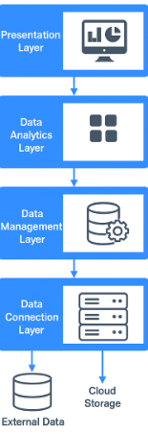
Module 2: Understanding Data
Big Data Analysis Framework
Data Management Layer:
Purpose is to preprocess data and facilitate the parallel execution of queries.
It handles data management tasks and can implement various schemes like "data-in-place" or constructing data repositories like data warehouses.
Data Analytic Layer:
  Has multiple functionalities, including performing statistical tests and applying machine learning algorithms to understand data.
  It is also used for constructing machine learning models and implementing model validation mechanisms.
  Type of processing: Cloud Computing, Grid Computing, H-Computing.
Presentation Layer:
Has mechanisms such as dashboards and applications that display the result of analytical engines and machine learning algorithms.

Slide 14
Module 2: Understanding Data
Big Data Analysis Framework
The Big Data processing cycle is described as an iterative process.
It is carried out on a permanent basis to ensure the data is suitable for data mining.
Involves data management that consist of following steps
Data collection: The initial task of gathering datasets.
Data preprocessing: Preparing the collected data.
Applications of machine learning algorithm: Using algorithms to analyze the data.
Interpretation of results and visualization of machine learning algorithm: Displaying the findings of the analysis.

Slide 15
Module 2: Understanding Data
Big Data Analysis Framework: Data Collection
A good quality data yields a better result, hence most of the time is spent for collecting good quality data.
‘Good data’ is one that has following properties
- Timeliness: The data should be relevant and not obsolete.
- Relevancy: The data should be ready for machine learning algorithms, with no bias and all necessary information available.
- Knowledge about the data: The data should be understandable, interpretable, and self-sufficient for the intended application.

Slide 16
Module 2: Understanding Data
Big Data Analysis Framework: Data Collection
Data Sources
Data sources are broadly classified into three categories:
Open or public data: Data that is free to use without stringent copyright restrictions, such as government census data, digital libraries, and healthcare databases.
Social media data: The vast amount of data generated by platforms like Twitter, Facebook, YouTube, and Instagram.
Multimodal data: Data that involves many modes, such as text, video, audio, and mixed types. These are heterogeneous in nature. Ex: WWW has huge amount of data distributed in internet.

Slide 17
Module 2: Understanding Data
Big Data Analysis Framework: Data Processing
Real-world data is often ‘dirty’ — incomplete, inaccurate, inconsistent, or contains outliers.
Goal: Make raw data usable for machine learning and analytics.
Dirty data may include:
    Incomplete data: Missing values or blank fields.
    Inaccurate data: Typographical or measurement errors.
    Outlier data: Values far outside expected range.
    Inconsistent data: Conflicting or duplicated entries.
    Data with missing values: Gaps due to entry or collection issues.
Types of Data Errors
    Random errors: Unpredictable data distortions.
    Systematic errors: Consistent distortions (e.g., bias in measurement).
    Duplication errors: Same data recorded multiple times.
    Typographical errors: Mistyped values or units.

Slide 18
Module 2: Understanding Data
Big Data Analysis Framework: Data Processing
What is Data Cleaning Process
Detect and correct or remove inaccurate records.
Handle missing values (e.g., replace, predict, or delete).
Identify and treat outliers.
Standardize data formats and units.
Remove duplicates.
Data Wrangling
Along with Data cleaning, Includes transformation, normalization, and integration.
Making raw data processable for machine-learning algorithm
Essential for improving data consistency and model performance.

Slide 19
Module 2: Understanding Data
Big Data Analysis Framework: Data Processing
Patient ID | Name | Age | Date of Birth | Fever | Salary
1 | John | 21 | — | Low | -1500
2 | Andre | 36 | — | High | —
3 | David | 5 | 10/10/1980 | High | 65000
4 | Raju | 136 | — | Yes | —
Observations from the Example
• Missing Data: John and Andre missing DoB; Salary missing for some entries.
• Inaccurate Data: David’s age recorded as 5 instead of 45.
• Noisy Data: John’s Salary = -1500 (invalid negative value).
• Outlier Data: Raju’s age = 136 (unrealistic, but legtimate).
Dirty data leads to poor analysis and unreliable results.
Raw data must be preprocessed to give accurate results.
Data preprocessing ensures quality and accuracy.
Data Processing improves the quality of the data mining techniques.
Data cleaning is the foundation for reliable AI and analytics systems.

Slide 20
Module 2: Understanding Data
Big Data Analysis Framework: Data Processing
Missing Data Analysis
• Missing data analysis is a key step in data cleaning.
• Goal: Handle missing values, reduce noise, and correct inconsistencies.
• Ensures accurate data mining and avoids model overfitting.
Causes of Missing Data
• Human errors during data entry.
• Sensor or system failures.
• Data corruption or loss.
• Optional fields left blank in collection forms.

Slide 21
Module 2: Understanding Data
Big Data Analysis Framework: Data Processing
Procedures to solve the problem of missing data:
Ignore the Tuple
  Discard records with missing values.
  Useful only when percentage of missing data is small.
  Not suitable for large-scale missing data.
Manual Filling of Missing Values
  Domain expert analyses and fills missing values.
  Accurate but time-consuming and impractical for large datasets.
Use a Global Constant
  Replace missing data with values like “Unknown” or “Infinity.”
  May cause false patterns during analysis.
Use Attribute Value
  Replace missing values with a known value, e.g., average income.
  Common and simple, but may oversimplify data patterns.

Slide 22
Module 2: Understanding Data
Big Data Analysis Framework: Data Processing
Procedures to solve the problem of missing data:
Use Attribute Mean (per Class)
  Compute mean for all samples in the same class.
  Replaces missing values more contextually than global mean.
Use Most Probable Value
  Predict missing values using models like classification or decision tree.
  Provides more intelligent estimation of missing data.
Drawbacks / Bias
Some methods can introduce bias or error.
Estimated values may not equal the true values.
The difference between estimated and actual values = error or bias.

Slide 23
Module 2: Understanding Data
Big Data Analysis Framework: Data Processing
Removal of Noisy or Outlier Data:
• Noise = random error or variance in measured values.
• Outliers = data points that deviate significantly from other observations.
• Both can distort analysis and reduce model accuracy.
• Goal: Detect and smooth noisy data for better data quality.
Causes of Noise or Outliers
• Human or instrument errors during data collection.
• Transmission errors.
• Data entry mistakes.
• Unexpected or rare events in real-world data.

Slide 24
Module 2: Understanding Data
Big Data Analysis Framework: Data Processing
Techniques to Remove Noise:
Binning Method (Bucketing)
Sort data and divide into equal-frequency bins (groups).
Neighbor values are used to smooth the noisy data.
Acts as a discretization technique (reduces variation).
Types of Smoothing Techniques
    1. Smoothing by Means: Replace all values in a bin with the mean of that bin.
    2. Smoothing by Medians: Replace all values with the median of that bin.
    3. Smoothing by Bin Boundaries: Replace values with the closest boundary value (minimum or maximum of bin).
Notes:
Mean is the average, median is the middle value, and mode is the most frequent value in a dataset.
The mean is calculated by summing all values and dividing by the count,
while the median is found by ordering the data and finding the center point.
The mode is simply the number that appears most often and can be useful for categorical data.

Slide 25
Module 2: Understanding Data
Big Data Analysis Framework: Data Processing
Example – Binning Process
Given Data: S = {12, 14, 19, 22, 24, 26, 28, 31, 34} and Bin Size: 3
Bin | Original Data (Equal frequency bin method) | Smoothing by Means | Smoothing by Boundaries
1 | 12, 14, 19 | 15, 15, 15 | 12, 12, 19
2 | 22, 24, 26 | 24, 24, 24 | 22, 22, 26
3 | 28, 31, 32 | 30.3, 30.3, 30.3 | 28, 32, 32
Advantages of Binning
Simple and efficient.
Reduces data variability caused by random noise.
Enhances accuracy in classification and prediction models.
Useful for preparing data for further analysis or visualization.
Limitations
May oversimplify data.
Choice of bin size affects results.
Not effective for non-numeric or highly skewed data.
Notes:
Observations(from table)
Smoothing by Means → reduces fluctuations by using the average.
Smoothing by Boundaries → keeps extreme values (min & max) unchanged.
Helps in reducing random noise while preserving data trends.

Slide 26
Module 2: Understanding Data
Big Data Analysis Framework: Data Processing
Data Integration and Data Transformations:
Data Integration
Combines data from multiple sources into a single dataset.
Helps remove redundancy and detect inconsistencies.
Essential step before data preprocessing for mining or ML tasks.
Data Transformation
Converts data into a suitable format for analysis.
Improves efficiency and accuracy of mining algorithms.
Includes operations such as normalization, aggregation, smoothing, etc.
Need for Normalization (attribute values are scaled to fit in a range)
Ensures all attributes are within a similar scale.
Prevents attributes with large ranges from dominating analysis.
Commonly used in machine learning, neural networks, and distance-based models.
Notes:
Example: 0 to 1 can be range

Slide 27
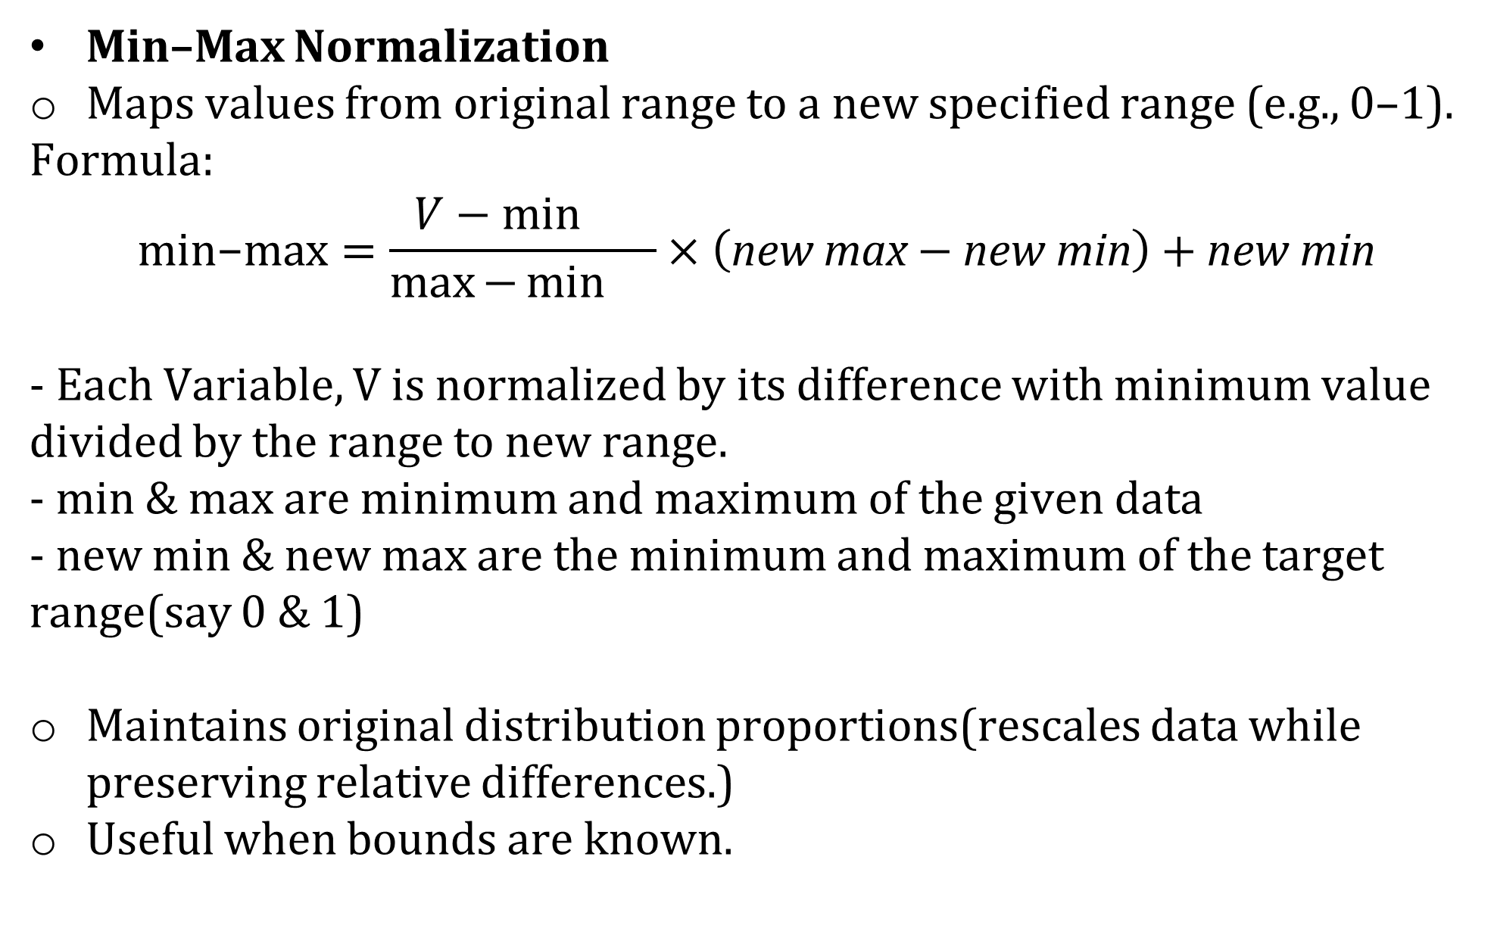
Module 2: Understanding Data
Big Data Analysis Framework: Data Processing
Data Integration and Data Transformations:
Types of Normalization
Min–Max Normalization
Maps values from original range to a new specified range (e.g., 0–1).
Formula:
$$\text{min−max}=\frac{V−\min{}}{\max{−}\min{}}×\left(\text{new max}−\text{new min}\right)+\text{new min}$$
- Each Variable, V is normalized by its difference with minimum value divided by the range to new range.
- min & max are minimum and maximum of the given data
- new min & new max are the minimum and maximum of the target range(say 0 & 1)
Maintains original distribution proportions(rescales data while preserving relative differences.)
Useful when bounds are known.
Example:Given set of MarksV: (88, 90, 92, 94)
Original range → min = 88, max = 94.
Target range → 0 to 1.
Normalized values:
  88 → 0
  90 → 0.33
  92 → 0.66
  94 → 1
Notes:
Ex: 88, (88-88)/(94-88) X(1-0)+0=0
90 (90-88)/(94-88) X (1-0)+0= 0.33

Slide 28
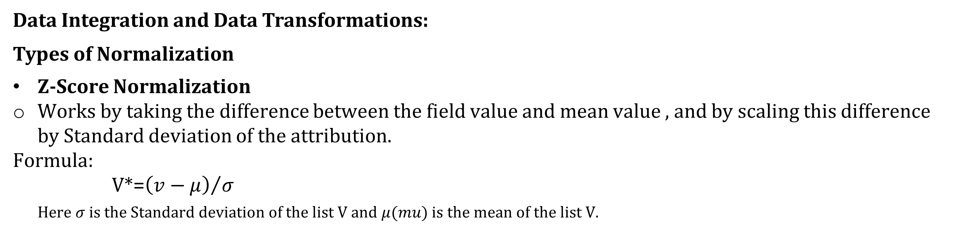
Module 2: Understanding Data
Big Data Analysis Framework: Data Processing
Data Integration and Data Transformations:
Types of Normalization
Z-Score Normalization
Works by taking the difference between the field value and mean value , and by scaling this difference by Standard deviation of the attribution.
Formula:
V*=${\left(v−μ\right)}/σ$
Here $σ$is the Standard deviation of the list V and $μ(mu)$ is the mean of the list V.
Example: Consider the Mark list V={10,20,30}, convert marks to z-score.
Soln: Mean=20, Standard deviation is 10, then
z-score of 10= (10-20)/10= (-10)/10= -1
z-score of 20=0
z-score of 30=1
Z-scores are used to detect outlier detection.
If data value z-score function is either < -3 or >+3 then is is possibly the outlier.
Major disadvantage is that this function is extremely sensitive to outliers as it is dependent on mean value.
Data Reduction
Reduces data size but produces the same result
Different ways: data aggregation, feature selection and dimensionality reduction.

Slide 29
Module 2: Understanding Data
Descriptive Statistics
Descriptive statistics deals with summarizing and describing datasets.
• It is not concerned with prediction or machine learning — only with understanding the existing data.
• Main goal: To present data in a meaningful and understandable form.
Data visualization is used to investigate and communicate data effectively.
• Graphs, charts, and plots help in understanding patterns and trends.
• It assists in explaining data insights to non-technical audiences or decision-makers
Exploratory Data Analysis (EDA)
• EDA combines descriptive statistics and visualization.
• Helps to understand data characteristics before applying machine learning or data mining.
• Focus: To explore, clean, and prepare data for further analysis

Slide 30
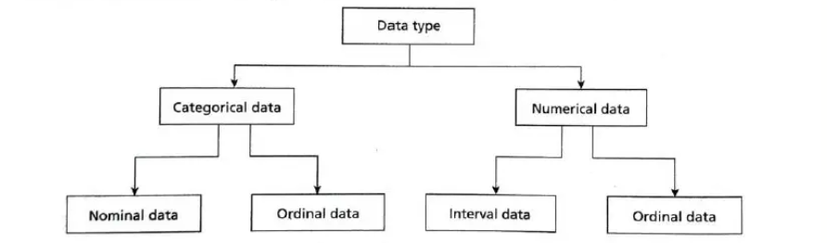
Module 2: Understanding Data
Descriptive Statistics
Fundamental concepts of datatypes:
Dataset and Data Types
A dataset is a collection of data objects — such as records, samples, or observations.
Each data object has attributes (features) that describe its properties.
Every attribute should be associated with a value(this is called as Measurement).
Data types can be classified as below fig.
Ratio data
Notes:
Attributes can be numerical (e.g., Age) or categorical (e.g., Blood Test, Fever, Disease).

Slide 31

Module 2: Understanding Data
Descriptive Statistics
Fundamental concepts of datatypes:
1. Categorical or Qualitative Data
Categorical data represents categories or labels.
It can be divided into two subtypes:
a. Nominal Data
      - Data represented by names, labels, or symbols.
      - No numeric or ordered meaning.
      - Example: Patient ID, Gender, Blood Type.
      - Only operations like equality (=) and inequality (≠) make sense.
      - Example: The average of patient IDs has no meaning.
b. Ordinal Data
- Data that has a natural order or ranking.
- Example: Fever = Low, Medium, High.
- The order matters (Low < Medium < High), but differences between values are not measurable.
- Useful for ranked scales like satisfaction levels or severity levels.
Notes:
Attributes can be numerical (e.g., Age) or categorical (e.g., Blood Test, Fever, Disease).

Slide 32
Module 2: Understanding Data
Descriptive Statistics
Fundamental concepts of datatypes:
2. Numeric or Quantitative Data
Numeric data represents measurable quantities.
It can be divided into two subtypes:
a. Interval Data
-Numeric data where differences between values are meaningful, but zero is arbitrary.
-Example: Temperature in °C or °F (difference between 30° and 40° is 10°).
-Permissible operations: Addition (+) and Subtraction (–) only.
b. Ratio Data
-Numeric data where both differences and ratios are meaningful.
-Has a true zero point (zero means absence of the quantity).
-Examples: Height, Weight, Age, Income.
-All mathematical operations are allowed (+, –, ×, ÷).
Data Type | Example | Order Exists? | True Zero? | Allowed Operations
Nominal | Patient ID | ❌ No | ❌ No | =, ≠
Ordinal | Fever (Low/Med/High) | ✅ Yes | ❌ No | =, ≠, <, >
Interval | Temperature (°C/°F) | ✅ Yes | ❌ No | +, –
Ratio | Age, Weight | ✅ Yes | ✅ Yes | +, –, ×, ÷

Slide 33
Module 2: Understanding Data
Descriptive Statistics
Fundamental concepts of datatypes:
Another way of classifying the data is as below:
1.Discrete Data
- Recorded as whole numbers (integers).
- Represents countable quantities — cannot take fractional values.
- Examples: Number of students in a class, Employee ID numbers, Survey responses (1, 2, 3, etc.)
Key idea: Data that can be counted.
2.Continuous Data
- Can take any value within a range, including decimals.
- Represents measurable quantities.
- Examples:Height, Weight, Age, Temperature
- Even though some values appear discrete (like age in years), they can have decimals (e.g., 12.5 years).
Key idea: Data that can be measured.

Slide 34
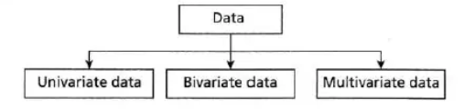
Module 2: Understanding Data
Descriptive Statistics
Fundamental concepts of datatypes:
Third way of classifying the data is based on number of variables used in the dataset.
Univariate Data
Dataset has only one variable.
Used to describe and summarize a single attribute.
Example: Distribution of ages of patients.
Also called single-variable data.
Bivariate Data
Dataset has two variables.
Used to study relationships or correlations between two attributes.
Example: Relationship between height and weight.
Multivariate Data
Dataset has three or more variables.
Used in complex analysis and machine learning models.
Example: Dataset with age, income, education, and spending score.

Slide 35
Module 2: Understanding Data
Univariate Data Analysis and Visualization
Univariate Analysis
Univariate analysis is the simplest form of statistical analysis.
It deals with a dataset containing only one variable.
A variable can also be referred to as a category.
It does not explore cause-and-effect or relationships between variables.
The main aim is to describe the data and identify patterns.
Key components of univariate data description include:
    Frequency distributions (data visualization)
    Measures of central tendency (mean, median, mode)
    Measures of dispersion/variation (range, variance, standard deviation)
    Shape of the data (skewness, kurtosis)

Slide 36
Module 2: Understanding Data
Univariate Data Analysis and Visualization
Data Visualization:
Data visualization is essential for understanding and interpreting data.
Graphs help to present information clearly to users and customers.
Common graphs used in univariate analysis include:
  Bar charts
  Histograms
  Frequency polygons
  Pie charts
Advantages of graphs:
  Easy presentation of data
  Summarization of large datasets
  Clear description of data
  Helpful in exploring patterns and trends
  Supports comparison of different sets of data

Slide 37
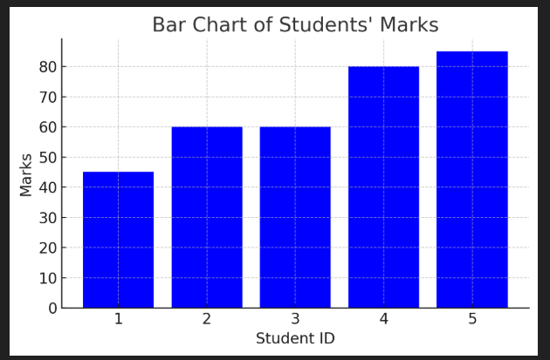
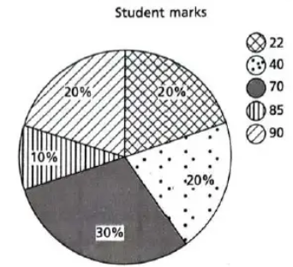
Module 2: Understanding Data
Univariate Data Analysis and Visualization
Bar Chart (Bar Graph)
Used to show frequency distribution of variables.
Ideal for discrete data.
Useful for explaining counts of nominal data.
Helps in comparing the frequency of different groups.
Example given: Bar chart for students’ Marks = {45, 60, 60, 80, 85} with Student IDs = {1, 2, 3, 4, 5}
Pie Chart
A pie chart is useful for showing percentage frequency distribution of univariate data.
It visually represents how much each category contributes to the whole dataset.
Example in the given dataset of students’ marks: {22, 22, 40, 40, 70, 70, 70, 85, 90, 90} contains 10 students in total.
Notes:
Attributes can be numerical (e.g., Age) or categorical (e.g., Blood Test, Fever, Disease).

Slide 38
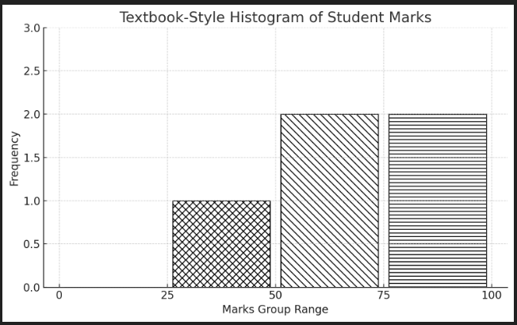
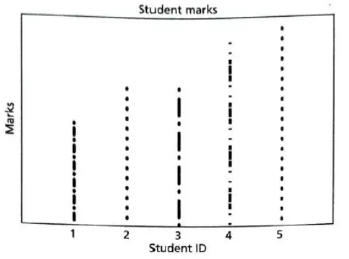
Module 2: Understanding Data
Univariate Data Analysis and Visualization
Histogram
A histogram is a graphical tool used to display frequency distributions.(data is distributed across defined intervals/bins).
It helps in understanding the nature, spread, and shape of a dataset.
Useful in data mining for analysing numerical data.
Helps visually identify:
  -Mode (peak value) - Concentration of values
  - Spread and variation - Skewness (left/right)
Dot Plots
Shows data values using dots positioned along a scale.
It is similar to a bar chart but uses individual points instead of bars & are less cluttered.
Helps visualize frequency and distribution of a small dataset.
Useful for comparing values across categories.
Easy to identify who scored more or less by simple visual inspection.
Example: Student IDs: {1, 2, 3, 4, 5} with Marks: {45, 60, 60, 80, 85}
Notes:
Histogram:Marks grouped into ranges (bins):0–25,26–50,51–75,76–100
The histogram reveals that the number of students in the 76–100 range is 2.
Advantages of Histogram
Easy to identify the central tendency and data pattern.
Shows the frequency of values in each group.
Helps detect outliers or unusual data behavior.
Good for understanding shape of distribution (normal, bimodal, skewed, uniform, etc.).
Dot Plots:Dot plot clearly shows:
Student 5 scored the highest.
Student 1 scored the lowest.
Student 2 and 3 share the same mark (60).
Advantages
Clean, simple, and easy to read.
Helps quickly compare individual values.
Shows repeated values clearly.

Slide 39




Module 2: Understanding Data
Univariate Data Analysis and Visualization
Central tendency
Central tendency helps summarize large data into a single representative value.
It explains where the data tends to cluster or concentrate.
Common measures: Mean, Median, Mode.
1. Mean (Arithmetic Average)
Mean represents the centre or balanced point of the dataset.
It is the most commonly used average in daily situations such as: Average income, Average marks, Average traffic
Weighted Mean
    - This gives different importance to all items as importance varies (unlike arithmetic mean which gives equal weightage to all items.
    - Computed by adding the product of proportion and group mean.
    - Mostly used when the samples sizes are unequal.
Geometric Mean
- It is the Nth Root of the product of N items.
- For larger cases, computing Geometric mean is difficult(anti-log) .
Mean is extreme sensitive to noise. Even small change in i/p, impacts the mean drastically.
Hence often top 2% is chopped & then Mean is calculated for larger dataset.

Slide 40
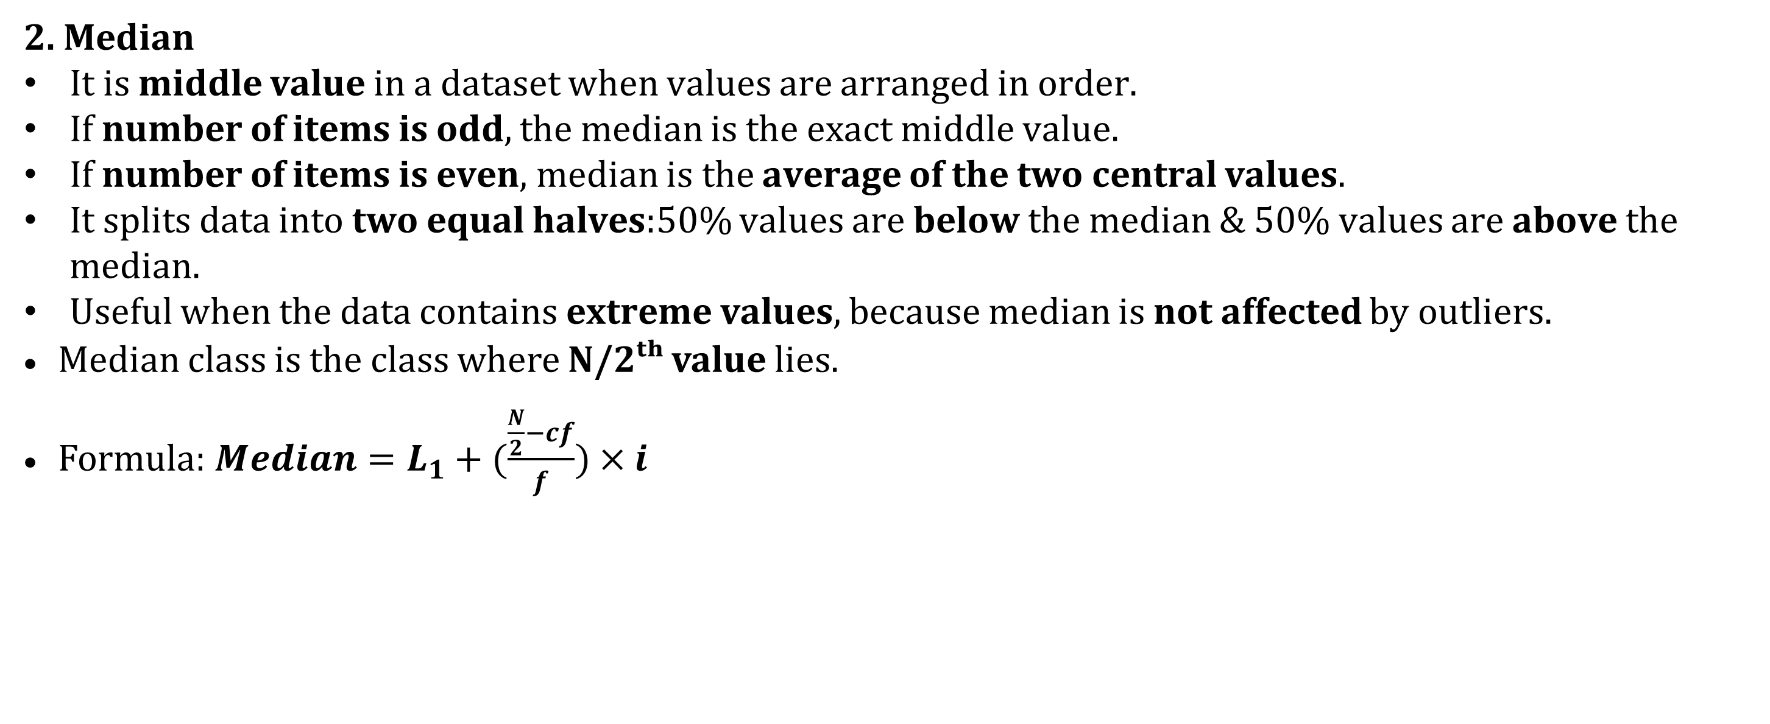
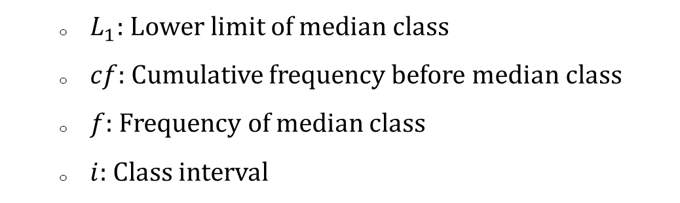
Module 2: Understanding Data
Univariate Data Analysis and Visualization: Central Tendency
2. Median
It is middle value in a dataset when values are arranged in order.
If number of items is odd, the median is the exact middle value.
If number of items is even, median is the average of the two central values.
It splits data into two equal halves:50% values are below the median & 50% values are above the median.
Useful when the data contains extreme values, because median is not affected by outliers.
Median class is the class where N/2ᵗʰ value lies.
Formula:$Median=L_{1}+(\frac{\frac{N}{2}−cf}{f})×i$
Class interval | Frequency (f)
10 – 20 | 5
20 – 30 | 8
30 – 40 | 12
40 – 50 | 7
50 – 60 | 3
- Total Nos of Observations(N) = 5+8+12+7+3 =35, So N/2=17.5
- Cumulative Frequency(cf): up to 10-20 cf is 5, up to 20-30 cf is 5+8(13), upto 30-40, cf is 5+8+12(25) which surpasses 17.5 hence Median Class is 30-40.
- L1= 30 cf=13 f=12 i=(40-30)=10
Median= 30+(17.5-13)/12*10 = 30+0.375*10=30+3.75=33.75
The median of the distribution is 33.75.
That means 50% of observations lie below ~33.75 and 50% above
  $L_{1}$: Lower limit of median class
  $cf$: Cumulative frequency before median class
  $f$: Frequency of median class
  $i$: Class interval

Slide 41
Module 2: Understanding Data
Univariate Data Analysis and Visualization: Central Tendency
2. Mode
Mode is the value that occurs most frequently in the dataset.
Represents the highest frequency item.
Applicable mainly for discrete data.
Not suitable for continuous data where values do not repeat.
A dataset can have: One mode: Unimodal, Two modes: Bimodal and Three modes: Trimodal
Useful in identifying the most common or typical value in a dataset.
Finding the Mode: Prepare a frequency table and then Identify the value(s) with the highest frequency.
Example: Values: 2, 3, 3, 4, 4, 4, 5, 6
The value with highest frequency(3 times) is 4.
So Mode is 4

Slide 42
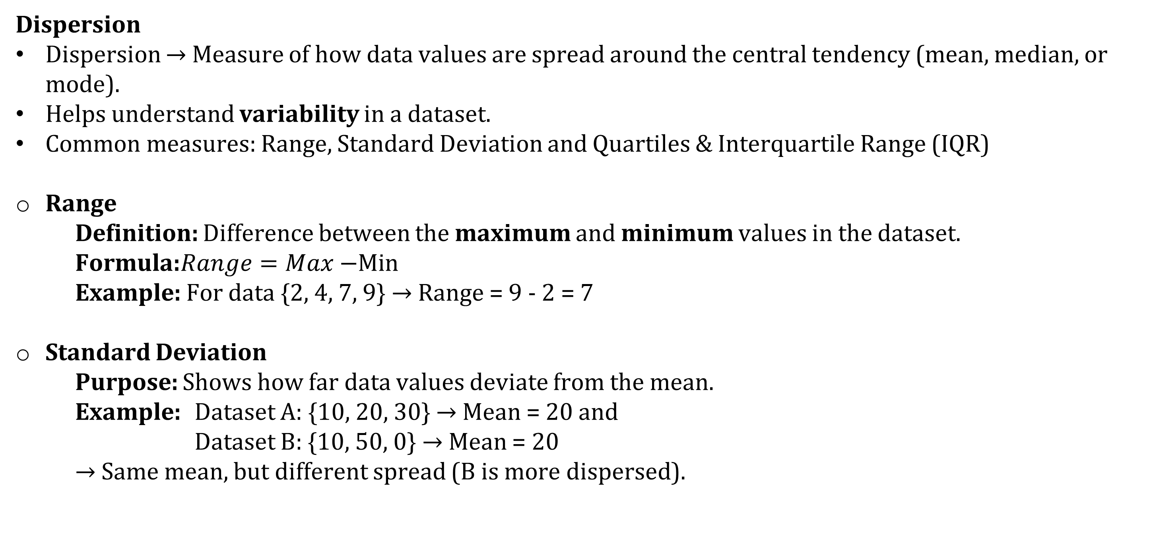
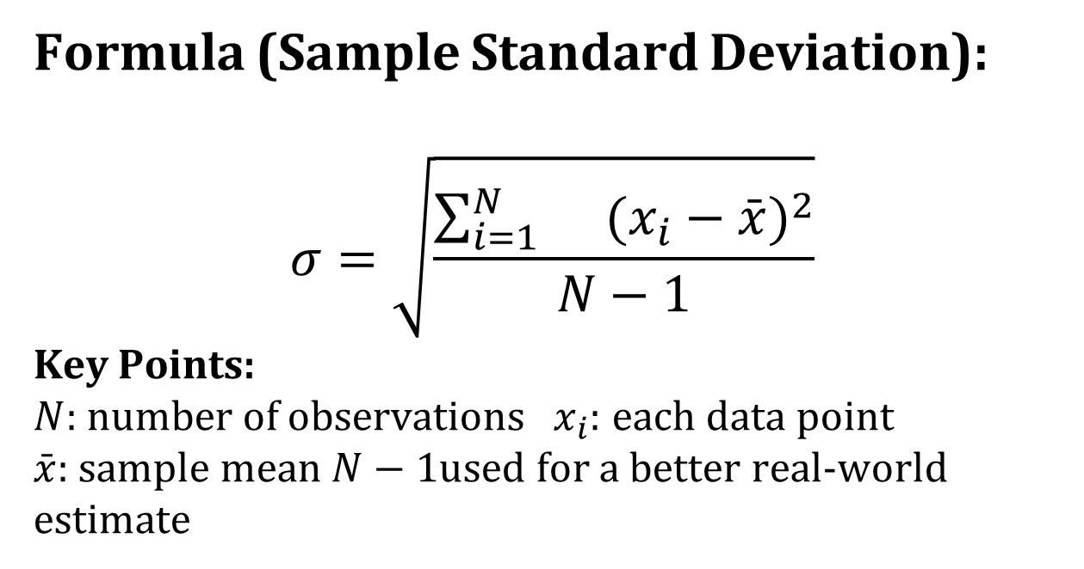
Module 2: Understanding Data
Univariate Data Analysis and Visualization:
Dispersion
Dispersion → Measure of how data values are spread around the central tendency (mean, median, or mode).
Helps understand variability in a dataset.
Common measures: Range, Standard Deviation and Quartiles & Interquartile Range (IQR)
Range
Definition: Difference between the maximum and minimum values in the dataset.
Formula:$Range=Max−$Min
Example: For data {2, 4, 7, 9} → Range = 9 - 2 = 7
Standard Deviation
Purpose: Shows how far data values deviate from the mean.
Example: Dataset A: {10, 20, 30} → Mean = 20 and
Dataset B: {10, 50, 0} → Mean = 20
→ Same mean, but different spread (B is more dispersed).
Formula (Sample Standard Deviation):
$$σ=\sqrt{\frac{\sum_{i=1}^{N}{}(x_{i}−\overset{ˉ}{x})^{2}}{N−1}}$$
Key Points:
  $N$: number of observations$x_{i}$: each data point
  $\overset{ˉ}{x}$: sample mean $N−1$used for a better real-world estimate
Notes:
Use population standard deviation when your data set includes every single member of the group you are interested in.
Use sample standard deviation when your data set is a subset of a larger group and you want to use it to make inferences about that larger group

Slide 43
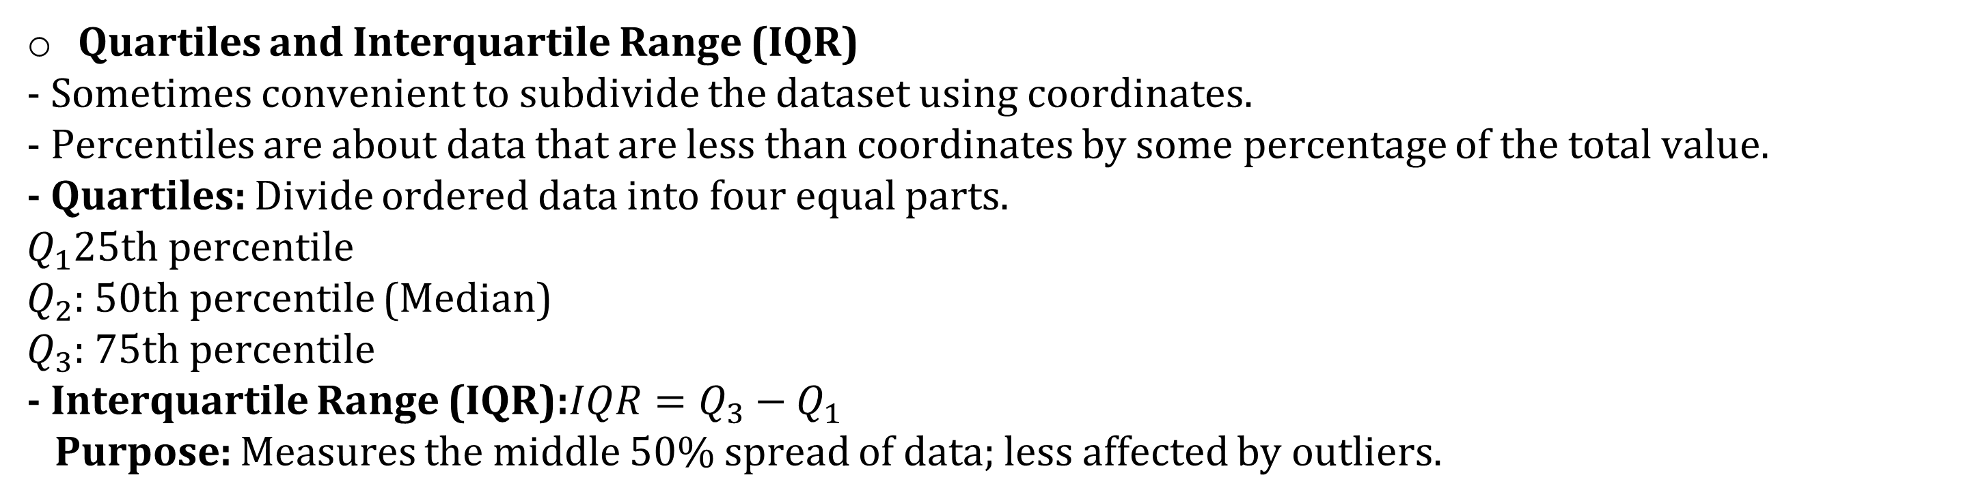
Module 2: Understanding Data
Univariate Data Analysis and Visualization:
Quartiles and Interquartile Range (IQR)
- Sometimes convenient to subdivide the dataset using coordinates.
- Percentiles are about data that are less than coordinates by some percentage of the total value.
- Quartiles: Divide ordered data into four equal parts.
  $Q_{1}$25th percentile
  $Q_{2}$: 50th percentile (Median)
  $Q_{3}$: 75th percentile
- Interquartile Range (IQR):$IQR=Q_{3}−Q_{1}$
Purpose: Measures the middle 50% spread of data; less affected by outliers.
Example: For patient’s age List {31,24,34,19,22,12,14,28,26}, find the IQR
Solu: Order the age list {12,14,19,22,24,26,28,31,34} has 9 values.
Median is 5th Position, i.e 24.
1st Quartile is median of the scores below the median i.e {12,14,19,22}, i.e (14+19)/2=16.5
3rd Quartile is median of the scores above the median i.e {26,28,31,34}, i.e(28+31)/2=29.5
IQR= Q3-Q1 =(29.5-16.5)=13
Semi Inter Quartile Range(SIQR)= ½ of IQR
SIQR=(1/2)*13=6.5

Slide 44
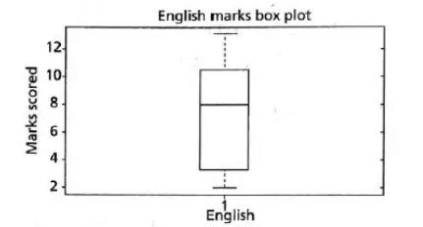
Module 2: Understanding Data
Univariate Data Analysis and Visualization:
Five-point Summary and Box Plots
The Median, Quartile Q1&Q2 and minimum & maximum written in order as below is known as five-point summary.
< Minimum, Q1, Median, Q3, Maximum>
- Box Plots: Way for plotting five number summaries.
- Box plots are suitable for continuous variables and nominal variable.
- The box contains bulk data and are between 1st and 3rd Quartiles.
- The line inside the box indications location –mostly Median of the data.
- If median is not equidistant then the data is skewed.
- The whiskers that project from ends of the box indicate the spread of the tails and the maximum & minimum of the data value.
Example: Find 5-Point summary of the list {13,11,2,3,4,8,9}
Ordered list {2,3,4,8,9,11,13} with 7 values
Minimum= 2 Maximum=13 Median=8
1st Quartile is median of the scores below the median i.e {2,3,4}, =3=Q1
3rd Quartile is median of the scores above the median i.e {9,11,13}= 11=Q3

Slide 45
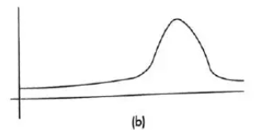
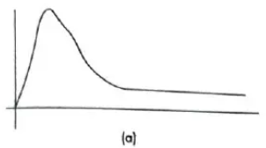
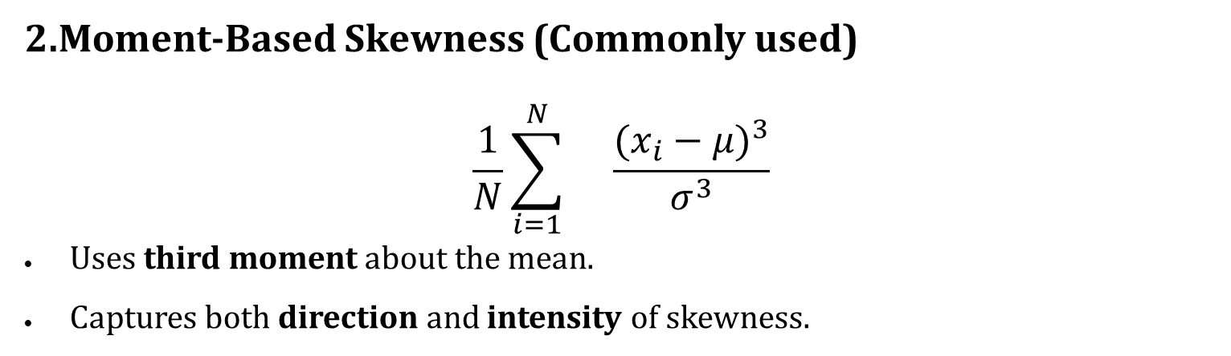
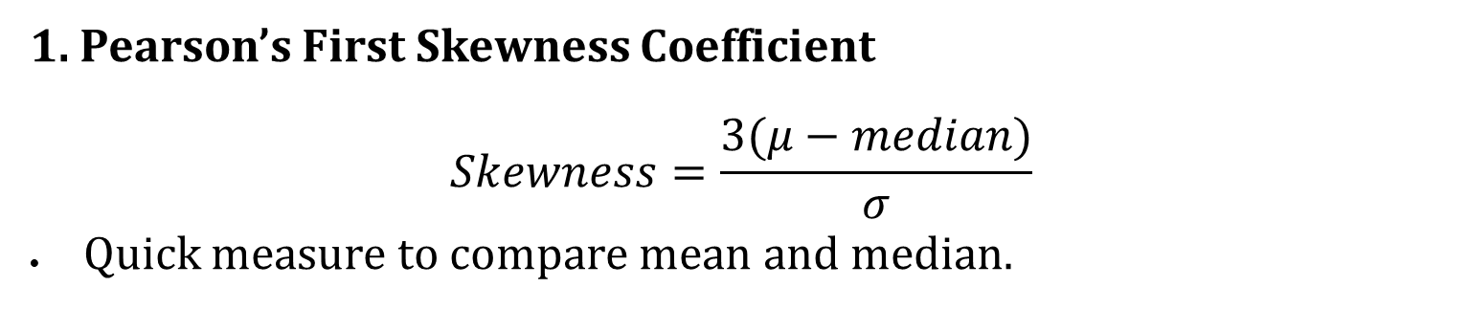
Module 2: Understanding Data
Univariate Data Analysis and Visualization:
Shape
Skewness and Kurtosis(called moments) indicate the symmetry/asymmetry and peak location of the dataset.
Skewness:
Skewness measures the direction and degree of asymmetry in a distribution.
Zero skewness = perfectly symmetrical distribution.(Mean=Median)
a) Positive Skew (Right Skew)
Tail stretches to the right side.
More extreme high values.
Mean > Median.
Bulk of data lies on the left.
Skewness > 0 → Positively skewed.
b) Negative Skew (Left Skew)
Tail stretches to the left.
More extreme low values.
Median > Mean.
Bulk of data lies on the right.
Skewness < 0 → Negatively skewed.
1. Pearson’s First Skewness Coefficient
$$Skewness=\frac{3(μ−median)}{σ}$$
Quick measure to compare mean and median.
2.Moment-Based Skewness (Commonly used)
$$\frac{1}{N}\sum_{i=1}^{N}{}\frac{(x_{i}−μ)^{3}}{σ^{3}}$$
Uses third moment about the mean.
Captures both direction and intensity of skewness.

Slide 46



Module 2: Understanding Data
Univariate Data Analysis and Visualization:
Kurtosis
Kurtosis is measure of whether the data is heavy tailed or light tailed relative to the normal distribution.
Normal distribution has bell-shaped curve with no long tails, Low Kurtosis tends to have light tails.
Implication: High kurtosis suggests more outliers; low kurtosis suggests fewer.
Mean Absolute Deviation (MAD)
Another dispersion measure and is robust for outliners.
Definition: Average of absolute deviations from the mean.
Use: Helps detect outliers and understand variability without squaring deviations.
Coefficient of Variation (CV)
Definition: Ratio of standard deviation to mean; useful for comparing variability across datasets with different units.
Use: Ideal for comparing performance, risk, or consistency across different contexts (e.g., investment returns, manufacturing quality).
Interpretation: Lower CV = more consistency; higher CV = more variability.

Slide 47
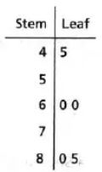
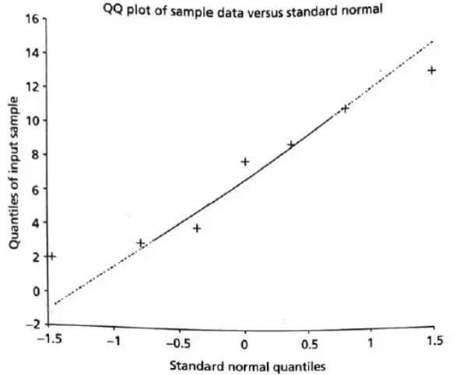
Module 2: Understanding Data
Univariate Data Analysis and Visualization:
How a Stem & Leaf Plot Works
-Each row begins with a stem (e.g., 0,1,2,3,4, 5, 6...).
-Leaves represent individual values belonging to that stem.
-Example: Plot for English subject marks {45,60,60,80,85}
  - "60" appears as stem = 6, leaf = 0
  If two students scored 60 → leaves are 0, 0
Special Univariate Plots
Stem and Leaf Plot
A visual tool to understand shape and distribution of a dataset.
Splits each value into two parts:
  -Stem → all digits except last
  -Leaf → last digit
Shows frequency, spread, outliers and patterns in data clearly.
Q–Q Plot (Quantile–Quantile Plot)
It is a 2D scatter plot against theoretical normal distribution data or 2 datasets-quartiles of 1st & 2nd data sets.
Used to check if data follows a normal distribution.
If data is normal → points fall approximately on the 45-degree reference line.
Points deviating upward or downward shows departure from normality ( can indicate skewness (asymmetry), heavy or light tails)
Larger deviations → Stronger evidence that data is not normally distributed
-Example: Q-Q Plot for marks {13,11,2,3,4,8,9}
Notes:
Before Q-Q plot:
Shape of the Dataset & Normality
Ideal distribution for many statistical tests is a bell-shaped curve.
Indicates normal distribution.
Many statistical methods assume data is approximately normal.

Slide 48
Module 2: Understanding Data
In statistics (especially in univariate analysis), 1st, 2nd, and 3rd-order measures refer to three categories of descriptive measures that summarize different characteristics of a dataset.
Order of Measure | Meaning | What it tells | Examples
1st-Order | Central Tendency | Centre of data | Mean, Median, Mode
2nd-Order | Dispersion | Spread of data | Range, SD, Variance
3rd-Order | Shape | Symmetry & peakedness | Skewness, Kurtosis
Univariate data description involves finding the frequency distributions, central tendency measures, dispersion or variation and shape of the data.
Univariate Analysis helps
To describe and summarize a single variable
To identify data issues
To check variable distribution
To prepare data for further analysis
Notes:
Bivariate: 2 variables, deals with finding relationship/correlation among the data. Example: temperature and sale of sweater. Ex: scatter plot, line chart
Multivariate: more than 2 variables. Like bivariate but have more than 2 dependent variable. Example: patients info in hospital used for analyzing any desiese. Example: heatmap, pairplot

