Slide 1
Exploratory Data Analysis of Booking Dataset
An analysis of booking trends and patterns

Slide 2
Dataset Overview
The dataset is obtained from Booking.com and contains information about bookings.
The analysis includes basic statistics, missing values, and distributions of various features.

Slide 3
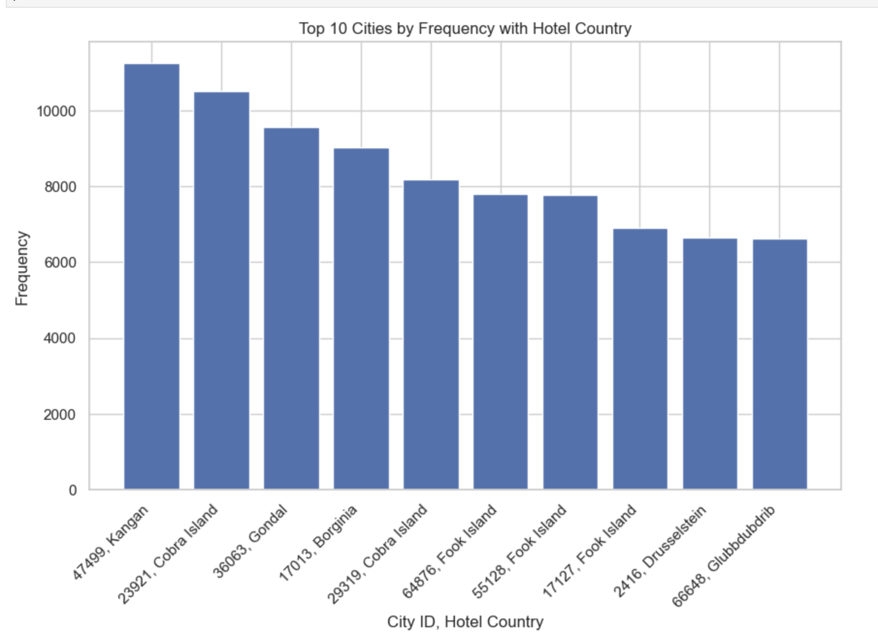
Most Popular Cities
The analysis identifies the most popular cities based on the number of bookings.
The top 10 cities with the highest number of bookings are presented.

Slide 4
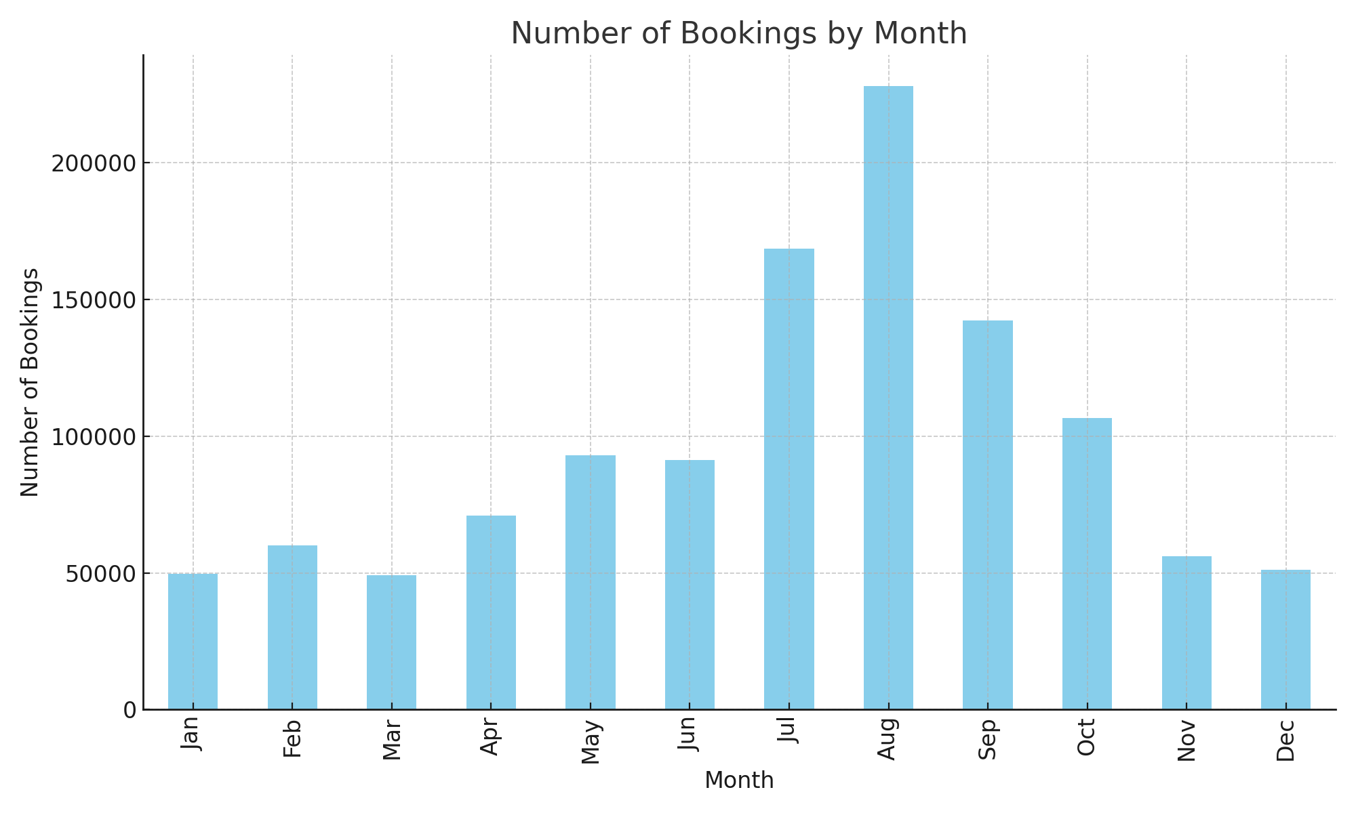
Bookings per Month
The analysis examines the number of bookings made per month
August had the highest bookings

Slide 5
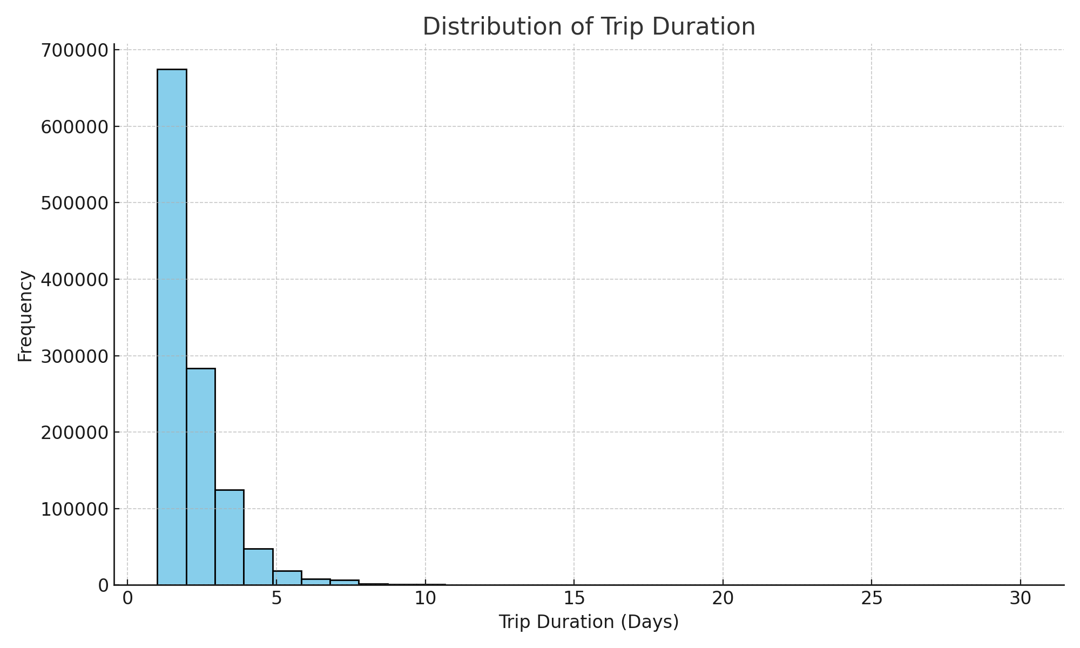
Trip Duration Distribution
The distribution of trip durations (in days) is analyzed.
The histogram shows the frequency of different trip lengths, most trips lasted 1-2 days

Slide 6
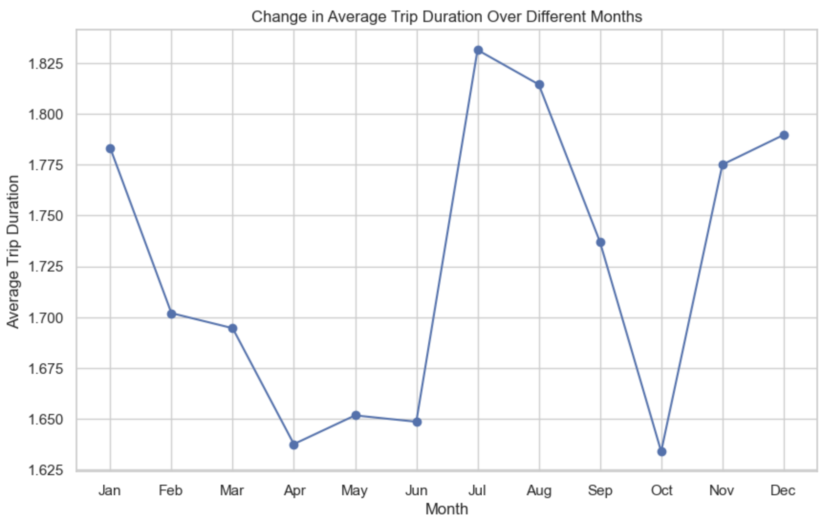
Change in Trip Duration Over Months
Seasonality peaks in Jan, Jul and December during winter/ summer holiday season

Slide 7
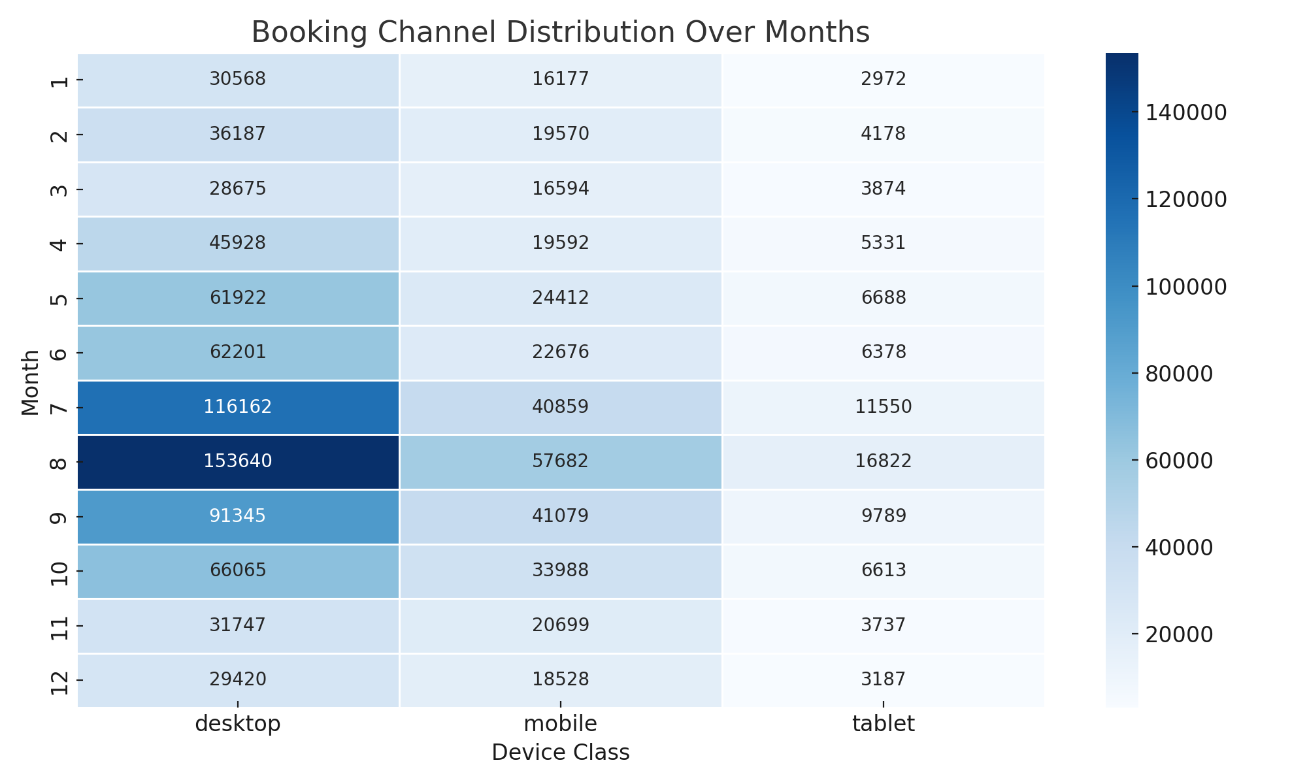
Booking Channel Distribution Over Months
The booking channel distribution over different months is visualized.
A heatmap shows the proportion of bookings made through various device classes each month.

Slide 8
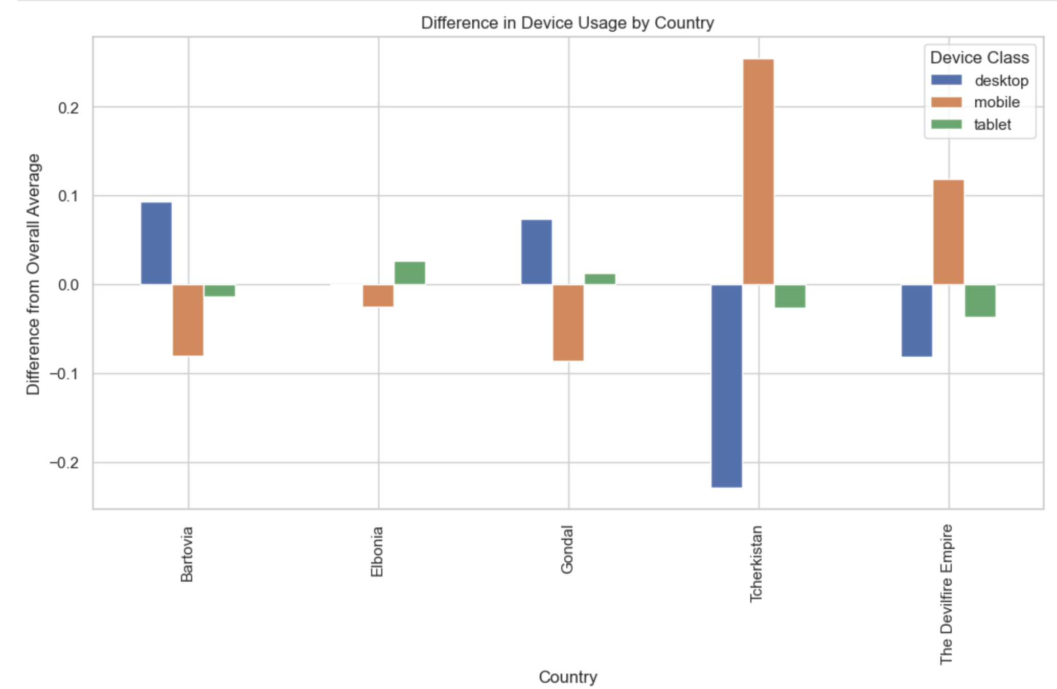
Device Usage by Country
The analysis explores the difference in device usage by country compared to the overall average.
A bar plot shows the variation in device class usage for different countries.

Slide 9
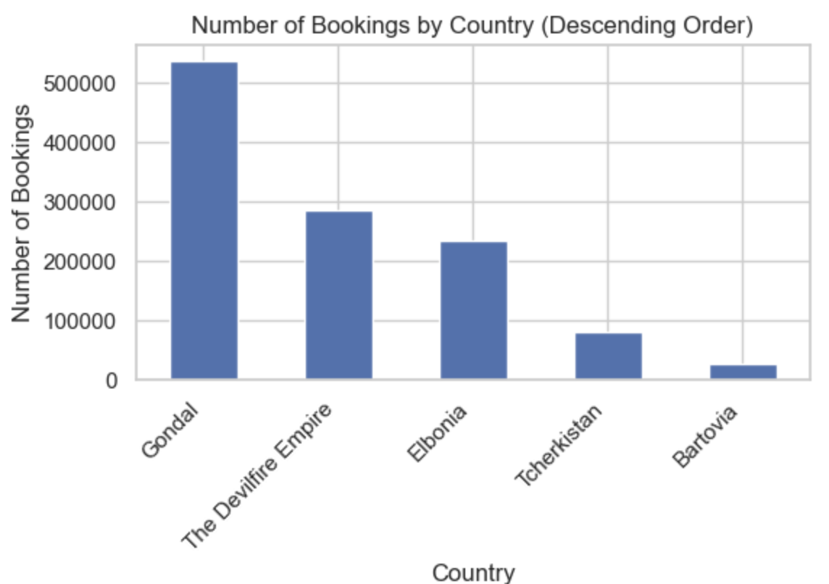
Number of Bookings by Country
The number of bookings by country is analyzed.
A bar plot shows the number of bookings for each country in descending order.

