Slide 1
Unix System Programming
NAMRATA BATHLI
Assistant Professor
Department of CSE
AGMRCET, Varur

Slide 2
BCS515C – UNIX System Programming
Semester: V
Credits: 3
Teaching Hours: 40
CIE: 50 Marks
SEE: 50 Marks
Total: 100 Marks
Exam: 3 Hours
Course Type: Theory
Course Objectives
The course aims to help students:
Understand UNIX concepts, commands, terminology, and the UNIX file system.
Explain the fundamental design of the UNIX operating system.
Understand system calls provided in the UNIX environment.
Design and develop applications/services over UNIX.
Unix System Programming

Slide 3
Syllabus- Module 1
Introduction:
Unix Components/Architecture. Features of Unix. The UNIX Environment and UNIX Structure, Posix and Single Unix specification. General features of Unix commands/ command structure. Command arguments and options. Basic Unix commands such as echo, printf, ls, who, date, passwd, cal, Combining commands. Meaning of Internal and external commands. The type command: knowing the type of a command and locating it. The root login. Becoming the super user: su command.
Unix files:
Naming files. Basic file types/categories. Organization of files. Hidden files. Standard directories. Parent child relationship. The home directory and the HOME variable. Reaching required files- the PATH variable, manipulating the PATH, Relative and absolute pathnames. Directory commands – pwd, cd, mkdir, rmdir commands. The dot (.) and double dots (..) notations to represent present and parent directories and their usage in relative path names. File related commands – cat, mv, rm, cp, wc and od commands.
Text Book1: Chapter-1, 2, 3, 4, 5
Unix System Programming

Slide 4
Syllabus- Module 2
File attributes and permissions: The ls command with options. Changing file permissions: The relative and absolute permissions changing methods. Recursively changing file permissions. Directory permissions.
The shells interpretive cycle: Wild cards. Removing the special meanings of wild cards. Three standard files and redirection.
Connecting commands: Pipe. Basic and Extended regular expressions. The grep, egrep. Typical examples involving different regular expressions.
Shell programming: Ordinary and environment variables. The. profile. Read and read-only commands. Command line arguments. exit and exit status of a command. Logical operators for conditional execution. The test command and its shortcut. The if, while, for and case control statements. The set and shift commands and handling positional parameters. The here(<<) document and trap command. Simple shell program examples.
Text Book1: Chapter-6,8,13,14
Unix System Programming

Slide 5
Syllabus- Module 3
Unix Standardization and Implementations: Introduction, Unix Standardization, UNIX System Implementation.
File I/O: Introduction, File Description, open, create, read, write, close, fcntl functions.
Files and Dictionaries: mkdir and rmdir functions, reading dictionaries, chdir, fchdir and getcwd functions. Device Special files.
The Environment of a UNIX Process: Introduction, main function, Process Termination, Command-Line Arguments, Environment List, Memory Layout of a C Program, Shared Libraries, Memory Allocation, Environment Variables, setjmp and longjmp functions, getrlimit, setrlimit functions.
Text Book 2: 2,3,4,7.
Unix System Programming

Slide 6
Syllabus- Module 4
Process Control: Introduction, Process Identifiers, fork, vfork, exit, wait, waitpid, wait3,wait4 Functions, Race Conditions, exec Functions.
Overview of IPC Methods, Pipes, popen, pclose Functions, Coprocesses, FIFOs, System V IPC, Message Queues, Semaphores.
Shared Memory, Client-Server Properties, Passing File Descriptors, An Open Server-Version.
Text Book2: Chapter 8, 15,17
Unix System Programming

Slide 7
Syllabus- Module 5
Signals and Daemon Processes: Introduction, Signal Concepts, Signal Functions, SIGCLD Semantics, Kill and Raise functions, Alarm and Pause Functions, Signal Sets, sigprocmask function, sigpending function, sigaction function, sigsetjmp and siglongjmp functions, sigsuspend function, abort function, system function, sleep, nanosleep and clock_nanosleep functions, sigqueue functions, job-control signals, signal names and numbers.
Daemon Processes: Introduction, Daemon Characteristics, Coding Rules, Error Logging, Client-Server Model.
Text Book 2: Chapter 10, 13
Unix System Programming

Slide 8
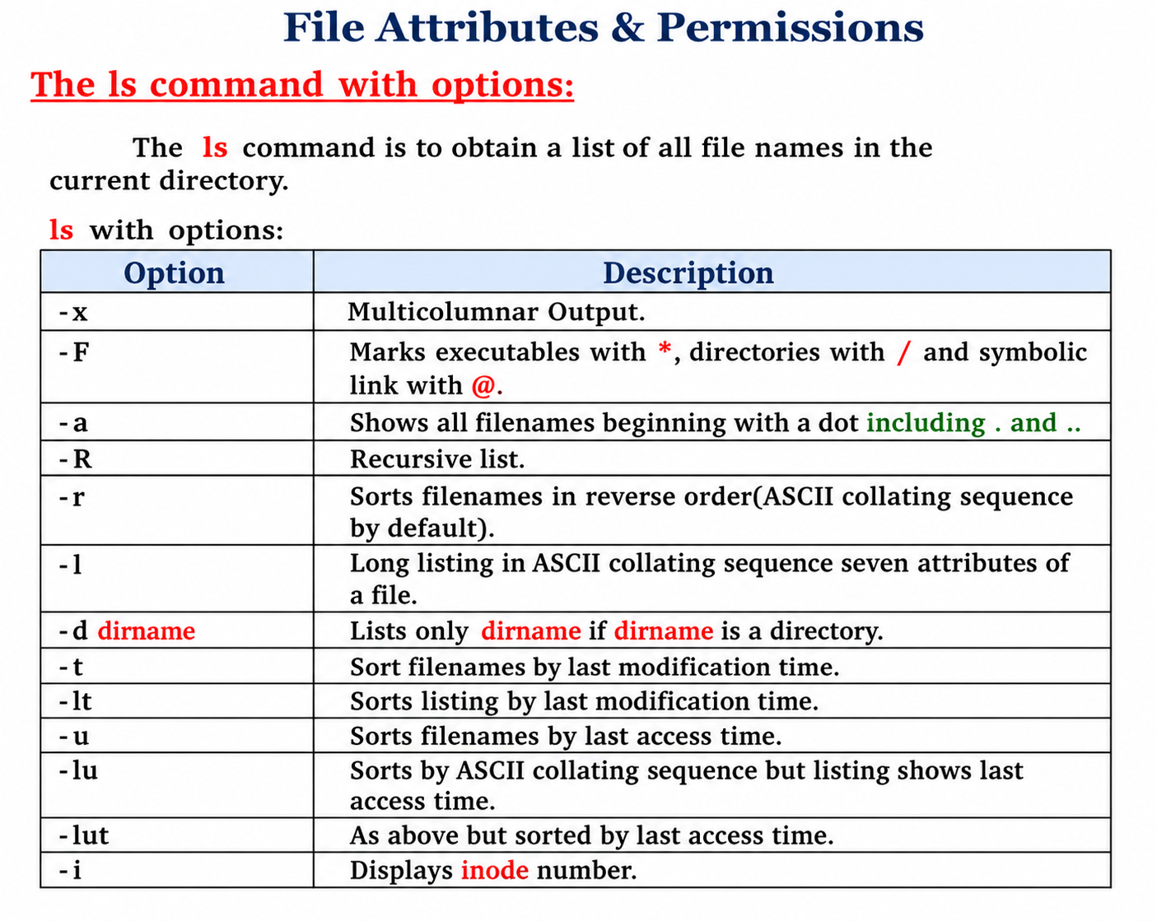
Unix System Programming

Slide 9
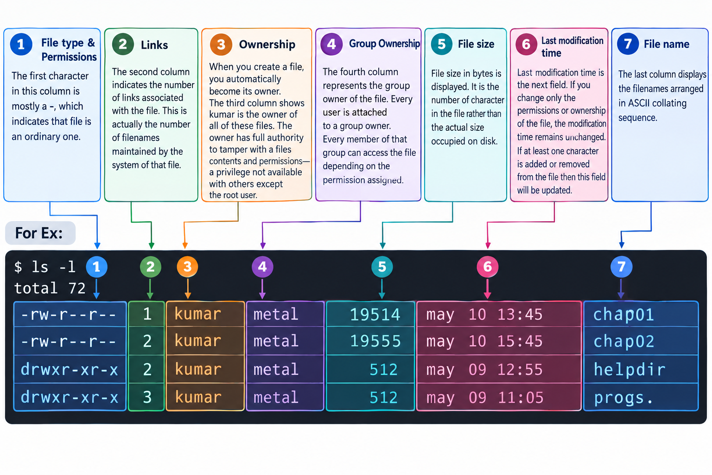
Unix System Programming

Slide 10
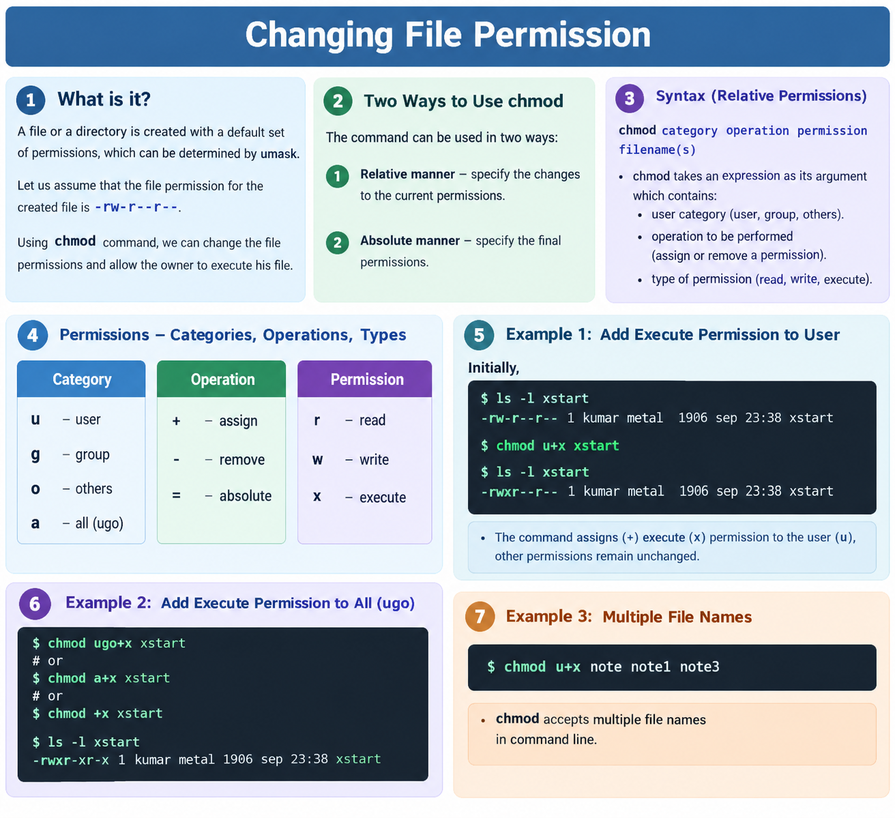
Unix System Programming

Slide 11
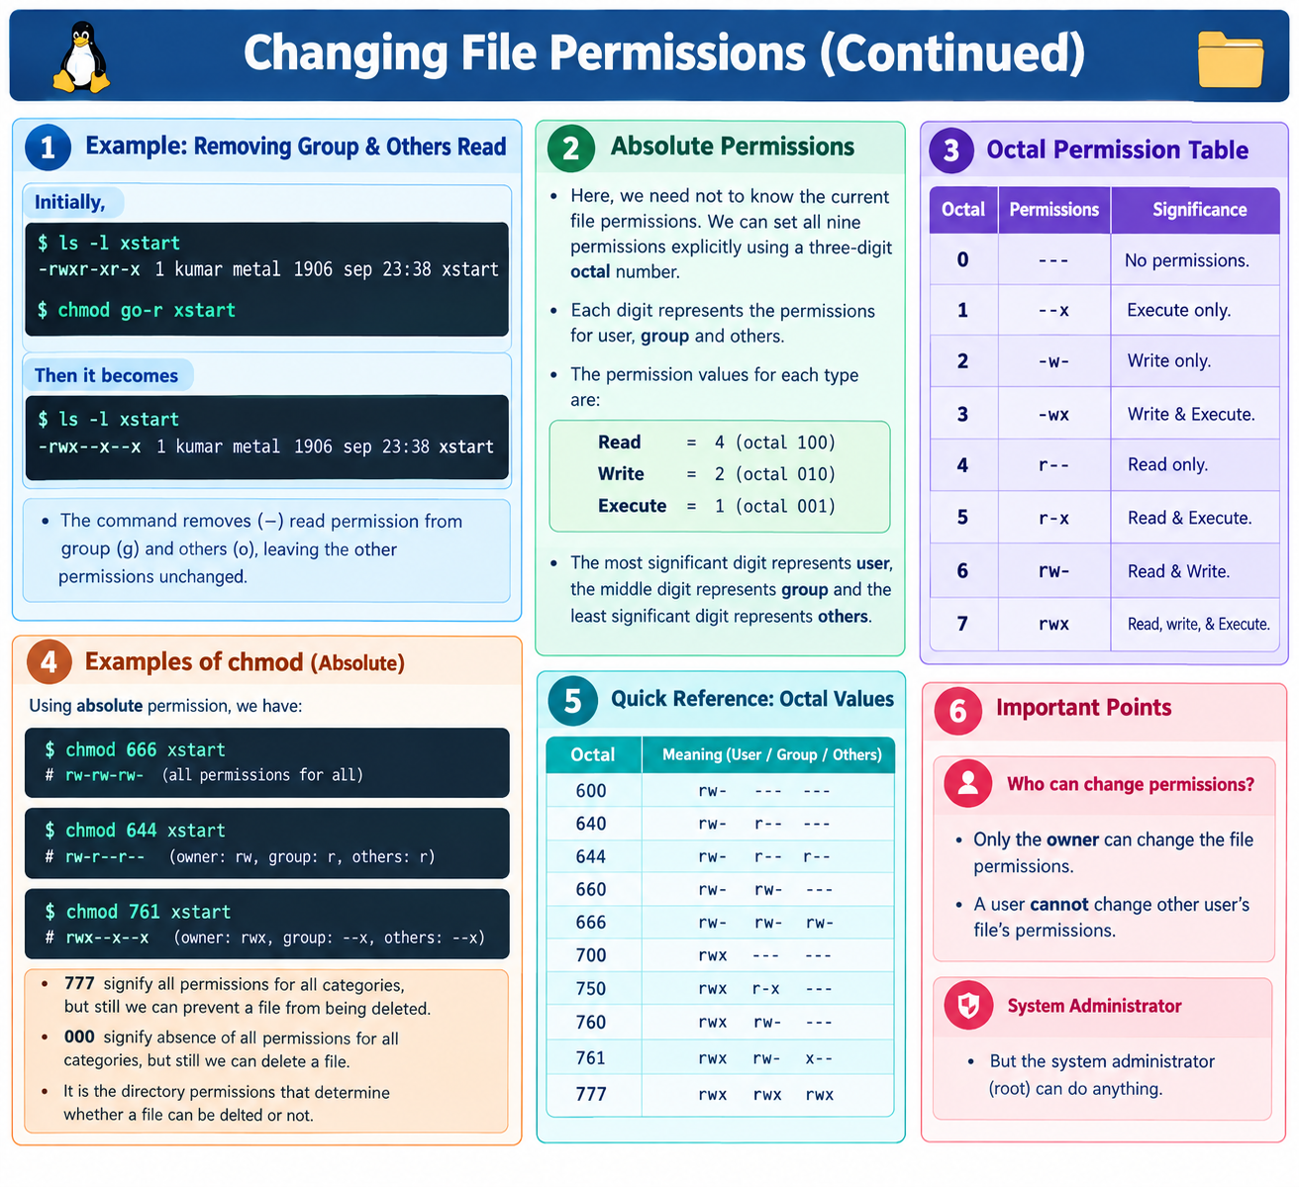
Unix System Programming

Slide 12
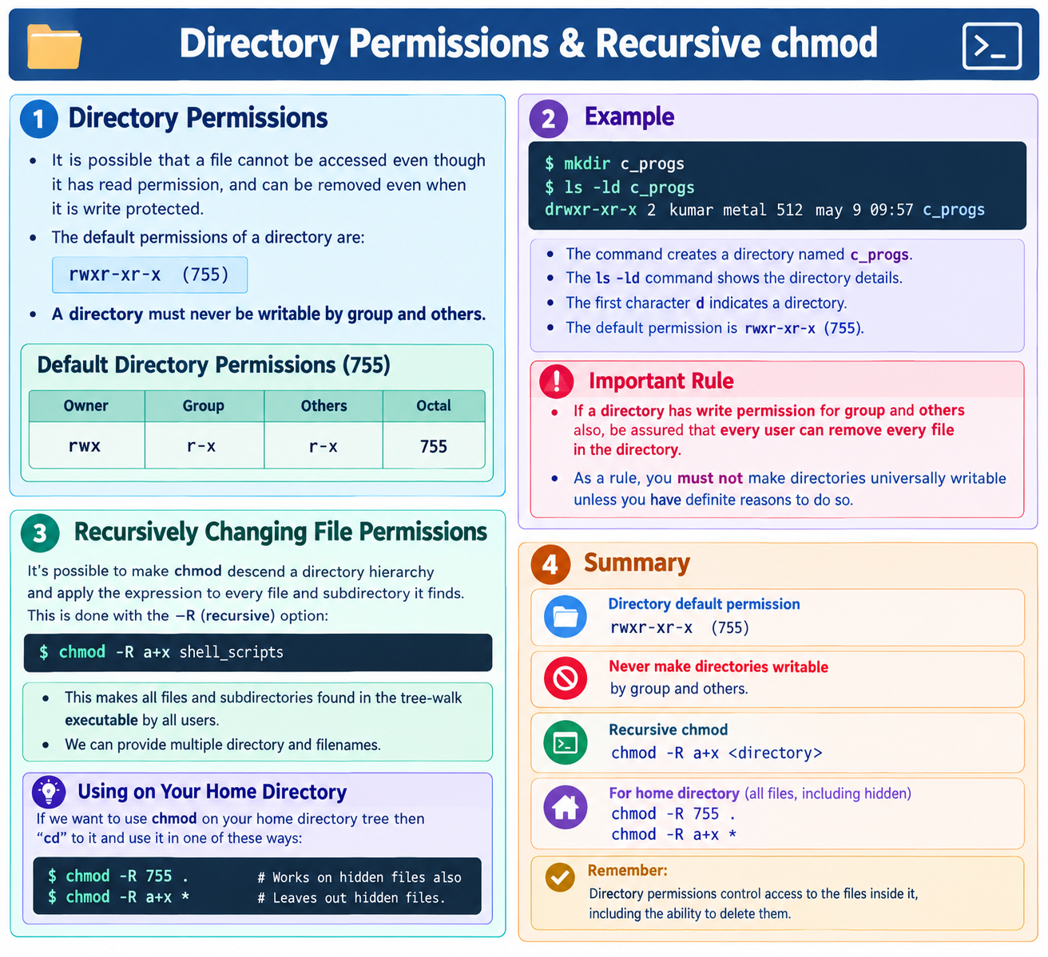
Unix System Programming

Slide 13
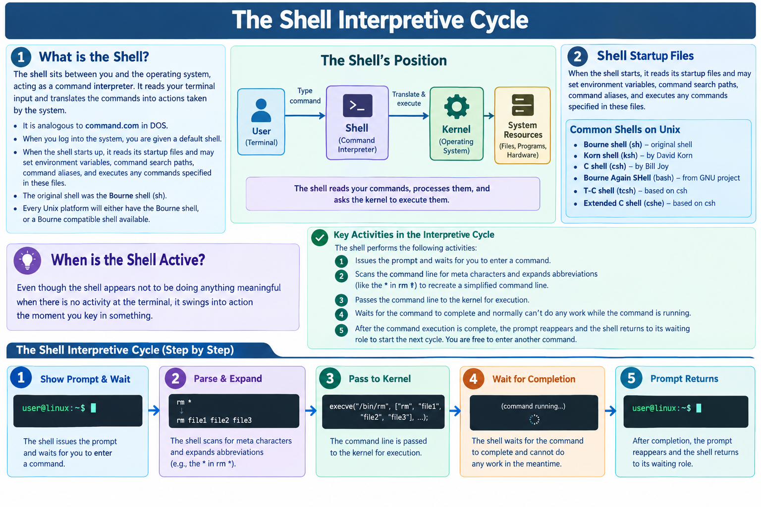
Unix System Programming

Slide 14
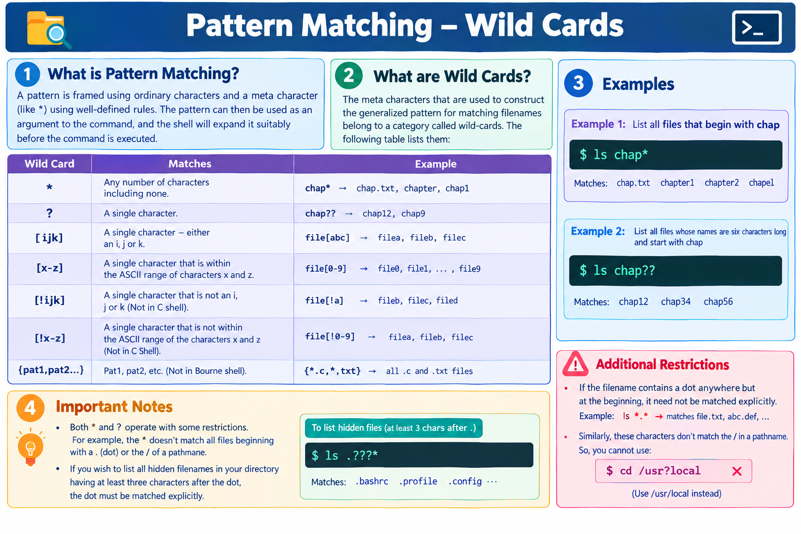
Unix System Programming

Slide 15
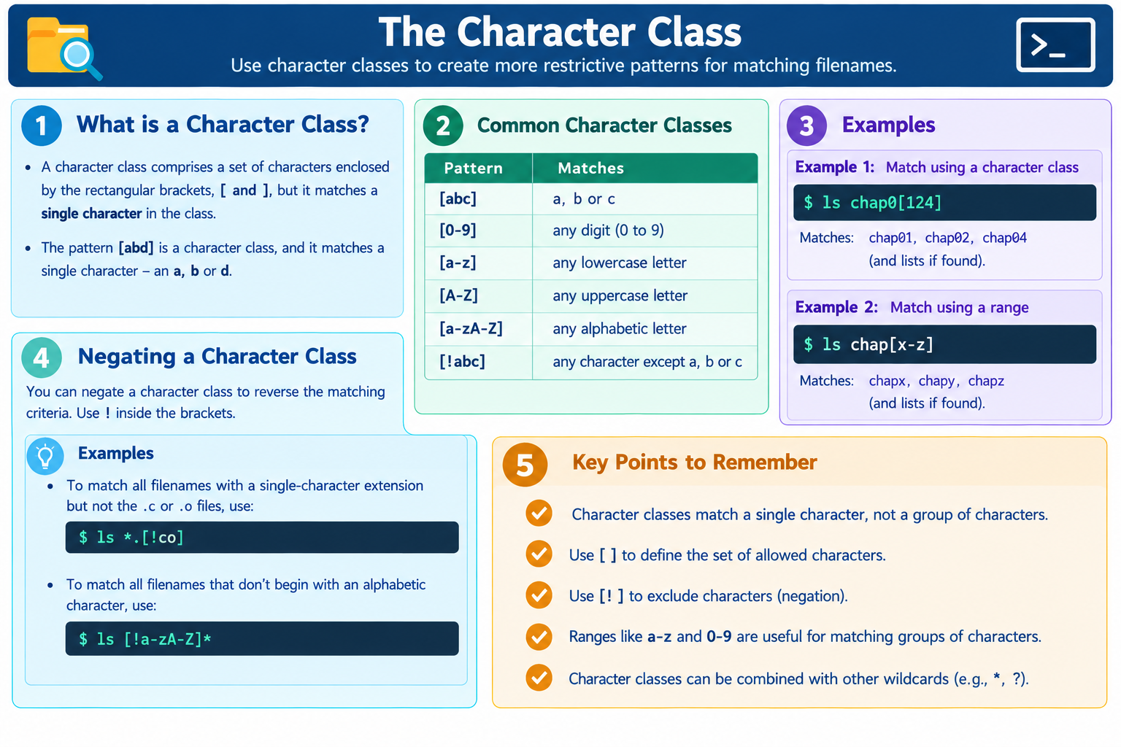
Unix System Programming

Slide 16
End of Module-2
Unix System Programming

