Slide 1
STUDENT ATTENDANCE AND PERFORMANCE TRACKER
Prepared By: Harshit Pandey and Geetha
Enrollment No:EN12026096961
Enrollment No:EN12027097079
Batch code:DA804S80

Slide 2

Introduction
Managing student attendance and academic performance manually can be time-consuming and prone to errors.
This project provides a database system that helps educational institutions store, manage, and analyze student attendance and performance records efficiently.
The system allows quick access to student information, attendance records, examination results, and performance reports.

Slide 3
Problem Statement
Existing Problems
Attendance records are difficult to maintain manually.
Student performance data is scattered across different files.
Generating reports takes significant time.
Identifying low-performing students is challenging.
Maintaining data consistency is difficult.
Lack of data management.
Proposed Solution
Develop a MYSQL-based database system that stores attendance and performance data in a structured format and generates useful reports automatically.

Slide 4
Objectives
To maintain accurate student, faculty, course, and department records.
To record and monitor student attendance for each course.
To manage course enrollments and examination details.
To track student performance through marks and grades.
To identify students with low attendance or poor academic performance.
To generate reports that support academic monitoring and decision- making.
To reduce manual record-keeping and improve data accuracy.
To demonstrate the use of SQL concepts such as tables, relationships, primary keys, foreign keys, joins, and queries.

Slide 5
Database Design
The database consists of the following entities:
Department
Student
Faculty
Course
Enrollment
Attendance
Exam
Result
Alert Log
The database is designed in normalized form to reduce redundancy and improve consistency

Slide 6
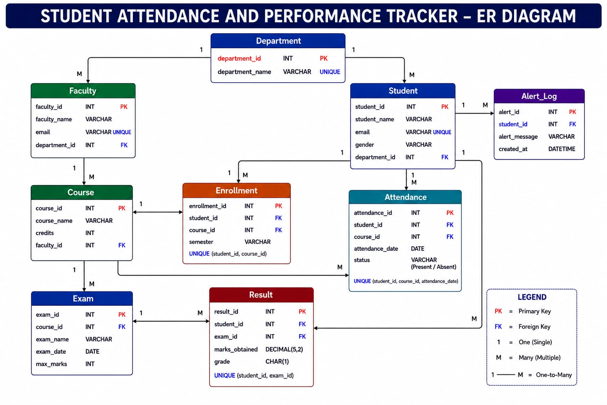

Slide 7
Database Constraints
Constraints Implemented
To ensure data accuracy and consistency:
Primary Key
Foreign Key
Unique Constraint
NOT NULL Constraint
CHECK Constraint
Benefits
Prevent duplicate records
Maintain referential integrity
Improve data quality

Slide 8

SQL Operations Performed
SQL Concepts Used
DDL Commands
CREATE
ALTER
DML Commands
INSERT
UPDATE
DELETE
DQL Commands
SELECT
WHERE
ORDER BY
Advanced Concepts
Joins
Subqueries
Aggregate Functions
Stored Procedures
Triggers

Slide 9
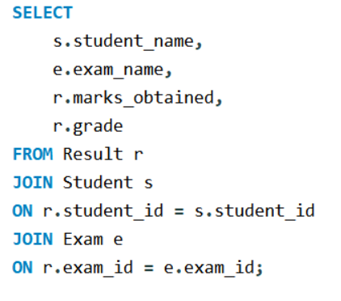
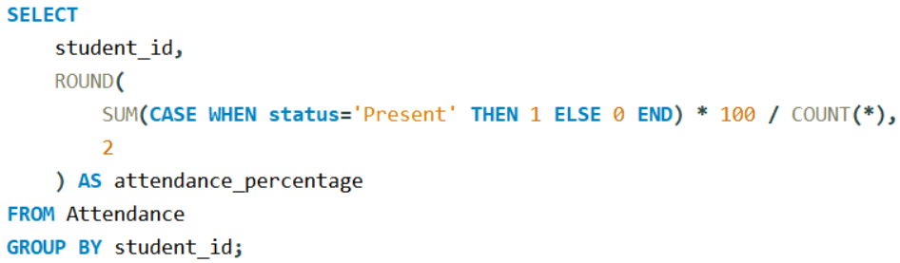
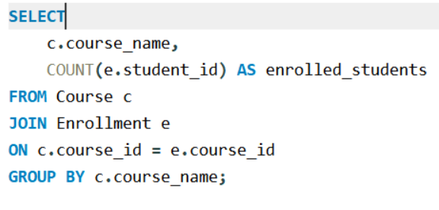
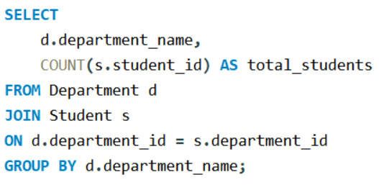
Important queries
Attendance Analysis Student Performance Analysis
Displays marks and grades obtained by student
Calculates attendance records for students.
Department-wise Student Count Course Enrollment Analysis
Shows the number of students in each department.

Slide 10
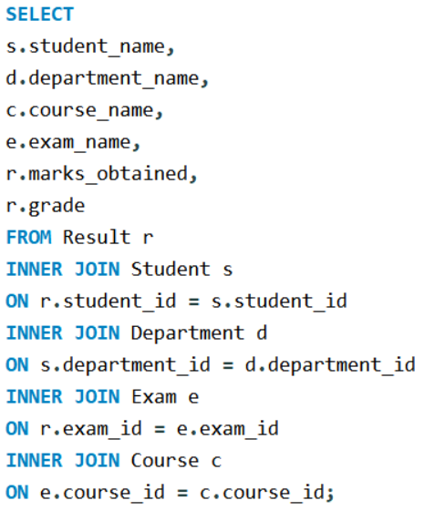
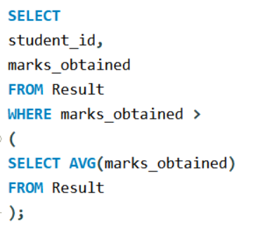
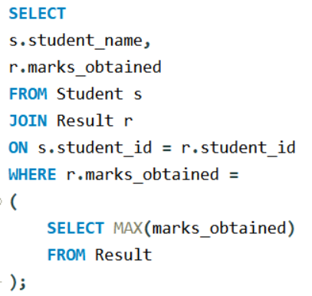
Joins and Subqueries Joins
Used to combine information from multiple tables.
Examples:
Student and Department Report
Student Performance Report
Attendance Report
Subqueries
Used for advanced analysis.
Examples:
Students scoring above average marks.
Highest scoring student.
Largest department analysis.

Slide 11
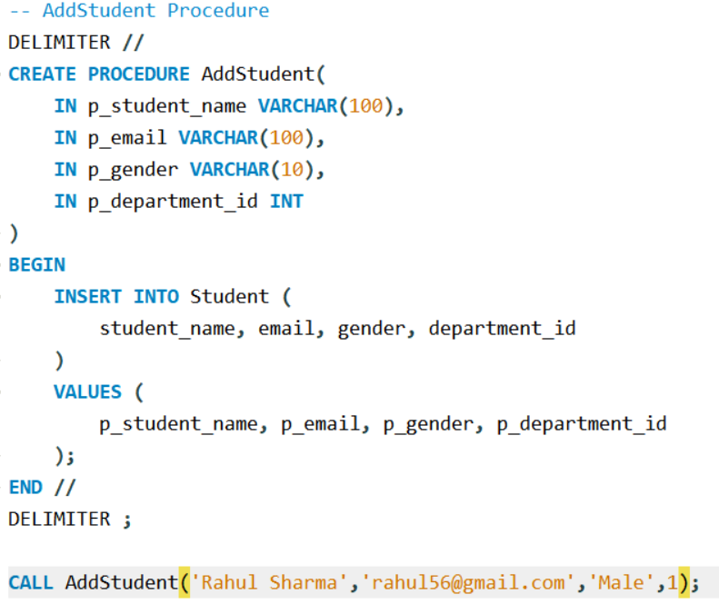
Stored Procedures
Implemented to automate key academic operations:
• AddStudent – Add new student records
• InsertResult – Insert marks and generate grades
• GetStudentPerformance – Generate student performance reports
• MarkAttendance – Record student attendance
• GetCourseEnrollment – Display course-wise enrolment count

Slide 12
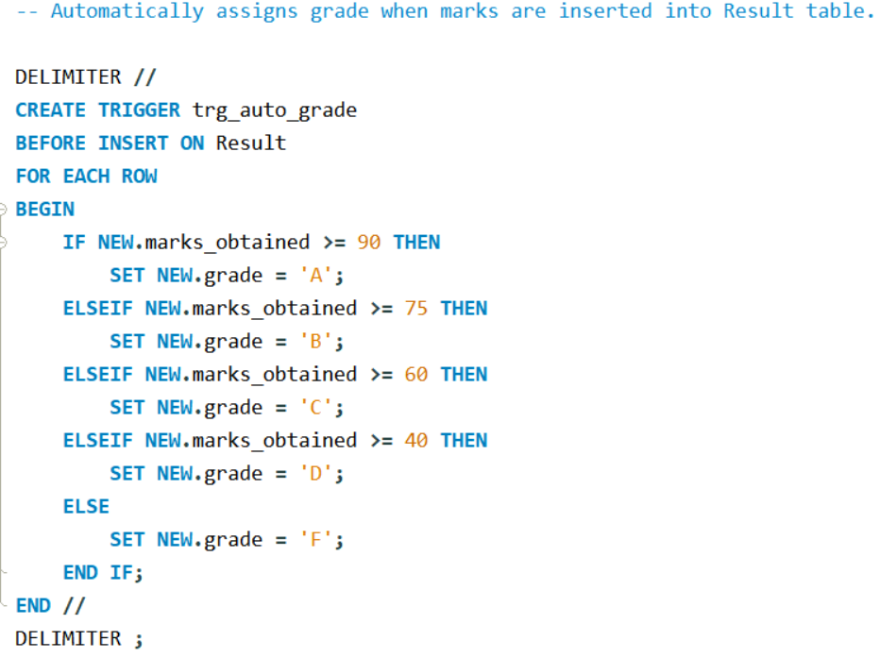
Triggers
Implemented to enforce data integrity and automate alerts:
• Automatic Grade Assignment : Based on marks obtained
• Marks Validation : (accepts only values between 0–100)
• Attendance Alert Generation : When a student is marked absent
• Low Attendance Warning : After repeated absences

Slide 13
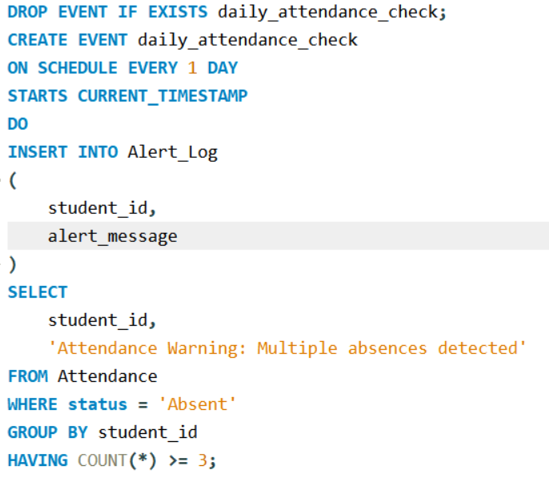
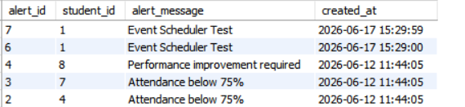
EVENTS
Event Scheduler Implementation
Implemented MySQL Event Scheduler for automated attendance monitoring.
Created a daily attendance check event that runs automatically every day.
Identifies students having 3 or more absences from attendance records.
Automatically generates warning entries in the Alert_Log table.
Demonstrates database automation using scheduled tasks.
Benefits
Automated attendance monitoring.
Timely warning generation for students with low attendance.
Reduces manual effort and improves efficiency.
Ensures consistent execution of attendance checks.
Outcome
Students with multiple absences are automatically flagged.
Warning messages are stored in Alert_Log for further action.
Attendance tracking process becomes fully automated.

Slide 14
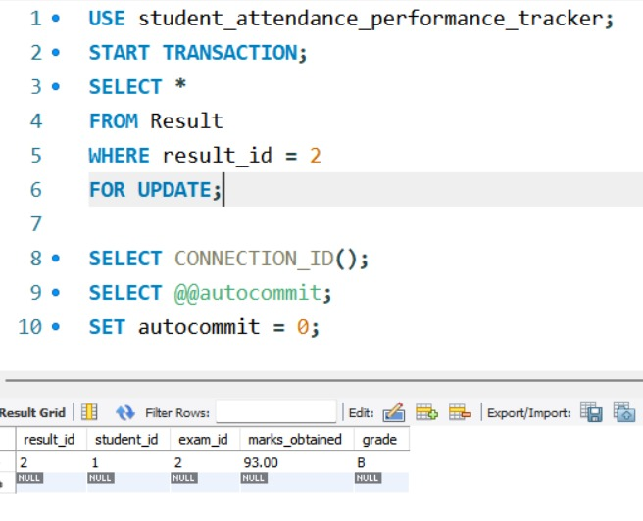
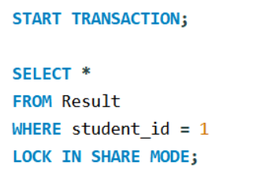
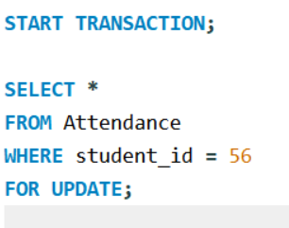
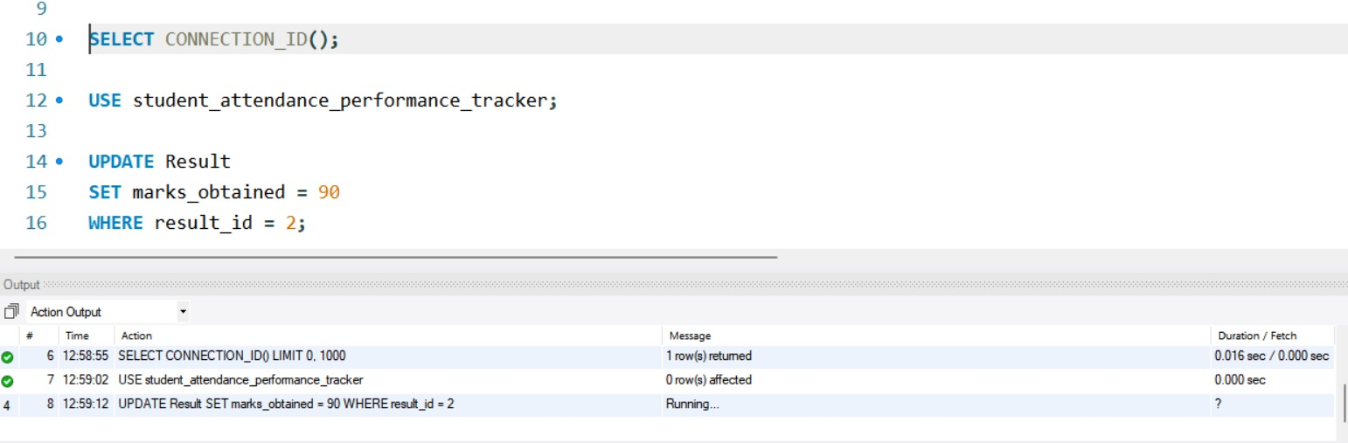
LOCKS
Locking Mechanism Implementation
Implemented row-level locking using MySQL transactions.
Used FOR UPDATE lock on Result and Attendance tables.
Prevents simultaneous modification of records during processing.
Ensures consistency while generating performance reports and attendance analysis.
Implemented LOCK IN SHARE MODE for safe data viewing without allowing concurrent updates.
Locks Implemented
Exclusive Lock (FOR UPDATE)
Result table during performance analysis.
Attendance table during attendance processing.
Shared Lock (LOCK IN SHARE MODE)
Result records during report viewing.
Allows multiple users to read data while preventing modifications.
Outcome
Prevents conflicting updates.
Maintains data integrity.
Supports reliable transaction processing.

Slide 15
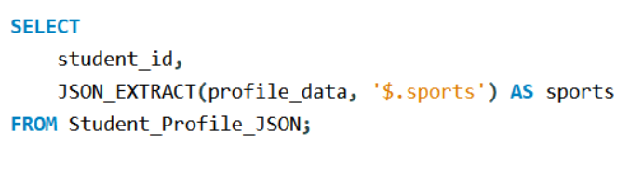
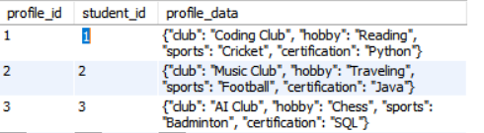
JSON Implementation
JSON was used to store additional student profile information.
Example:
{
"sports":"Cricket",
"club":"Coding Club",
"certification":"SQL"
}
Functions Used
JSON Object
JSON_EXTRACT()

Slide 16
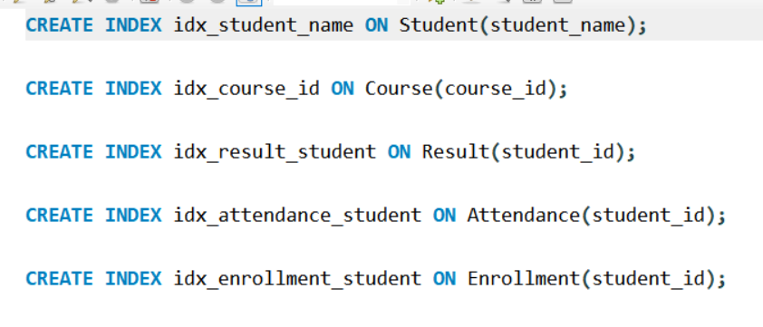
Performance Optimization
Query Optimization
Indexes were created to improve query performance.
Indexed Columns
student_id
course_id
Student_name
Benefits
Faster searching
Improved reporting speed
Better database performance

Slide 17
Results and Outcomes
The system successfully:
Tracks student attendance efficiently.
Stores examination results securely.
Generates analytical reports.
Supports academic performance monitoring.
Maintains data integrity and consistency.
Business Value
Helps institutions make better academic decisions using accurate data.

Slide 18
Conclusion
The Student Attendance and Performance Tracker provides an efficient solution for managing student records, attendance, and academic performance using SQL.
The project demonstrates database design, query writing, automation, optimization, and reporting techniques.
Future Scope
Web Application Integration
Real-Time Attendance System
Dashboard and Data Visualization
Student Performance Prediction

Slide 19
Questionare
Q1. What problem does your project solve?
Q2. Explain your ER Diagram.
Q3. Why did you normalize the database?
Q4. Which SQL concepts did you use in this project?
Q5. Why did you use JOINs and Subqueries?
Q6. Why did you use Stored Procedures and Triggers?
Q7. What did you learn from this project?

Slide 20


