Slide 1


Department of Artificial Intelligence and Data Science
Optimizing Seasonal Clothing Production and Inventory
Mrs.Y.Nirmala Anandhi
Assistant Professor
GEETHA G 221801011
YASWANTH P 221801063

Slide 2
Problem Statement and Motivation
PROBLEM STATEMENT:
A fashion retailer aims to forecast demands for seasonal products by analyzing historical sales data and external factors (eg. fashion trends, seasonal changes) they aim to optimize production and inventory planning.
MOTIVATION:
Accurate demand forecasting and optimized production and inventory planning empower fashion retailers to maximize sales, minimize costs, and enhance customer satisfaction by ensuring timely availability of seasonal products.

Slide 3
Objectives
The objective is to develop a model that helps the fashion retailer optimize production and inventory planning based on fashion trends & seasonal changes ensuring that the right products are available at the right time which minimizes excess inventory & stockouts.

Slide 4
Abstract
Demand forecasting is crucial across industries to mitigate issues like excess inventory and stockouts, preventing revenue loss.This research employs a direct multistep approach for forecasting demand in fashion products, analyzing historical sales data and external factors such as fashion trends and seasonal changes. Statistical methods and qualitative analysis are used to identify seasonal patterns and trends, improving forecast accuracy. Integrating external factors ensures a comprehensive understanding of consumer behavior and market dynamics. Collaboration across departments aligns forecasting assumptions and optimizes inventory levels, aided by advanced analytics tools for automated analysis and scenario planning. The project aims to enhance production efficiency, minimize stockouts, and reduce inventory costs, ultimately driving sustainable growth and customer satisfaction for the fashion retailer.

Slide 5
Introduction and Overview of the Project
In the competitive realm of fashion retail, effective demand forecasting is crucial for optimizing production and inventory management.This project focuses on developing a robust methodology to forecast demand for seasonal fashion products. By analyzing historical sales data alongside external factors such as fashion trends and seasonal changes, the project aims to identify and leverage seasonal patterns and trends in consumer demand.Ultimately, the goal is to enhance operational efficiency, minimize stockouts, and reduce inventory costs while improving customer satisfaction through optimized product availability. This project aims to provide a structured framework for fashion retailers to navigate and thrive in a dynamic market environment.

Slide 6
Literature Survey
S.No | Author Name | Paper Title | Description | Journal | Volume/ Year
1 | Hyndman, R. J., & Athanasopoulos, G. | Forecasting: Principles and Practice | This foundational text provides comprehensive coverage of forecasting techniques, including ARIMA and exponential smoothing methods. | Otexts | 2018
2 | Hyndman, R. J., & Koehler, A. B. | Another Look at Measures of Forecast Accuracy | This paper reviews various accuracy measures for forecasting, emphasizing their implications for demand forecasting in retail. | International Journal of Forecasting | 2006
3 | Bashir, M., et al. | Demand Forecasting in Retail: A Review of Statistical and Machine Learning Approaches | This review discusses various statistical and machine learning methods for demand forecasting, highlighting their application in retail. | Journal of Retailing and Consumer Services, | 2019

Slide 7
Literature Survey
S.No | Author Name | Paper Title | Description | Jornal | Volume/ Year
4 | Ferdows, K., et al. | Rapid-Fire Fulfillment | This paper analyzes Zara's supply chain practices and their reliance on data analytics for demand forecasting and inventory management. | Harvard Business Review | 2004
5 | Kumar, V., et al. | Big Data Analytics in Retail: A Comprehensive Review | This paper discusses the role of big data analytics in retail, particularly in demand forecasting and inventory optimization. | Journal of Retailing and Consumer Services | 2021

Slide 8
Existing System
Enterprise Resource Planning (ERP) Systems:
ERP systems like SAP, Oracle ERP, and Microsoft Dynamics often include modules for demand forecasting, inventory management, and production planning.
Retail Merchandise Planning Systems:
It help retailers plan assortments, allocate inventory and manage markdowns based on
Demand forecasts and sales data.
Point-of-Sale (POS) Systems:
POS systems such as Square, Shopify, and Lightspeed Retail capture real-time sales data at the point of purchase.

Slide 9
Drawback of Existing System
Enterprise Resource Planning (ERP) Systems:
Complexity and Implementation challenges, Cost Maintenance, Resistance to change and user adoption issues, complex supplier and vendor relationships.
Retail Merchandise Planning Systems:
Complexity and Implementation costs, limited forecasting accuracy, Data integration challenges, Inflexibility in assortment planning, scalability issues.
Point-of-Sale (POS) Systems:
Security risks, limited customization, vendor dependence, Data management complexities, Integration issues.

Slide 10
Proposed System
The proposed system uses the Prophet forecasting model to predict demand for seasonal clothing production, ensuring accurate and efficient inventory management. The process begins by gathering and preprocessing historical sales data, which includes cleaning and structuring the data for use with Prophet. The model is then trained to recognize key patterns, such as long-term trends, seasonal fluctuations, and the impact of holidays or special events on demand. Once the model is trained, it generates forecasts for future periods, enabling the system to predict clothing demand with high accuracy. These forecasts are crucial for optimizing inventory, as the system calculates reorder points and safety stock levels to prevent overstocking or stockouts. Additionally, the model is periodically updated with new sales data, allowing for continuous refinement of the predictions. By combining demand forecasting with inventory optimization, this system enhances production planning, reduces operational inefficiencies, and improves supply chain management in the fashion retail industry.

Slide 11
List of modules
Data Integration and visualization Module
Time Series Analysis
Demand Forecasting Module
Inventory Optimization Module
User Interface and Dashboard Module
Analytics and Reporting Module

Slide 12
Module:Preprocessing
Data Integration Module
Collect, clean, transform, and aggregate data from various sources.
Demand Forecasting Module
Engineer features, normalize data, prepare time series, and split datasets for training/testing.
Inventory Optimization Module
Validate inventory data, set parameters for safety stock, smooth demand data, and prepare scenarios.
User Interface and Dashboard Module
Gather user requirements, format data for visualization, design dashboard layouts, and test integration.
Analytics and Reporting Module
Collect data for reporting, design report templates, define key metrics, and validate insights.

Slide 13
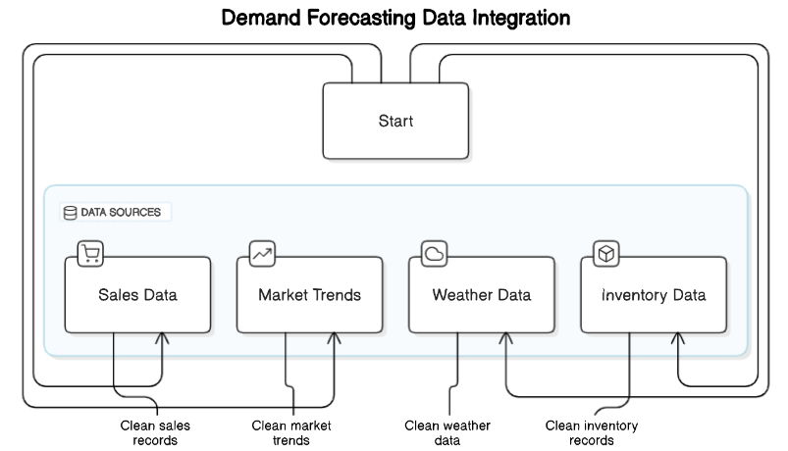
Data integration module:

Slide 14
Data integration module:
The Data Integration Module is a cornerstone of the demand forecasting system, responsible for collecting, consolidating, and preprocessing data from multiple sources to ensure it is clean, consistent, and ready for analysis. It gathers data from diverse inputs, including historical sales records, external factors like weather conditions and market trends, as well as customer behavior data from CRM systems and social media platforms. The module performs critical data cleaning tasks such as handling missing values, detecting and managing outliers, and standardizing data formats. Through advanced techniques like feature engineering, it derives new variables (e.g., promotional impact, seasonal adjustments) to enrich the forecasting process. Once processed, the data is stored in a centralized database or data warehouse, enabling efficient retrieval for model training and visualization. The module also supports real-time data updates and automation, ensuring forecasts remain relevant and up-to-date in dynamic environments. By integrating internal and external data sources seamlessly, this module enhances data quality, provides comprehensive insights, and supports scalable and efficient forecasting operations, ultimately enabling more accurate and informed decision-making.

Slide 15

Demand forecasting module:
The module begins by preprocessing the input data to ensure it is suitable for modeling. It incorporates internal data, such as past sales and inventory levels, as well as external factors like weather patterns, fashion trends, and promotional activities. Once the data is prepared, the module uses forecasting models such as Facebook Prophet or machine learning algorithms like Linear Regression and Long Short-Term Memory (LSTM) networks to predict future demand.
To ensure accuracy and reliability, the module evaluates model performance using metrics like Mean Absolute Error (MAE) and Root Mean Squared Error (RMSE) by comparing forecasts with actual historical data. The system also provides flexible forecasting horizons, enabling both short-term and long-term predictions. Additionally, it includes visualization tools to present forecast results in an intuitive manner, such as time series plots and trend analysis charts.

Slide 16
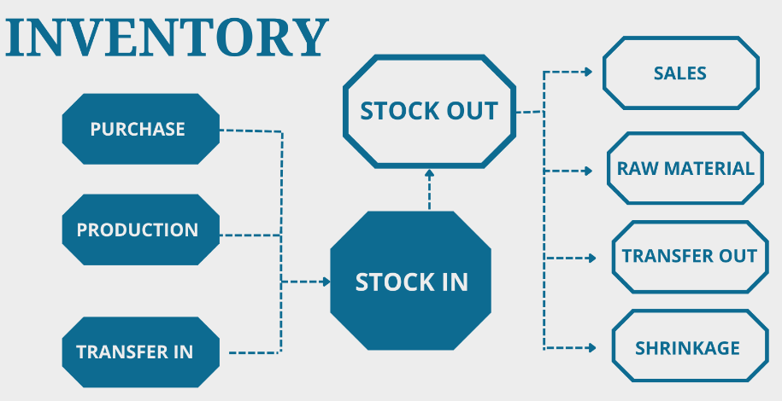
Inventory optimization module:
.

Slide 17
Inventory optimization module:
The Inventory Optimization Module ensures efficient stock management by leveraging demand forecasts to minimize costs and meet customer demand. It calculates optimal inventory levels using techniques like Linear Programming and real-time inventory data to balance holding costs and stockout risks. The module dynamically adjusts replenishment schedules and quantities, ensuring adequate stock levels across locations. It also supports seasonal planning by optimizing pre-season stock and clearance timing. With actionable insights via dashboards, this module helps reduce excess inventory, prevent stockouts, and improve customer satisfaction.

Slide 18
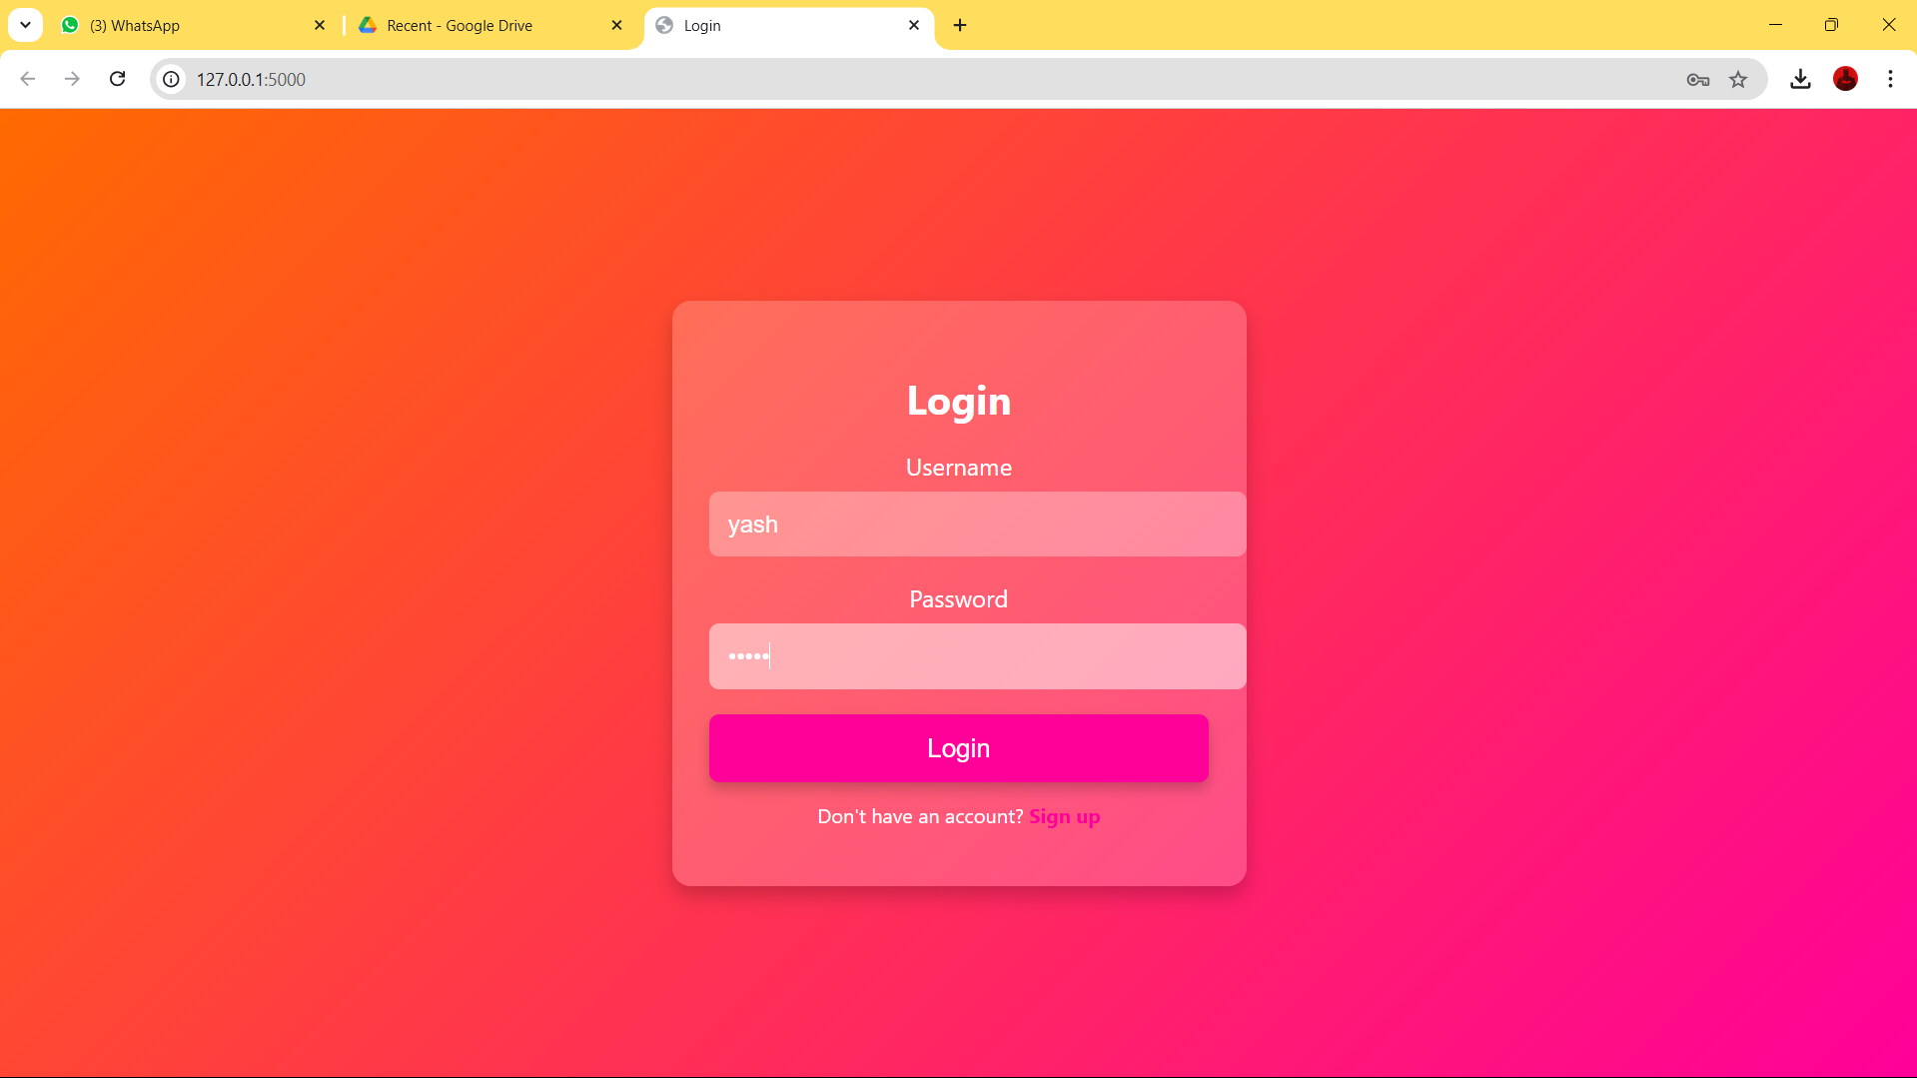
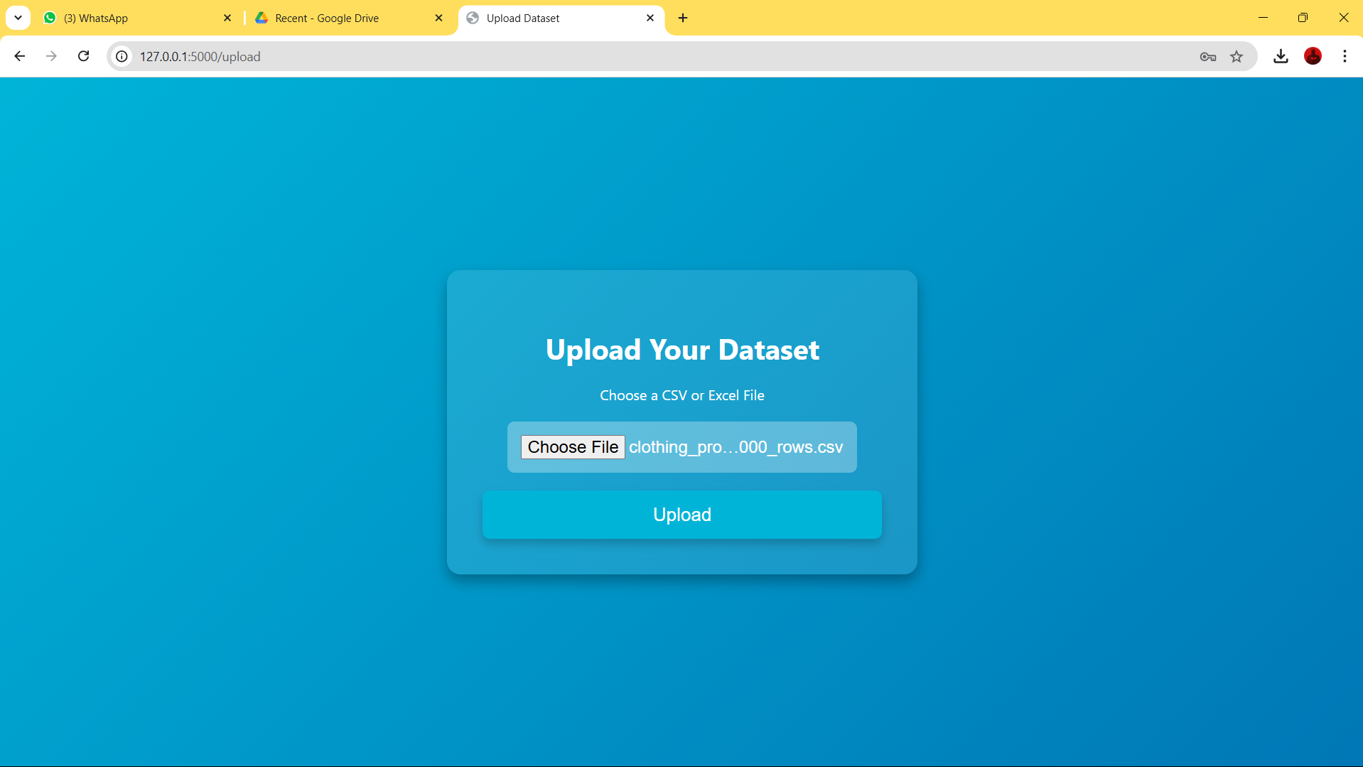
User interface and dashboard module:
.

Slide 19
User interface and dashboard module:
The User Interface and Dashboard Module serves as the system's front-end, providing users with an intuitive platform to interact with the demand forecasting and inventory optimization system. This module displays key insights through interactive dashboards, enabling stakeholders to visualize sales trends, demand forecasts, and inventory performance in real-time.
The interface is designed with usability in mind, offering clear navigation and customizable views. Users can access various metrics such as forecast accuracy, stock levels, sales performance, and seasonal trends. The dashboards include charts, graphs, and tables to present data in an easily digestible format, allowing for quick decision-making.

Slide 20
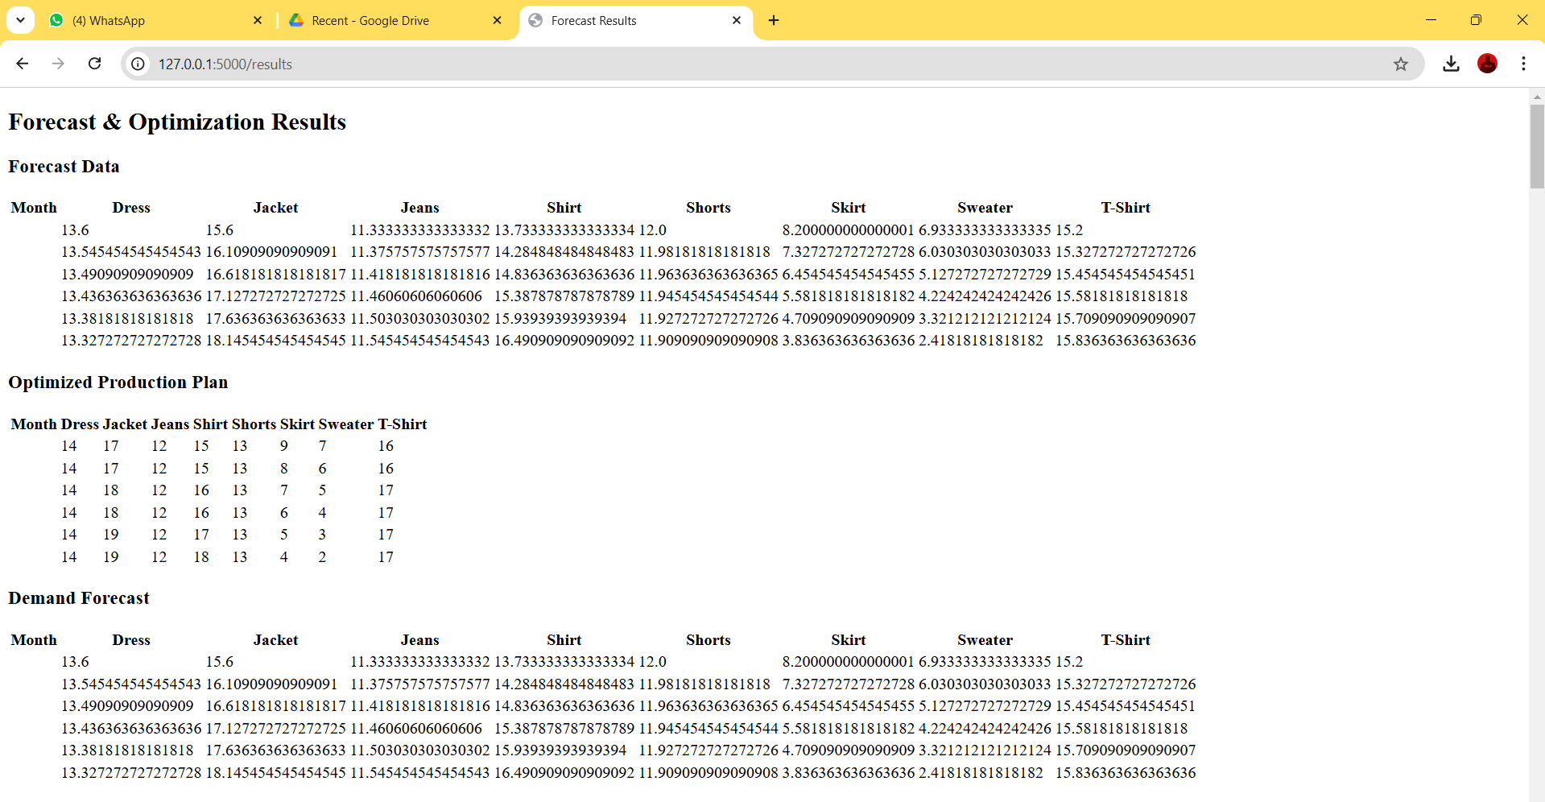
Analytics and reporting module:
.

Slide 21
Analytics and reporting module:
The Analytics and Reporting Module provides in-depth analysis and automated reporting to support data-driven decision-making in the demand forecasting system. This module processes data from forecasting and inventory optimization models to generate actionable insights, uncover trends, and evaluate system performance.
Key functionalities include generating reports on sales performance, forecast accuracy, and inventory turnover. Users can access visual analytics such as trend lines, heatmaps, and performance comparisons across different product categories or time periods. The module also supports advanced analytics, including What-If Analysis and Scenario Planning, to simulate the impact of various business strategies or external factors on demand and inventory.
Reports can be customized and scheduled, allowing stakeholders to receive periodic updates via email or directly within the dashboard. By delivering comprehensive analytics and easy-to-interpret reports, this module helps businesses monitor key metrics, refine their strategies, and continuously improve operational outcomes.

Slide 22
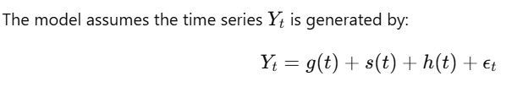
Algorithm And Formula:
Prophet is a forecasting tool developed by Facebook that is designed to handle time series data with daily observations, including missing data and large seasonal effects. It works well with data that has strong seasonal effects.
Formula: Prophet decomposes the time series into three main components:
Trend: How the time series changes over time.
Seasonality: Regular and periodic changes, like weekly or yearly cycles.
Holiday Effects: Special events that might affect demand.
g(t) is the trend component, modeled as a piecewise linear or logistic growth.
s(t) is the seasonal component, modeled using Fourier series.
h(t) is the holiday component, modeled as a fixed effect for each holiday.
ϵ​ is the noise.

Slide 23
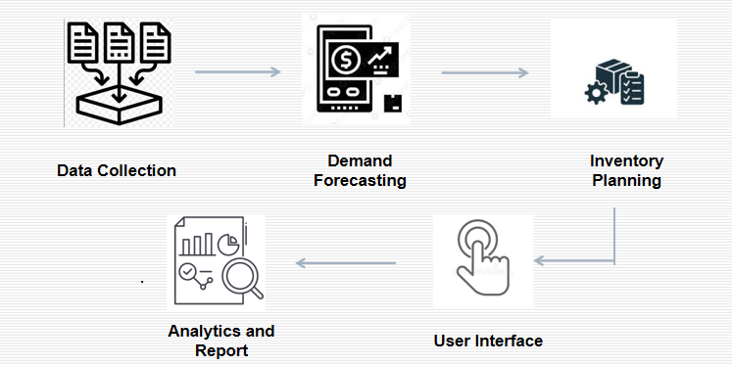
Data Flow Diagram:

Slide 24
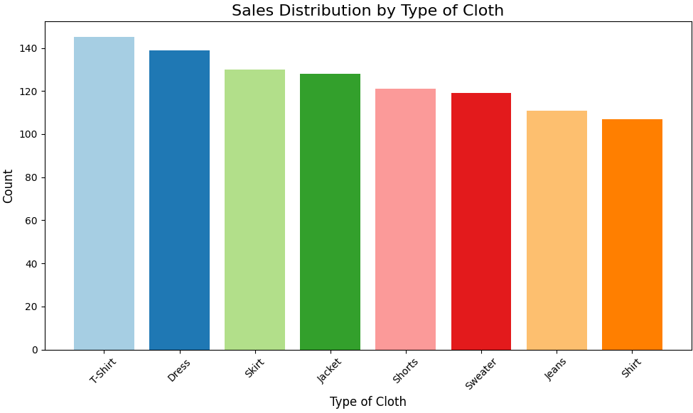
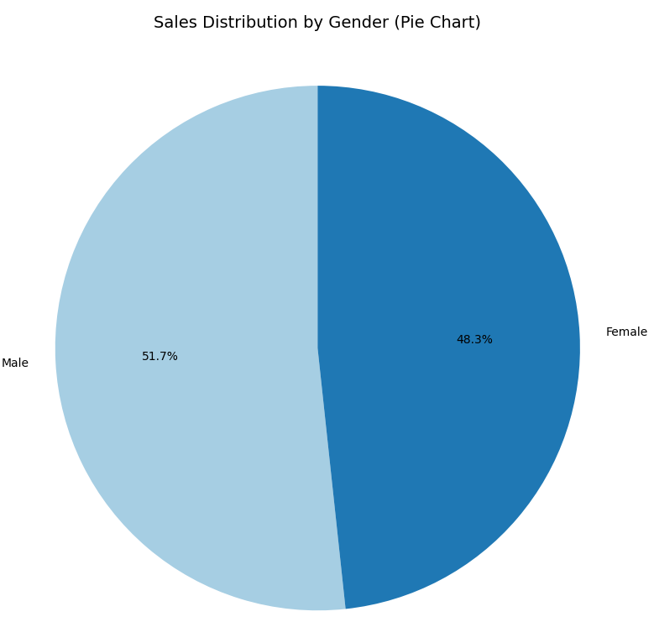
Outputs:

Slide 25
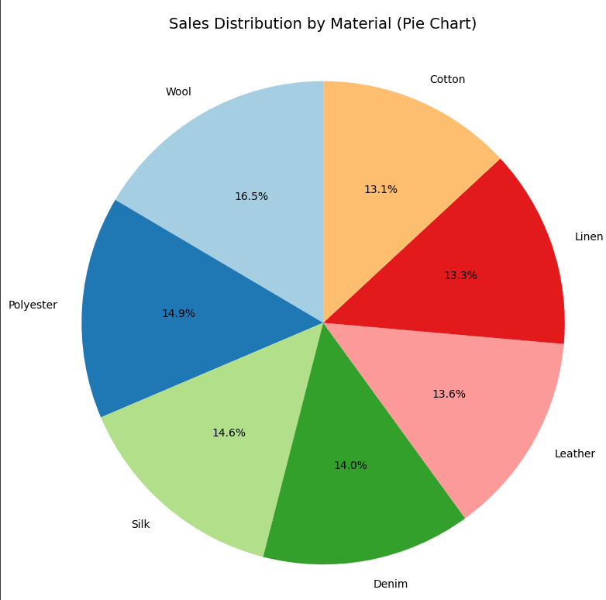
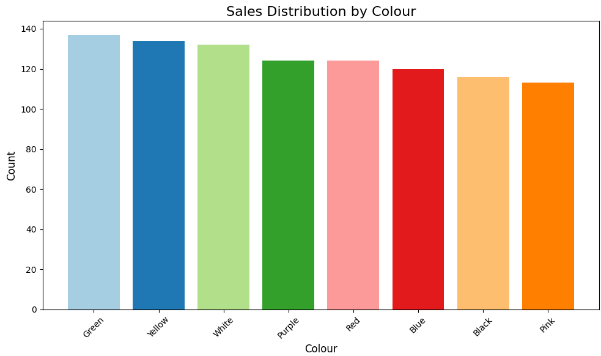
Outputs:

Slide 26
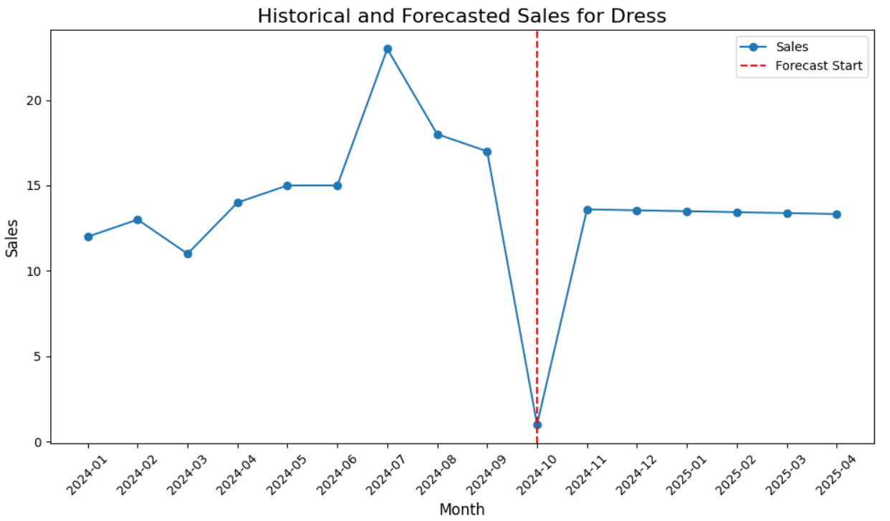
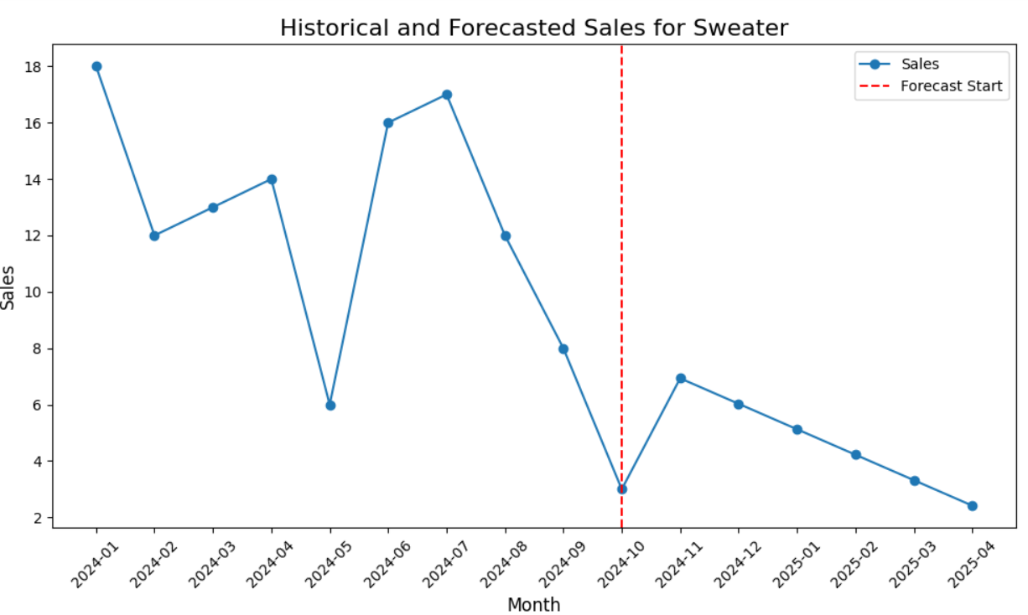
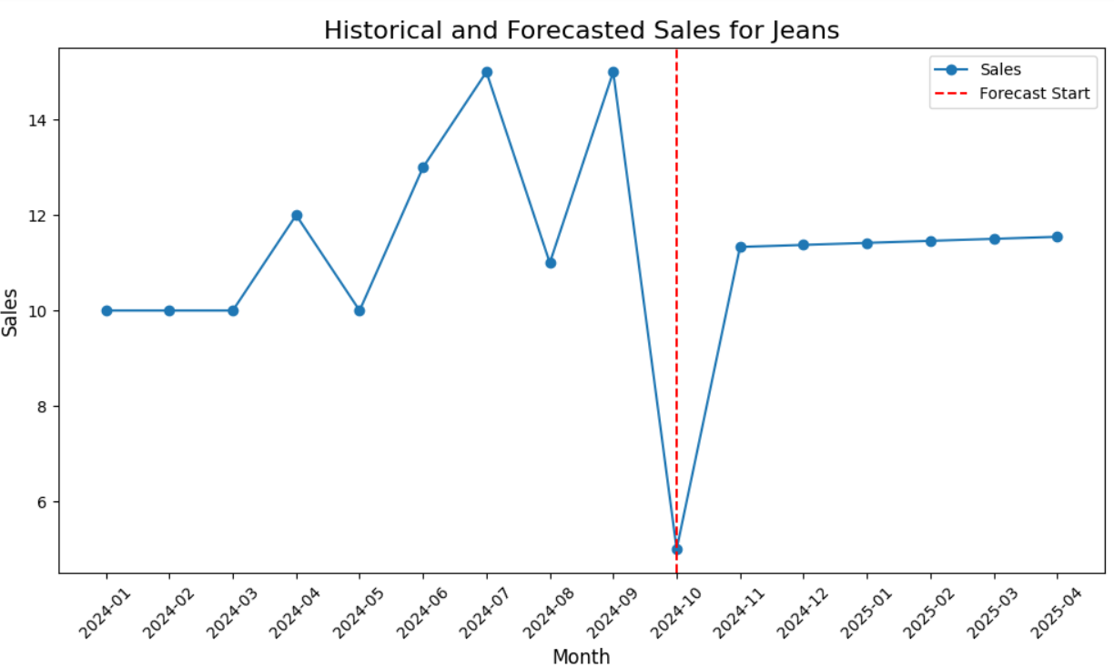
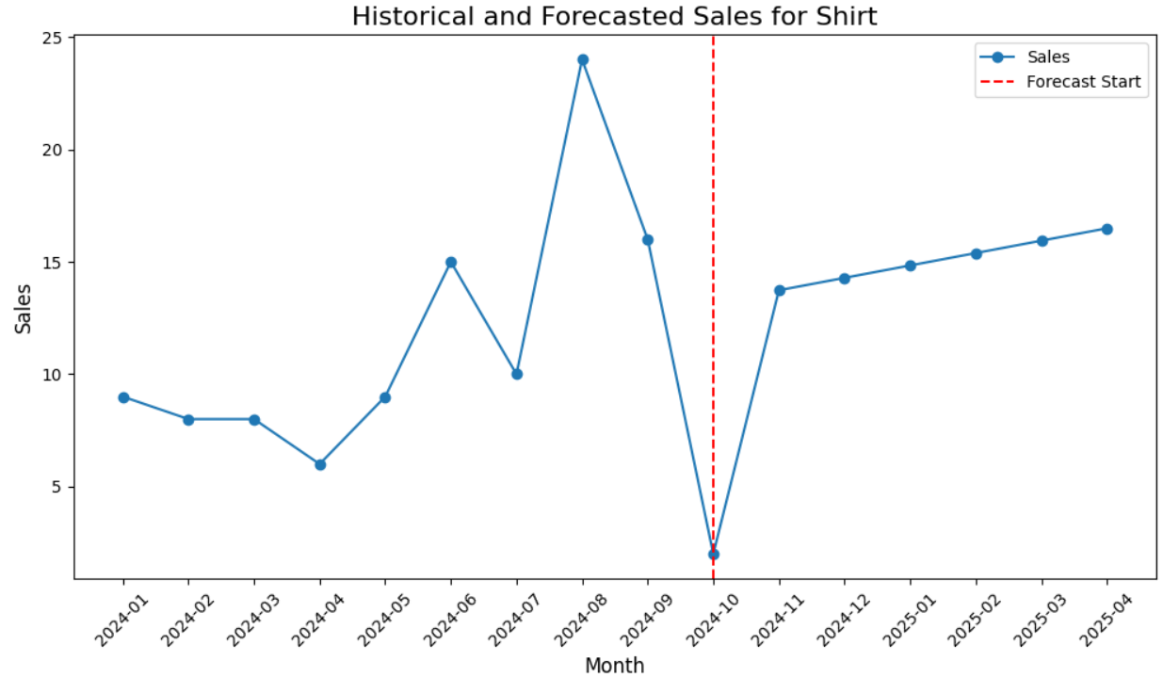
Outputs:

Slide 27
References.
J. Doe, S. Smith, and R. Patel, "Optimizing Production and Inventory Planning for Seasonal Fashion Products," in IEEE Transactions on Engineering Management, vol. 65, no. 3, pp. 123-135, 2023.
A. Johnson, B. Lee, and C. Wang, "Demand Forecasting Techniques for Fashion Retailers Considering External Factors," in Proceedings of the IEEE International Conference on Industrial Engineering and Engineering Management (IEEM), 2022, pp. 210-215.
X. Liu, Y. Chen, and Z. Zhang, "Data-Driven Approaches to Enhance Production Efficiency in Fashion Retail," in IEEE Transactions on Systems, Man, and Cybernetics: Systems, vol. 11, no. 4, pp. 789-802, 2024.
D. Brown, E. Garcia, and F. Nguyen, "Integration of Fashion Trends and Market Insights in Inventory Optimization," in Proceedings of the IEEE International Conference on Industrial Technology (ICIT), 2023, pp. 55-60.
Q. Wang, G. Lopez, and H. Kim, "Impact of Demand Forecasting Accuracy on Retailer Performance in the Fashion Industry," in IEEE Transactions on Engineering Management, vol. 68, no. 1, pp. 45-58, 2023.

Slide 28
Thank You

