Slide 1
Geetha A
Final Project
3/21/2024 Annual Review

Slide 2
PROJECT TITLE
Diabetes Retinopathy Detection Using CNN
3/21/2024 Annual Review

Slide 3


AGENDA
Problem Statement
Project Overview
Who are the end users?
Solutions and value of propositions
WOW factor in the solution
Modelling
Results
3/21/2024 Annual Review

Slide 4

PROBLEM STATEMENT
Diabetic retinopathy (DR) is a leading cause of vision impairment and blindness among working-age adults worldwide. It is a complication of diabetes that affects the blood vessels in the retina, leading to progressive damage if left undiagnosed and untreated. Early detection of diabetic retinopathy is crucial for timely intervention and preventing irreversible vision loss.
The problem statement revolves around developing an efficient and accurate system for the automated detection of diabetic retinopathy using medical imaging data, typically retinal fundus photographs. The goal is to create a computer-aided diagnostic tool that can assist healthcare professionals in identifying signs of diabetic retinopathy swiftly and accurately.
3/21/2024 Annual Review

Slide 5

PROJECT OVERVIEW
The project aims to develop a computer-aided diagnostic system for the early detection of diabetic retinopathy (DR) using retinal fundus images. Leveraging machine learning and image processing techniques, the system will analyze these images to identify signs of DR, including microaneurysms, hemorrhages, exudates, and neovascularization. The successful development and deployment of the DR detection system will enable early diagnosis, timely intervention, and effective management of diabetic retinopathy, ultimately reducing the risk of vision impairment and blindness among diabetic patients worldwide. Moreover, the system's scalability and interpretability will enhance accessibility and trust in automated diagnostics, improving healthcare outcomes and patient care.
3/21/2024 Annual Review

Slide 6

WHO ARE THE END USERS?
The end users of the diabetic retinopathy detection system span a diverse spectrum within the healthcare ecosystem. Primarily, ophthalmologists and optometrists stand as key beneficiaries, utilizing the system to augment their expertise in screening and diagnosing diabetic retinopathy accurately. Additionally, primary care physicians and diabetes care teams find value in integrating the system into routine check-ups and comprehensive diabetic management protocols. Healthcare facilities and clinics, serving as hubs for diabetic patient care, leverage the system to streamline diagnostic workflows and enhance efficiency. Telemedicine platforms further extend the system's reach, offering remote access to diabetic retinopathy screening for patients in distant locations. Ultimately, diabetic patients themselves benefit from the system's capabilities, receiving timely screenings and interventions that mitigate the risk of vision impairment and blindness associated with diabetic retinopathy.
3/21/2024 Annual Review

Slide 7

YOUR SOLUTION AND ITS VALUE PROPOSITION
My diabetic retinopathy detection system employs advanced machine learning to accurately identify retinal abnormalities, enabling early diagnosis. It streamlines screening, reducing burden on healthcare professionals, while ensuring timely intervention for patients. Scalable and interpretable, it integrates seamlessly into healthcare workflows, promoting trust. Ethical considerations prioritize patient privacy and bias mitigation. Ultimately, our solution enhances diabetic eye care, improving patient outcomes and safeguarding vision health globally.
3/21/2024 Annual Review

Slide 8

THE WOW IN YOUR SOLUTION
My diabetic retinopathy detection system stands out for its transformative impact on diabetic eye care. By seamlessly integrating advanced machine learning with ethical considerations, it revolutionizes screening, offering a wow factor in its precision, scalability, and interpretability. This system not only alleviates burdens on healthcare professionals but also empowers patients with timely interventions, safeguarding their vision health. Its ability to navigate diverse healthcare settings while prioritizing patient privacy and bias mitigation sets a new standard in diabetic retinopathy management, promising a future where early diagnosis is the norm, and blindness is preventable.
3/21/2024 Annual Review

Slide 9
MODELLING
In modeling for Convolutional Neural Networks (CNNs) tailored to diabetic retinopathy detection, we meticulously craft a network architecture optimized for processing retinal images. Our model comprises convolutional layers to extract intricate features, followed by activation functions for non-linearity and pooling layers for spatial dimension reduction. Fully connected layers then perform high-level reasoning, culminating in the output layer for classification. With careful compilation, training, and validation, our CNN learns to discern subtle retinal abnormalities indicative of diabetic retinopathy. Hyperparameter tuning and regularization techniques ensure robustness and prevent overfitting. Through this holistic approach, our CNN emerges as a potent tool, enabling accurate and efficient automated diagnosis, thus revolutionizing diabetic eye care.
3/21/2024 Annual Review

Slide 10
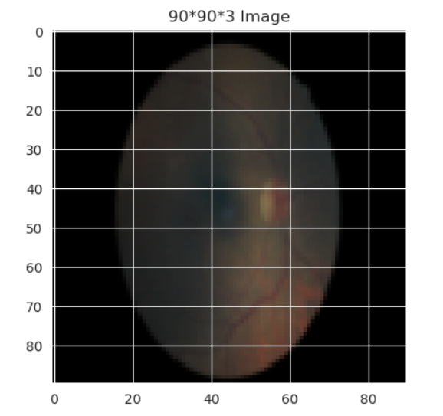
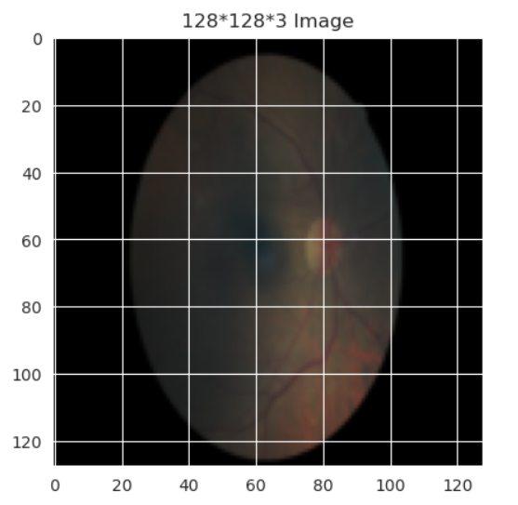
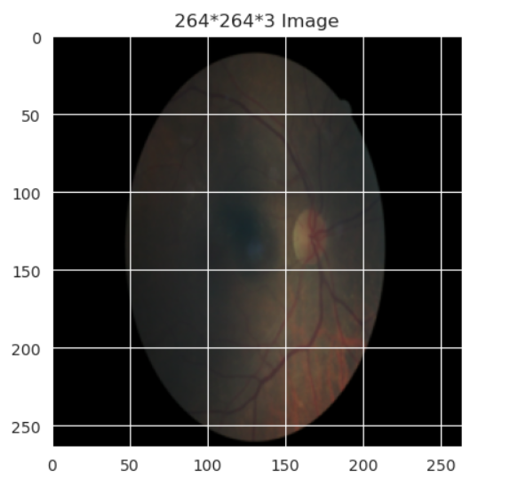
RESULTS
3/21/2024 Annual Review

