Slide 1
Customer Churn Prediction presentation
CUSTOMER CHURN PREDICTIONUSING PYTHON
Minor Project Report
Submitted By
Name:Bonagiri geetha
College Name:CMR Technical campus
Internship Organization:SkillHigh
Department:CSE(Data science)
Academic Year: 2025-2026

Slide 2
Introduction
Customer Churn Prediction is a Machine Learning application used to identify customers who are likely to leave a company’s service.
Customer churn is one of the major challenges faced by telecom companies because losing customers directly affects revenue and business growth.
Retaining existing customers is more cost-effective than acquiring new customers.
By predicting churn early, companies can take preventive actions to improve customer satisfaction and customer retention.
This project uses the Telco Customer Churn dataset, which contains customer information such as demographics, internet services, contract type, monthly charges, tenure, and payment methods.
Data preprocessing techniques such as handling missing values and label encoding are applied to prepare the dataset for Machine Learning.

Slide 3
Objective
To analyze customer data and understand the factors influencing customer churn.
To build a Machine Learning model that can accurately predict whether a customer will leave the telecom service or continue using it.
To preprocess and clean the dataset by handling missing values and converting categorical data into numerical format.
To identify important customer attributes such as contract type, tenure, monthly charges, and internet services that affect churn behavior.
To apply the Random Forest Machine Learning algorithm for classification and prediction.
To evaluate the model performance using accuracy score, confusion matrix, and classification report.

Slide 4
Dataset
The project uses the Telco Customer Churn Dataset, which contains customer information collected from a telecom company.
The dataset is widely used for Machine Learning and Data Analytics projects related to customer retention and churn prediction.
It contains a total of 7043 customer records and 21 columns/features.
Each row in the dataset represents an individual customer and their service details.
The dataset includes both categorical and numerical attributes related to customer behavior and telecom services.

Slide 5
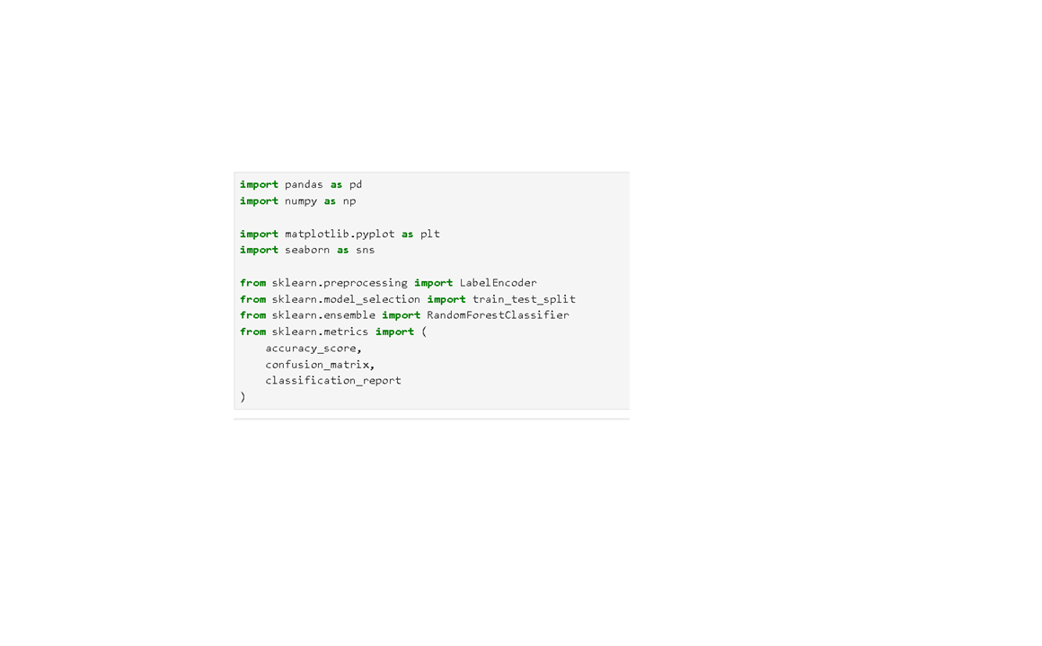
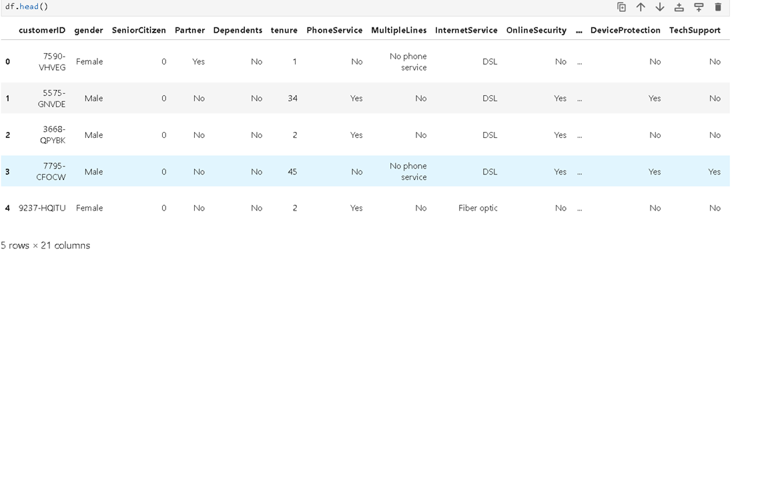

Slide 6
Important Features in the Dataset
Gender
SeniorCitizen
Partner
Dependents
tenure
PhoneService
InternetService
OnlineSecurity
TechSupport
treamingTV / StreamingMovies
Contract
PaperlessBilling
PaymentMethod
MonthlyCharges
TotalCharges
Churn

Slide 7
Technologies Used
Python
Python is the primary programming language used for developing the project.
It is widely used in Machine Learning, Data Science, and Data Analytics because of its simplicity and powerful libraries.
2. Pandas
Pandas is used for data manipulation and analysis.
It helps in loading, cleaning, filtering, and processing the dataset.
Functions such as read_csv(), head(), and isnull() were used during preprocessing.
3.NumPy
NumPy is used for numerical computations and array operations.
It provides fast mathematical calculations and supports handling large datasets efficiently.
It is commonly used along with Pandas in Machine Learning projects.

Slide 8
4.Matplotlib
Matplotlib is used for data visualization.
It helps in creating graphs and plots for better understanding of data patterns.
In this project, it was used to display the feature importance graph.
5.Seaborn
Seaborn is a visualization library built on top of Matplotlib.
It provides attractive and informative statistical graphs.
It was used to create bar plots for feature importance analysis.
6.Scikit-learn
Scikit-learn is the main Machine Learning library used in the project.
It provides tools for data splitting, preprocessing, model training, and evaluation.
Functions used include:
train_test_split()
LabelEncoder()
RandomForestClassifier()
accuracy_score()
confusion_matrix()
Classification_report()

Slide 9
7.Jupyter Notebook
Jupyter Notebook was used as the development environment for writing and executing Python code.
It allows step-by-step execution, visualization, and documentation in a single notebook.
It is widely used for Data Science and Machine Learning projects.
8.Machine Learning Algorithm – Random Forest
Random Forest is a supervised Machine Learning algorithm used for classification tasks.
It works by combining multiple decision trees to improve prediction accuracy.
It handles large datasets effectively and reduces overfitting.
In this project, it achieved approximately 79% prediction accuracy.

Slide 10
Data Preprocessing
1.Data Preprocessing
Data preprocessing is one of the most important steps in Machine Learning because raw data often contains missing values, inconsistent formats, and categorical information that cannot be directly used by ML algorithms.
The main objective of preprocessing is to clean and transform the dataset into a suitable format for model training and prediction.
2.Dataset Loading
The Telco Customer Churn dataset was loaded into the Jupyter Notebook environment using the Pandas library.
The dataset was imported using the read_csv() function.
3.Checking Missing Values
The dataset was examined for missing or null values using the isnull().sum() function.
It was found that the TotalCharges column contained missing values.

Slide 11
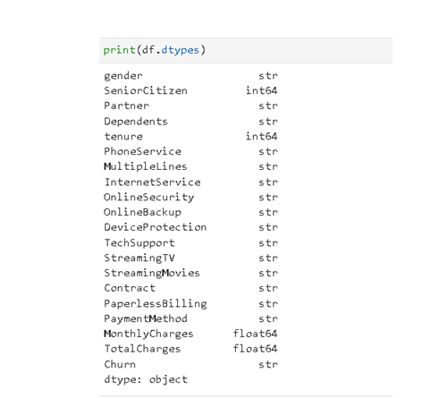
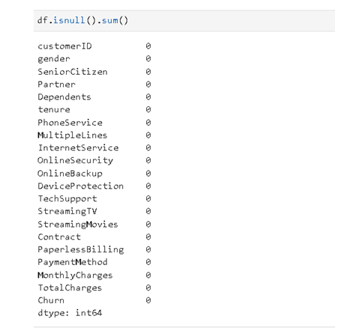

Slide 12
4.Handling Missing Values
The TotalCharges column was converted into numeric format using pd.to_numeric().
Missing values were replaced with the median value of the column to avoid data loss and maintain dataset consistency.
Median was used because it is less affected by extreme values.
5.Removing Unnecessary Columns
The customerID column was removed from the dataset because it does not contribute to customer churn prediction.
Removing irrelevant features helps improve model performance and reduces complexity.
6.Encoding Categorical Data
Many columns in the dataset contained text values such as:
Male/Female
Yes/No
Contract types
Machine Learning algorithms cannot process text directly, so Label Encoding was applied.

Slide 13
Label Encoding converted categorical values into numerical format.
Example:
Male → 1 Female → 0 Yes → 1 No → 0
7.Feature and Target Separation
The dataset was divided into:
Features (X) → Input variables used for prediction
Target (y) → Output variable (Churn)
This separation is necessary for supervised Machine Learning.
8.Train-Test Split
The dataset was divided into training and testing sets using train_test_split().
80% of the data was used for training the model.
20% of the data was used for testing and evaluation.
This helps evaluate how well the model performs on unseen data.
9.Importance of Data Preprocessing
Improves data quality and consistency
Reduces errors in model training
Enhances prediction accuracy
Helps Machine Learning algorithms work efficiently
Increases reliability of the final model

Slide 14
Machine Learning Model
1.Machine Learning Model
In this project, the Random Forest Classifier algorithm was used to predict customer churn.
Random Forest is a supervised Machine Learning algorithm mainly used for classification and prediction tasks.
It is one of the most popular and powerful algorithms because it provides high accuracy and handles large datasets efficiently.
2.Why Random Forest Was Chosen
Random Forest gives better prediction accuracy compared to many basic algorithms.
It can handle both numerical and categorical data effectively.
It reduces the problem of overfitting by combining multiple decision trees.
It works well with complex datasets and provides reliable results.
It is easy to implement and suitable for customer churn prediction problems.

Slide 15
3.How Random Forest Works
Random Forest creates multiple decision trees during training.
Each tree analyzes different parts of the dataset.
Every tree makes its own prediction.
The final prediction is determined by majority voting among all trees.
This improves prediction accuracy and model stability.
4.Model Parameters Used
n_estimators = 100
Indicates the number of decision trees created in the forest.
random_state = 42
Ensures consistent and reproducible results during execution.

Slide 16
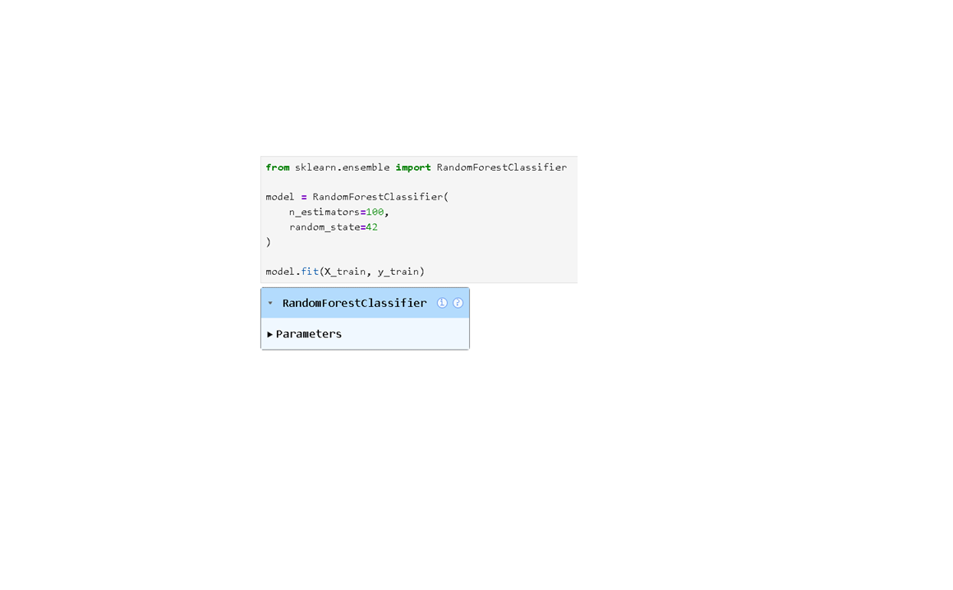
5.Model Training Process
The cleaned and preprocessed dataset was divided into:
Training Data (80%)
Testing Data (20%)
The training dataset was used to train the Random Forest model.
The testing dataset was used to evaluate the performance of the model.

Slide 17
6.Prediction Process
After training, the model predicts whether a customer will:
Stay with the company
Leave the company (Churn)
Predictions are based on customer behavior, service usage, charges, and contract details.
7.Model Evaluation
The model performance was evaluated using:
Accuracy Score
Confusion Matrix
Classification Report
The Random Forest model achieved approximately 79.56% accuracy, indicating good prediction performance.

Slide 18
Model Evaluation
Model evaluation measures the performance of the Machine Learning model.
The Random Forest model achieved approximately 79.56% accuracy.
Accuracy shows how correctly the model predicts customer churn.
A Confusion Matrix was used to compare actual and predicted results.
A Classification Report provided:
Precision
Recall
F1-Score
The evaluation results indicate that the model performs effectively in predicting customer churn.
The model can help telecom companies identify high-risk customers and improve customer retention strategies.

Slide 19
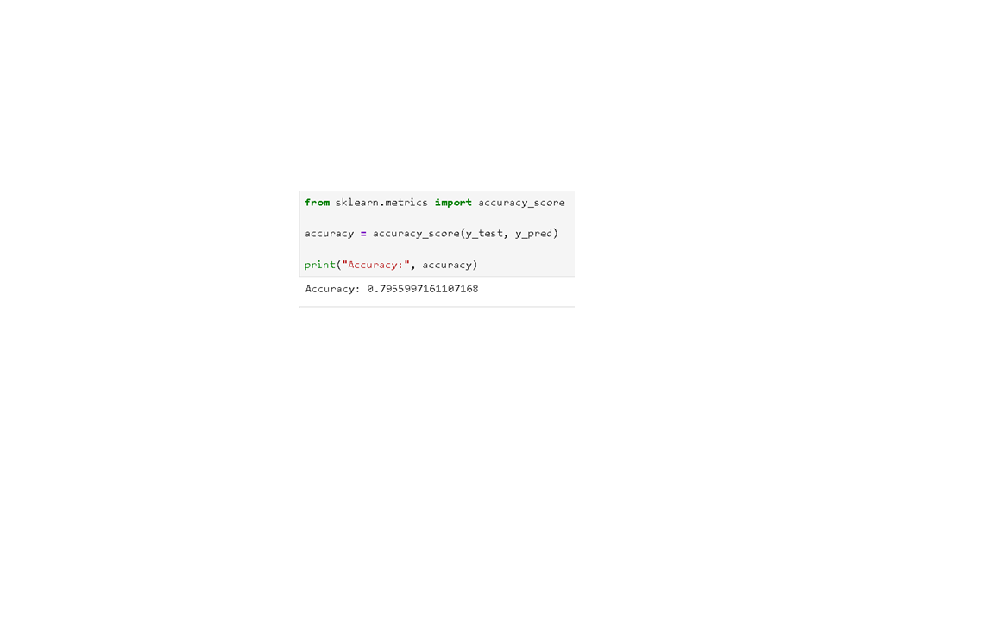
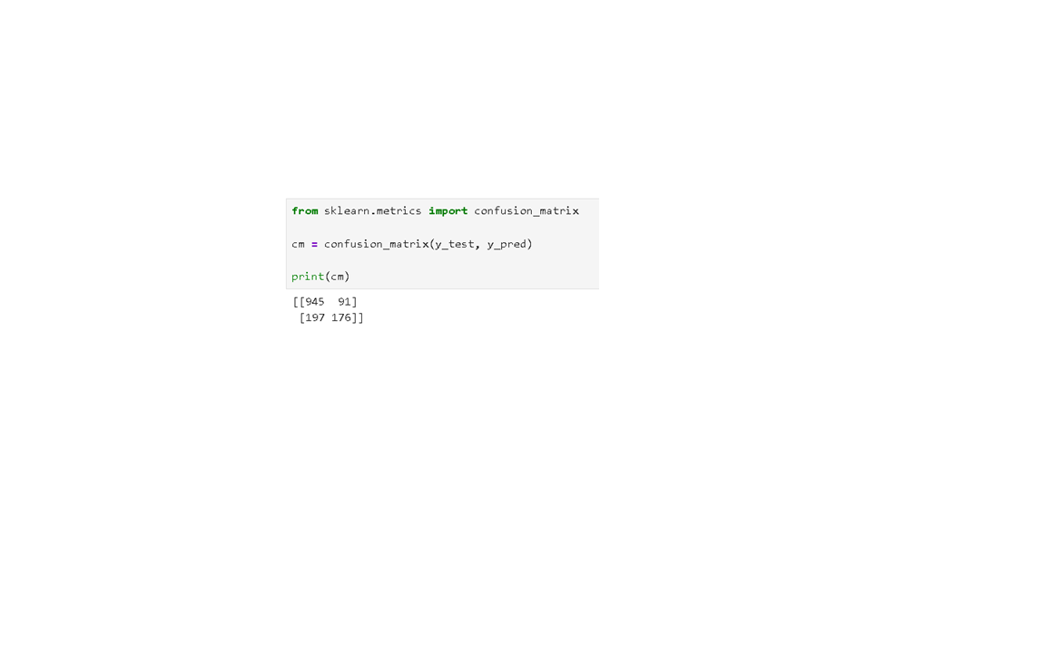

Slide 20
Feature Importance
Feature Importance identifies the most influential factors affecting customer churn.
The Random Forest model calculated the importance of each feature automatically.
Important features identified include:
Contract Type
Tenure
Monthly Charges
Total Charges
Internet Service
Customers with short contracts, low tenure, and high monthly charges are more likely to churn.
Feature importance analysis helps companies understand customer behavior and improve retention strategies.
A bar graph was created to visualize the importance of different features.

Slide 21
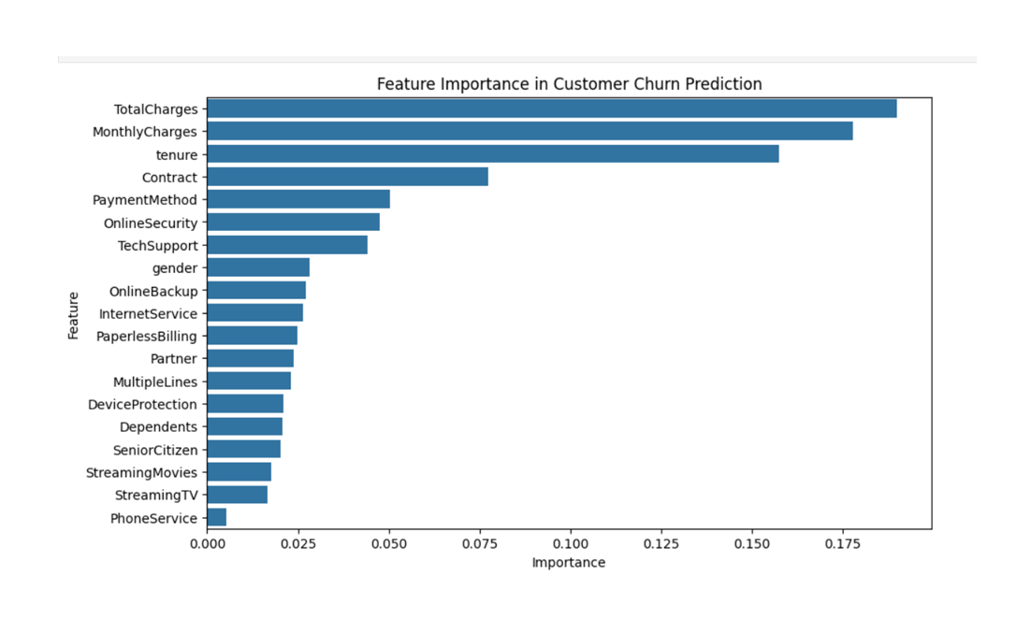

Slide 22
Advantages
Helps predict customers who are likely to leave the company.
Improves customer retention strategies.
Supports better business decision-making.
Reduces customer loss and increases profitability.
Random Forest provides good prediction accuracy.
Handles large datasets effectively.
Feature importance helps identify key churn factors.
Disadvantages
Prediction accuracy is not always 100%.
Requires proper data preprocessing and cleaning.
Random Forest model may take more training time for large datasets.
Results depend on the quality of the dataset.
Complex models can be difficult to interpret compared to simple algorithms.
Incorrect or missing data can affect model performance.

Slide 23
Future Scope
Use advanced Machine Learning algorithms such as XGBoost and Neural Networks to improve prediction accuracy.
Deploy the project as a web application using Streamlit or Flask.
Integrate real-time customer data for live churn prediction.
Improve feature engineering and hyperparameter tuning for better performance.
Apply the model in other industries such as banking, insurance, and e-commerce.
Add customer feedback and social media analysis for more accurate predictions.
Develop automated customer retention and recommendation systems based on churn predictions.

Slide 24
Conclusion
The Customer Churn Prediction project was successfully implemented using Machine Learning techniques.
Data preprocessing, missing value handling, and label encoding were performed to prepare the dataset.
The Random Forest algorithm was used to predict customer churn effectively.
The model achieved approximately 79.56% accuracy, showing good prediction performance.
Important factors influencing churn were identified using feature importance analysis.
The project helps telecom companies identify high-risk customers and improve customer retention strategies.
This project demonstrates the practical application of Machine Learning in solving real-world business problems.

Slide 25
Thank You

