Slide 1

“Backup rotation scheme using tower of Hanoi”
Guided by,
Mr.Vikas.B.O
Assistant Professor,
Department of ISE,
New Horizon College of Engineering
Bangalore
Presented by,
Deepa.S, Geetha .B .C
IV semester A Section,
Department of ISE,
New Horizon College of Engineering
Bangalore

Slide 2
CONTENTS
Introduction
Purpose of Study
Problem Statement
System Requirement
System Design
Expected Outcome

Slide 3
INTRODUCTION
Regular backups are vital to protect against failures of the software, the hardware, or even of the users.
There is always a conflict between the need to have frequent backups and the cost of keeping such backups for a long time.
The name comes from the children's game where you start with three pegs on a piece of board.
The object is to move a pile of discs from one peg to another by moving one disc at a time and never putting a larger disc on a smaller one.

Slide 4
PURPOSE OF STUDY
Tower of Hanoi, How does this help with backups?
ABACABADABACABAEABACABADABACABA
The five-disc solution above is a string of 31 characters which consists of five different letters.
It won't give us a backup for every day of the month but at the end of the month you would have a very good spread of data on your five tapes:
A.One day old
B.Two days old
C.Four days old
D.Eight days old

Slide 5
A set of n tapes (or other media) will allow backups for 2^{n−1} days before the last set is recycled.
So, 3 tapes will give 4 days' worth of backups, and on the 4th day Set C will be overwritten;
4 tapes will give 8 days, and Set D is overwritten on the 9th day; 5 tapes will give 16 days, etc. Files can be restored from 1, 2, 4, 8, 16, ..., 2^{n−1} days ago.

Slide 6
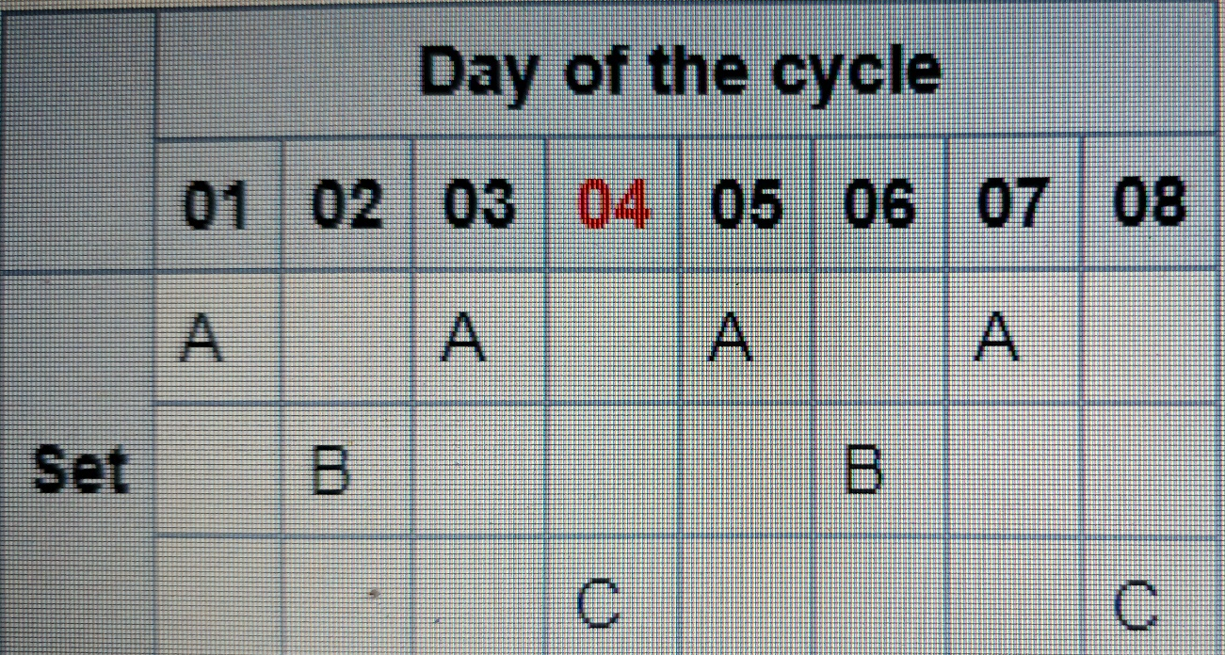
How do we do it in practice?
Three-tape Hanoi schedule(for a week)
ABACABAC

Slide 7
PROBLEM STATEMENT
“To design and implement Back up Rotation System to reduce tapes requirement compared with the GFS scheme”.

Slide 8
SYSTEM REQUIREMENTS
Hardware System Configuration:
Processor - Intel Core i5
Speed - 1.8 GHz
RAM - 256 MB (min)
Hard Disk - 10 GB
Software System Configuration:
Operating System - Fedora
Programming Language - C++
Compiler - Dev c++Compiler

Slide 9
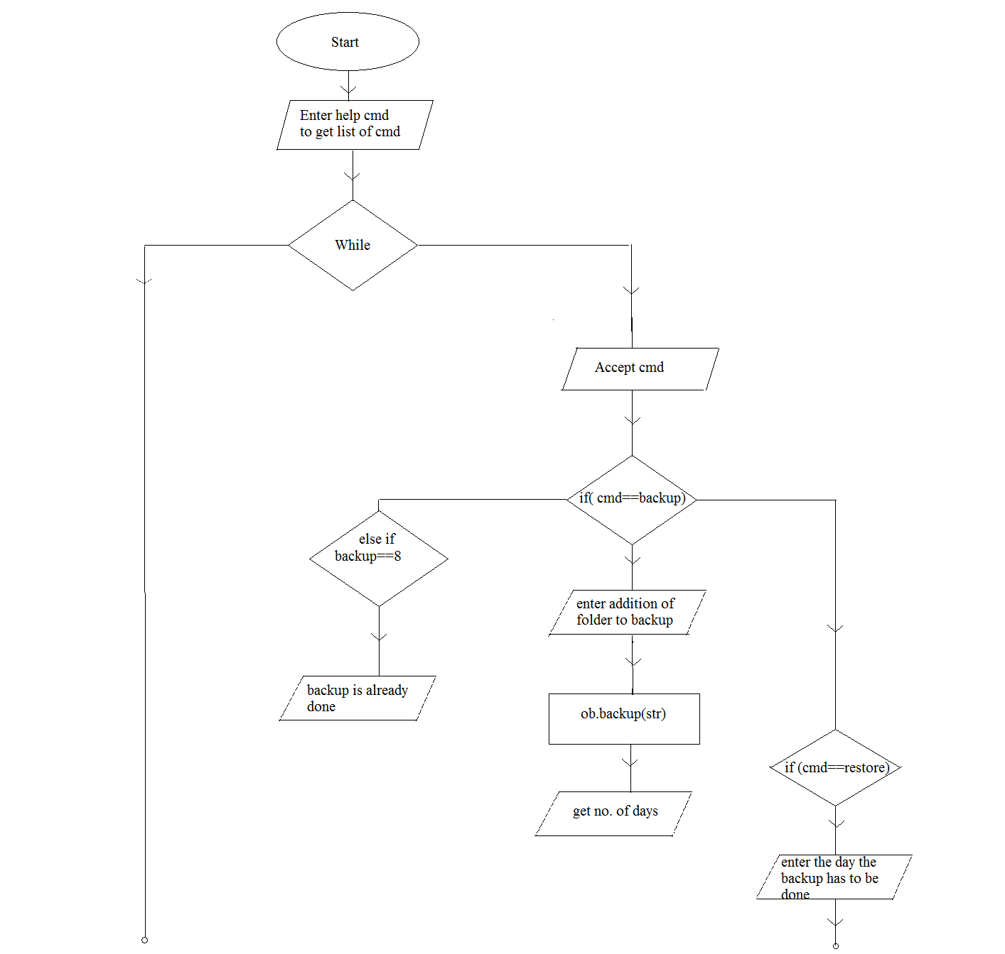
SYSTEM DESIGN

Slide 10
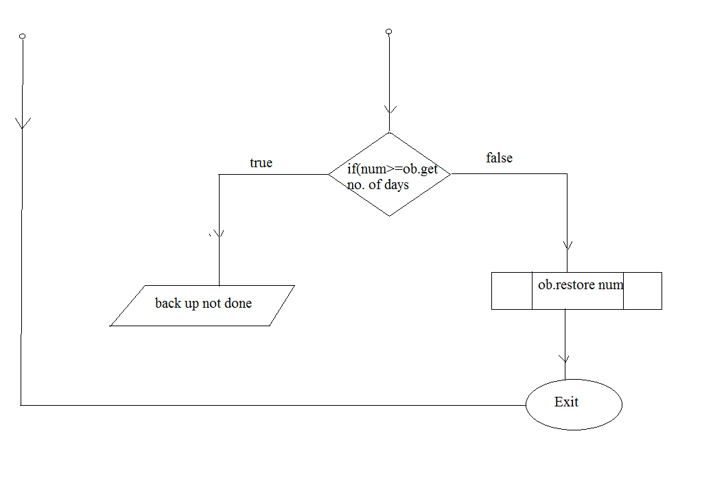

Slide 11
ALGORITHM
Step 1: Start
Step 2: Enter help to get list of commands
While(true)
Accept command
If( cmd==“back up”)
Enter address of folder to back up
1.Ob.backup(str);
Get number of days
Else if(backup==8)
Backups are already done
Step 3: if( cmd==“restore”)
Enter the day to backup and restore
If(num>= ob.get number of days() )

Slide 12
It is not yet backed up
1.ob.restore(num);
Step 4: if(cmd==“exit”)
Process done
Else
If(cmd==“help”)
1.ob.help();
Else
Invalid command
Step 5: Stop

Slide 13
EXPECTED OUTCOME
Once the tower of Hanoi backup scheme is selected, it is possible to specify the scheme schedule and the number of levels.
Best practise suggests that five levels should be used if you are applying the Tower of Hanoi to weekly backups and eight levels for daily backups.
Regular backups are vital to protect ourselves against failures of the software, the hardware, or even of the users.
There is always a conflict between the need to have frequent backups and the cost of keeping such backups for a long time. The Tower of Hanoi pattern is a useful compromise.

Slide 14
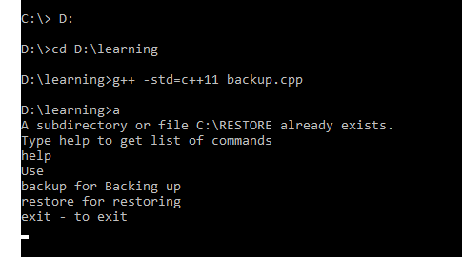
OUTPUT
Snapshot 1: Navigating the backup cpp file location using g++ -std=c++11backup.cpp command. Type help to get list of commands

Slide 15
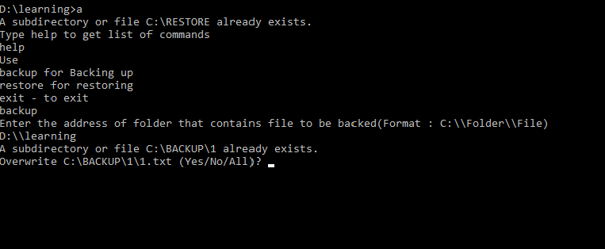
SNAPSHOT 2
Snapshot 2: Backup command is entered. Enter the address of that folder that contains a file to backup in the above mentioned manner.

Slide 16
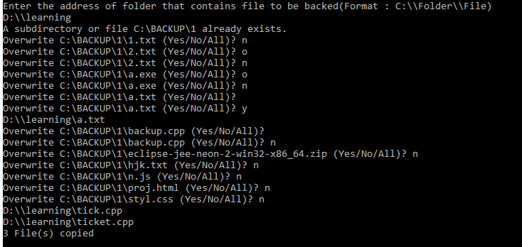
SNAPSHOT 3
Snapshot 3: If the files are already backed up, then it asks permission to overwrite. If we give yes(y) it overwrites and 13 files are copied

Slide 17
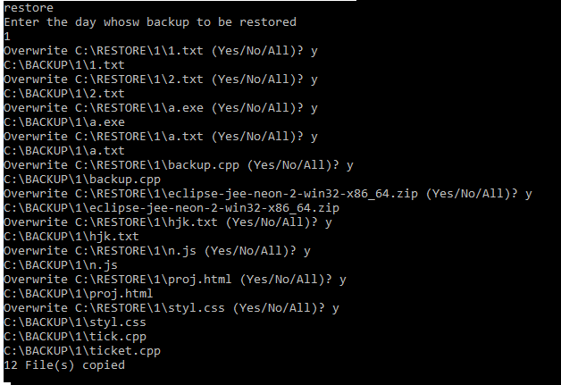
SNAPSHOT 4
Snapshot 4: Restore command is entered. The day 1 is entered to restore. If the files are already restored it ask permission to overwrite to restore the files y is entered the files are restored.

Slide 18

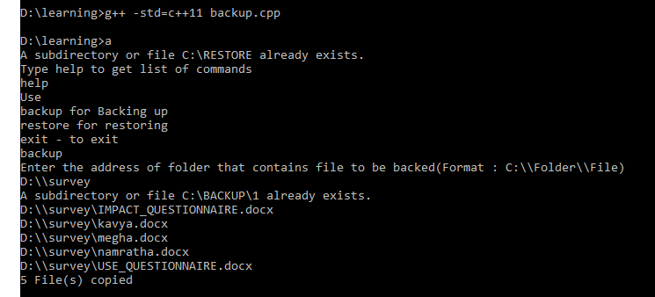
SNAPSHOT
Snapshot 5: Restore command is enter It asks the day to restore the backup files. The day 2 is taken as input. The day 2 files are not backed up yet hence it displays error message.
Snapshot 6: Navigating the backup cpp file location using g++ -std=c++11backup.cpp command.
Type help to get list of commands .Enter the address of that folder that contains a file to backup in the above mentioned manner. New address is entered to backup

Slide 19
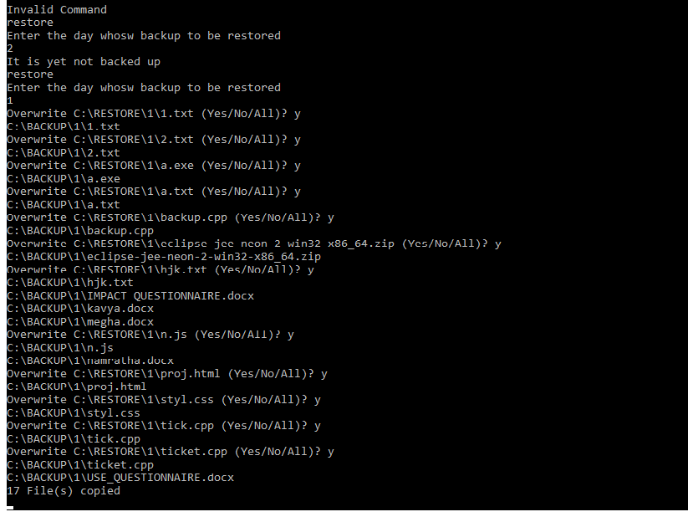
SNAPSHOT
Snapshot 7: If the files are already backed up, then it asks permission to overwrite. If we give yes(y) it overwrites and 13 files are copied.

Slide 20
REFERENCES
The following sources were very helpful during the completion of project:
https://www.alvechurchdata.co.uk/hints-and-tips/softhanoi.html
https://en.wikipedia.org/wiki/Backup_rotation_scheme

Slide 21
THANK YOU

