Slide 1

MOVIE REVIEW Sentiment analysis
Team Spark Crafters
Anand K K (TL)
Kavya R
Geetha S

Slide 2
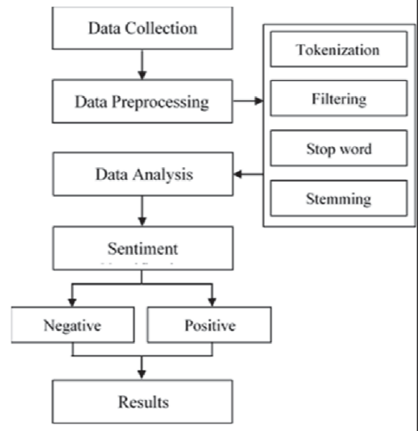
FLOW DIAGRAM

Slide 3
LOGISTIC REGRESSION
Logistic Regression as the ML algorithm for doing sentiment analysis
Supervised Machine Learning Algorithm
Doing binary classification tasks by predicting the probability of an outcome

Slide 4

THANK YOU

