Slide 1


Intelligent Traffic Signal Control System Using IoT Sensors for Dynamic Vehicle Density Management
A smart, adaptive approach to urban traffic management through real-time IoT sensing and dynamic signal control.
GUMMADI GEETHANANDH
323129520062

Slide 2


Problem Statement
The Urban Traffic Challenge
The Root Cause
Traffic congestion at road intersections is a major challenge in urban areas worldwide, causing cascading effects across transportation networks.
Conventional traffic signals operate using fixed timing schedules that cannot adapt to changing traffic conditions — creating a fundamental mismatch between signal behavior and real-world demand.
Congestion increases travel time and causes unnecessary delays
Excessive traffic contributes to increased fuel consumption
Vehicle congestion increases environmental pollution
Fixed-time signals are unable to respond to real-time vehicle density, making them inefficient by design.
There is a clear need for an intelligent system that dynamically controls signal timing based on real-time vehicle density data.

Slide 3
Proposed Solution
An Intelligent Traffic Signal Control System powered by IoT sensors that continuously monitors and adapts to real-world traffic conditions.
Continuous Monitoring
Dynamic Adjustment
IoT sensors continuously monitor vehicle density at road intersections in real time.
Traffic signal timings are automatically adjusted according to current traffic conditions.
Real-Time Intelligence
Centralized Platform
Real-time traffic information is used to improve vehicle movement and reduce delays.
A secure, user-friendly interface enables traffic authorities to monitor and manage intersections efficiently.

Slide 4
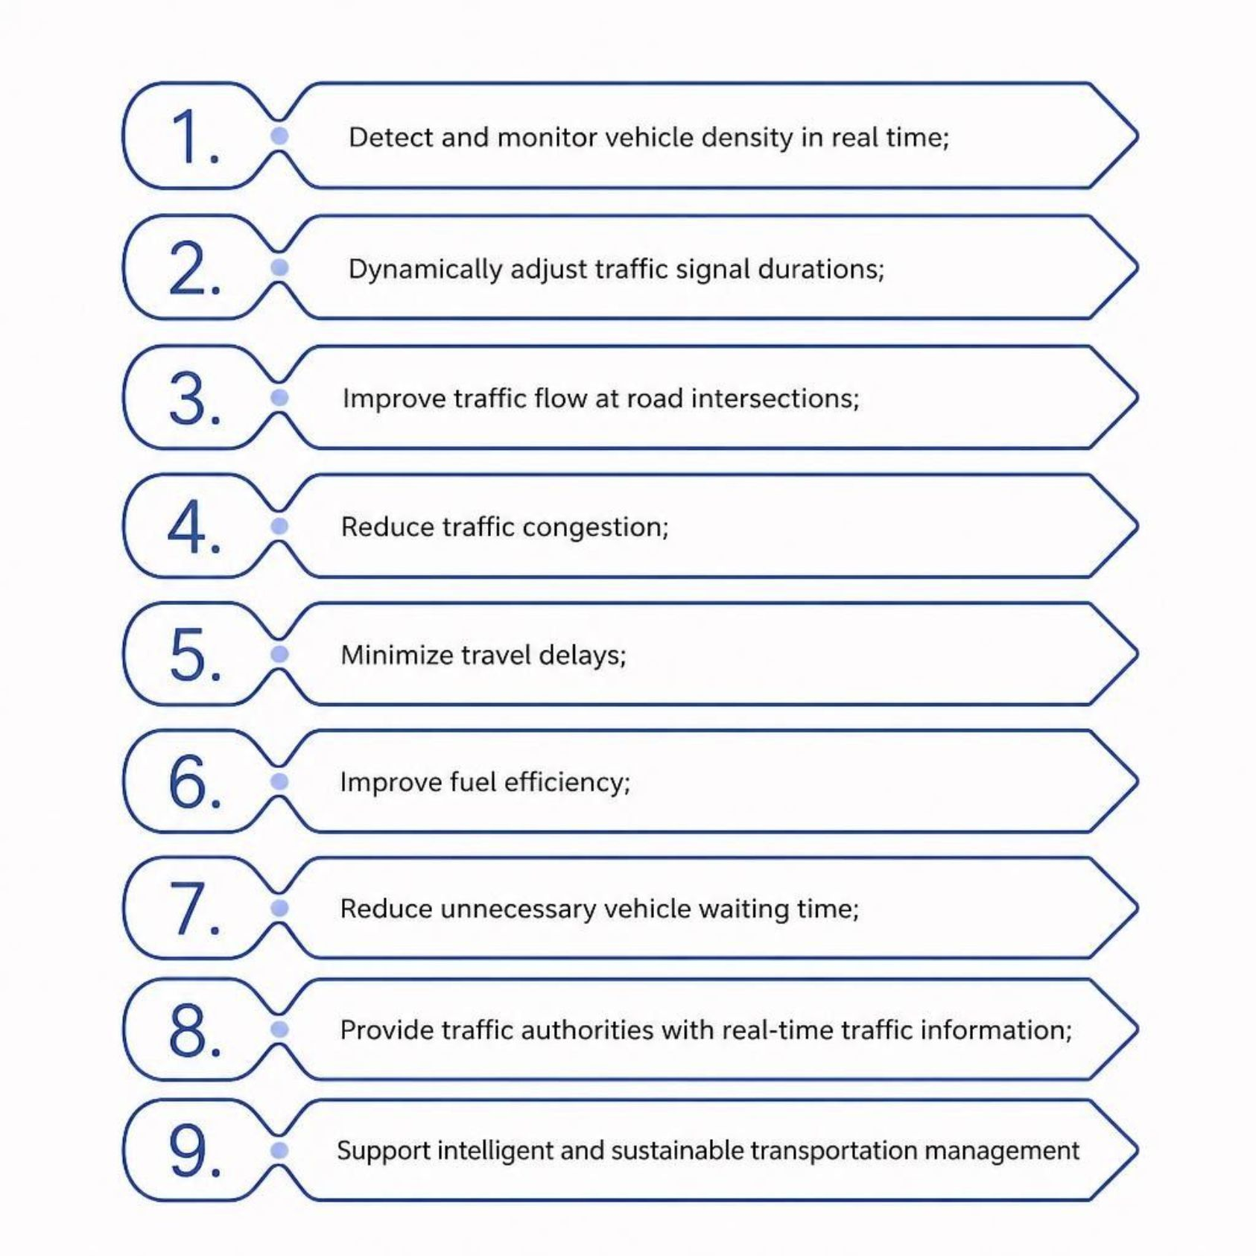
Objectives
Core Mission
The system is designed to bridge the gap between static signal infrastructure and the dynamic nature of urban traffic — delivering measurable improvements across efficiency, environment, and authority oversight.
Real-time density detection and monitoring
Dynamic signal duration adjustment
Reduced congestion and travel delays
Improved fuel efficiency
Sustainable transportation management

Slide 5
System Components
Ultrasonic Detection Sensors
Camera-Based Sensors
Detect vehicles and estimate traffic density at each lane of an intersection.
Alternative detection method for vehicle identification and density estimation.
IoT Communication Modules
Cloud Connectivity
Transmit traffic information from sensors to the processing and cloud layer.
Centralized data management and monitoring for all connected intersections.
Traffic Signal Controllers
Centralized Dashboard
Adjust signal durations dynamically based on processed analytics output.
Displays traffic information, signal status, and system alerts in real time.

Slide 6
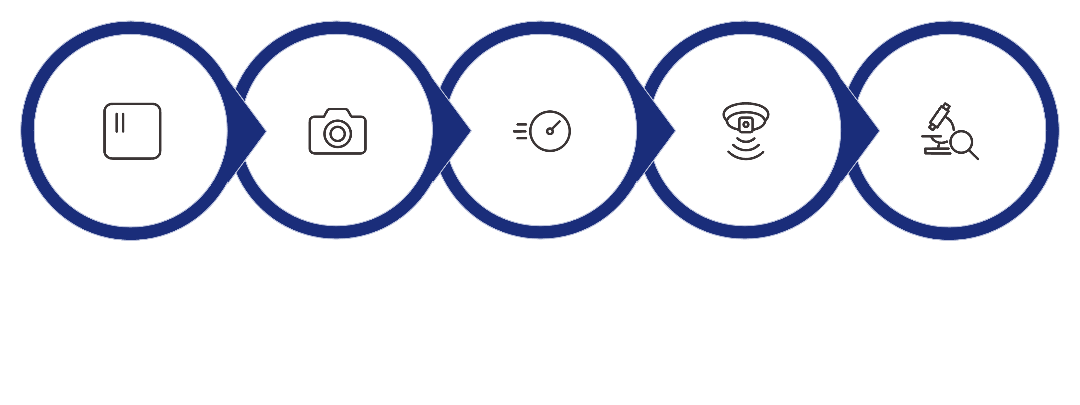
System Working Process
A seamless 10-step pipeline from sensor installation to authority oversight — fully automated and continuously active.
Continuous Measurement
Data Transmission
Sensors Installed
Vehicle Detection
Real-time Analytics
Each step in the pipeline operates in a continuous feedback loop — ensuring the system remains responsive to changing traffic conditions at all times.

Slide 7

Dynamic Traffic Signal Control
How Dynamic Control Works
Real-time vehicle density directly influences traffic signal timing — replacing rigid fixed schedules with intelligent, condition-responsive control.
Higher vehicle density receives longer signal durations
Lower-density lanes receive appropriately shorter durations
Dynamic control prevents inefficient fixed-time operation
Continuous monitoring enables response to changing conditions
Goal: optimize vehicle movement and improve intersection flow

Slide 8
Monitoring Dashboard and Analytics
The centralized dashboard provides traffic authorities with a comprehensive, real-time view of all intersection activity and system health.
Live Vehicle Density
Current Signal Status
Congestion Levels
Real-time vehicle count at each intersection lane, updated continuously from sensor feeds.
Active signal phases and timing displayed for all monitored intersections.
Traffic intensity classification enabling rapid identification of problem areas.
Historical Traffic Trends
System Alerts
Pattern analysis for traffic prediction and long-term infrastructure planning.
Automated notifications for anomalies, sensor faults, and critical traffic conditions.
Historical trends enable traffic authorities to understand recurring patterns and make data-driven decisions for better long-term traffic management.

Slide 9
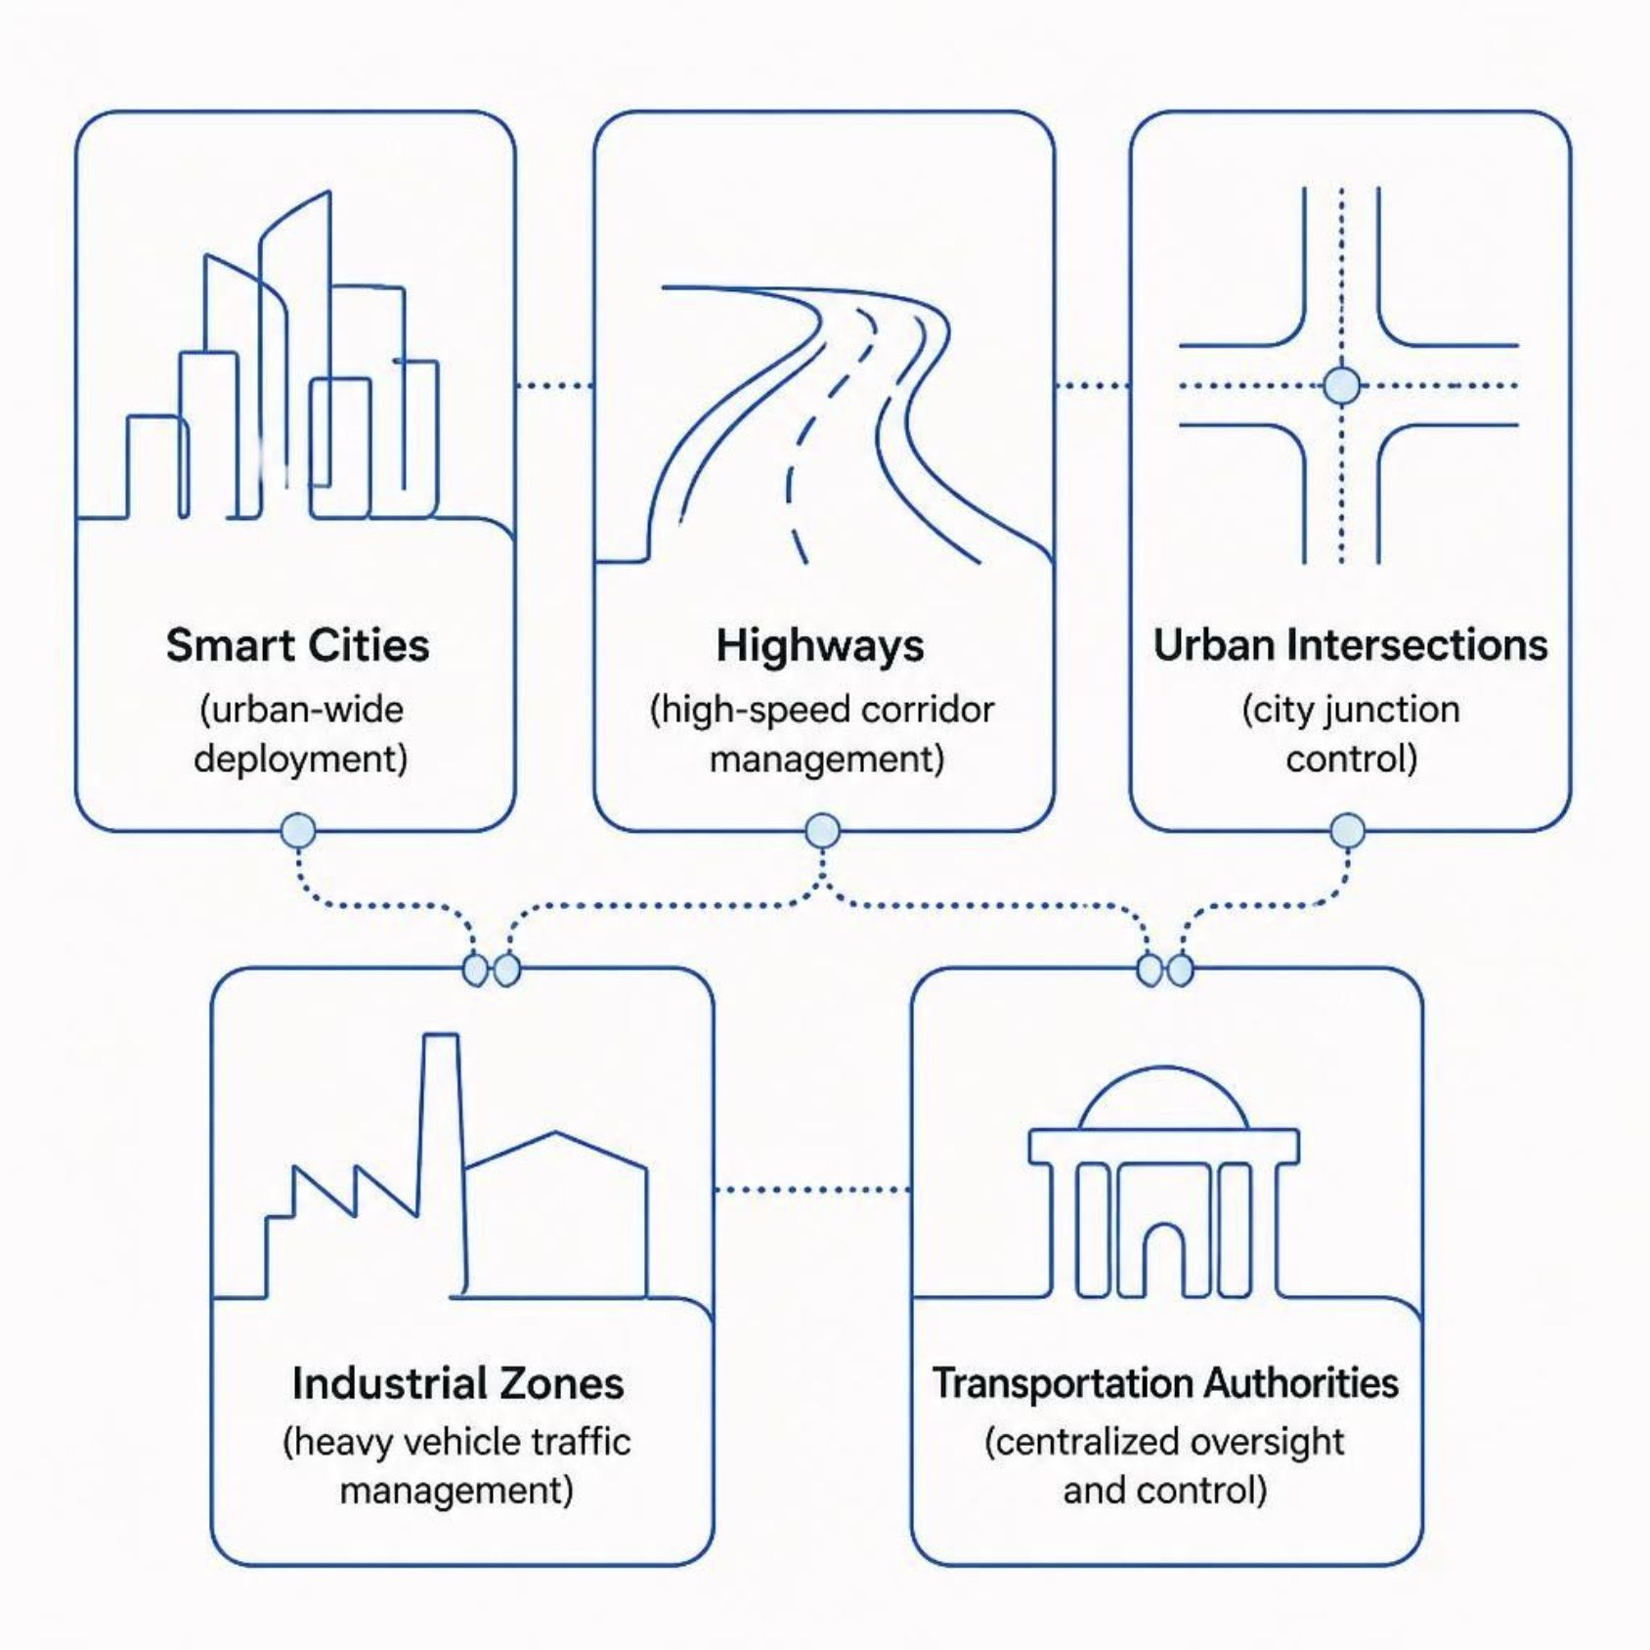
Benefits and Applications
Application Domains
Key Benefits
Reduced Congestion
Fuel Efficiency
Less gridlock and improved intersection throughput
Reduced idling and unnecessary waiting lowers consumption
Real-Time Monitoring
Smarter Signals
Authorities gain live visibility into all traffic conditions
More efficient use of traffic signal infrastructure
The system is designed to be secure and scalable across all deployment environments.

Slide 10

Conclusion
The Intelligent Traffic Signal Control System represents a modern, data-driven approach to one of urban infrastructure's most persistent challenges.
IoT-Powered Monitoring
Continuous vehicle density monitoring through ultrasonic and camera-based IoT sensors.
Dynamic Signal Intelligence
Real-time analytics drive adaptive signal timing, reducing congestion, delays, and fuel consumption.
Centralized Authority Control
Traffic authorities gain efficient, real-time oversight of all road conditions through a unified dashboard.
Sustainable Smart Cities
The solution supports sustainable transportation and smart city development — creating more efficient, responsive, and intelligent urban mobility systems.

