Slide 1

FIELD AND IRRIGATION MONITORING SYSTEM USING IOT
Under the guidance of :
Dr . C.D. Naidu
Principal , VNRVJIET
Mr . Ramesh Reddy
Associate Professor , ECE.
NAME (Batch 1) ROLL.NO
SWAMY KRISHNA 18071A0409
P.GEETHANJALI 18071A0444
YASHAS CHANDRA 18071A0449
P.ROHIT 18071A0450
SRINIVAS 19075A0403

Slide 2
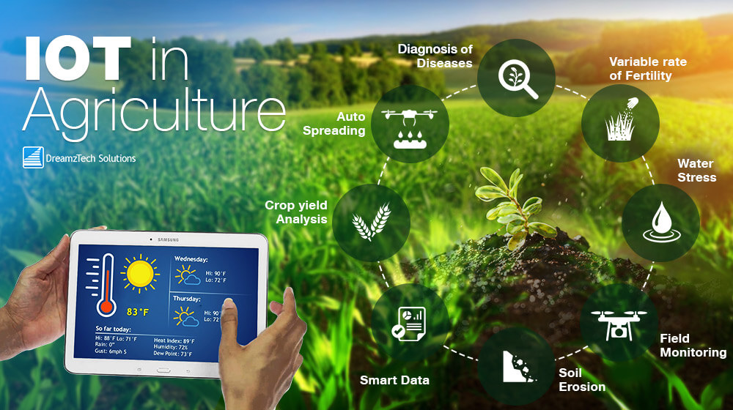
INTRODUCTION
One of the things that everyone on earth has in common is the need for food.
Agricultural development is critically important to improving food security and nutrition.
A rise in the population has immensely increased the pressure on the agriculture sector.
With the advent of technology, this decade is witnessing a shift from conventional approaches to the most advanced ones.
The Internet of Things (IoT) has transformed both the quality and quantity of the agriculture sector.

Slide 3
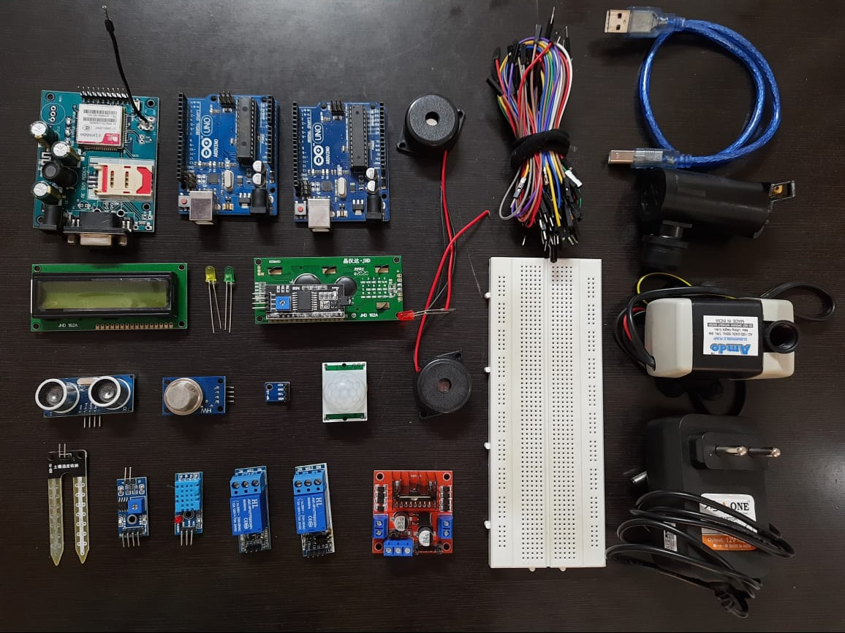
OVERVIEW OF THE PROJECT
The proposed system makes use of GSM modem, Sensors, Arduino board.
Sensor data obtained is transferred to GSM and to Thingspeak to help the user monitor the crop.
If crop is in unusual condition , user receives an SMS notification to take necessary decisions.
This approach is effective in terms of time and cost.
Irrigation Process is automated in our project
Components used

Slide 4
NATIONAL Level status
S.NO | NAME OF THE JOURNAL | YEAR | NAME OF THE AUTHORS | WORK CONTRIBUTED | MERITS AND DEMERITS OF THE WORK
1 | Real time automation of agricultural environment | 2014 | Prachi Patil ; Akshay Narkhede , Ajita Chalke ; Harshali Kalaskar ; Manita Rajput | The system proposes a soil moisture sensor at each place where the moisture has to be monitored. Once the moisture reaches a particular level, the system takes appropriate steps to regulate or even stop the water flow. | Monitoring the soil moisture condition of the farm as well as controlling the soil moisture by monitoring the level of water in the water source
2 | Regulation of water in agriculture field using Internet Of Things | 2015 | V.Vijay hari Ram ; H. Vishal ; S. Dhanalakshmi ; P.Meenakshi Vidya | This regulator provides an intelligent monitoring platform framework and system structure for facility agriculture ecosystem based on IOT. This will be a catalyst for the transition from traditional farming to modern farming. | Provides an intelligent monitoring platform framework and system structure for facility agriculture ecosystem based on IOT
3 | Fusion of drone and satellite data for precision agriculture monitoring | 2016 | Deepak Murugan ; Akanksha Garg ; Tasneem Ahmed ; Dharmendra Singh | The methodology is able to successfully classify vegetation into the two classes and the results are verified with the help of drone image both visually, and quantitatively in the form of area estimation. | Classifying vegetation into sparse and dense vegetation classes by employing fusion of freely available satellite data and drone imagery
4 | Precision Agricultural Monitoring Systems Using IoT | 2017 | Terteil A. A. Ali , Viraj Choksi2, Dr. M B Potdar | The precision agricultural system is based on the Global Positioning Systems (GPS), Machine to Machine Communications (M2M), IoT technologies, sensors and Big Data to optimize crop yields, reduce the waste of resources and minimizing the environmental impact of farming. | Deploying Green Internet of Things technologies, which it will help to conserve the energy and utilize the agriculture resources effectively.

Slide 5
NATIONAL Level status
S.NO | NAME OF THE JOURNAL | YEAR | NAME OF THE AUTHORS | WORK CONTRIBUTED | MERITS AND DEMERITS OF THE WORK
5 | Smart Secured Real Time Agriculture Monitoring System | 2018 | Bipin Sarode , Mayur Rajabhau Chate , Satyajit Sen | They have proposed a low-cost and easy accessible IoT-based smart agriculture monitoring system along with double-tier data storage facility to store and secure such a huge volume of data by an IoT device. | Designing a smart as well as a cost efficient and more user friendly system will be idealistic challenge.
6 | Modern Agriculture Using Wireless Sensor Network (WSN) | 2019 | D. Devi Kala Rathinam ; D. Surendran ; A. Shilpa ; A. Santhiya Grace ; J. Sherin | In this paper wireless sensor nodes are used to monitor the crops. The temperature, humidity and some other theft detection can be made using sensors. This helps to increase the productivity of agriculture. | WSN is used for monitoring, measuring temperature, irrigation system, measuring water supply .
7 | Sensor Based Waste Water Monitoring for Agriculture Using IoT | 2020 | Rekha P ; Sumathi K ; Samyuktha S ; Saranya A ; Tharunya G ; Prabha R | Estimation of water quality parameters, for instance, pH, Turbidity, Temperature, BOD, TDS that helps to identified the deviations in the parameters and provides an alert messages when there is an abnormal level. | The monitoring of urban waste water for agriculture use provides a smart solution for testing the quality of water by using array of sensors and the measured value is displayed in LCD.

Slide 6
INTERNATIONAL LEVEL status
S.NO | NAME OF THE JOURNAL | YEAR | NAME OF THE AUTHORS | WORK CONTRIBUTED | MERITS AND DEMERITS OF THE WORK
1 | Automated Irrigation System Using a Wireless Sensor Network and GPRS Module | 2013 | Joaquín Gutiérrez ; Juan Francisco Villa-Medina ; Alejandra Nieto-Garibay ; Miguel Ángel Porta-Gándara | An automated irrigation system was developed to optimize water use for agricultural crops. The system has a distributed wireless network of soil-moisture and temperature sensors placed in the root zone of the plants. | The system has a distributed wireless network of soil-moisture and temperature sensors placed in the root zone of the plants and gateway unit handles sensor information, triggers actuators, and transmits data to a web application.
2 | SMS-based Smarter Agriculture decision support system for yellow corn farmers in Isabela | 2015 | Rhia Trogo ; Jed Barry Ebardaloza ; Delfin Jay Sabido ; GerryBagtasa ; Edgardo | This paper they focused on how the solution is developed so that farmers may be able to identify the best date to start planting, best date to harvest and optimal water | Automated Weather Station (AWS) sensors, numerical climate model, numerical weather model, corn cultivar parameters, SMS technology are used
3 | Design and implementation of a cloud-based IoT scheme for precision agriculture | 2016 | Ahmed Khattab ; Ahmed Abdelgawad ; Kumar Yelmarthi | They presented an IoT architecture customized for precision agriculture applications. Precision agriculture is one of the paradigms which can use the IoT advantages to optimize the production efficiency and uniformity across the agriculture. | They proposed three-layer architecture collects the needed data and relays it to a cloud-based back-end where it is processed and analyzed.
4 | From parallel plants to smart plants: intelligent control and management for plant growth | 2017 | Mengzhen Kang ; Fei-Yue Wang | They have presented the three steps toward the parallel management of plant: growth description (the crop model), prediction, and prescription. | The possibilities of passing the knowledge of experienced farmers to younger generation, as well as the application to the parallel breeding of plant through such system, are discussed.
5 | Technology-Assisted Decision Support System for Efficient Water Utilization: A Real-Time Testbed for Irrigation Using Wireless Sensor Networks | 2018 | Rahim Khan ; Ihsan Ali ; Muhammad Zakarya ; Mushtaq Ahmad ; Muhammad Imran ; Muhammad Shoaib | An efficient methodology that employs WSN as a data collection tool and a decision support system (DSS). The proposed DSS can assist farmers in their manual irrigation procedures or automate irrigation activities. | The complexity of the algorithm is O(1) for dynamic datasets generated by sensor nodes and O(n) for static datasets. Different issues in technology-assisted irrigation management and their solutions are also addressed.

Slide 7
INTERNATIONAL LEVEL status
S.NO | NAME OF THE JOURNAL | YEAR | NAME OF THE AUTHORS | WORK CONTRIBUTED | MERITS AND DEMERITS OF THE WORK
6 | Internet-of-Things (IoT)-Based Smart Agriculture: Toward Making the Fields Talk | 2019 | Muhammad Ayaz ; Mohammad Ammad-Uddin ; Zubair Sharif ; Ali Mansour ; El-Hadi M. Aggoune | This is a survey paper about the latest inventions of sensors and technical equipments like harvesting robots, IOT tractors, agricultural practices. | State-of-the-art IoT-based architectures and platforms used in agriculture are also highlighted wherever suitable. They identify current and future trends of IoT in agriculture and highlight potential research challenges.
7 | Recent Developments of the Internet of Things in Agriculture: A Survey | 2020 | Vippon Preet Kour ; Sakshi Arora | In this paper they described about the innovative projects using MIOT,RIOT,OS and ideas proposed by ieee authors on agricultural issues. | The domain of IoT along with the communication technologies and goals, protocols, architectures are studied and put forward. Small scale farmers will be targeted for the development of sustainable and robust model.

Slide 8
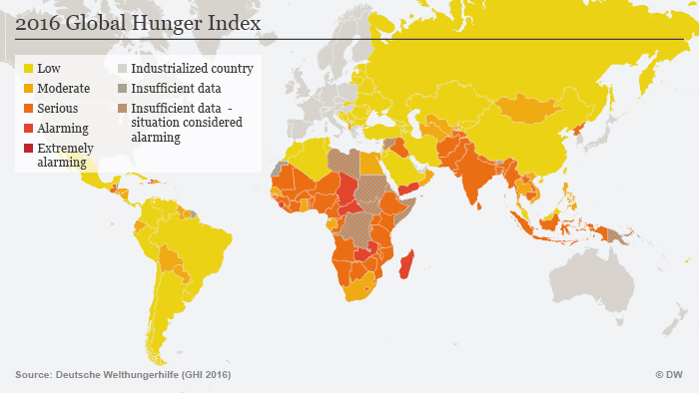
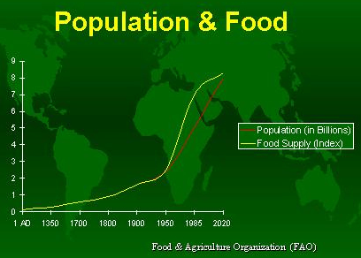
PROBLEM STATEMENT
Decrease in Cultivation land and increase in the population is leading to food scarcity and hunger deaths.

Slide 9
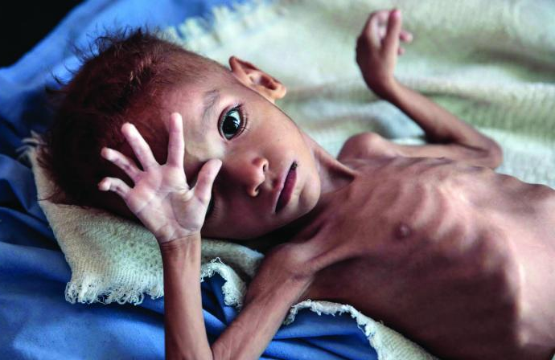
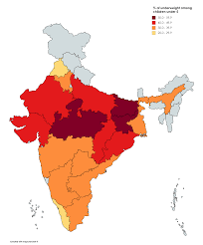
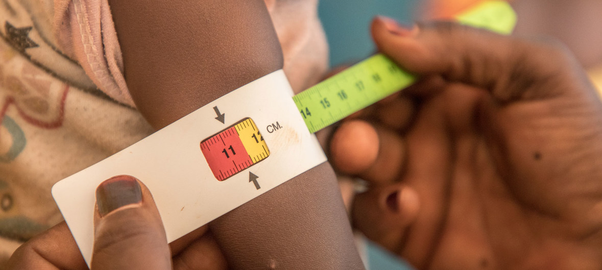
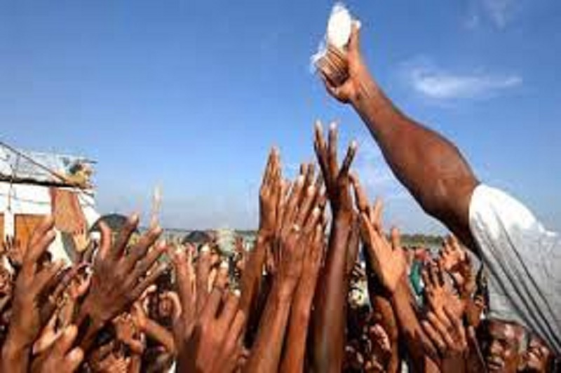
MOTIVATION
One day I have been to read a newspaper article about “Hunger Facts”.
This article left me with shocking facts like:
1/3rd of the world’s hungry live in India.
15% of the Indian population every night sleeps hungry.
Over 25 lakh Indians die of hunger every year.
Under-nutrition remains a silent emergency in India, with almost 50% of Indian children underweight and more than 70% of the women and children with serious nutritional deficiencies as anemia.
India being the second largest producer of wheat and rice, the world's major food staples, these facts made me dig deeper into the issues and find what exactly is the problem behind this food scarcity.

Slide 10
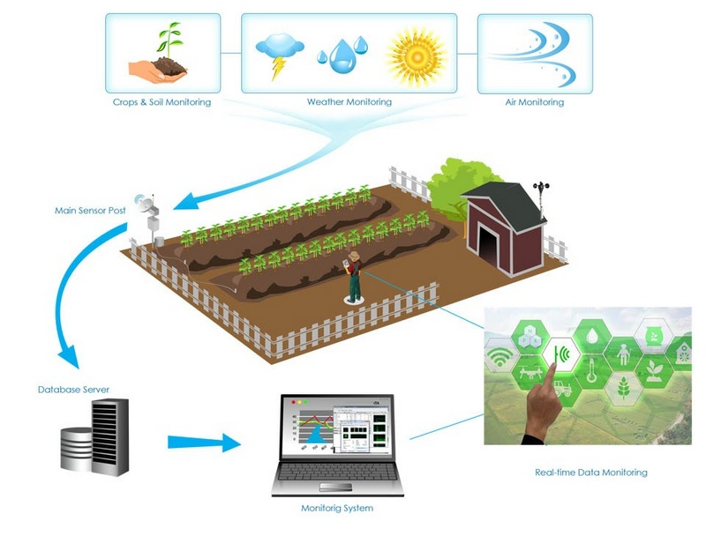
AIM OF THE PROJECT
The aim of this project is to monitor the Irrigation & field parameters like Temperature, humidity, air quality, soil moisture, rain fall, PIR and water level in wells through GSM modem and Thingspeak using Solar energy.

Slide 11
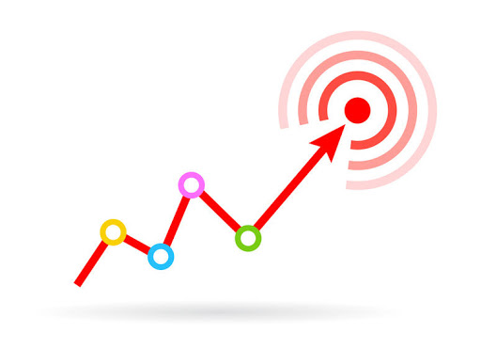
OBJECTIVES OF THE PROJECT
1. Collecting sensor data and transfer it to Thingspeak.
2. Getting SMS Notification in Crop’s unusual conditions through GSM.
3. Implementation of decisions taken by user to normalize the
conditions.(Irrigation).
4. Ensure Crop safety from animals, birds and other humans. (Use solar energy for whole project).
3
1
4
2

Slide 12
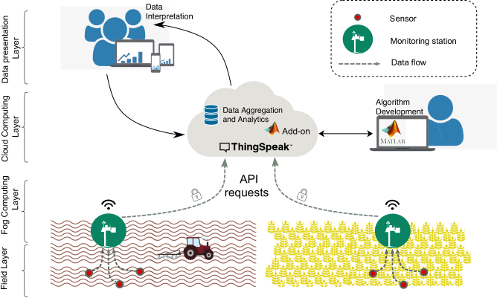
Objective - 1
Collecting sensor data and transfer it to Thingspeak.
For sensor data to be continuously read & stored, we choose Thingspeak.
This stored data can be used in analysing the crop yield.

Slide 13
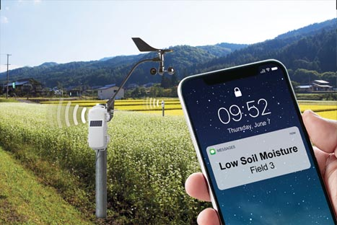
Objective - 2
Getting SMS Notification in Crop’s unusual conditions through GSM.
If any sensor crosses threshold value, which is harmful for crop growth then Farmer gets SMS notification to Alert him/her about the crops harmful condition.
As Wifi would not be available in all conditions , we have chosen basic SMS mode to communicate with the farmer.

Slide 14
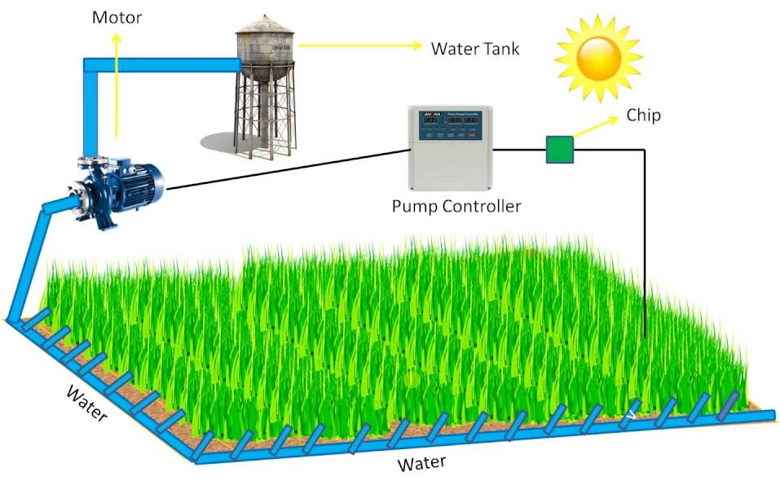
Objective - 3
Implementation of decisions taken by user to normalize the conditions.(Irrigation)
When moisture content in soil is less than the required amount , then automatically water is pumped to fields.
Motor will be turned off automatically once moisture in soil is raised to required level.
And this can also be controlled through SMS command as a reply to sensor notification.

Slide 15
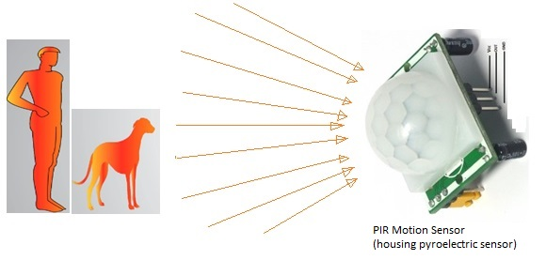
Objective - 4
Ensure Crop safety from animals, birds and other humans.
Security of field is also a noticeable problem in crop production.
So, to monitor field security we included PIR sensor which can detect species entering field.
And this goes to farmer as an SMS notification informing him/her about security.

Slide 16
BLOCK DIAGRAM OF THE PROJECT
Arduino UNO
GSM modem SIM900 with antenna
Soil M.S
Sends Data to Thingspeak
Saves sensor data & analyses Yield
Temp . S
Sends SMS notification
If Sensor crosses threshold value
Humidity
Receives SMS
commands
User decision is sent as SMS-GSM
Gas . S
Ultra sonic . S
RELAY
Motor
ON / OFF
PIR . S

Slide 17
PROJECT STEPS
PROJECT STEPS | PROJECT OBJECTIVE DESCRIPTION
STEP 1 | Setup the circuit with Temperature, humidity, air quality, barometric pressure Sensors, GSM, Arduino.
STEP 2 | Develop the Arduino code for sending sensor data to GSM.
STEP 3 | Check for the output at various conditions by changing the environment conditions artificially.
STEP 4 | Research and Checking for threshold values of sensors for unusual conditions.
STEP 5 | Develop Arduino code including threshold conditions and to receive SMS notifications at unusual conditions. And check the output.
STEP 6 | Set up the irrigation system with ultrasonic sensor and soil moisture sensor, Rain sensor, motor, relay.
STEP 7 | Generate code including irrigation parts, 1) Automatic filling of tank, 2)Pumping water to field when soil moisture goes down.
STEP 8 | Run the code to check the output whether water is supplied to crop or not, automatic filling of water tank.
DONE / NOT
Done
Done
Done
Done
Done
Done
Done
Done
STEP 9 | Include the Security sensor (PIR) with buzzers in circuit to ensure safety of crop from animals and other humans.
Done
Done
STEP 10 | Develop code for new setup (security) and Run the entire code for checking the final output of the whole project.
STEP 11 | Implement the entire project in app and include weather conditions.
STEP 12 | Implement the entire project with Solar energy using solar panels.

Slide 18
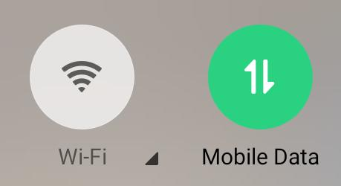


NOVELTY OF THE WORK (UNIQUENESS)
Design of system is in a user-friendly manner (from farmers perspective and ease of using)
The project keeps the farmer updated regarding the status of the crop via SMS notifications.
Our project does not require any WIFI, it works with mobile data. This helps farmers even though there is no WIFI in field area.
Power consumption of our system is comparatively less because we use Solar energy during day time , this reduces half of the energy consumption.
Efficient use of water is possible through our irrigation system involved in our project
Design is portable and sustainable farming control systems for large as well as small farms.

Slide 19
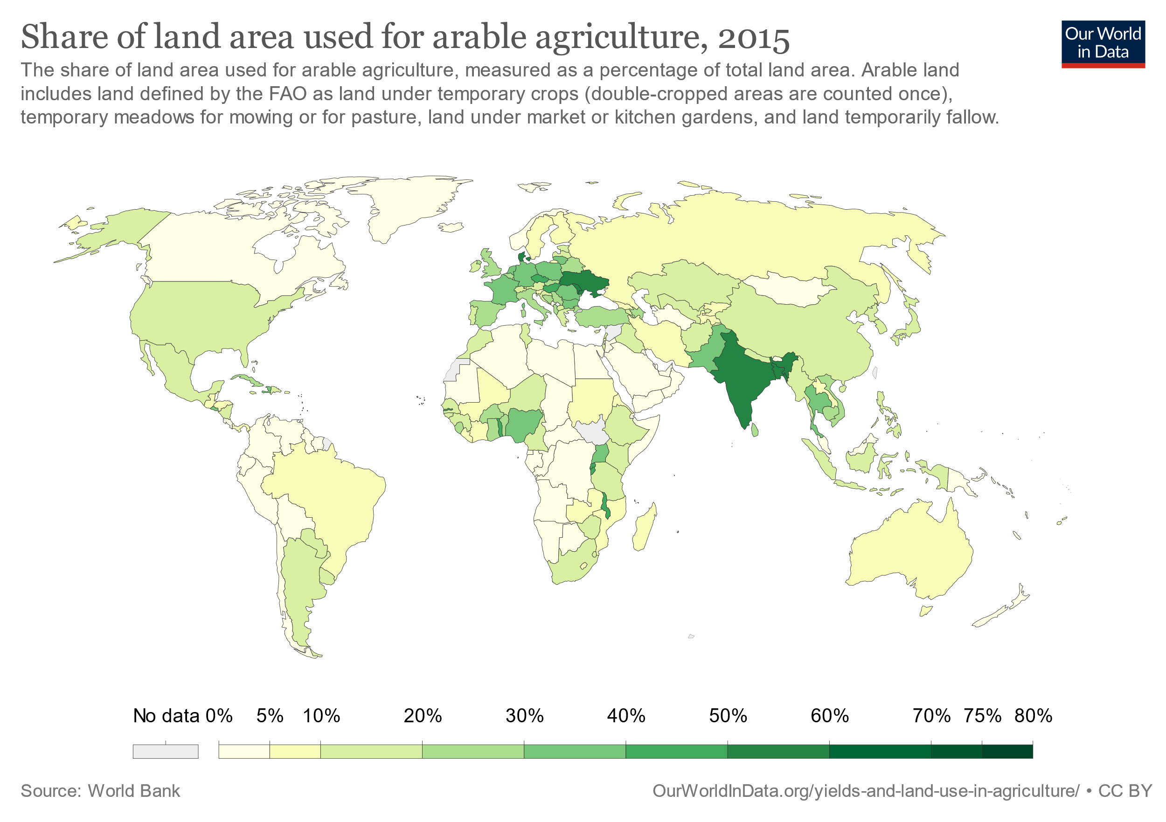
IMPORTANCE OF PROPOSED PROJECT IN THE CONTEXT OF CURRENT STATUS
According to the forecasted figures, in 2050, the world population is expected to touch 9.8 billion.(approximately 25% more than current figure)
The total arable area for food production was 19.5 million square miles (39.47% of the world’s land area), which was reduced to approximately 18.6 million square miles (37.43% of the world’s land area) at present.
The gap between demand and supply of food is becoming more significant and alarming with the passage of time.
To respond to these demands with a range of issues, farmers need new technology-based methods to produce more from less land and with fewer hands.

Slide 20
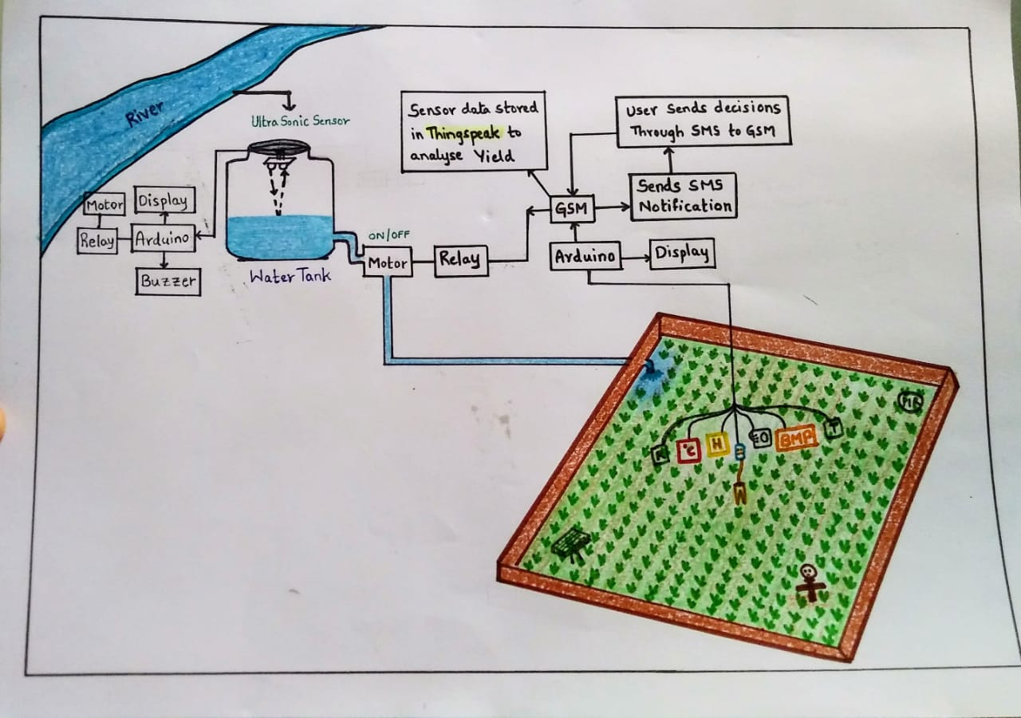
Expected OUTCOME OF THE PROJECT
Automatic filling of tank/well.
ON/OFF the motor by user, based on moisture content in soil and rainfall.
SMS notification to user if sensors cross the threshold value.
Data transfer to Thingspeak.

Slide 21
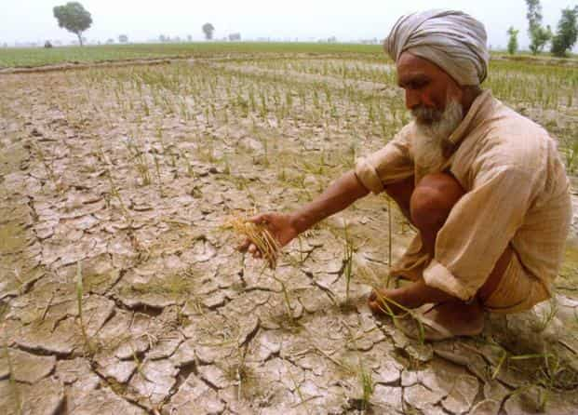
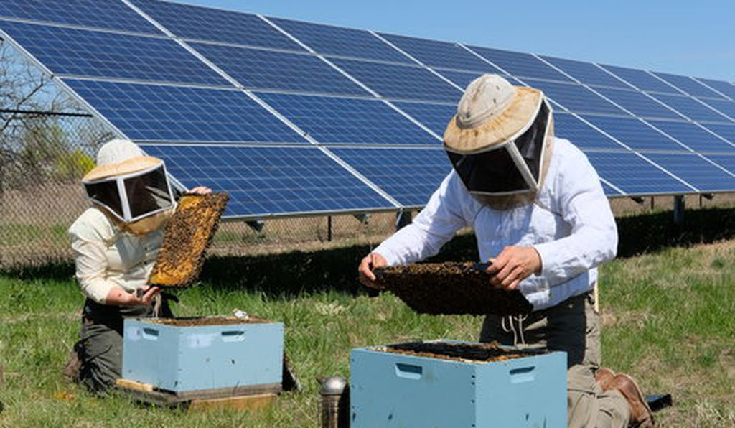
APPLICATIONS
This project will bring benefits like easy usage, efficient use of water, lower power consumption and an affordable one.
Our project eliminates the need of physical work(watering plants, security of crop) of farmers and growers and thus increasing the productivity in every possible manner.
So , Our project will be a good implementation in the areas which see droughts and frequent power losses.
Remote areas where farmers have less knowledge on technology , our project helps them to increase their field productivity as it is a farmer friendly system with less cost.
So , this system has scope to implement in any agricultural lands for good yields.

Slide 22
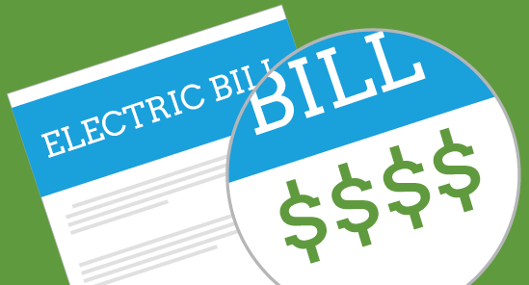
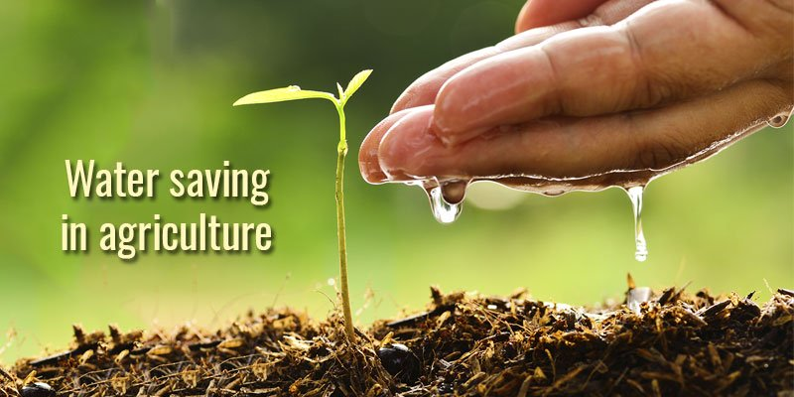
SOCIETAL IMPACT OF THE PROJECT
Increase in the efficiency and productivity of agricultural crops.
Decreases the power bill of the farmers as solar energy is used.
Farmers can utilise their time of irrigation and field monitoring in some other works in order to earn livelihood as crop security & irrigation is automated in our project.
Water wastage is reduces as water for irrigation is used precisely.

Slide 23

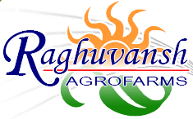
DELIVERABLES
S.NO. | NAME OF THE INDUSTRY | TYPE OF THE INDUSTRY | YOUR PROJECT WORK…WHERE IT IS USEFUL AND HOW IT IS USEFUL TO THAT PARTICULAR INDUSTRY
1. | JK Agri Genetics Ltd , Headquarters at Hyderabad, Andhra Pradesh(India) | Research and development , production, processing and marketing | It is among the list of top seed company in India. Cotton, Maize, Paddy, Pearl Millet, Sorghum, Sunflower, Castor, Mustard, Wheat, Sorghum Sudan grass, Fodder beet, Tomato, Okra, Chilies, and other vegetable seeds are produced and processed. So, our project is useful to increase their productivity and decrease the investments(power, water).
2. | Raghuvansh Agro farms Ltd | Cultivation, processing, and distribution of agricultural produce. | Cultivation of Organic Vegetables, Organic Grains, and Cereals. Apart from this , the Company is also engaged in dairy farming, production, distribution of dairy products and manufacturing of organic manure. So, our project helps them to manage time between cultivation and dairy production as our system is an automated one and also increase their productivity and decrease the investments(power, water).

Slide 24
TIME SCHEDULE OF ACTIVITES
S.NO | TASK | TENTATIVE DATES & DURATION | NO. OF DAYS REQUIRED
1 | Problem statement , Preparation Block Diagram , Picturising the project | 23-07-2020 to 24-07-2020 | 2
2 | STEP 1 | 25-07-2020 | 1
3 | STEP 2 | 26-07-2020 to 30-07-2020 | 5
4 | STEP 3 | 31-07-2020 to 04-08-2020 | 5
5 | STEP 4 | 05-08-2020 to 06-08-2020 | 2
6 | STEP 5 | 07-08-2020 to 10-08-2020 | 4
7 | STEP 6 | 11-08-2020 to 12-08-2020 | 2
8 | STEP 7,8 | 13-08-2020 to 18-08-2020 | 6
9 | STEP 9,10 | 21-08-2020 to 24-08-2020 | 4
10 | STEP 11 | 25-08-2020 to 29-08-2020 | 5
11 | STEP 12 | 30-08-2020 to 31-08-2020 | 2
12 | Thesis Preparation | Before final review | 4
13 | Final Slides Preparation | Before final review | 4

Slide 25

SOFTWARE and HARDWARE(S) USED
Arduino Software - arduino-1.8.9-windows
Apparatus: (Part 1- Field monitoring)
Temperature sensor.
humidity sensor.
Air quality – Gas sensor.
PIR sensor.
GSM modem SIM900 with antenna.
Arduino UNO.
Jumper wires.
16*2 LCD Display with 12C adapter.
Solar panels.
Apparatus: (Part 2- Irrigation Monitoring)
Ultrasonic sensor to measure Water level.
Soil moisture sensor.
Dc motor & pipe (2 sets)
Relays. (2)
Buzzer. (1)
16*2 LCD Display with 12C adapter.
Battery-12v (3)
Water Tanks (2).

Slide 26
EXPERTISE AVAILABLE
S.NO. | NAME AND DESIGNATION OF THE EXPERT | TYPE OF HELP/ASSISTANCE TAKEN
1. | Mr . Ramesh Reddy Associate Professor , ECE | Received guidance in development of software part of project. Gave suggestions how to work in team to gain knowledge as much as possible by doing projects. Helped in understanding step wise improvements in our technical skills to work for innovations. Had 4 ZOOM meetings with sir about the troubles faced during execution of project and he guided us in solving them.
2. | Shiva , CSE 4th year. | Helped in debugging GSM issues
3. | Srikar , ECE 3rd year. | Helped in debugging GSM issues

Slide 27
ROLES AND RESPONSIBILITIES
S.NO | NAME OF THE STUDENT | ROLES AND RESPONSIBILITIES
1 | GEETHANJALI. POLISETTY | Arduino coding for irrigation monitoring, Field monitoring App development , Prototype development.
2 | ROHIT. PALLATI | Arduino coding for irrigation monitoring , Field monitoring , including weather data , Prototype development.
3 | YASHA CHANDRA SAI | Arduino coding for irrigation monitoring , Field monitoring , including weather data.
4 | SRINIVAS | Arduino coding for including weather data
5 | SWAMY KRISHNA | App development.
We team together work in all parts of the project to ensure that entire team is aware of what exactly happening in project.
So, Roles and responsibilities are classified according to the Sources and feasibilities.

Slide 28
DATA COLLECTION
We had gone through Agricultural facts between 2012 & 2020 in “Our world in data” .
This is the survey website of world’s total agricultural land in use.
We spoke with few farmers available near by about their difficulties in farming.
These discussions gave us an idea about farming activities and struggles behind monitoring crops in hard conditions like droughts , less electrified fields, etc…
We even referred to some newspaper articles on farming issues.
…………this process helped us to empathise the situations and think about the real time implementable solutions.

Slide 29
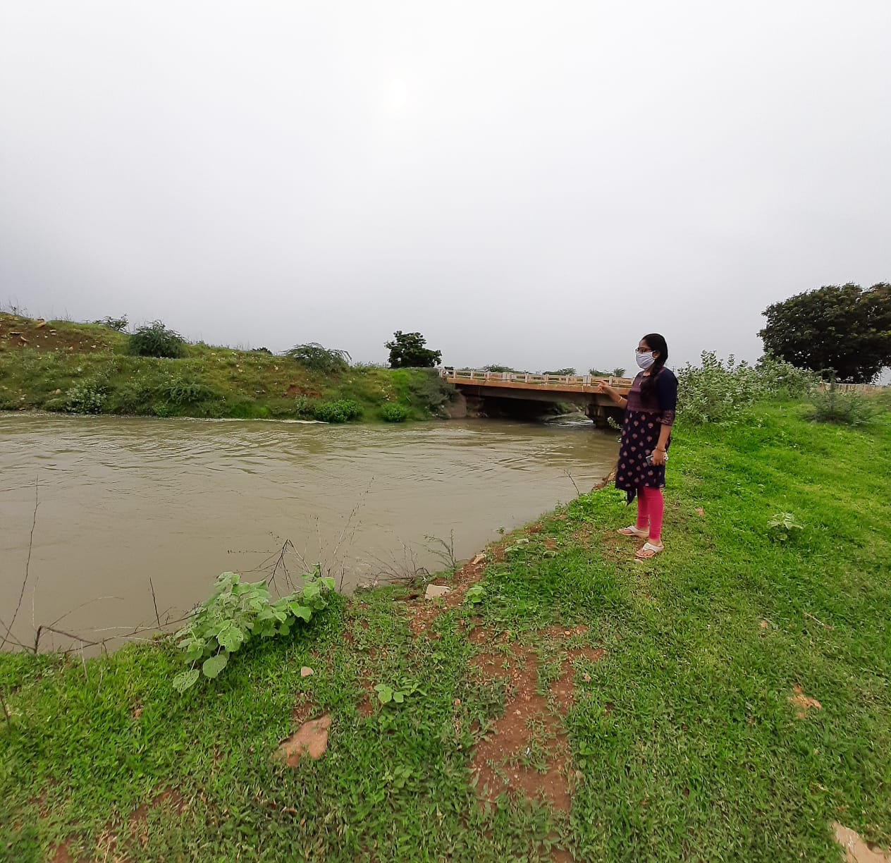
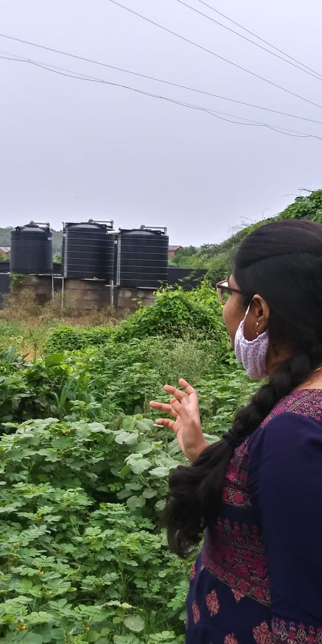
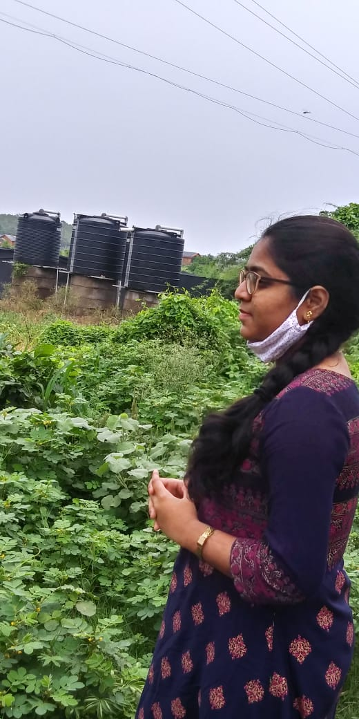
Went on a visit to the fields to understand farming… and noticed these which gave me and my team an idea in making these practices more simple , effective and productive.

Slide 30
REFERENCES
[1]. Sensor Based Waste Water Monitoring for Agriculture Using IoT. By Rekha P ; Sumathi K ; Samyuktha S ; Saranya A ; Tharunya G ; Prabha R 2020
[2]. Modern Agriculture Using Wireless Sensor Network (WSN) by D. Devi Kala Rathinam ; D. Surendran ; A. Shilpa ; A. Santhiya Grace ; J. Sherin 2019
[3]. Smart Secured Real Time Agriculture Monitoring System Volume 07, Issue 08 (August – 2018) by : Bipin Sarode , Mayur Rajabhau Chate , Satyajit Sen
[4]. R B lagido; J Lobo, S Leite; C Sousa, L Ferreira; J Silva Cardoso “Using the smartphone camera to monitor heart rate and rhythm in heart failure patients”, IEEE-EMBS International Conference on Biomedical and Health Informatics (BHI), 2014 Vol. 6, Issue 11, November 2017
[5]. Fusion of drone and satellite data for precision agriculture monitoring 2016 11th International Conference on Industrial and Information Systems (ICIIS) by Deepak Murugan ; Akanksha Garg ; Tasneem Ahmed ; Dharmendra Singh

Slide 31
REFERENCES (Contd..)
[6]. Regulation of water in agriculture field using Internet Of Things by V.Vijay hari Ram ; H. Vishal ; S. Dhanalakshmi ; P.Meenakshi Vidya 2015 IEEE Technological Innovation in ICT for Agriculture and Rural Development (TIAR)
[7]. Real time automation of agricultural environment Prachi Patil ; Akshay Narkhede ; Ajita Chalke ; Harshali Kalaskar ; Manita Rajput International Conference for Convergence for Technology-2014
[8]. Recent Developments of the Internet of Things in Agriculture: A Survey by Vippon Preet Kour ; Sakshi Arora 2020
[9]. Internet-of-Things (IoT)-Based Smart Agriculture: Toward Making the Fields TalkMuhammad Ayaz ; Mohammad Ammad-Uddin ; Zubair Sharif ; Ali Mansour ; El-Hadi M. Aggoune in 2019
[10]Technology-Assisted Decision Support System for Efficient Water Utilization: A Real-Time Testbed for Irrigation Using Wireless Sensor Networks By Rahim Khan; Ihsan Ali; Muhammad Zakarya; Mushtaq Ahmad; Muhammad Imran; Muhammad Shoaib 2018

Slide 32
Thank You ! Batch -1

