Slide 1

Capstone Warmup
SPOILER BLOCKER EXTENSION
Rivial-9
David Ajibola -100735374
GeethaMurugan -100890042
Nithish Thokala - 100902425
Preeja Vimala Antony - 100899911
Sayeed Ahmed - 100853349

Slide 2

Problem Statement
Many individuals experience the frustration of having the plot or surprises of their favorite movies or shows spoiled by others who share spoilers. To address this issue, there is a need to develop a browser extension that effectively blocks out any mentions or discussions related to the user's chosen show or movie, replacing them with pleasant and unrelated images such as cats. By implementing this extension, users can enjoy their favorite content without the risk of encountering unwanted spoilers.

Slide 3
Scope
Development of a browser extension compatible with popular web browsers such as Chrome, Firefox, and Safari
Replacement of spoilers with visually appealing and unrelated images, such as cats or other user-customizable options.
Testing the extension on a variety of platforms and devices to ensure optimal performance and user experience.
Documentation to assist users in installing, configuring, and utilizing the Spoiler Blocker Extension effectively.

Slide 4
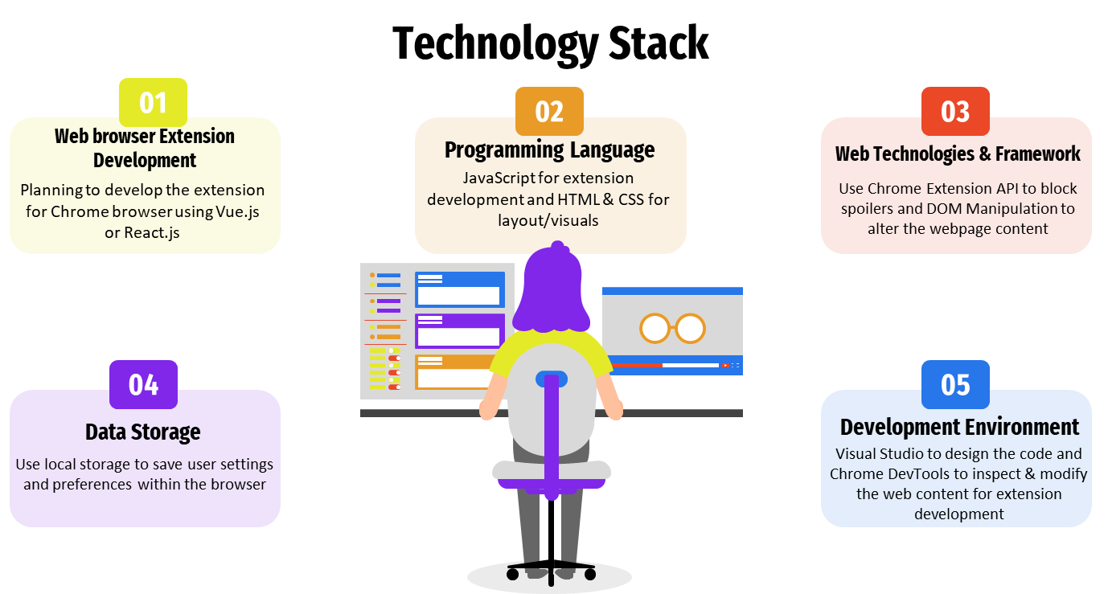

Slide 5
Project Execution Plan
Research Phase
Design Phase
Development Phase
Testing Phase
Iterative Refinement
Final Testing and Evaluation
Documentation and Presentation
Identify areas for improvement
Review existing spoiler blocker extensions.
Gather user feedback
Define extension scope.
Create user-friendly interface.
Plan technical requirements.
Implement spoiler detection algorithms, browser integration, and user interface components.
Test functionality, compatibility, and fix bugs.
Implement improvements based on user feedback.
Test extension performance and stability.
Prepare project report and presentation.

Slide 6
Deliverables
Browser Extension: Developing a spoiler blocker extension compatible with popular web browsers such as Chrome.
User Interface: Creating an intuitive and user-friendly interface that allows users to customize their spoiler blocking preferences.
Spoiler Detection Algorithm: Implementing an effective algorithm that can identify and block potential spoilers across various websites.
Customization Option: Providing users with the ability to define keywords, phrases, or specific content types (e.g., images, videos) to be blocked as spoilers.
Real-time Updates: Incorporating a mechanism to ensure that the spoiler detection algorithm remains up-to-date by regularly updating it with the latest keywords and trends.
Whitelist Functionality: Including a feature that enables users to authorize certain websites or content sources where spoiler blocking should be disabled.

Slide 7
Use Cases
Protecting TV Shows and Movies
Shielding Sports Events
Gaming Spoiler Protection
Book and Literature Preservation
Preserving Surprise in TV Shows
Customized Spoiler Blocking

Slide 8
Testing
Planning to use Jasmine and Sinon-chrome for Unit Testing for non-React Code.
Using ReactTestUtils or Enzyme for Unit Testing for React Components.
Identifying Integration issues with Integration Tests using Selenium.

Slide 9
Thank you

