Slide 1
Online advertisement

Slide 2
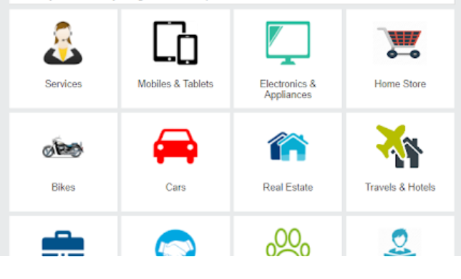
Description
An Interactive web application which enables users to advertise in the site.
platform which provides:
- Information about the products.
- Can communicate with advertiser.

Slide 3
Roles
Admin
Registered users
Viewers

Slide 4
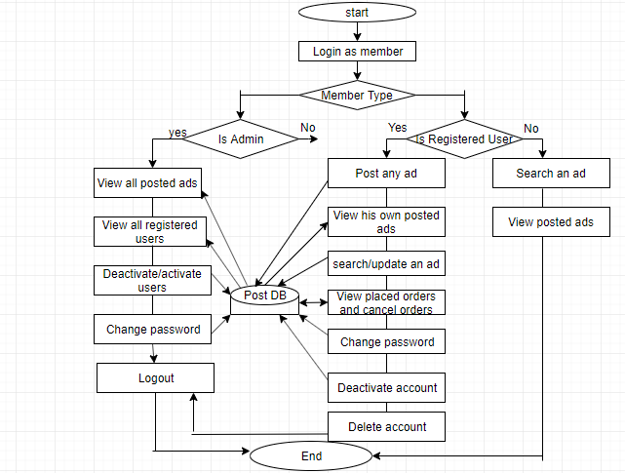
Flowchart

Slide 5
Technologies Used:
Front-end: Angular 6
Back-end: Spring Boot
Database: Mongo DB

Slide 6
Operations performed:
Registered users:
Registration
Login
Posting ads
Modifying ads
Removing ads
Search for an ad

Slide 7
Viewers:
View advertisements
Logout

Slide 8
Admin
Login

Slide 9
Registration & Login:
Users can register by providing required credentials.
Registered users can manage the ads of products in the site.

Slide 10
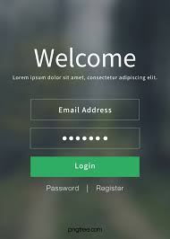
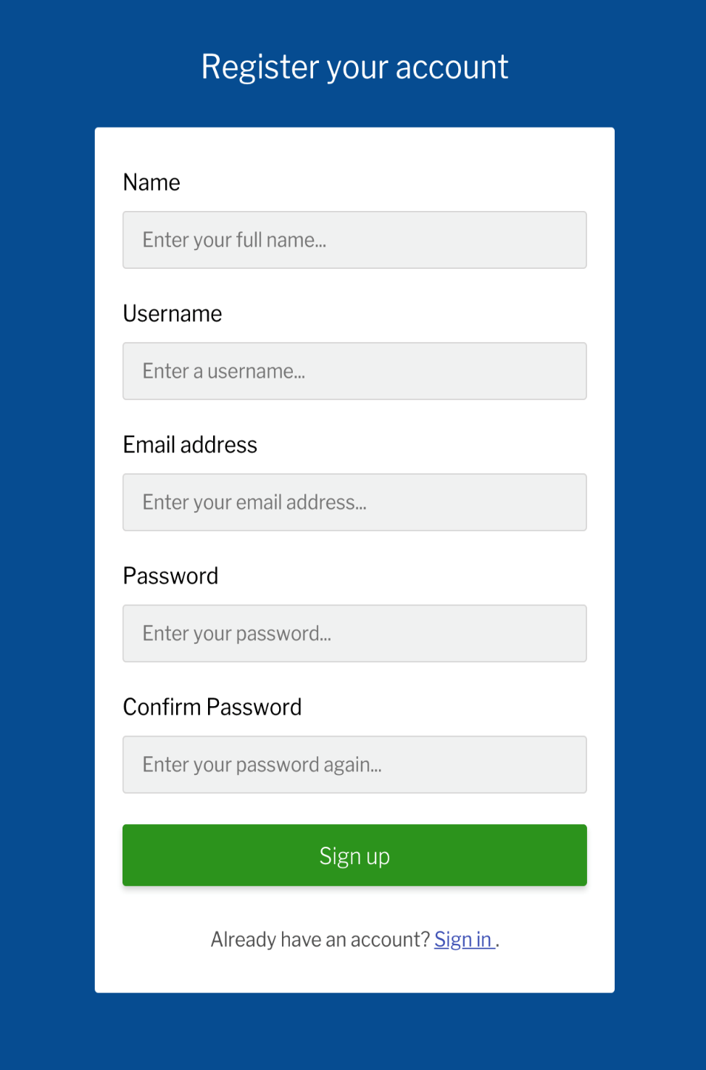

Slide 11
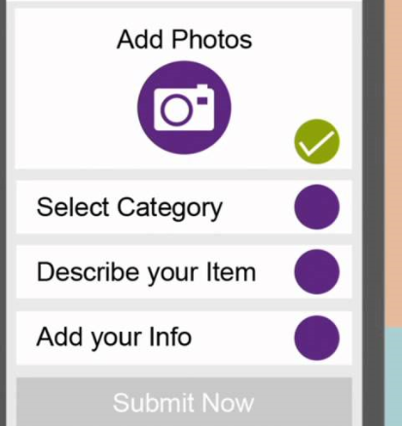
Posting ads:
An interactive interface which provides
the registered user to post ads.
Ads contain information like contact number,
email id, product name, price & description.

Slide 12
Modifying ads:
Can modify the ads based on market price.

Slide 13
Removing ads:
Admin and Registered users have the authority to remove the ads from the site.

Slide 14
Search for an advertisement:
Registered Users and viewers can search for particular product based on their requirement.

Slide 15
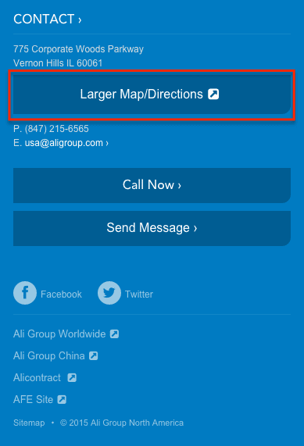
Contact us

Slide 16


