Slide 1
Assemblies in .NET

Slide 2
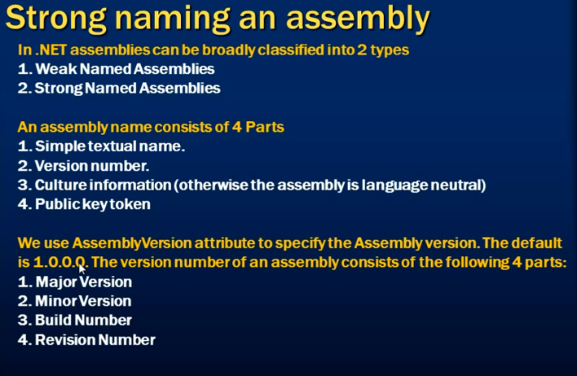

Slide 3
Location of the Assembly
Assembly Location: C:\ operating system Directory
Ex: C:\windows\Assembly

Slide 4
Create project console application
Write any code to display some message
Build your Application.
Assembly file is created in solution .
Open the file.
If we need we can change the major and minor version.
Build and revision we cant change

Slide 5
In GAC most of the assemblies culture netural
Some of the assemblies having culture.
To generate a strong name ➔ Vs command propmt➔ right click run as Admin
C:\widows\system32> sn.exe –k D:\MyStrongKeys.snk

Slide 6
It will give a public and private key token.
And strongnamekey file is created in the given location (D:\)
Goto that location and copy the file name MyStrongKeys.➔ goto console application project and assembly file Add Assembly key attribute after the assemblyversion.

Slide 7
[Assembly:AssemblyKeyFile(“ D:\\MyStrongKeys.snk”)]
Build the Solution
Build succeded
To install the assembly in to GAC.
c:\"Path of dll"\>gacutil/i dllname.dll
http://www.codeproject.com/Tips/585817/Installing-a-DLL-into-the-Global-Assembly-Cache-GA

Slide 8
Add class library
add some statement into

