Slide 1
Maven

Slide 2


Slide 3
To check maven installed in your machine or not
Mvn -version

Slide 4
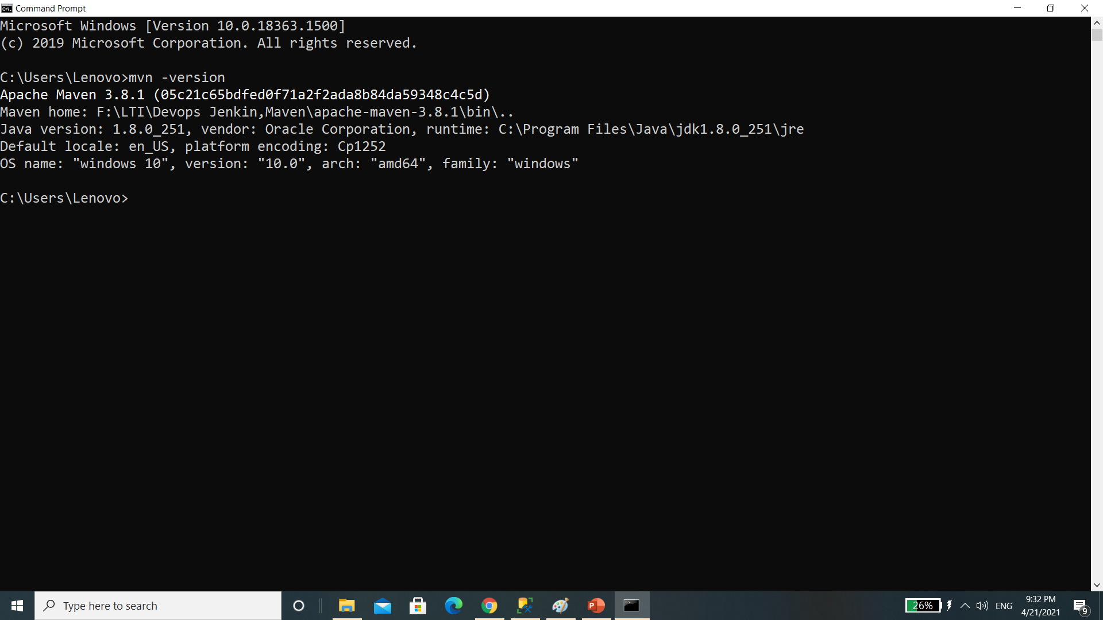

Slide 5


Slide 6


Slide 7
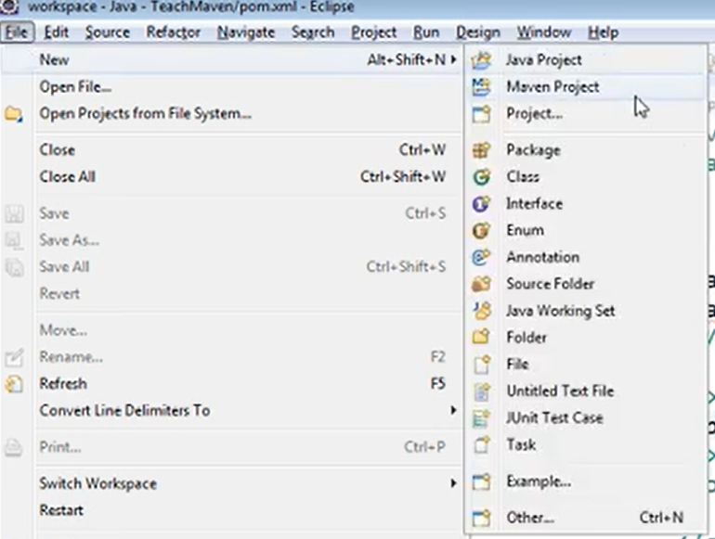

Slide 8
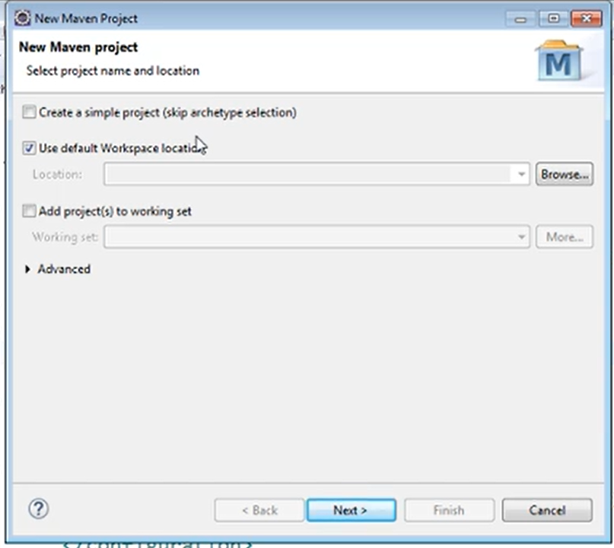

Slide 9
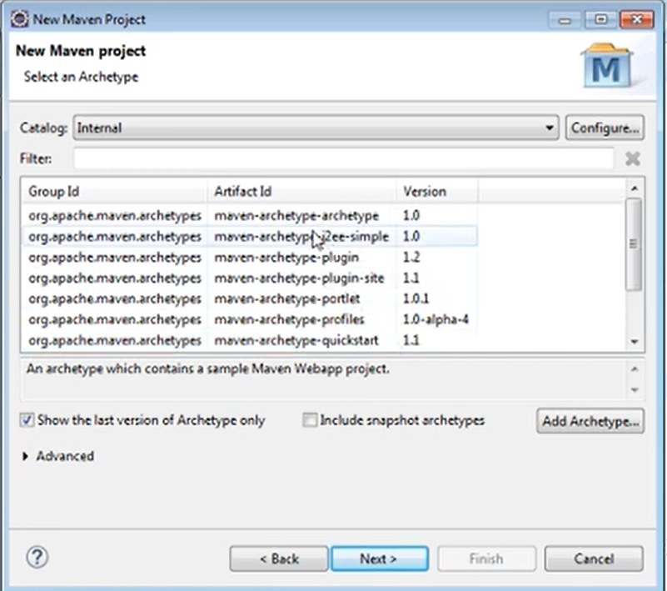

Slide 10
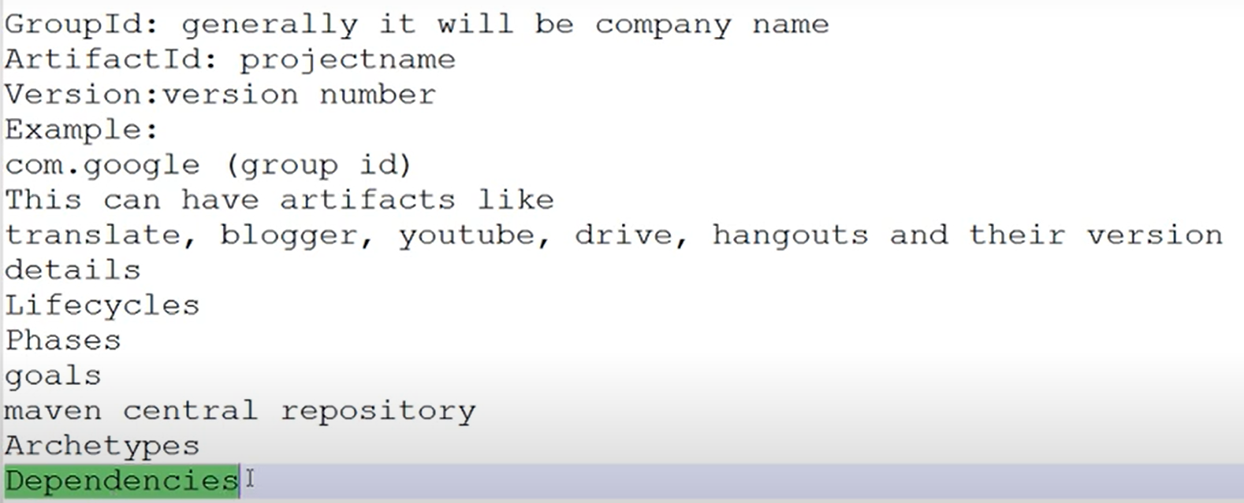

Slide 11
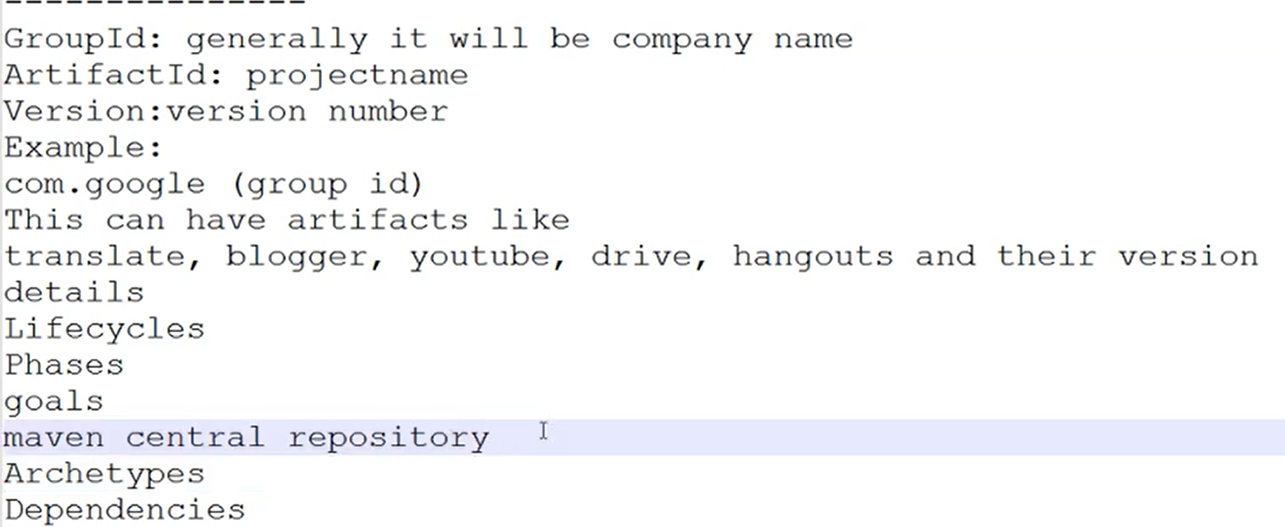

Slide 12
