Slide 1
7) n8n

Slide 2
n8n Basics
n8n: Open source automation tool to connect different applications and services
Name
  ‘n’ -> Stands for node, because n8n is built with Node.js
  ‘8n’ -> Shorthand for automation
  n + 8n = nodemation -> node automation -> n8n
Why n8n?
  No coding needed
  Open source and free
  Many tool connections available out of the box
Using n8n (https://n8n.io/pricing/)
  Hosting our applications on the cloud: Paid
  Hosting them on our local machine: Free

Slide 3
Using/Installing n8n
Option | Description | Where it Runs | Prerequisites | License / Cost
Cloud | Sign up at app.n8n.cloud for a 14-day free trial of the hosted n8n service | n8n Cloud (hosted by n8n team) | Just a browser and internet connection | Requires registration; subscription after trial
Docker | Run n8n Community Edition in a Docker container on our machine (https://docs.n8n.io/hosting/installation/docker/) | Our local machine (Dockerized) | Docker installed | Free (CE, no license key required)
npm | Install n8n Community Edition using npm and run it directly from Node.js (https://docs.n8n.io/hosting/installation/npm/) | Our local machine (Node.js runtime) | Node.js + npm installed | Free (CE, no license key required)

Slide 4
n8n Using Docker
Install Docker: https://docs.docker.com/get-started/get-docker/
docker volume create n8n_data
docker run -it --rm --name n8n -p 5678:5678 -e GENERIC_TIMEZONE="Asia/Calcutta" -e TZ="Asia/Calcutta" -e N8N_ENFORCE_SETTINGS_FILE_PERMISSIONS=true -e N8N_RUNNERS_ENABLED=true -v n8n_data:/home/node/.n8n -v C:/Users/akaha/myfiles:/files docker.n8n.io/n8nio/n8n
To update it to the latest image: Once it starts running, open Docker Desktop -> Images -> docker.n8n.io … -> Actions -> pull
Browser: localhost:5678
  Email: Dummy (root@root.com)
  First Name: Dummy (Atul)
  Last Name: Dummy (Kahate)
  Password: Dummy (Root@1234)
  After the first screen -> Send me a free licensed key -> Enter our real email id to receive it -> Get the key -> Usage and plan -> Paste key
Production hosting: n8n cloud, hostinger VPS/cloud, render/railway, etc

Slide 5
n8n Examples
Example | Details
1_basic_chatbot* | Add a Google Gemini AI LLM to respond to user’s chat questions
2_chatbot_with_tool_and_memory | Add a Wikipedia tool and memory to the chatbot
3_form_sheet_email | Create a form for users and save data in Google Sheets and send an acknowledgement to the user over email
4_read_cheque* | Fetch a cheque image from Google Drive and read its contents, extract in JSON format and store in an Airtable table
5_google_sheet_airtable | When a file is added to google drive, email it to an ID and note in Airtable
6_client_onboarding_system | When a new prospective client inquires, acknowledge the inquiry by email and store the client details in Google Sheets

Slide 6
1_basic_chatbot
Create workflow
Add first step-> + Symbol -> On chat message
Click + symbol after On chat message component
AI -> AI Agent -> Chat Model: Gemini
Configure Gemini API Key
Test

Slide 7
4_read_cheque
Sign up on airtable
Create a new workspace and name it as n8n
Create a new base (like Database) named cheques_data
Open cheques_data and create a table named cheque: Columns id, payer, payee, cheque_date, amount, bank, raw
On the n8n Screen, click on your account icon (bottom left) -> Builder hub -> Create token -> name as n8n -> Scopes: data.records:write and schema.bases:read -> Access: n8n-cheques_data
Copy the token -> Come back to n8n -> Select n8n -> Create a record -> Add details
See next slide for all screens

Slide 8
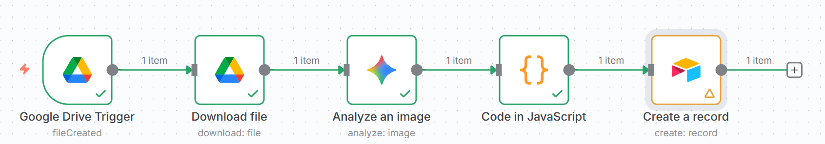
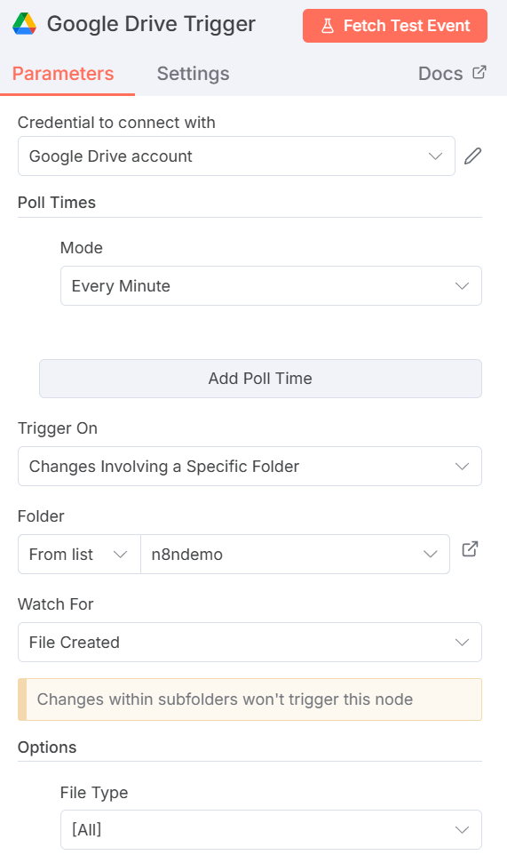
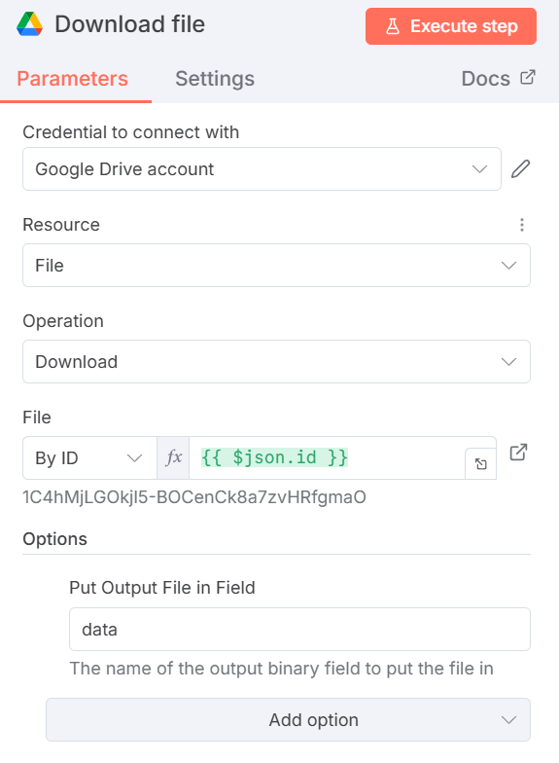
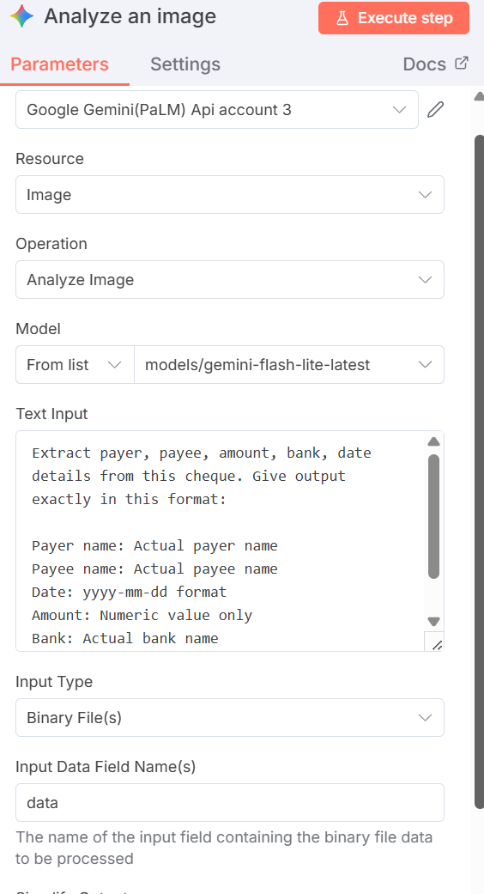
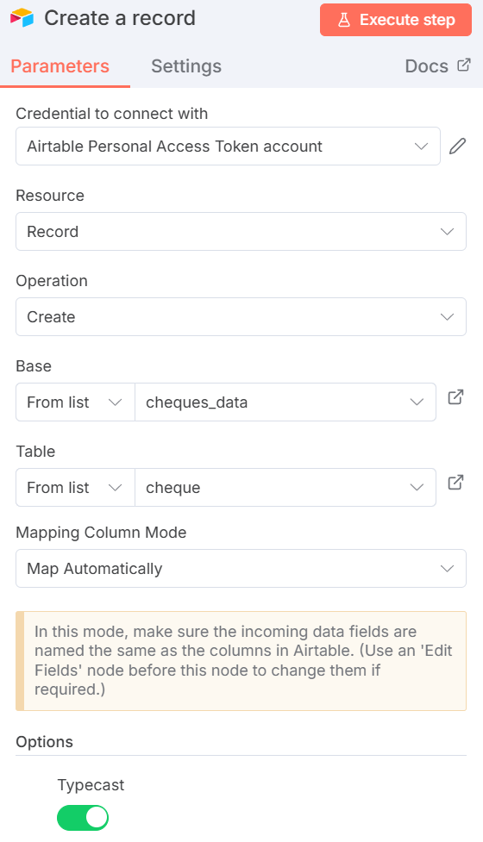
4_read_cheque (JavaScript Code – Next Slide)

Slide 9
4_cheque
// -------------------------------------------
// 1. READ TEXT FROM YOUR JSON STRUCTURE
// -------------------------------------------
const text =
item.json?.candidates?.[0]?.content?.parts?.[0]?.text || "";
// -------------------------------------------
// 2. SPLIT INTO LINES
// -------------------------------------------
const lines = text.split("\n");
function getValue(label) {
const line = lines.find(
l => l.toLowerCase().startsWith(label.toLowerCase())
);
if (!line) return "";
return line.split(":")[1].trim();
}
// -------------------------------------------
// 3. EXTRACT FIELDS
// -------------------------------------------
const payer = getValue("Payer name");
const payee = getValue("Payee name");
// Amount
let amountRaw = getValue("Amount");
let amount = null;
if (amountRaw) {
amount = parseFloat(amountRaw.replace(/,/g, "").trim());
}
// -------------------------------------------
// 4. DATE FORMAT FIX
// -------------------------------------------
function formatDate(d) {
if (!d) return null;
// Already ISO YYYY-MM-DD
if (/^\d{4}-\d{2}-\d{2}$/.test(d)) return d;
// DD/MM/YYYY or DD-MM-YYYY
const m = d.match(/(\d{1,2})[\/-](\d{1,2})[\/-](\d{4})/);
if (m) {
const [_, dd, mm, yy] = m;
return `${yy}-${mm.padStart(2, "0")}-${dd.padStart(2, "0")}`;
}
return null;
}
const cheque_date = formatDate(getValue("Date"));
const bank = getValue("Bank");
// -------------------------------------------
// 5. RETURN CLEAN JSON (ALL FIELDS AT TOP LEVEL)
// -------------------------------------------
return {
json: {
payer,
payee,
amount,
bank,
cheque_date, // date at top level
raw: text
}
};

Slide 10
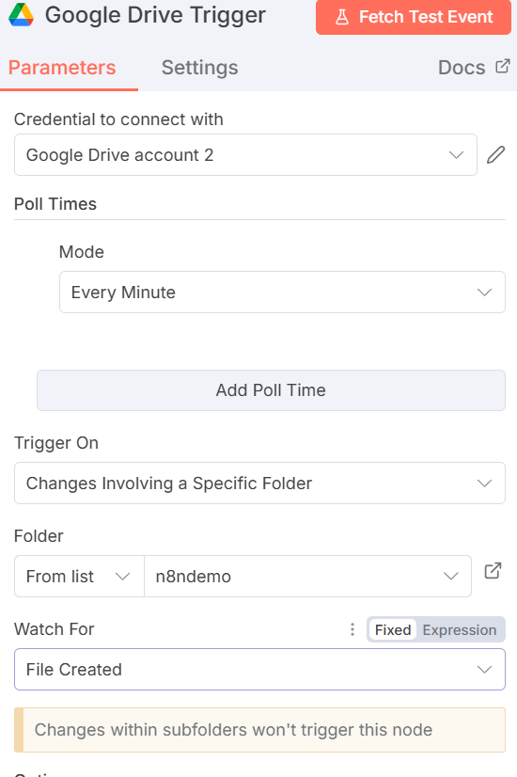
5_google_drive_airtable
When a new file is uploaded to google drive, detect it, send by email to a recipient, and save file details (name, ID, creation date, recipient) in airtable
Add Google Drive -> On changes involving a specific folder
Ensure Google credentials work, then select a folder in the dropdown and Watch for File Created
Then open this directory in Google Drive and add a file
In n8n, click on Fetch Test event in Google Drive Trigger screen
It should show the newly added file

Slide 11
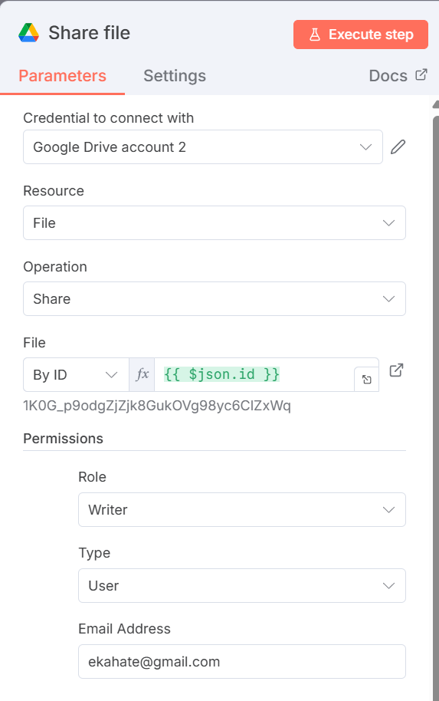
5_google_drive_airtable
Add a second Google Drive -> Share file node
In File -> By ID -> Drag the ID of the file from the previous node
Set permissions as shown
Add email id and Execute step to test it

Slide 12
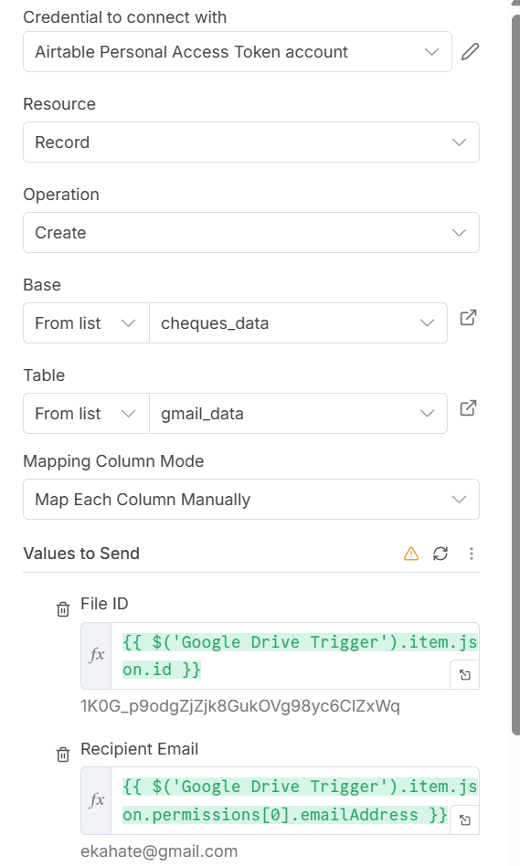
5_google_sheet_airtable
In Airtable, create a new table containing two columns
N8n: Add Airtable -> Add a record
Map columns and test

Slide 13
6_client_onboarding_system
Objectives:
  Allow a prospective client to fill an inquiry form
  Acknowledge the client’s inquiry with an email
  Save the client’s request in our google sheets file

Slide 14
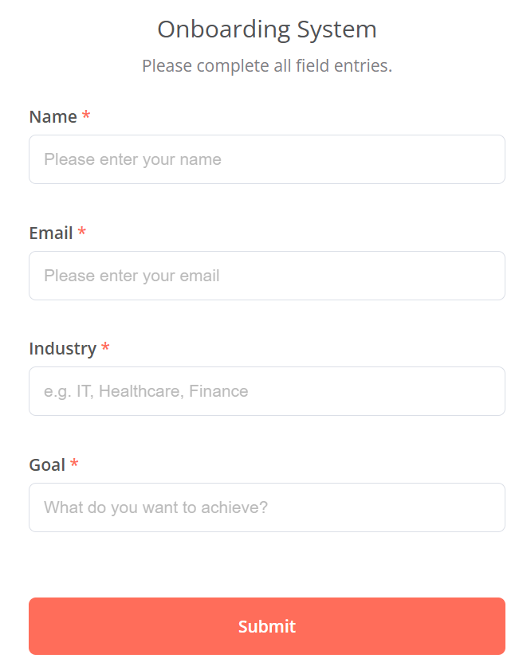
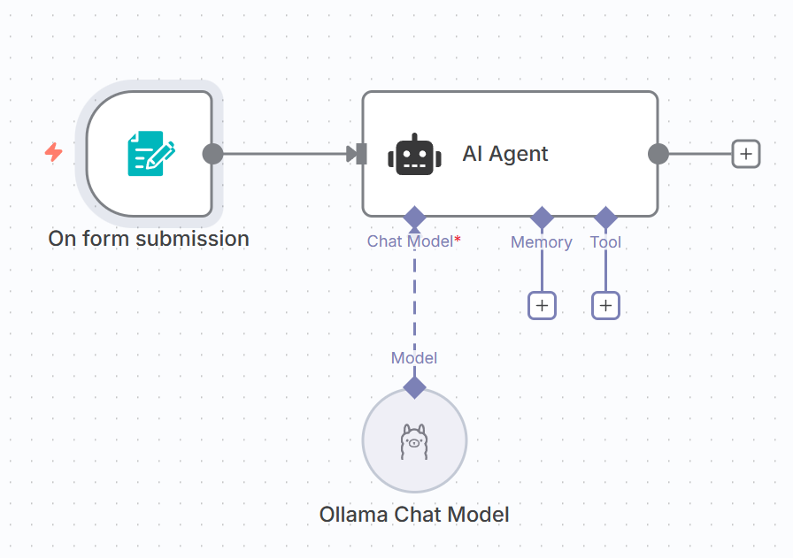
6_client_onboarding_system
Add form submission
Add AI Agent and configure Ollama
Give user message (Next slide)

Slide 15
6_client_onboarding_system
User message for AI agent (Ollama)
Can you generate a warm and professional welcome email for a new client based on the information provided?
The message should be friendly, brief, and personalized—while still sounding professional.
It should reflect the clientʼs industry and their goals for our collaboration. Below is the clientʼs information:
Name: {{ $json.Name }}
Email: {{ $json.Email }}
Company Industry: {{ $json.Industry }}
Goals for the Partnership: {{ $json.Goal }}
Make sure to always end the email with the following sign-off:
Best regards,
Bob Bob
VP of Internal Relations
ABC Corp
Do not use placeholders like {{ $json.Name }} or {{ $json.Email }} under any circumstances, even if some information is missing.
Return the result in 3 separate fields:
Subject: The emailʼs subject line
Body: The main email content
Email: {{ $json.Email }}
Summary: A concise overview of the potential client based on the information provided above

Slide 16
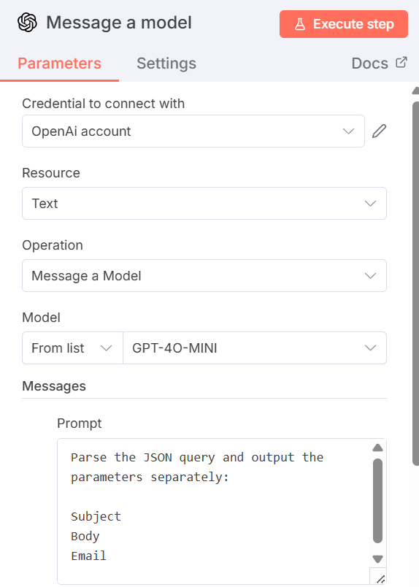
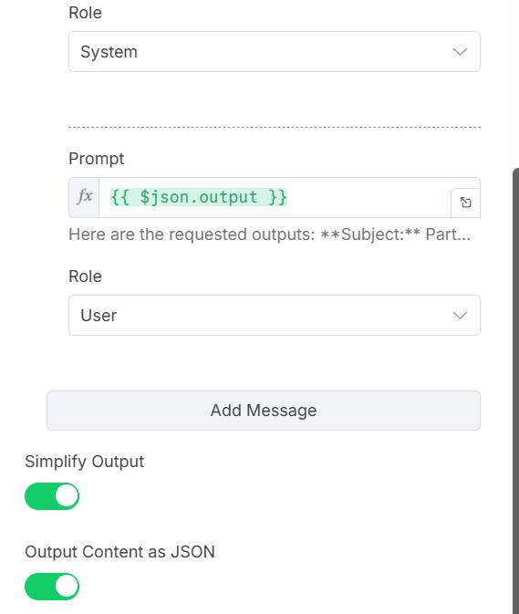
6_client_onboarding_system
Next, search OpenAI -> Message a model … Add this and test

Slide 17
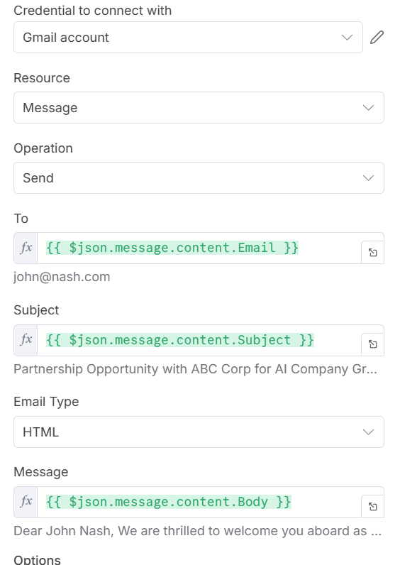
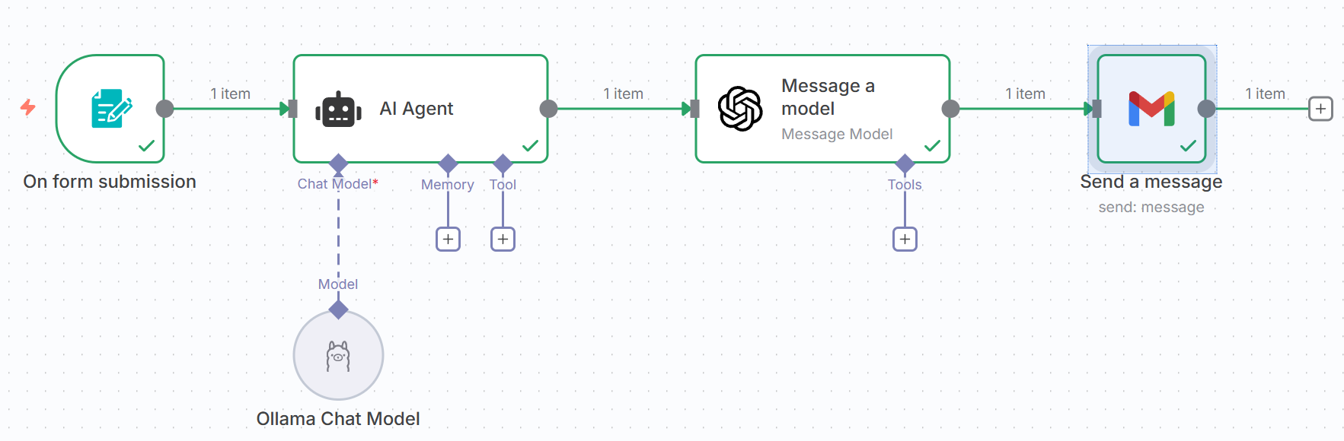
6_client_onboarding_system
Add gmail to the end and test

Slide 18
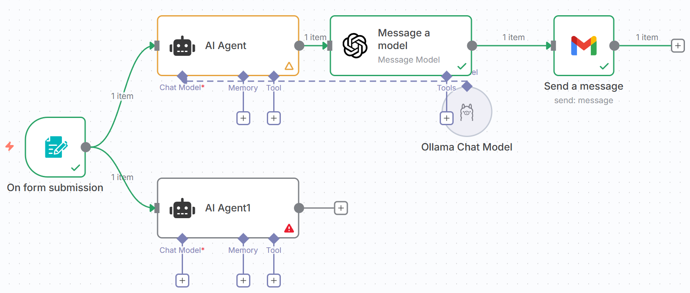
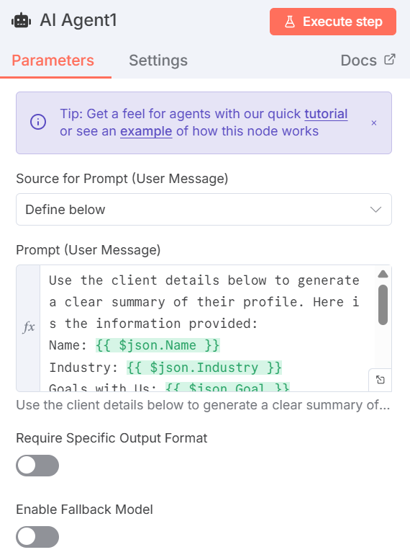
6_client_onboarding_system
Now add another AI agent at the bottom – Add the prompt as shown on the next slide – Add chat model as Ollama/OpenAI and test

Slide 19
6_client_onboarding_system
Prompt for the new agent
Use the client details below to generate a clear summary of their profile. Here is the information provided:
Name: {{ $json.Name }}
Industry: {{ $json.Industry }}
Goals with Us: {{ $json.Goal }}
Return the following fields separately:
Name: {{ $json.Name }}
Email: {{ $json.Email }}
Summary: A concise overview of the client based on the information provided above

Slide 20
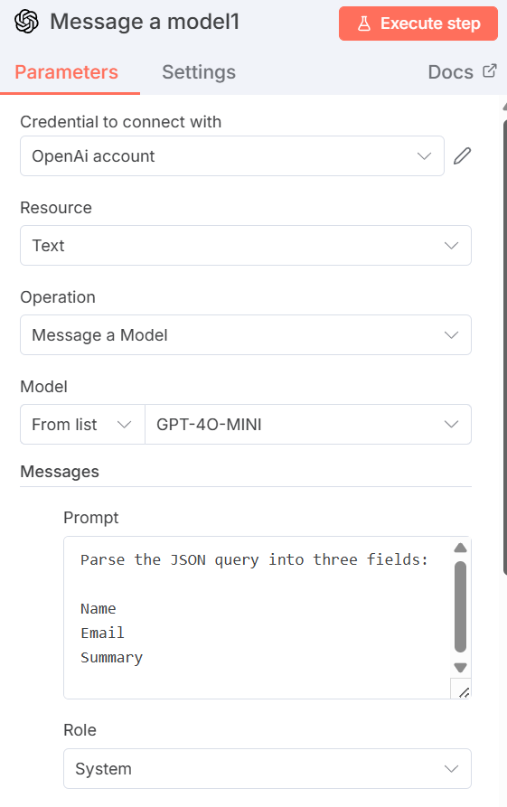
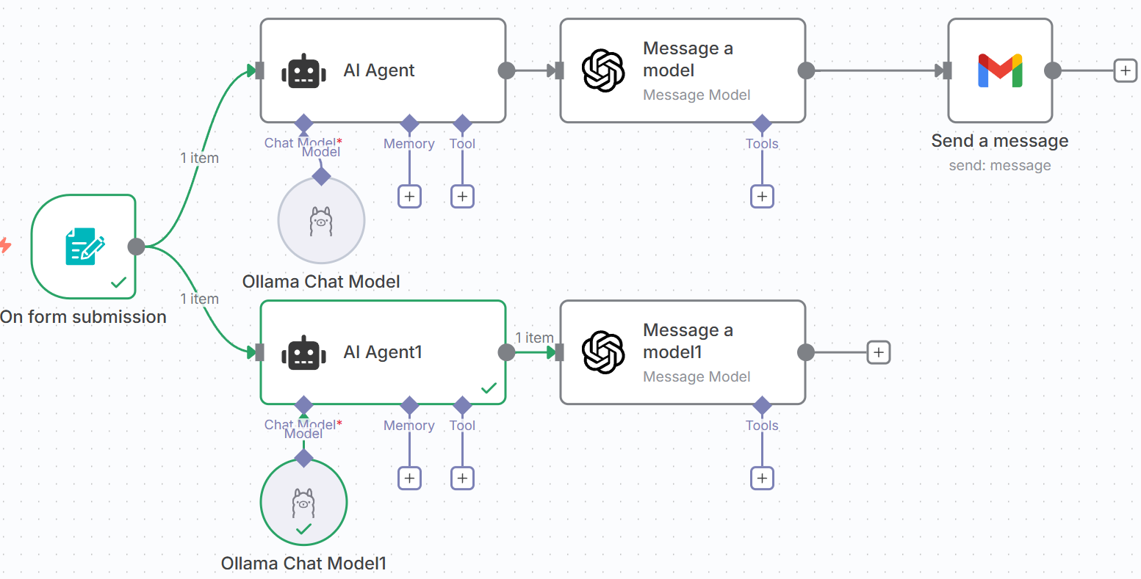
6_client_onboarding_system
Now copy the earlier OpenAI Message a Model node and attach below also – But change the prompt and test

Slide 21
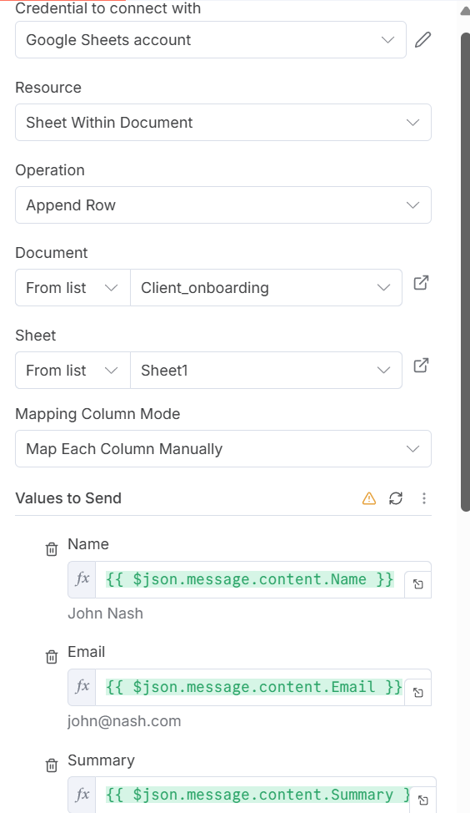
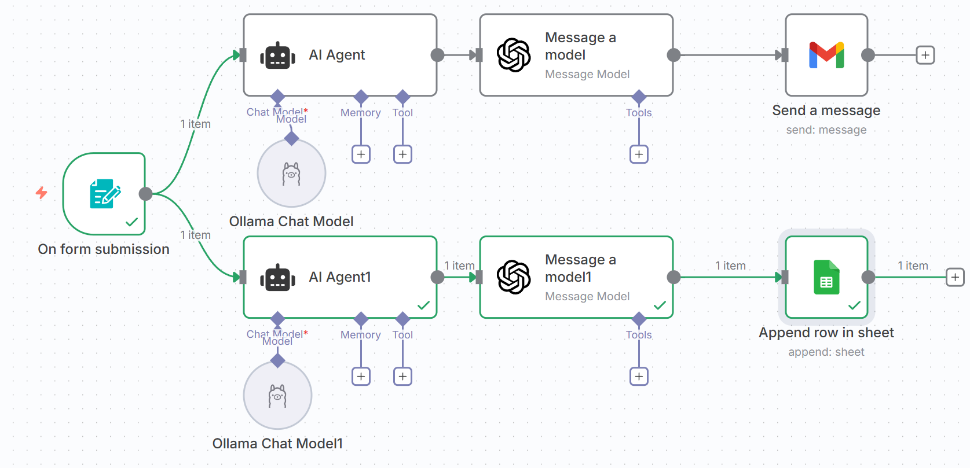
6_client_onboarding_system
In Google Sheets, create a file client_onboarding with columns Name, Email, and Summary
Now attach google sheet node and test

Slide 22
Google Credentials Setup
In n8n, on a new workflow screen, search for google drive select Triggers -> On changes involving a specific folder
Credentials to connect with -> Create new credential
In the browser: console.cloud.google.com -> API and services -> Click on My first project -> New project -> Project name: n8ndemo -> Location: Do not change -> Create
Select n8ndemo -> Enable APIs and services -> Google Drive API -> Enable
Credentials -> Create credentials -> OAuth Client ID -> Configure consent screen -> Get started
App name: n8n-app -> Email: Our email id -> Next -> Audience: External -> Next -> Contact information -> Our email id -> Next -> Agree -> Continue -> Create
Audience -> Add users -> Our email id
Clients -> Create client -> Application type: Web application -> Authorized Redirect URIs -> Copy paste from n8n screen -> Create -> Copy client id and Client secret and paste in n8n screen
On the google page -> Search for gmail -> Enable … Repeat for Sheets, Calendar
Now n8n screen again -> Save and test connection

Slide 23
Discord Setup
Create a new account on Discord, or log in
Create a new channel named n8n
Click the edit channel button next to the channel name
Integrations -> Webhooks -> New Webhook -> Spidey Bot -> Copy Webhook URL
In n8n integration for Discord, Connection type: Webhook -> Create new credentials -> Paste the above Webhook URL from Discord
Operation -> Send a message

Slide 24
n8n and LLM
To connect n8n to an LLM
  First add a chat trigger node
  Then add an agent node
For using local Ollama with n8n running as a Docker container
  For the Ollama account setup on n8n
    Create new credential -> Base URL: http://host.docker.internal:11434 -> API key: ollama -> Model: llama 3.2 (Or whatever we have downloaded on our machine)

