Slide 1
IBM University Engagement Project Submission
“Exploring the Power of Agentic AI with IBM Cloud and Orchestrate”

Slide 2

Project Tile –
AI-Powered Fitness Buddy
Domain of Project –
Healthcare / Fitness
Student Name | Recent Passport Photo | Email ID | Mobile number [WhatsApp]
Geethika Sandireddy |  | sandhireddygeethika@gmail.com | 9989462623

Slide 3
Problem Statement
The Challenge
Many people struggle to maintain a healthy lifestyle because they lack reliable fitness guidance, structured workout plans, and accurate nutrition advice. Beginners often find confusing information online, making it difficult to choose suitable exercises, maintain consistency, stay hydrated, and follow healthy eating habits safely.
The Objective
To address these challenges, this project develops an AI-powered Fitness Buddy using IBM watsonx Orchestrate.
The assistant helps users:
Generate beginner workout plans
Provide healthy eating guidance
Suggest hydration and recovery practices
Share muscle gain and weight loss tips
Answer fitness-related questions using the uploaded Fitness Knowledge Base
Deliver beginner-friendly and reliable fitness guidance

Slide 4
Proposed Solution
The proposed solution is an AI-powered Fitness Buddy developed using IBM watsonx Orchestrate to provide intelligent, accurate, and beginner-friendly fitness guidance.
The assistant retrieves information exclusively from the uploaded Fitness Knowledge Base, ensuring responses remain reliable and knowledge-driven.
The system assists users by providing workout recommendations, healthy eating guidance, hydration advice, recovery suggestions, and fitness tips through natural language conversations.
The agent is configured with customized behavior instructions and guidelines to ensure safe, structured, and beginner-friendly responses while preventing unsupported or misleading information.
Overall, the solution provides an intelligent fitness assistant that encourages healthy lifestyles using IBM Agentic AI.

Slide 5
Technology Used
IBM watsonx Orchestrate Used to build and configure the AI-powered Fitness Buddy. Manages the agent's behavior, guidelines, and knowledge retrieval.
Retrieval-Augmented Generation (RAG) Retrieves relevant fitness information from the uploaded Fitness Knowledge Base before generating responses, ensuring accurate and knowledge-based answers.
IBM Foundation Model Powers natural language understanding, reasoning, and response generation for the Fitness Buddy agent.
Fitness Knowledge Base Serves as the trusted knowledge source containing beginner workout plans, healthy eating guidance, hydration advice, muscle gain tips, weight loss recommendations, recovery practices, and fitness FAQs.
IBM Cloud Provides the cloud platform for hosting and running IBM watsonx Orchestrate services.

Slide 6
Orchestrate component Used -
1) Chat Input
Interface where users enter fitness-related queries such as workout plans, healthy eating guidance, hydration advice, weight loss, muscle gain, and recovery tips.
2) AI Fitness Buddy Agent
Processes user queries and retrieves relevant information from the uploaded Fitness Knowledge Base to generate accurate and structured responses.
3) IBM Foundation Model
Provides natural language understanding, reasoning, and response generation for the Fitness Buddy agent.
4) Knowledge Source
Uses the uploaded Fitness Knowledge Base as the Retrieval-Augmented Generation (RAG) knowledge source, ensuring responses are generated only from the uploaded document.
5) Behavior & Guidelines
Controls the agent's response style, formatting, retrieval rules, and ensures that responses are generated only from the uploaded Fitness Knowledge Base while preventing unsupported information.
6) Chat Output
Displays structured responses including workout plans, healthy eating guidance, hydration advice, muscle gain tips, weight loss recommendations, recovery guidance, and fitness safety tips.

Slide 7
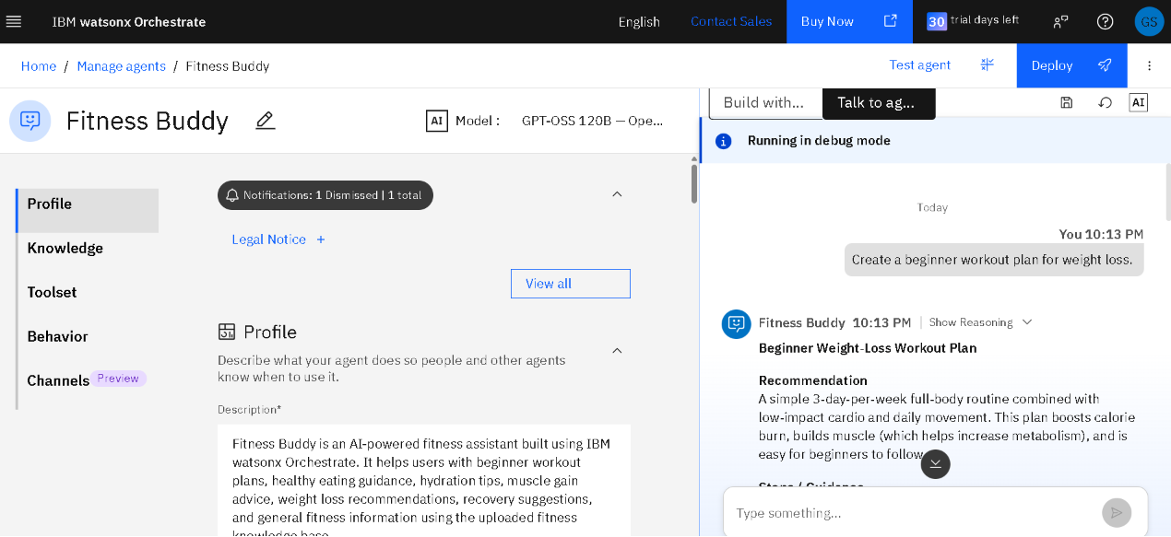
Orchestrate Workflow

Slide 8
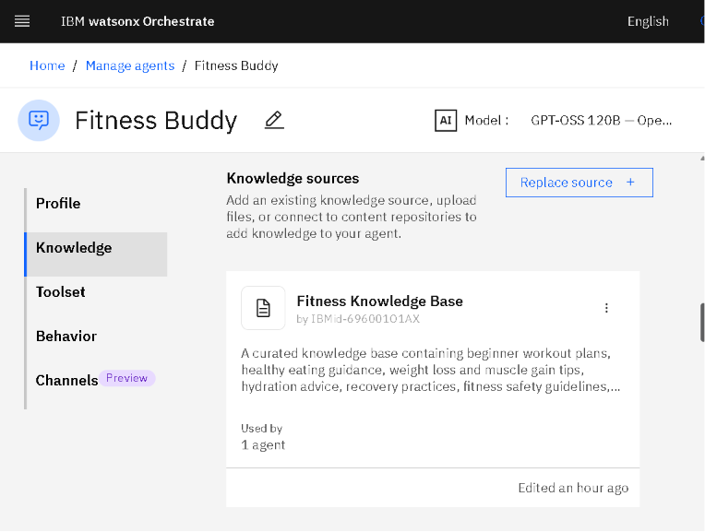
Architecture blueprint

Slide 9
Role of Agentic AI in the Solution
Agentic AI enables the Fitness Buddy to function as an intelligent and goal-oriented fitness assistant rather than a simple question-answering chatbot. Built using IBM watsonx Orchestrate, the agent understands user queries, retrieves relevant information from the uploaded Fitness Knowledge Base, and generates accurate, structured responses using Retrieval-Augmented Generation (RAG).
The agent can interpret different fitness-related requests, such as beginner workout plans, healthy eating guidance, hydration advice, muscle gain tips, weight loss recommendations, and recovery suggestions. By following predefined behavior instructions and guidelines, it provides consistent, safe, and beginner-friendly responses while ensuring that answers are generated only from the uploaded knowledge base.
Overall, Agentic AI makes the solution intelligent, reliable, context-aware, and user-friendly, helping individuals achieve their fitness goals with trustworthy AI-powered guidance.

Slide 10
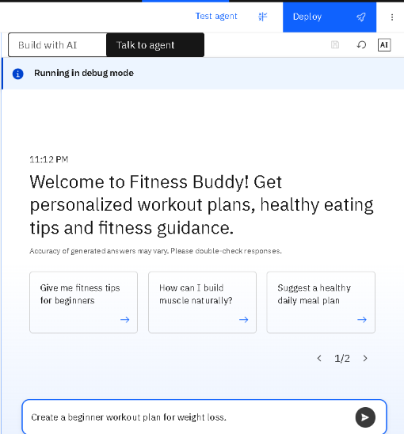
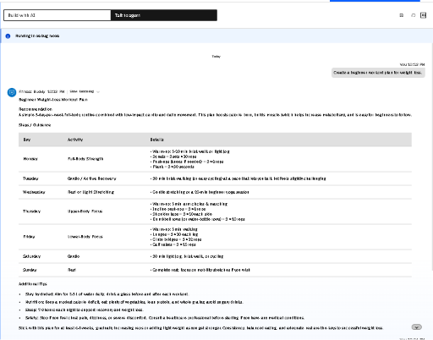
Token Usage
Before Prompt
After the Prompt
·
·
·
The Fitness Buddy agent successfully retrieved information from the uploaded Fitness Knowledge Base and generated a structured, beginner-friendly response using IBM watsonx Orchestrate.

Slide 11
Novelty and Uniqueness
The proposed Fitness Buddy stands out by combining Agentic AI, Retrieval-Augmented Generation (RAG), and a knowledge-driven fitness assistant into a single intelligent solution.
Knowledge-Base Driven Responses – Answers are generated only from the uploaded Fitness Knowledge Base, ensuring accurate and reliable information.
AI-Powered Fitness Guidance – Provides beginner workout plans, healthy eating guidance, hydration advice, and recovery tips.
Safe Recommendations – Avoids unsupported or unsafe fitness advice by following predefined behavior instructions and guidelines.
Structured Responses – Presents information in a clear and beginner-friendly format for improved user experience.
Built with IBM watsonx Orchestrate – Demonstrates how IBM Agentic AI can be used to create a domain-specific AI assistant without building a custom application.

Slide 12
GitHub Repository
Project Repository:
https://github.com/geethika-sandireddy/AI-Powered-Fitness-Buddy
·
·

Slide 13
Future Scope
Personalized Fitness Plans – Generate customized workout and nutrition plans based on age, fitness goals, and activity levels.
Wearable Device Integration – Connect with fitness trackers and smartwatches to provide real-time activity monitoring.
Voice-Based Interaction – Allow users to interact with the Fitness Buddy using voice commands for a hands-free experience.
Multilingual Support – Support multiple languages to make fitness guidance accessible to a wider audience.
BMI and Health Tracking – Include BMI calculation, calorie tracking, and progress monitoring.
Mobile Application – Develop a mobile app for anytime, anywhere fitness assistance.
·

Slide 14
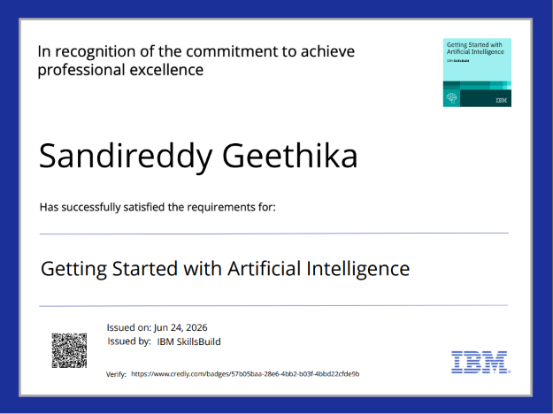
Certificates Earned:

Slide 15
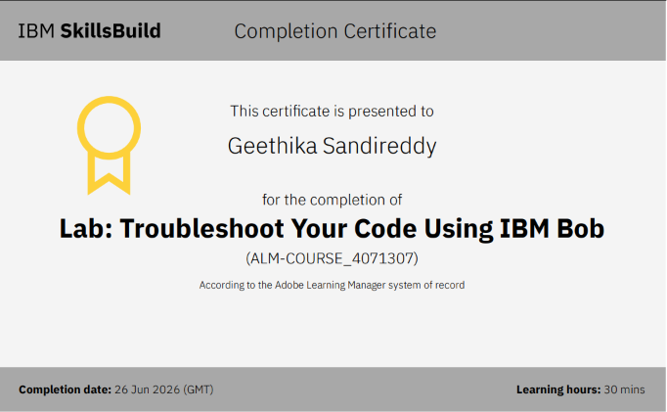
Certificates Earned:

Slide 16


