Slide 1
Unit-II
CPU Scheduling –
Scheduling Criteria,
Scheduling Algorithms,
Multiple -Processor Scheduling.
Process Management and Synchronization –
The Critical Section Problem,
Synchronization Hardware and Software,
Semaphores, and
Classical Problems of Synchronization,
Critical Regions,
Monitors.

Slide 2
CPU Scheduling
CPU scheduling is the process of deciding which process will own the CPU to use while another process is suspended.
The main function of the CPU scheduling is to ensure that whenever the CPU remains idle, the OS has at least selected one of the processes available in the ready-to-use line.

Slide 3
Short Term Scheduler
It is also called as CPU scheduler.
Short-term schedulers, also known as dispatchers, make the decision of which process to execute next. Short-term schedulers are faster than long-term schedulers.
It is the change of ready state to running state of the process.
CPU scheduler selects a process among the processes that are ready to execute and allocates CPU to one of them.
Its main objective is to increase system performance in accordance with the chosen set of criteria.

Slide 4
Categories of Scheduling
There are two categories of scheduling:
Non-preemptive: Here the resource can’t be taken from a process until the process completes execution.
The switching of resources occurs when the running process terminates and moves to a waiting state.
Preemptive: Here the OS allocates the resources to a process for a fixed amount of time. During resource allocation, the process switches from running state to ready state or from waiting state to ready state.
This switching occurs as the CPU may give priority to other processes and replace the process with higher priority with the running process.

Slide 5
Scheduling Criteria
There are several different criteria to consider when trying to select the "best" scheduling algorithm for a particular situation and environment, including:
CPU utilization - Ideally the CPU would be busy 100% of the time, so as to waste 0 CPU cycles. On a real system CPU usage should range from 40% ( lightly loaded ) to 90% ( heavily loaded. )
Throughput - Number of processes completed per unit time. May range from 10 / second to 1 / hour depending on the specific processes.

Slide 6
Turnaround time - Time required for a particular process to complete, from submission time to completion. (Wall clock time.) or The total amount of time spent by the process in system is called Turnaround time.
Waiting time - How much time processes spend in the ready queue waiting their turn to get on the CPU.
Response time – if the process are arrive at the system and it gets the scheduled for the first time is called response time.

Slide 7
Scheduling Algorithms
CPU scheduling deals with the problem of deciding which of the processes in the ready queue is to be allocated the CPU.
There are different CPU-scheduling algorithms
First-come, first-served scheduling (FCFS) algorithm
Shortest Job First Scheduling (SJF) algorithm
Priority Scheduling algorithm
Round-Robin Scheduling algorithm
Multilevel Queue Scheduling algorithm

Slide 8
First-come, first-served scheduling (FCFS) algorithm
FCFS is considered as simplest CPU-scheduling algorithm.
The first come first serve scheduling algorithm states that the process that requests the CPU first is allocated the CPU first.
It is implemented by using the FIFO queue.
FCFS is a non-preemptive scheduling algorithm.
FCFS is easy to implement and use.

Slide 9
Arrival time (AT) − Arrival time is the time at which the process arrives in ready queue.
Burst time (BT) or CPU time of the process − Burst time is the unit of time in which a particular process completes its execution.
Completion time (CT) − Completion time is the time at which the process has been terminated.
Turn-around time (TAT) − The total time from arrival time to completion time is known as turn-around time. TAT can be written as,
Turn-around time (TAT) = Completion time (CT) – Arrival time (AT)

Slide 10
Waiting time (WT) − Waiting time is the time at which the process waits for its allocation while the previous process is in the CPU for execution. WT is written as,
Waiting time (WT) = Turn-around time (TAT) – Burst time (BT)
Gantt chart − Gantt chart is a visualization which helps to scheduling and managing particular tasks in a project.
It is used while solving scheduling problems, for a concept of how the processes are being allocated in different algorithms.

Slide 11
Processes | Arrival Time | Burst Time
P1 | 0 | 4
P2 | 1 | 3
P3 | 2 | 1
P4 | 3 | 2
P5 | 4 | 5

Slide 12
Advantages Of FCFS Scheduling
It is an easy algorithm to implement since it does not include any complex way.
Every task should be executed simultaneously as it follows FIFO queue.
FCFS does not give priority to any random important tasks first so it’s a fair scheduling.

Slide 13
Disadvantages Of FCFS Scheduling
FCFS results in convoy effect which means if a process with higher burst time comes first in the ready queue then the processes with lower burst time may get blocked and that processes with lower burst time may not be able to get the CPU if the higher burst time task takes time forever.
If a process with long burst time comes in the line first then the other short burst time process have to wait for a long time, so it is not much good as time-sharing systems.
Since it is non-preemptive, it does not release the CPU before it completes its task execution completely.

Slide 14
Shortest Job First Scheduling (SJF) algorithm:
A different approach to CPU scheduling is the Shortest-Job-First where the scheduling of a job or a process is done on the basis of its having shortest next CPU burst (execution time).
When the CPU is available, it is assigned to the process that has the smallest next CPU burst.
If two processes have the same length next CPU burst, FCFS scheduling is used to break the tie.
SJF is optimal – gives minimum average waiting time for a given set of processes.
The SJF algorithm can be either preemptive or no preemptive

Slide 15
Non pre- emptive – once CPU given to the process it cannot be preempted until completes its CPU burst. This scheme is known as the shortest-next-CPU-burst algorithm.
Preemptive – if a new process arrives with CPU burst length less than remaining time of current executing process, preempt. This scheme is known as the Shortest-Remaining-Time-First (SRTF).

Slide 16
Shortest Remaining Time
Shortest remaining time (SRT) is the preemptive version of the SJN algorithm.
The processor is allocated to the job closest to completion but it can be preempted by a newer ready job with shorter time to completion.

Slide 17
Priority Scheduling algorithm:
The SJF algorithm is a special case of the general priority scheduling algorithm.
A priority is associated with each process, and the CPU is allocated to the process with the highest priority.
Equal-priority processes are scheduled in FCFS order.
Note that we discuss scheduling in terms of high priority and low priority.
Priorities are generally indicated by some fixed range of numbers, such as 0 to 7 or 0 to 4,095. However, there is no general agreement on whether 0 is the highest or lowest priority.
Some systems use low numbers to represent low priority; others use low numbers for high priority. This difference can lead to confusion. We assume that high numbers represent high priority.

Slide 18
Priorities can be defined either internally or externally.
Internally: priorities use some measurable quantity or quantities to compute the priority of a process. For example, time limits, memory requirements, the number of open files.
Externally: priorities are set by criteria outside the operating system, such as the importance of the process, the type and amount of funds being paid for computer use.

Slide 19
Priority scheduling can be either preemptive or non preemptive.
When a process arrives at the ready queue, its priority is compared with the priority of the currently running process.
A preemptive priority scheduling algorithm will preempt the CPU if the priority of the newly arrived process is higher than the priority of the currently running process.
A non preemptive priority scheduling algorithm will simply put the new process at the head of the ready queue.

Slide 20
Starvation:
Starvation is a resource management problem where a process does not get the resources it needs for a long time because the resources are being allocated to other processes.
(in Simple words, low priority processes may never execute)
Aging:
Aging is a technique to avoid starvation in a scheduling system.
It works by adding an aging factor to the priority of each request. The aging factor must increase the requests priority as time passes and must ensure that a request will eventually be the highest priority request (after it has waited long enough)
(In simple words, as time progresses increase the priority of the process.)

Slide 21
Round-Robin Scheduling algorithm:
The round-robin (RR) scheduling algorithm is designed especially for timesharing systems.
It is similar to FCFS scheduling, but preemption is added to enable the system to switch between processes. A small unit of time, called a time quantum or time slice, is defined.
A time quantum is generally from 10 to 100 milliseconds in length. The ready queue is treated as a circular queue.
The CPU scheduler goes around the ready queue, allocating the CPU to each process for a time interval of up to 1 time quantum.
To implement RR scheduling, we keep the ready queue as a FIFO queue o£ processes. New processes are added to the tail of the ready queue. The CPU scheduler picks the first process from the ready queue, sets a timer to interrupt after 1 time quantum, and dispatches the process.

Slide 22
One of two things will then happen-
The process may have a CPU burst of less than 1 time quantum. In this case, the process itself will release the CPU voluntarily. The scheduler will then proceed to the next process in the ready queue.
Otherwise, if the CPU burst of the currently running process is longer than 1 time quantum, the timer will go off and will cause an interrupt to the operating system.

Slide 23
Introduction of Process Synchronization
Processes are categorized as one of the following two types:
Independent Process: The execution of one process does not affect the execution of other processes.
Cooperative Process: A process that can affect or be affected by other processes executing in the system.
Process synchronization problem arises in the case of Cooperative processes also because resources are shared in Cooperative processes.

Slide 24
Race Condition
When more than one process is executing the same code or accessing the same memory or any shared variable in that condition there is a possibility that the output or the value of the shared variable is wrong so for that all the processes doing the race to say that my output is correct this condition known as a race condition.
A race condition is a situation that may occur inside a critical section. This happens when the result of multiple thread execution in the critical section differs according to the order in which the threads execute.

Slide 25
What is Process Synchronization?
Process Synchronization is the task of coordinating the execution of processes in a way that no two processes can have access to the same shared data and resources.
It is specially needed in a multi-process system when multiple processes are running together, and more than one processes try to gain access to the same shared resource or data at the same time.
This can lead to the inconsistency of shared data. So the change made by one process not necessarily reflected when other processes accessed the same shared data.
To avoid this type of inconsistency of data, the processes need to be synchronized with each other.

Slide 26
The Critical Section Problem
Consider a system consisting of n processes {P0, P1, ..., Pn−1}.
Each process has a segment of code, called a critical section, in which the process may be changing common variables, updating a table, writing a file, and so on.
The important feature of the system is that, when one process is executing in its critical section, no other process is allowed to execute in its critical section.

Slide 27
The Critical Section Problem
That is, no two processes are executing in their critical sections at the same time.
The critical-section problem is to design a protocol that the processes can use to cooperate.
Each process must request permission to enter its critical section.

Slide 28
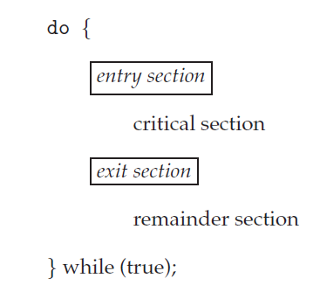
The Critical Section Problem
The section of code implementing this request is the entry section.
The critical section may be followed by an exit section.
The remaining code is the remainder section.
The entry section and exit section are enclosed in boxes to highlight these important segments of code.

Slide 29
The Critical Section Problem
A solution to the critical-section problem must satisfy the following three requirements:
Mutual exclusion: If process Pi is executing in its critical section, then no other processes can be executing in their critical sections.
Progress: If no process is executing in its critical section and some processes wish to enter their critical sections, then only those processes that are not executing in their remainder sections can participate in deciding which will enter its critical section next, and this selection cannot be postponed indefinitely.

Slide 30
The Critical Section Problem
Bounded waiting: There exists a bound, or limit, on the number of times that other processes are allowed to enter their critical sections after a process has made a request to enter its critical section and before that request is granted.

Slide 31
Peterson’s Solution
A classic software-based solution to the critical-section problem known as Peterson’s solution.
May not work correctly on Modern Computer Architecture.
However, it provides a good algorithmic description of solving the critical-section problem and illustrates some of the complexities involved in designing software that addresses the requirements of mutual exclusion, progress, and bounded waiting.

Slide 32
Peterson’s solution is restricted to two processes that alternate execution between their critical sections and remainder sections.
Let’s call the processes Pi and Pj.
Peterson’s solution requires two data items to be shared between the two processes.
int turn;
boolean flag[2];
int turn→The variable turn indicates whose turn it is to enter its critical section.
Boolean flag[2]→The flag array is used to indicate if a process is ready to enter its critical section.

Slide 33
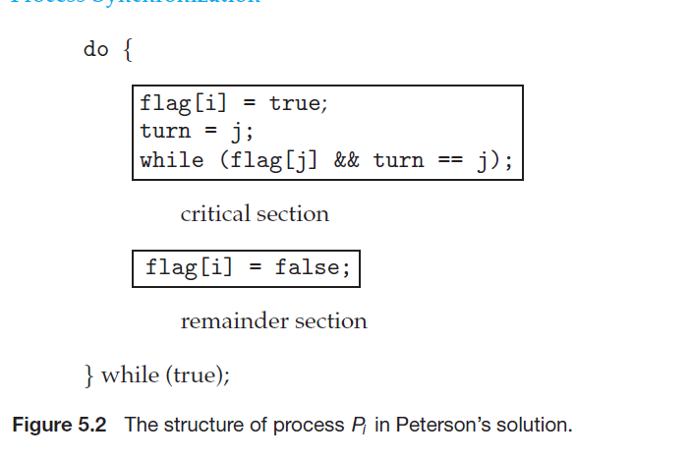
Process Pj in PeterSon’s solution
do {
flag[j] = true;
turn = i;
while (flag[i] && turn = = i);
/* critical section */
flag[j] = false;
remainder section
} while (true);

