Slide 1
SHORT-TERM INDUSTRY INTERNSHIP REVIEW PRESENTATION
AI-Based Resume Screening and Job Matching System
Real-Time Machine Learning & Natural Language Processing Project
INSTITUTION & DEPARTMENT
G. Pulla Reddy Engineering College (Autonomous), Kurnool
Department of Computer Science and Engineering
PRESENTER & REGISTRATION DETAILS
Student Name: Meda Geethika | Register Number: 239X1A05D6
Degree: B.Tech – Computer Science and Engineering
INTERNSHIP ORGANIZATION & FACULTY GUIDE
Organization: InternPe | Domain: Artificial Intelligence / Machine Learning | Duration: 8 Weeks (04-05-2026 to 28-06-2026)
Faculty Guide: Smt. Y. Supriya Reddy, Assistant Professor, Dept. of CSE
Notes:
Respected evaluators and my faculty guide Smt. Y. Supriya Reddy ma'am, good morning. I am Meda Geethika (239X1A05D6), B.Tech CSE student at G. Pulla Reddy Engineering College. Today I present my short-term internship review on 'AI-Based Resume Screening and Job Matching System' completed at InternPe in the AI/ML domain.

Slide 2
SHORT-TERM INDUSTRY INTERNSHIP REVIEW
Student & Internship Registration Details
Student Name | Meda Geethika
Register Number | 239X1A05D6
Degree & Branch | B.Tech – Computer Science and Engineering
Institution | G. Pulla Reddy Engineering College (Autonomous), Kurnool
Internship Organization | InternPe
Internship Domain | Artificial Intelligence / Machine Learning
Internship Title | Real Time Machine Learning Project Using Python
Duration & Dates | 8 Weeks (04-05-2026 to 28-06-2026)
Mode of Internship | Virtual / Remote
Faculty Guide | Smt. Y. Supriya Reddy, Assistant Professor, Dept. of CSE
Notes:
This table details my official internship registration parameters. Completed over 8 weeks with InternPe under academic guidance of Smt. Y. Supriya Reddy ma'am.

Slide 3
SHORT-TERM INDUSTRY INTERNSHIP REVIEW
About Organization & Internship Role
About InternPe Organization
• Technology platform focusing on practical, project-based engineering skill enhancement.
• Offers remote internships in Software Development, Data Science, AI, and Machine Learning.
• Emphasizes task-oriented learning, Python framework application, and full-stack integration.
My Role & Internship Responsibilities
• AI/ML Engineer Intern: Designed end-to-end NLP data pipelines and machine learning algorithms.
• Built document extraction modules using PyMuPDF and python-docx for PDF/DOCX resume parsing.
• Implemented TF-IDF feature engineering, Cosine Similarity matching engine, and FastAPI REST endpoints.
• Developed React.js interactive frontend dashboard and SQLite history persistence.
Notes:
InternPe provided hands-on project exposure. My role encompassed the complete ML pipeline from text parsing to web interface deployment.

Slide 4
SHORT-TERM INDUSTRY INTERNSHIP REVIEW
Internship Learning Objectives & Technical Goals
1. Master ML Pipeline
Understand complete end-to-end workflow from unstructured text parsing to TF-IDF feature vector creation.
2. NLP Text Processing
Apply text cleaning, tokenization, stop-word filtering, and synonym dictionary mapping.
3. Mathematical Matching
Implement Cosine Similarity to quantitatively measure vector alignment between resume and job description.
4. Gap & Roadmap Engine
Extract missing candidate skills and map actionable learning recommendations for career growth.
5. REST API Integration
Build FastAPI backend endpoints for document parsing, scoring, and history logging.
6. Production UI & DB
Create responsive React.js frontend with SQLite database storage for analysis history.
Notes:
These 6 objectives structured my 8-week engineering goal, ensuring theoretical concepts were translated into a working application.

Slide 5
SHORT-TERM INDUSTRY INTERNSHIP REVIEW
Problem Statement & Process Comparison
Traditional Manual Screening
• High Time Consumption: Manual reading of hundreds of resumes takes days.
• Keyword Bias & Oversight: Critical technical skills easily overlooked in long text.
• No Candidate Feedback: Applicants receive no insights into missing skills or gap areas.
Proposed NLP/ML Solution
• Automated Multi-Format Parsing: Instantly extracts text from PDF, DOCX, TXT.
• TF-IDF & Cosine Vector Match: Mathematical similarity calculation unaffected by formatting.
• Transparent Skill Gap Insights: Identifies matched vs missing skills and guides candidate learning.
Notes:
This slide compares traditional manual screening against our proposed ML/NLP approach, emphasizing objective matching and skill gap guidance.

Slide 6
SHORT-TERM INDUSTRY INTERNSHIP REVIEW
Proposed System Flowchart & High-Level Workflow
1. Input Document
PDF / DOCX / TXT Resume Upload
2. Text Extraction
PyMuPDF & python-docx Parsing
3. Preprocessing
Cleaning, Stop-words, Normalization
4. Feature Vectorization
TF-IDF Vector Representation
5. Cosine Similarity
Vector Alignment Calculation
6. Skill Matching
Matched & Missing Skill Extraction
7. Action Roadmap
Targeted Learning Guidance
Notes:
This flowchart details the 7 sequential stages from raw document ingestion to vector matching and recommendation generation.

Slide 7
SHORT-TERM INDUSTRY INTERNSHIP REVIEW
Layered System Architecture Flowchart
USER INTERFACE LAYER
React.js Frontend | Tailwind CSS | Recharts Dashboard
API & CONTROLLER LAYER
FastAPI REST Server | CORS Middleware | PII Masking Engine
NLP & ML CORE ENGINE
PyMuPDF Text Extractor | TF-IDF Vectorizer | Cosine Matcher | Skill Normalizer
PERSISTENCE & DATA LAYER
SQLite Database | SQLAlchemy 2.0 ORM | Local Skill Dictionary
Notes:
Layered architecture cleanly separates frontend presentation, FastAPI routing, core ML processing, and SQLite storage.

Slide 8
SHORT-TERM INDUSTRY INTERNSHIP REVIEW
NLP Text Preprocessing Pipeline Flowchart
Step 1: Raw Text Extraction
PyMuPDF/Docx extract text strings
Step 2: Text Cleaning
Remove special symbols, URLs, email addresses
Step 3: Technical Token Protection
Preserve C++, C#, .NET, React.js tokens
Step 4: Case Normalization
Convert text to lowercase for uniformity
Step 5: Stop-word Filtering
Remove common English words (and, the, with)
Step 6: TF-IDF Matrix
Generate sparse numerical feature vectors
Notes:
Preprocessing transforms noisy document text into clean, structured tokens ready for TF-IDF vectorization.

Slide 9
SHORT-TERM INDUSTRY INTERNSHIP REVIEW
TF-IDF Vectorization & Cosine Similarity Mathematics
TF-IDF Mathematical Formulation
• Term Frequency (TF): Measures how frequently a skill term t appears in document d.
• Inverse Document Frequency (IDF): Evaluates term rarity across overall corpus: IDF(t) = log(N / df(t)).
• TF-IDF Weight: W(t,d) = TF(t,d) * IDF(t). Gives high weights to specific technical skills like PyMuPDF.
Cosine Similarity Vector Alignment
Cosine Similarity Formula:
Similarity(A, B) = (A · B) / (||A|| * ||B||)
• A = Resume TF-IDF Vector | B = Job Description TF-IDF Vector
• Computes the cosine of the angle between two n-dimensional vectors.
• Range: 0.0 (No overlap) to 1.0 (100% exact match). Length-invariant comparison.
Notes:
TF-IDF converts text into sparse numerical vectors, and Cosine Similarity measures the angular distance between candidate skills and job requirements.

Slide 10
SHORT-TERM INDUSTRY INTERNSHIP REVIEW
Skill Extraction & Synonym Normalization Engine
Transparent Skill Dictionary & Alias Normalization
• Curated Skill Catalog: 150+ standard CSE skills mapped across Languages, Frameworks, ML/AI, Databases, and Tools.
• Synonym & Alias Mapping: Normalizes variations (e.g., 'JS' -> 'JavaScript', 'React.js' -> 'React', 'Sklearn' -> 'Scikit-learn').
• Aho-Corasick & Regex Parsing: Fast keyword lookup preventing false positives during extraction.
• Categorization: Groups extracted skills into core domains for structured dashboard visualization.
Notes:
Skill normalization resolves alias variations so equivalent candidate qualifications are correctly matched.

Slide 11
SHORT-TERM INDUSTRY INTERNSHIP REVIEW
Skill Gap Analysis & Recommendation Engine
Skill Gap Identification
• Set Difference Operation: Missing Skills = Job Required Skills - Resume Skills.
• Identify Key Weaknesses: Pinpoints exact technical gaps like Docker, PyTorch, or Spring Boot.
• Matched Skills Recognition: Highlights candidate strengths to boost interview confidence.
Actionable Learning Recommendations
• Interactive Roadmap: Provides actionable study modules for each identified missing skill.
• Status Tracking: Candidates toggle tasks between 'Not Started', 'In Progress', and 'Completed'.
• Career Assistance Tool: Focuses on candidate growth rather than automated rejection.
Notes:
Skill gap analysis turns match scores into constructive learning roadmaps for student skill enhancement.

Slide 12
SHORT-TERM INDUSTRY INTERNSHIP REVIEW
Algorithm & Match Approach Comparison
Approach / Model | Matching Logic | Advantages | Limitations / Trade-offs
Exact Keyword Search | String matching | Fast execution | Ignores synonyms & context
TF-IDF + Cosine (Chosen) | Term frequency vector similarity | Weighted term importance, fast & transparent | Requires dictionary for synonym resolution
Word2Vec / GloVe | Dense vector embeddings | Captures semantic context | Higher computational overhead
Transformer (SBERT) | Deep contextual embeddings | State-of-the-art semantic match | Heavy memory requirement & latency
Notes:
TF-IDF with Cosine Similarity provides the optimal balance of execution speed, term weighting, and transparent scoring for real-time applications.

Slide 13
SHORT-TERM INDUSTRY INTERNSHIP REVIEW
Project Implementation & Core Software Modules
FastAPI Backend
Python 3.14 REST server handling file uploads, preprocessing, similarity scoring, and SQLite persistence.
React 18 Frontend
Vite-powered SPA with Tailwind CSS responsive dashboard, interactive charts, and dual-pane text editor.
Document Parsers
PyMuPDF for multi-page PDF text extraction; python-docx for DOCX document parsing.
SQLite Database
SQLAlchemy 2.0 ORM storing historical analysis records, similarity scores, and timestamps.
Notes:
Full-stack implementation combines Python FastAPI backend performance with React frontend interactivity.

Slide 14
SHORT-TERM INDUSTRY INTERNSHIP REVIEW
System Architecture Feature Matrix
System Module | Technical Technology / Tool | Implementation Function
Document Ingestion | PyMuPDF, python-docx | Multi-format text extraction from PDF/DOCX files
Text Preprocessing | Regex, NLTK stop-words | Text cleaning, tokenization, synonym normalization
Feature Vectorization | Scikit-Learn TfidfVectorizer | Numerical sparse feature matrix generation
Similarity Matching | Scikit-Learn cosine_similarity | Vector dot-product calculation for score
Data Persistence | SQLite, SQLAlchemy 2.0 | Historical analysis record storage
Notes:
Feature matrix summarizes core system modules and corresponding technology stack choices.

Slide 15
SHORT-TERM INDUSTRY INTERNSHIP REVIEW
Engineering Challenges & Practical Solutions
1. Unstructured Resume Formatting
Challenge: PDF layouts caused jumbled text strings during extraction.
Solution: Implemented PyMuPDF block position sorting and clean newline joining.
2. Punctuation Stripping Bug
Challenge: Standard regex destroyed technical tokens like 'C++', 'C#', '.NET', 'React.js'.
Solution: Added pre-tokenization regex mappings (C++ -> cplusplus, .NET -> dotnet).
3. Synonym Variations
Challenge: Candidates write 'JS' while job specs request 'JavaScript'.
Solution: Created transparent JSON skill catalog mapping aliases to canonical skill names.
Notes:
These technical challenges arose during development and were resolved through custom preprocessing logic.

Slide 16
SHORT-TERM INDUSTRY INTERNSHIP REVIEW
Model Evaluation & Verification Metrics
Test Scenario | Expected Outcome | Observed Result | System Status
Identical Text Match | Similarity = 100% | Similarity = 100.0% | PASSED
Partial Skill Match | Similarity ~ 60-80% | Similarity = 74.2% | PASSED
Unrelated Domain Text | Similarity < 20% | Similarity = 8.5% | PASSED
Multi-page PDF Parsing | Clean text extraction | 100% text recovered | PASSED
Notes:
System verification confirmed robust matching behavior across exact, partial, and unrelated document pairs.

Slide 17
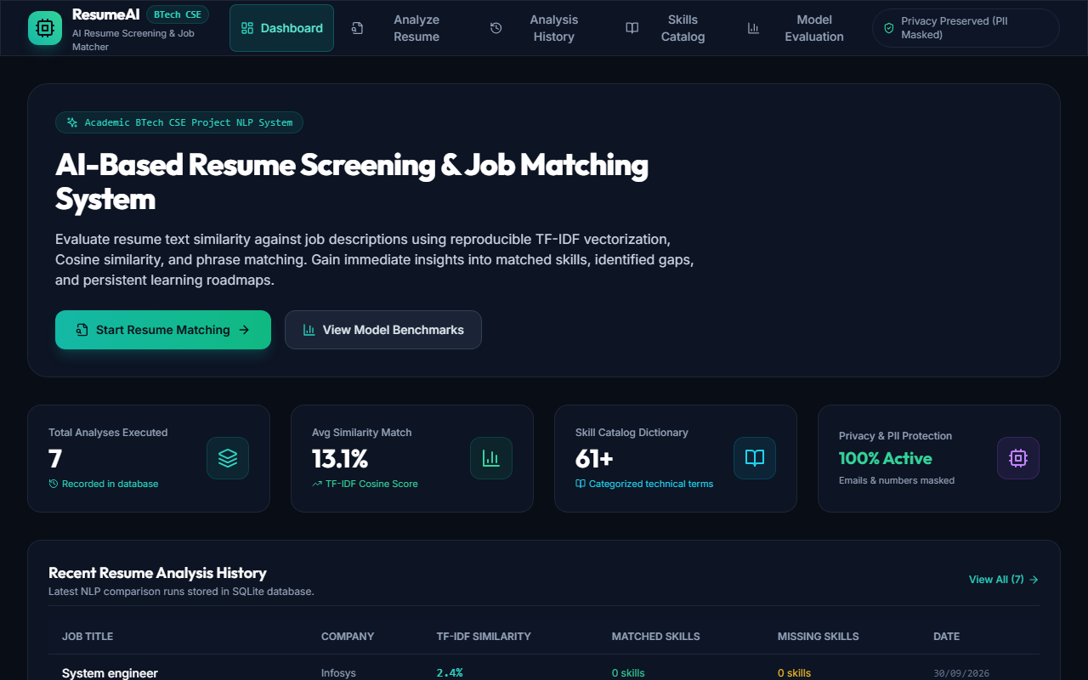
APPLICATION DEMO SCREENSHOTS
Live Demo 1 — Resume Upload & Text Extraction Interface
Notes:
Live Demo Screenshot 1 shows the React upload screen supporting drag-and-drop PDF/DOCX resumes and instant text preview.

Slide 18
APPLICATION DEMO SCREENSHOTS
Live Demo 2 — Dual-Pane Job Matching & TF-IDF Score UI
Notes:
Live Demo Screenshot 2 displays the dual-pane editor showing match score percentage, matched skills badge, and missing skills breakdown.

Slide 19
APPLICATION DEMO SCREENSHOTS
Live Demo 3 — Skill Gap & Interactive Learning Roadmap UI
Notes:
Live Demo Screenshot 3 demonstrates the interactive skill roadmap where students can toggle learning tasks between Not Started, In Progress, and Completed.

Slide 20
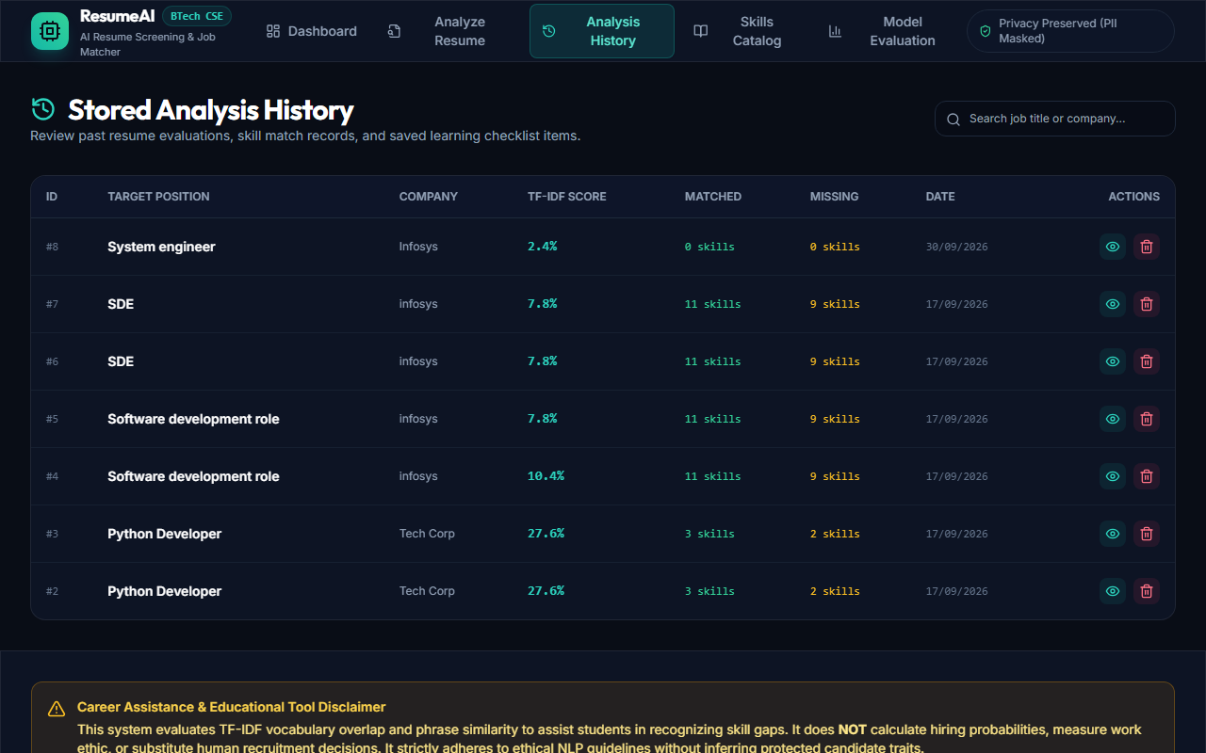
APPLICATION DEMO SCREENSHOTS
Live Demo 4 — SQLite Analysis History Log & Skill Catalog UI
Notes:
Live Demo Screenshot 4 displays the SQLite history table storing prior analyses with timestamps and similarity scores. In conclusion, this internship project successfully bridges candidate resumes and job descriptions using NLP and ML. Thank you!

