Slide 2
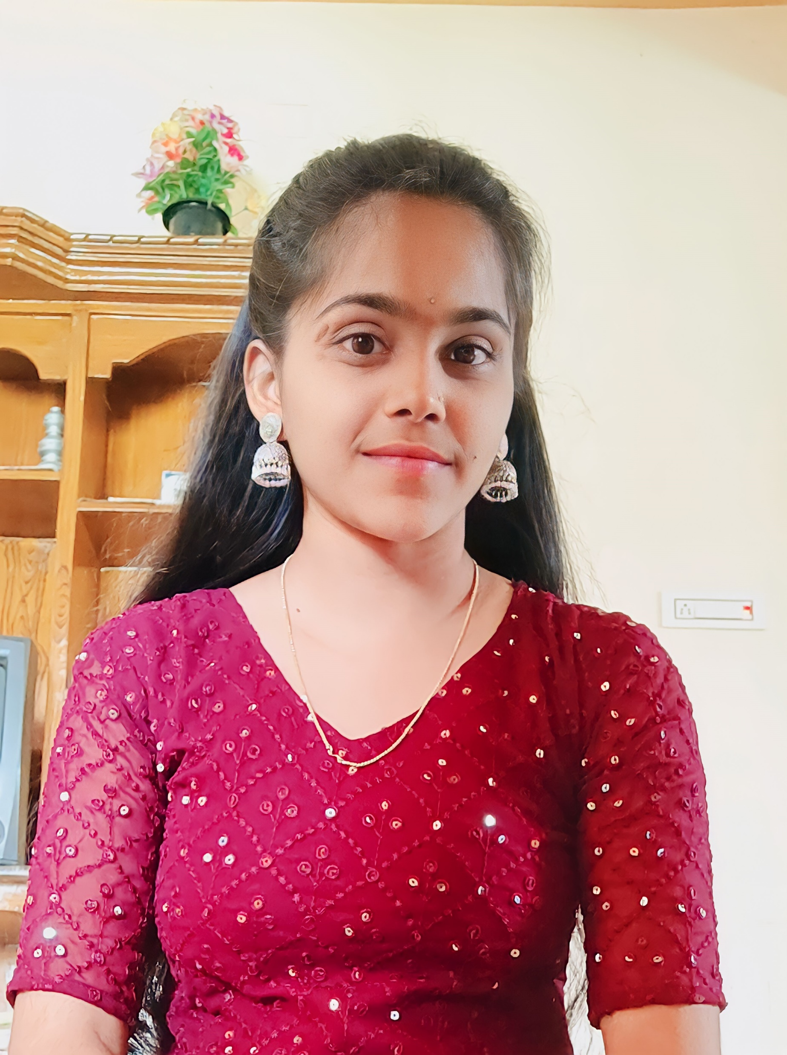
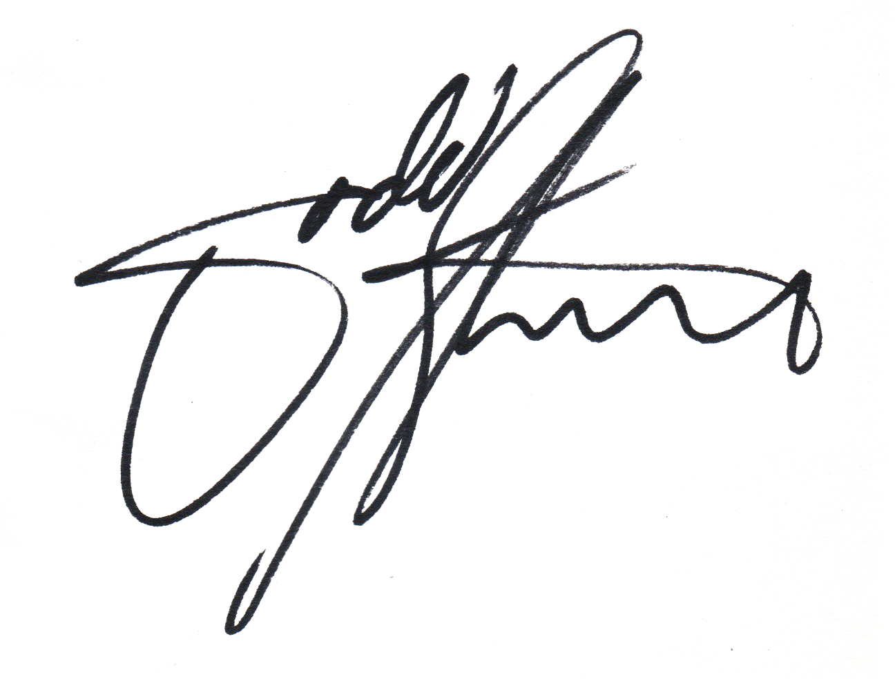

P.B.R
VISVODAYA INSTITUTE OF TECHNOLOGY AND SCIENCE
Kavali-524201.S.P.S.R.Nellore(Dt).Ph:08626-243930
IDENTITY CARD
Name : P.GEETHIKA
Course : B.Tech - ECE (LE)
Roll No : 21735A0414
Validity : 2021-2024
PRINCIPAL
This Photo by Unknown Author is licensed under CC BY-NC

Slide 3


P.B.R VISVIDAYA INSTITUTE OF TECHNOLOGY AND SCIENCE Kavali-524201.S.P.S.R.Nellore(Dt).ph:08626-243930
IDENTITY CARD
Name : P.GEETHIKA
Course : B.Tech - ECE (LE)
Roll No: 21735A0414
Validity : 2021-2024
PRINCIPAL

