Slide 1
NETGUARD Network Intrusion Detection System (NIDS) & Log Analysis Engine
Week 4 – Incident Response & Final Release
Intern: Bhima Geethika Sai Intern ID: TSH/F0E7D424 Organization: TechSkillHub Domain: Cyber Security

Slide 2
Project Architecture
NETGUARD SYSTEM ARCHITECTURE
Controlled Network Traffic / PCAP
↓
Snort IDS
↓
Custom Detection Rules
↓
Snort Alert Logs
↓
Logstash
↓
Elasticsearch
↓
Kibana
↓
Threat Monitoring
↓
Incident Response
Key Components
Wireshark – Network traffic and PCAP analysis
Snort – Intrusion detection
Logstash – Log processing
Elasticsearch – Alert storage
Kibana – SIEM visualization
NIST-aligned IR – Incident response

Slide 3
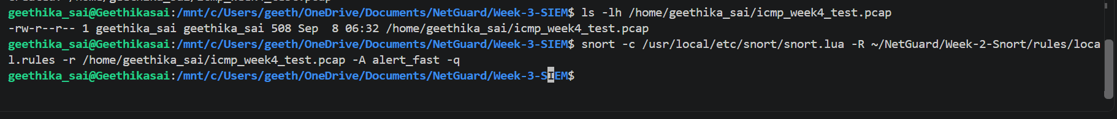
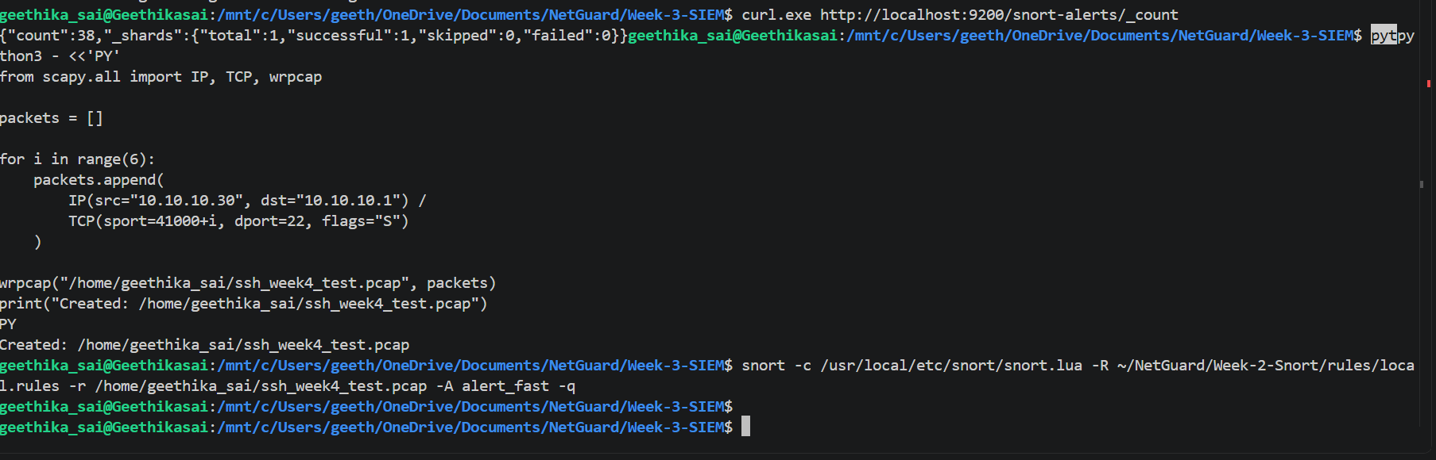
Attack Simulation & Detection
CONTROLLED ATTACK SIMULATIONS
Simulation | Source | Detection
ICMP Sweep | 10.10.10.10 | SID 1000001
TCP SYN Scan | 10.10.10.20 | SID 1000002
SSH Connection Burst | 10.10.10.30 | SID 1000003

Slide 4
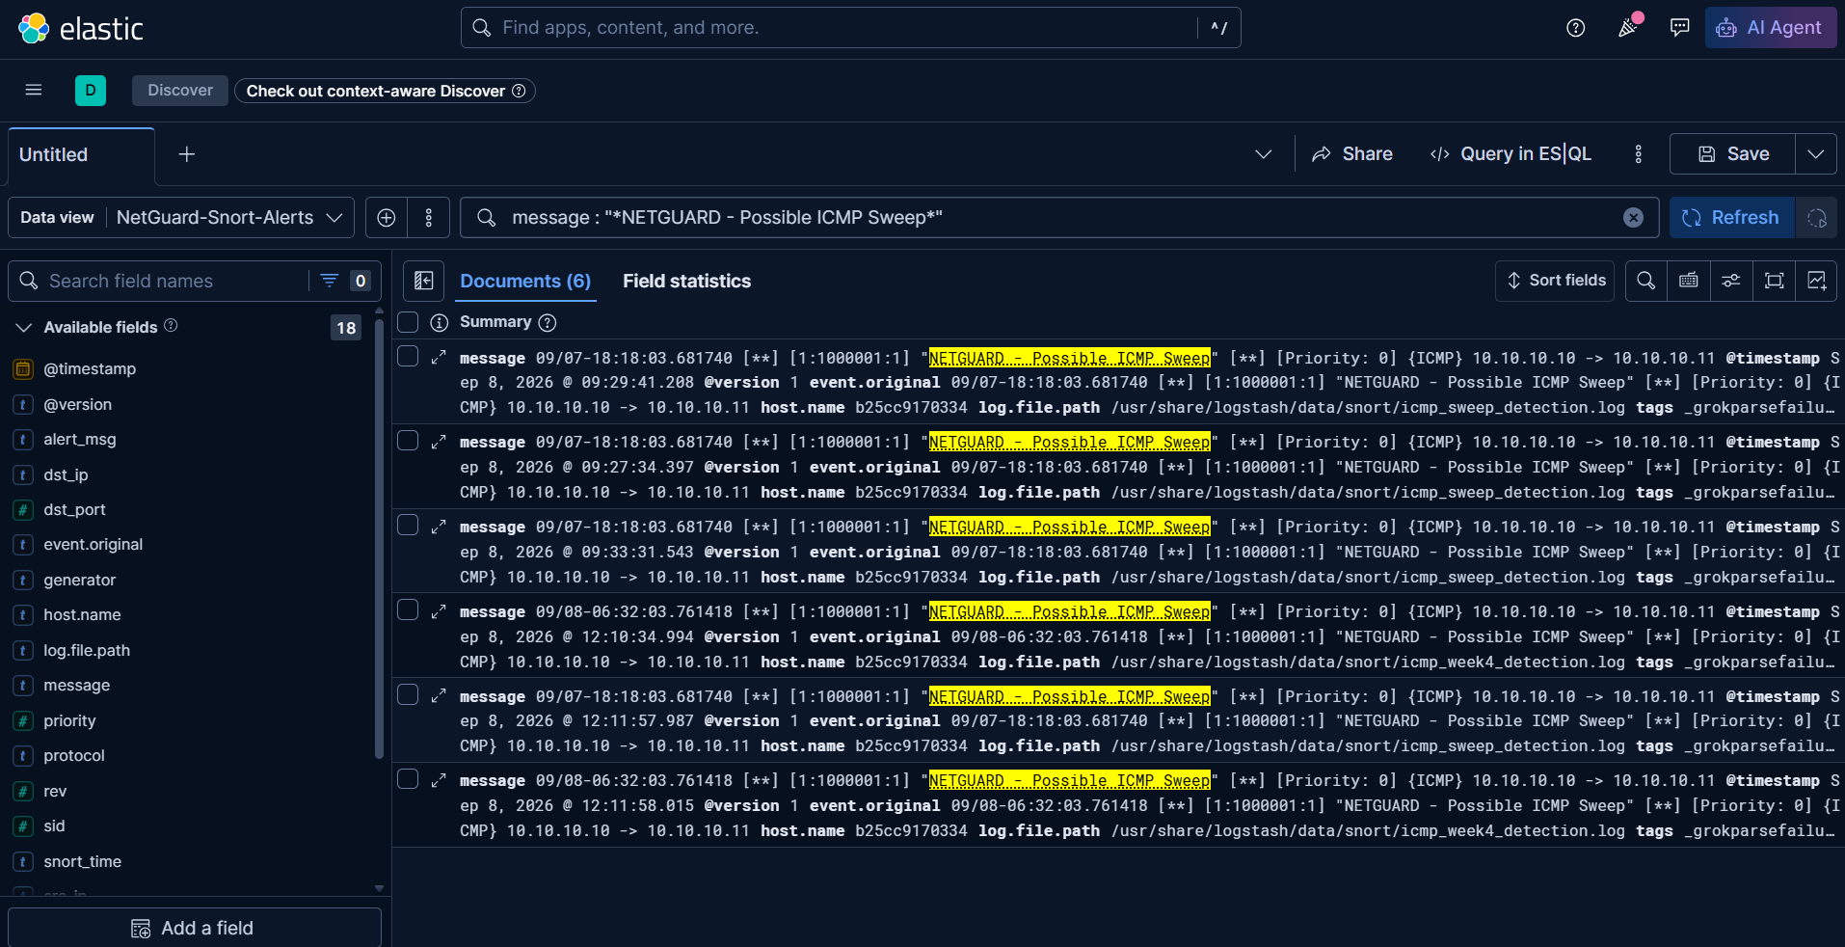
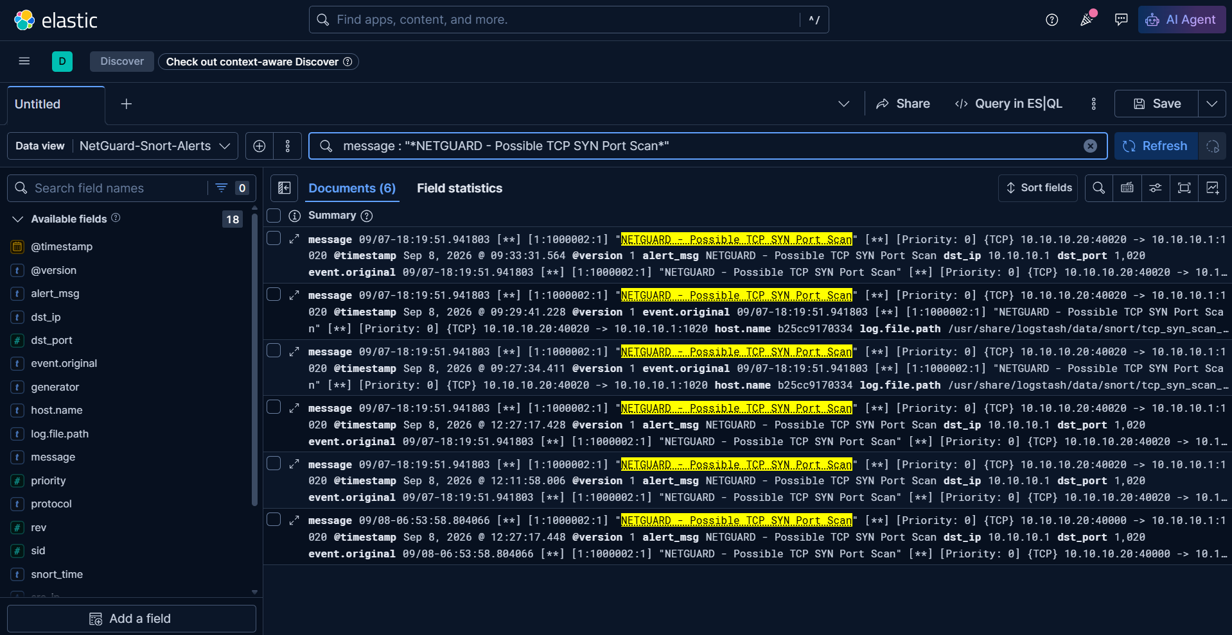
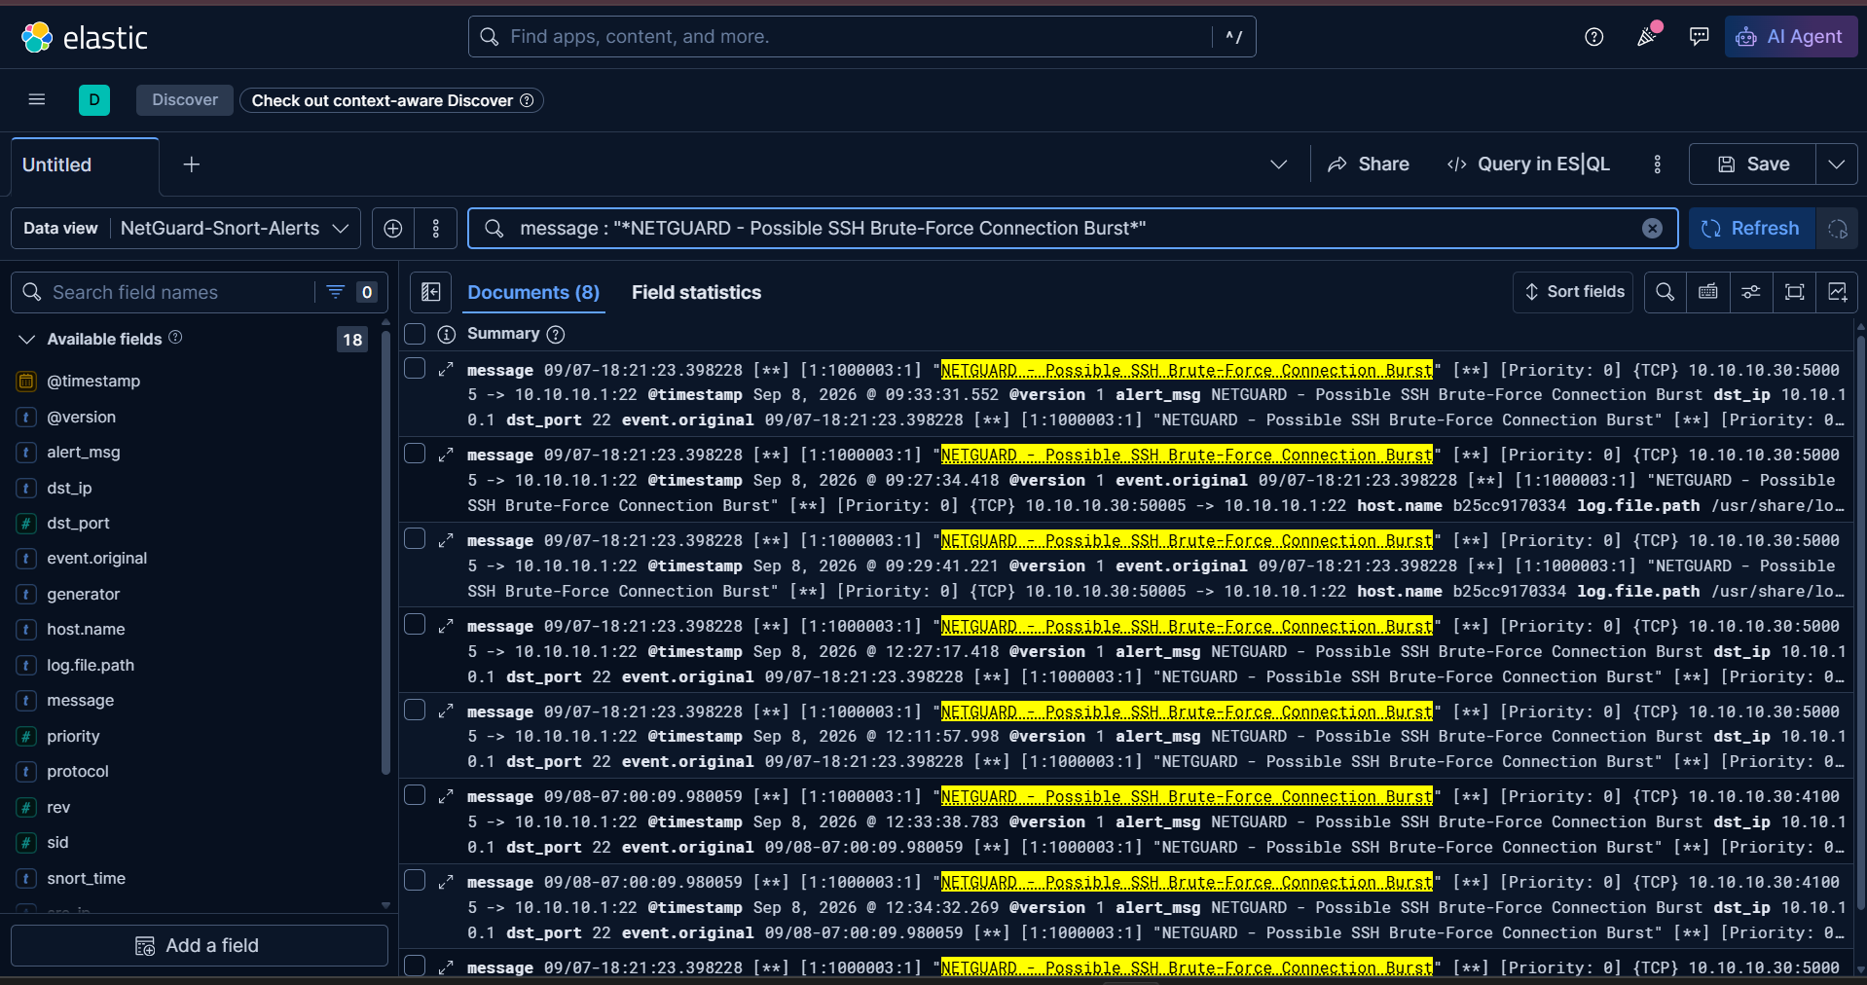
SIEM Monitoring
SIEM ALERT VERIFICATION
Snort → Logstash → Elasticsearch → Kibana
The generated alerts were successfully forwarded to the centralized SIEM and analyzed using Kibana Discover.

Slide 5
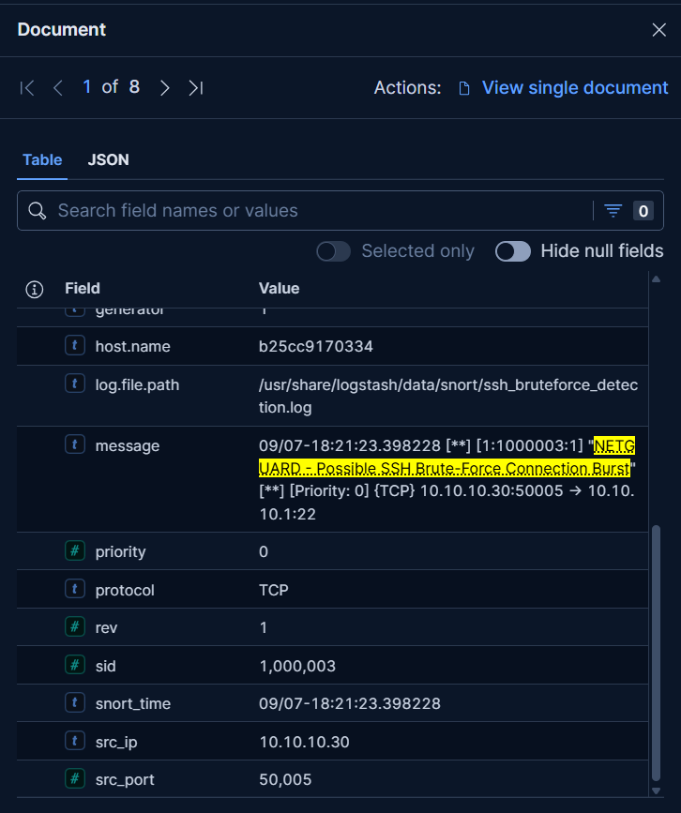
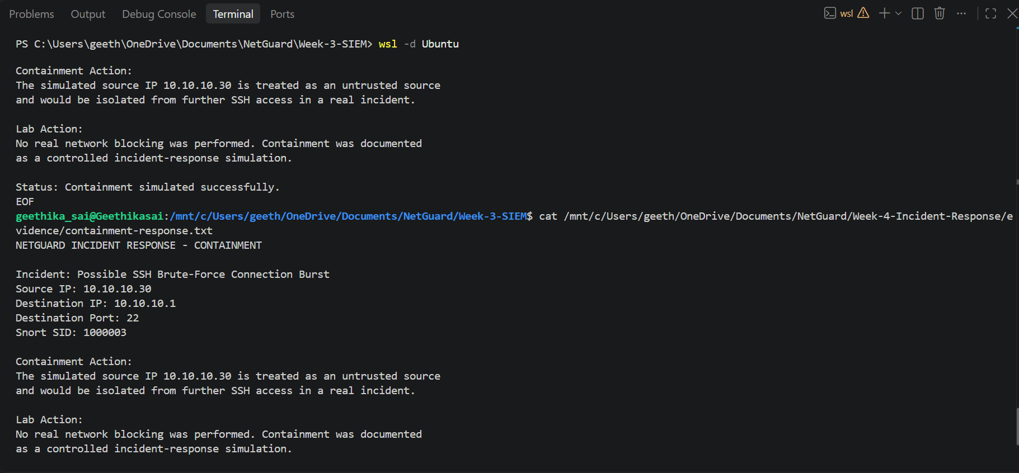
Incident Response
NIST-ALIGNED INCIDENT RESPONSE
1. Preparation
Snort and custom rules configured
ELK stack prepared
SIEM dashboard configured
2. Detection & Analysis
SSH brute-force alert detected
Source: 10.10.10.30
Destination: 10.10.10.1:22
SID: 1000003
3. Containment
Simulated source treated as untrusted
Isolation/blocking documented
No real network blocking performed
4. Eradication & Recovery
No persistent compromise established
Detection and evidence verified
5. Post-Incident Activity
Alert analyzed
Evidence preserved
Incident documented

Slide 6
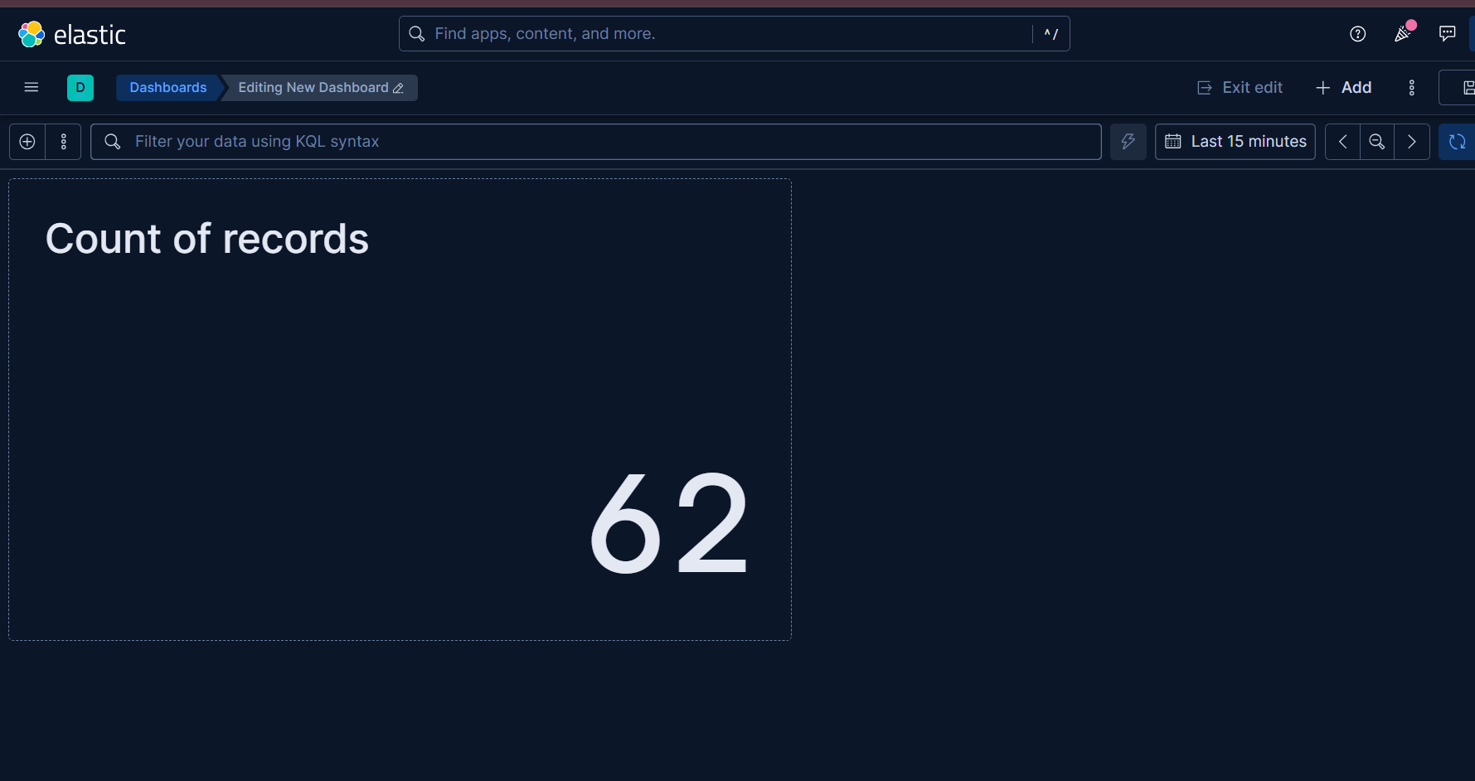
Final Results & Dashboard
RESULTS & FINAL THREAT MONITORING
ICMP sweep detection verified.
TCP SYN scan detection verified.
SSH brute-force detection verified.
Snort alerts integrated with ELK.
Kibana SIEM monitoring verified.
Incident response documented.
Final Outcome
Network Simulation → Detection → SIEM → Analysis → Response

