Slide 1
DATA-DRIVEN DECISION MAKING FOR DOLL STORE SUCCESS
BDM CAPSTONE PROJECT

Slide 2
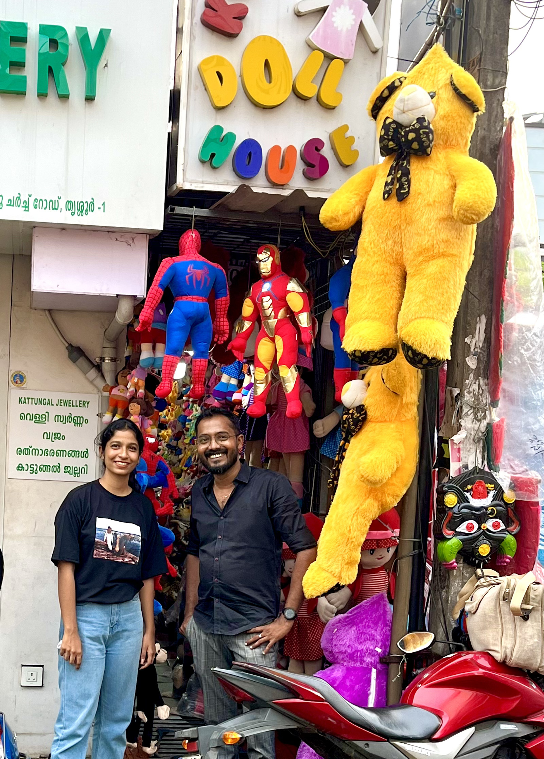
Details of organization
Kerala Doll House, located in Thrissur, sells around 600 varieties of dolls, including imported ones.
The company started functioning in 2018 and consists of five staff members.
It has both B2B and B2C Sales.

Slide 3
Problem statements
p
Stock shortages
Increased market prices
Decrease in buyers
The company faces common issues with stock shortages during the season while taking stock from different parts of the country
Stock shortages increase demand for products, leading to a hike in market prices, especially during peak seasons.
COVID-19 pandemic has significantly impacted the market and led to a decline in consumer spending.

Slide 4
PURCHASE ANALYSIS
72%
21%
.05%
41%
Teddy Dolls
Dolls
Toys
April Purchase

Slide 5
SALES ANALYSIS
37%
29%
Wholesale
Retail
Highest- April
Lowest- March
Teddy dolls- 98%
Dolls – 97%

Slide 6
PROFIT ANALYSIS
Highest
April and May is expected to grow more given it is a peak season
Lowest
March has low profits as it marks the end of fiscal year
May
March

Slide 7
results
Indian producers are currently unable to keep up with product demand. This clarifies the issues with inventory shortages and rising market prices.
The COVID-19 pandemic has had a significant impact on the market. It has caused economic uncertainty, job losses, and supply chain disruptions, leading to decreased consumer spending.

Slide 8



recommendations
STOCK SHORTAGES
Demand Forecasting
Increase inventory levels
Alternate suppliers
It accurately forecast the amount of inventory they will need on hand to satisfy demand.
The company can increase inventory levels in the run-up to the peak season.
Increasing the number of suppliers can help reduce delays and production issues.
.

Slide 9



INCREASED MARKET PRICES
Finding best prices
Think about substitutes
Better investment strategy
Search for the best deals on products and services by doing some comparison shopping.
The company might be able to locate substitutes for their current products that are less expensive.
A better investment plan would be to set aside seasonal months' profits and use them to stock up on more in-demand goods.

Slide 10



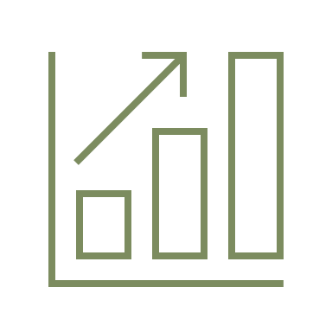
DECREASE IN BUYERS
Improve marketing
Price optimization
Discounts and promotions
Keep up with trends
This could include using different channels or creating more targeted campaigns.
Lowering prices will draw more customers.
This can be an effective method of getting people to try their products or services for the first time.
To ensure that their products or services are meeting the needs of their target market.

Slide 11
Thank you
Thank you
Thank You
Thank You
Thank you

