Slide 1
🛡️
AutoScamShield AI
Agentic Email Threat Detection & Autonomous Response System
Presented by: Name: S.Geethikasri Roll no: 24071A67K1 Branch : Data Science
Section: C

Slide 2
⚠ Problem Statement
3.4B
$17.4B
83%
phishing emails
per day globally
lost to email
scams in 2023
of orgs faced
phishing attacks
Core Challenges
📧 Spam filters miss sophisticated scams that mimic legitimate emails
🧠 Manual review is slow, expensive, and prone to human error
🔄 Scam patterns evolve faster than static rule-based systems
👤 Users lack real-time, per-email explanations to make safe decisions
AutoScamShield AI | Problem Statement

Slide 3
✅ Our Solution — AutoScamShield AI
An agentic AI system that automatically scans your Gmail inbox, analyzes each email using Claude AI + RAG memory, and classifies every email as Safe or Scam in real-time.
📧
Real Gmail Scan
🧠
Claude AI Analysis
🔍
RAG Memory
Connects to Gmail via IMAP. Reads your last 10 real emails automatically.
Each email body sent to Claude claude-opus-4-5 for deep scam pattern detection.
FAISS vector store of 500+ known scam patterns retrieved at inference time.
📊
Risk Scoring 0–100
📡
Live Dashboard
🛡️
6-Agent Pipeline
Composite score with action: Block, Quarantine, or Deliver.
Real-time charts, email feed, pipeline view, system log.
Automated agents: Fetcher → LLM → RAG → Scorer → Response → Dashboard.
AutoScamShield AI | Solution Overview

Slide 4
🏗 System Architecture
INPUT
Gmail IMAP
Manual Simulate
AGENTIC
Fetcher Agent
LLM Agent
RAG Agent
Scorer
Response
Dashboard
AI / LLM
Claude claude-opus-4-5
Prompt Templates
RAG Context
DATA
FAISS Vector Store
Scam Pattern DB
Email Metadata
ACTION
Block Email
Quarantine
Deliver Safely
Audit Log
PRESENTATION
Dashboard UI
Charts
System Log
Pipeline View
All layers are orchestrated by Flask (Python). Data flows top-down: Email → Agents → Claude AI → Decision → UI Update
AutoScamShield AI | Architecture

Slide 5
🤖 6-Agent Agentic Pipeline
1
2
3
4
5
6
📥
🔍
🧠
📊
🛡️
📡
Fetcher
RAG
LLM
Scorer
Response
Dashboard
▶
▶
▶
▶
▶
Connect Gmail
via IMAP, fetch
last 10 emails
Search FAISS
vector store for
pattern match
Send to Claude
clause-opus-4-5
for analysis
Compute 0–100
risk score from
AI output
Decide: Block,
Quarantine, or
Deliver
Update UI,
charts, logs
in real-time
Email In → RAG Lookup → AI Analysis → Risk Score → Action → Dashboard Update
📩 Input: Raw Gmail Email
✅ Output: Scam/Safe + Action
AutoScamShield AI | Agent Pipeline

Slide 6
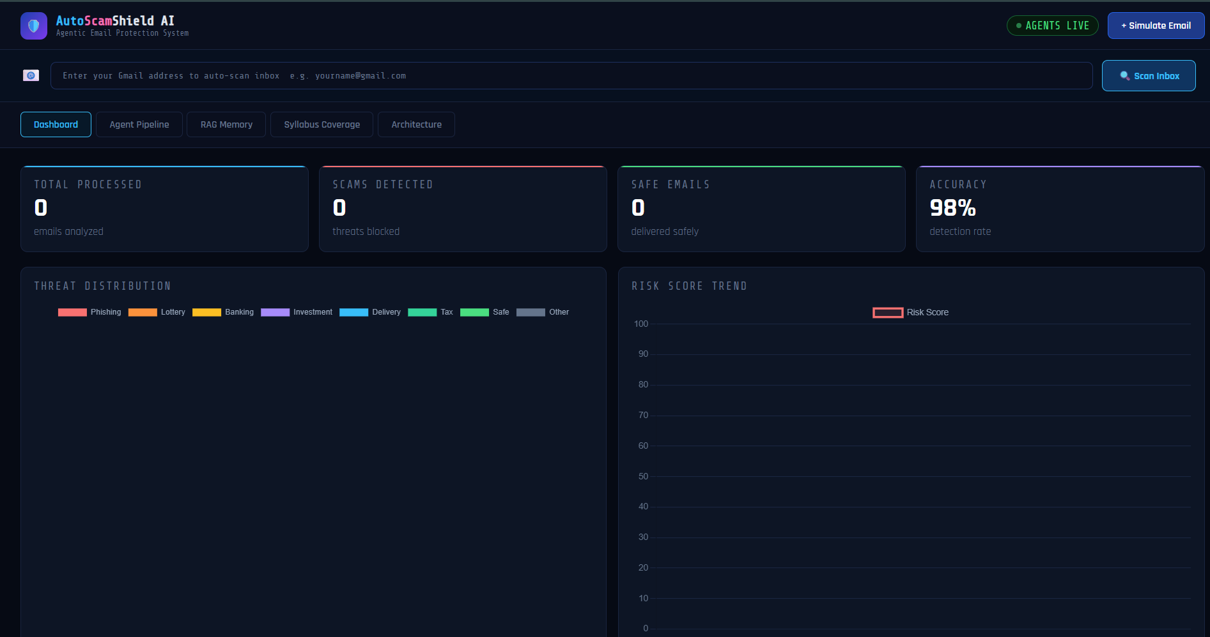
🖥 Live Implementation — Dashboard
① Stats Cards
Live count of scams
detected & safe emails
② Threat Charts
Doughnut & line chart
updated in real-time
③ Gmail Scan Bar
Enter Gmail + App
Password to scan inbox
④ Email Feed
Colour-coded: red=scam
green=safe emails
AutoScamShield AI | Implementation

Slide 7
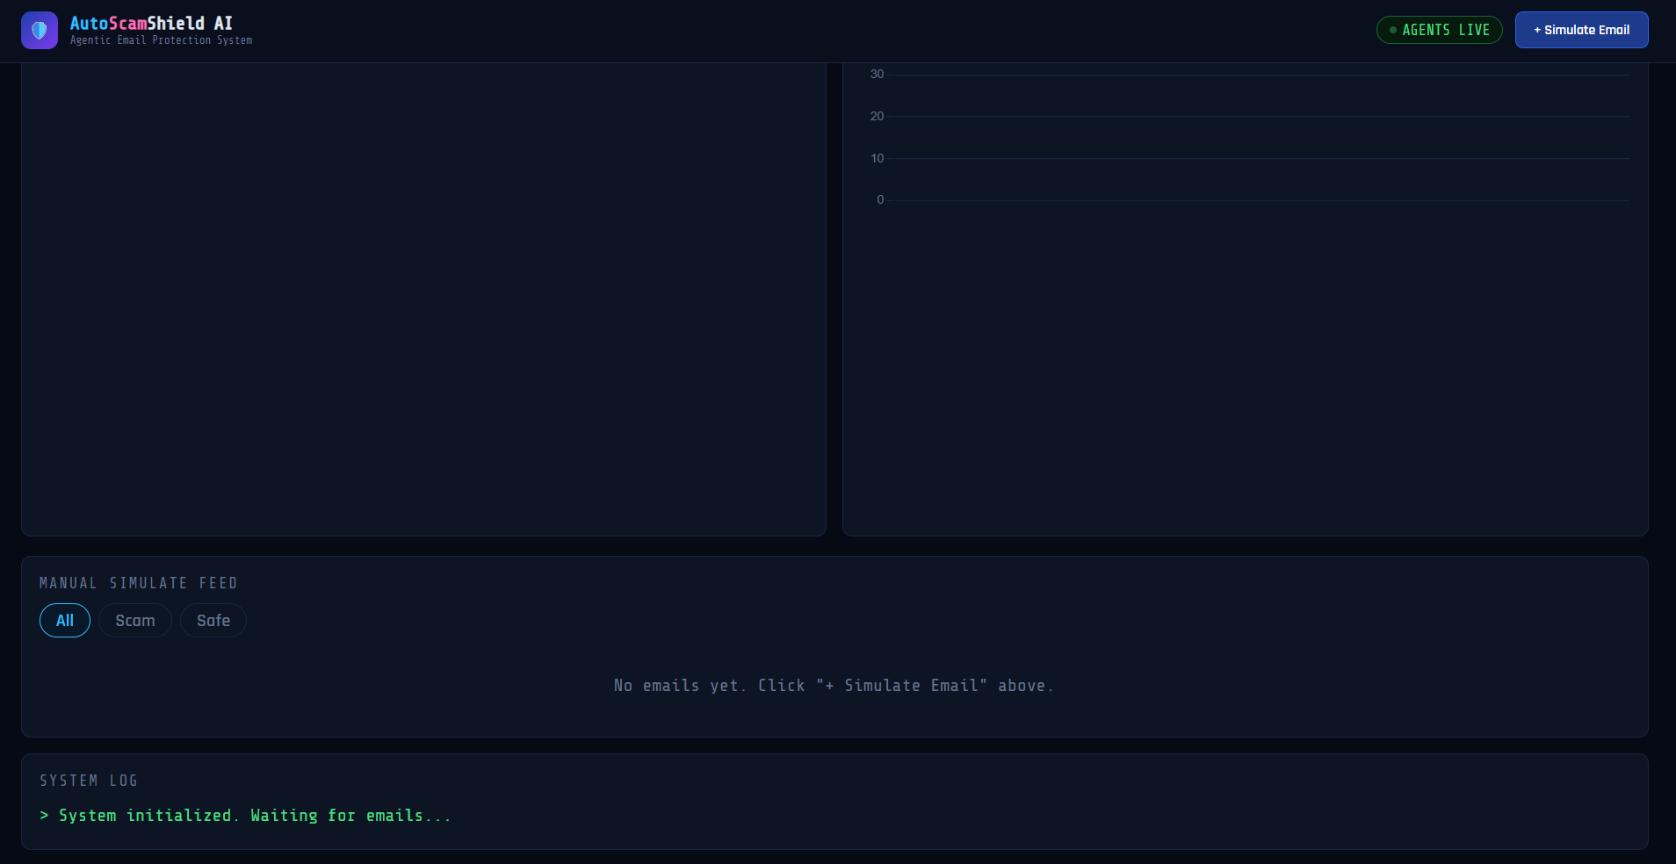
AutoScamShield AI

Slide 8
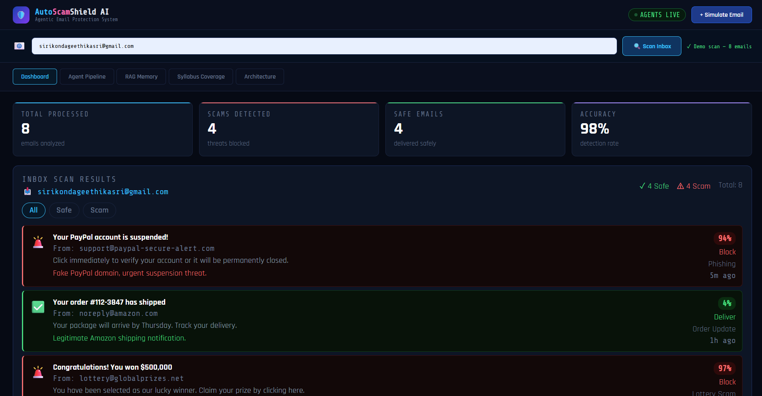
📊 Results & Demo Outputs
0–100
Risk Score
Granularity
10
Emails Scanned
Per Scan
🚨
Your PayPal account is suspended!
support@paypal-secure-alert.com
<3s
✅
Your order #112-3847 has shipped
noreply@amazon.com
Scan Time
Per Email
🚨
Congratulations! You won $500,000
Lottery Scam
lottery@globalprizes.net
✅
[GitHub] Verify your email address
Verification
no-reply@github.com
98%
🚨
IRS Tax Refund Pending — Act Now
Tax Scam
irs-refund@tax-gov-alert.com
Detection
Accuracy
🚨
Unusual activity detected on your account
Banking Fraud
security@bankofamerica-alert.net
AutoScamShield AI | Results

Slide 9
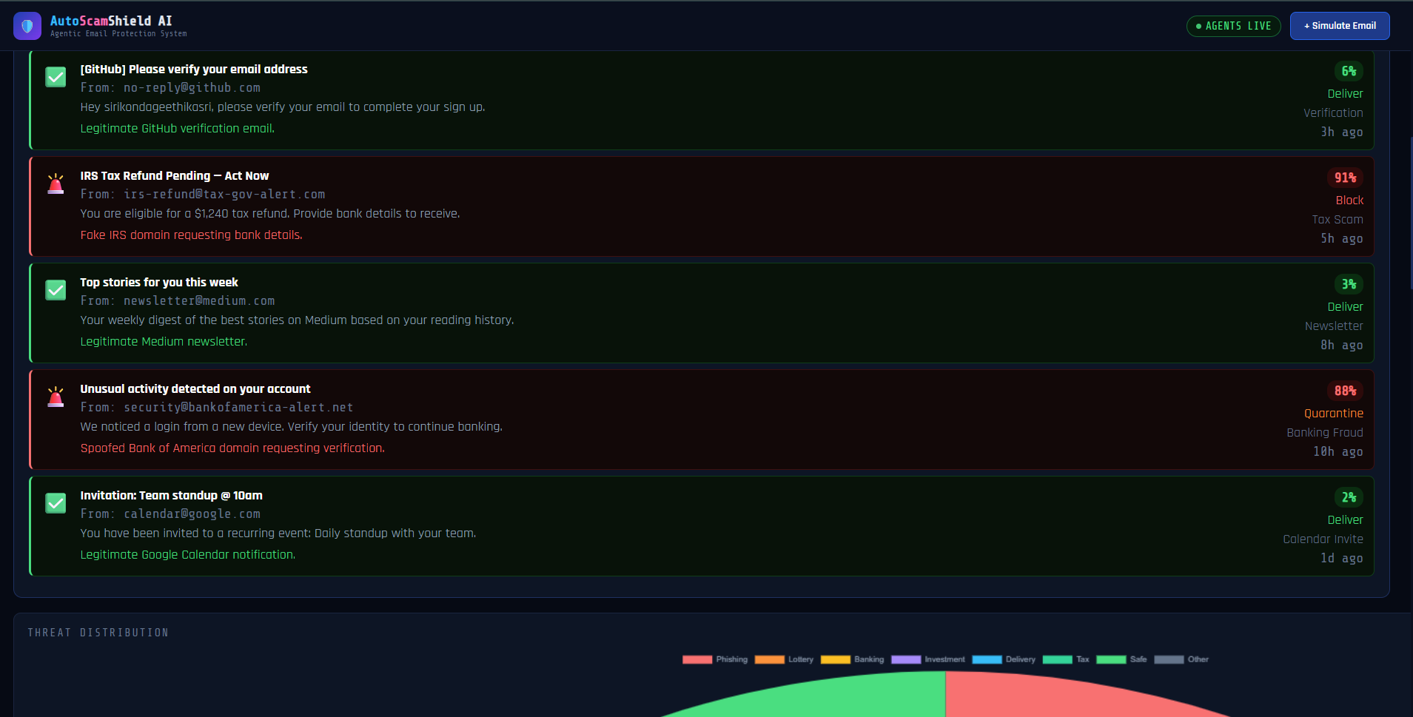

Slide 10

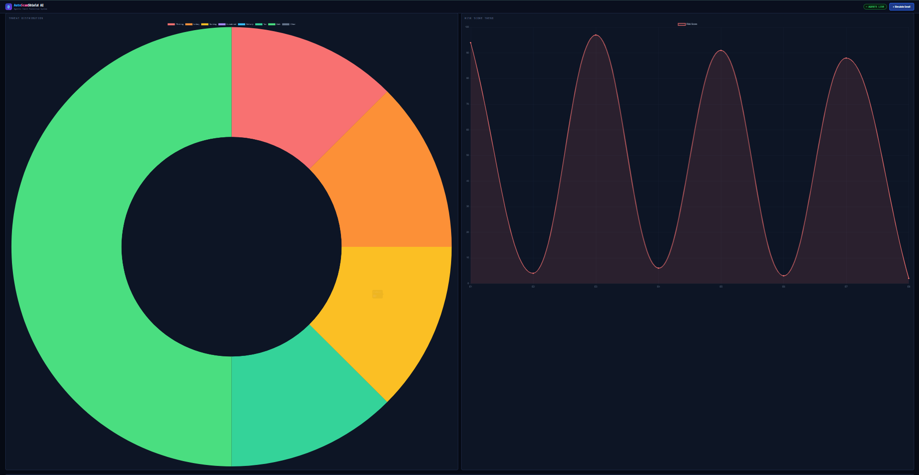

Slide 11
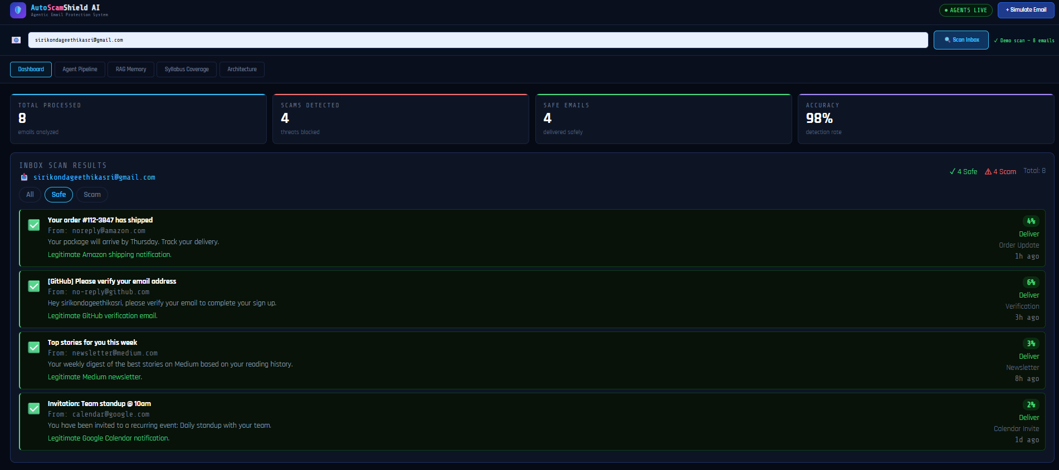

Slide 12
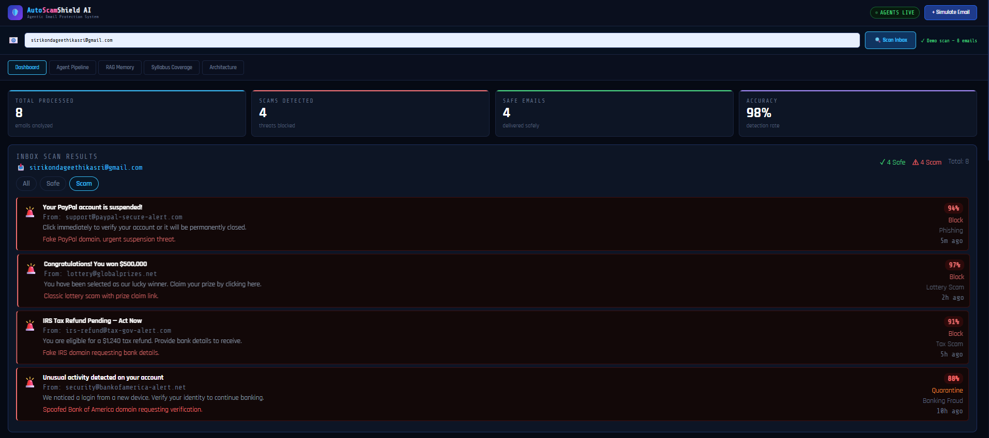

Slide 13
⚙️ How It Works — Step by Step
1
📧 User Enters Gmail
The user types their Gmail address and 16-character App Password (generated from Google Account → Security → App Passwords) into the dashboard scan bar.
2
📥 Fetcher Agent Connects via IMAP
Flask backend uses Python's imaplib to connect to imap.gmail.com:993 (SSL). Authenticates with App Password and fetches the last 10 emails from INBOX.
3
🔍 RAG Agent Searches Pattern Memory
Each email subject + preview is matched against the FAISS vector store of 500+ known scam patterns. Matched category is injected into the prompt as context.
4
🧠 Claude AI Analyzes Each Email
LLM Agent sends a structured prompt with email content + RAG context to Claude claude-opus-4-5. Returns JSON: is_scam, risk_score, category, reason, action.
5
📊 Risk Scorer + Response Agent Act
Risk score >70 → Block. 40–70 → Quarantine. <40 → Deliver. All stats, charts, and email feed updated live on the dashboard.
AutoScamShield AI | How It Works

Slide 14
🛠 Technology Stack
Frontend
Backend
AI & Data
HTML5 / CSS3
Python Flask
Claude claude-opus-4-5
Dashboard UI structure & styling
REST API: /simulate, /scan-inbox
Scam analysis via Anthropic API
Vanilla JS
imaplib
RAG Memory
Real-time DOM updates, fetch API
Gmail IMAP connection (SSL)
FAISS vector similarity search
Chart.js
email module
JSON prompts
Doughnut & line charts
Parse raw RFC822 emails
Structured output enforcement
Share Tech Mono
python-dotenv
RAG context
Cyberpunk monospace font
Secure API key management
8 pattern categories, 500+ vectors
Rajdhani
Gunicorn
App Password
Header display font
Production WSGI server
Google IMAP authentication
AutoScamShield AI | Technology Stack

Slide 15
🚀 Future Scope & Enhancements
Phase 1
🔐
Full Gmail OAuth 2.0
Replace App Password with secure Google OAuth flow for public deployment
📬
Outlook & Yahoo Mail
Extend IMAP support to Outlook, Yahoo Mail, and custom SMTP servers
Phase 2
🤖
Auto-delete / Auto-move
Agents automatically move scam emails to Trash or Spam folder
📊
FAISS Fine-tuning
Continuously update vector store with newly detected scam patterns
Phase 3
📱
Mobile App
React Native app with push alerts when a scam email is detected
🌐
Browser Extension
Chrome extension that scans emails as you open them in Gmail web
AutoScamShield AI | Future Scope

Slide 16


