Slide 1
Retail Revenue Analysis for Leadership Decision Making
Presented By
GEETHA P

Slide 2
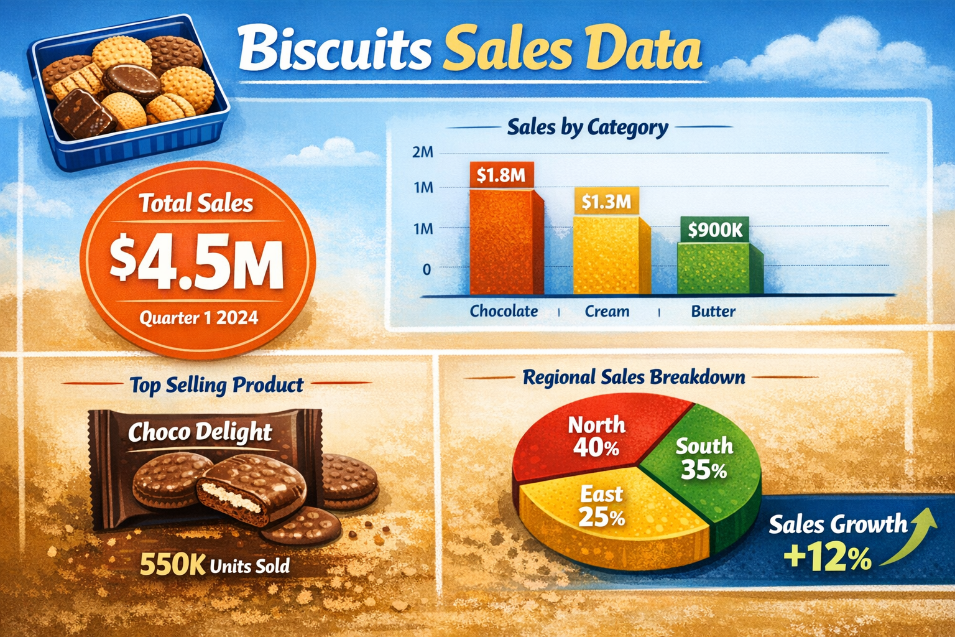

Slide 3
Product Revenue
Row Labels | Sum of Profit | Sum of Total Revenue | Sum of Profit Margin%
Britannia | 1193240 | 6562820 | 18.18%
Good Day | 312371 | 3436081 | 9.09%
Little Hearts | 5789610 | 11579220 | 50.00%
Malkist | 1163240 | 4071340 | 28.57%
Marie Gold | 589032 | 2650644 | 22.22%
Oreo | 4491830 | 8983660 | 50.00%
Parle | 633780 | 2218230 | 28.57%
Sunfeast | 594326 | 1485815 | 40.00%
Tiger | 1148924 | 6606313 | 17.39%
Unibic | 10868480 | 13973760 | 77.78%
Grand Total | 26784833 | 61567883 | 43.50%

Slide 4
REVENUE BY GENDER
Row Labels | Sum of Total Revenue | Count of Quantity Purchased
Female | 5844566 | 1131
Male | 51966838 | 10138
Other | 3756479 | 731
(blank) | 0
Grand Total | 61567883 | 12000

Slide 5
Revenue By Age
Row Labels | Sum of Total Revenue | Count of Quantity Purchased
19-28 | 9137780 | 1809
29-38 | 10001885 | 1873
39-48 | 9714535 | 1927
49-58 | 9374846 | 1928
59-68 | 9706694 | 1862
69-78 | 9995037 | 1902
79-88 | 3637106 | 699
119-128 | 0
Grand Total | 61567883 | 12000

Slide 6
Revenue By Gender and Age
Row Labels | Count of Unit Price | Sum of Total Revenue
19-28 | 1809 | 9137780
Male | 1545 | 7847118
Female | 155 | 796050
Other | 109 | 494612
29-38 | 1873 | 10001885
Male | 1596 | 8557907
Female | 156 | 731754
Other | 121 | 712224
39-48 | 1927 | 9714535
Male | 1645 | 8290287
Female | 166 | 827185
Other | 116 | 597063
49-58 | 1928 | 9374846
Male | 1611 | 7847720
Female | 208 | 1003686
Other | 109 | 523440
59-68 | 1862 | 9706694
Male | 1558 | 8050313
Female | 185 | 1099279
Other | 119 | 557102
69-78 | 1902 | 9995037
Male | 1606 | 8403296
Female | 184 | 950303
Other | 112 | 641438
79-88 | 699 | 3637106
Male | 577 | 2970197
Female | 77 | 436309
Other | 45 | 230600
119-128 |  | 0
(blank) |  | 0
Grand Total | 12000 | 61567883
Male
₹ 5,19,66,838
Female
₹ 58,44,566
Other
₹ 37,56,479

Slide 7
Top 3 Sales Representatives
Top 5 Revenue Contributors
Row Labels | Sum of Total Revenue
Travis Doyle | 23.06%
seph Hill | 22.34%
April Watkins | 19.93%
Susan Dean | 18.37%
Sara Robertson | 16.31%
Grand Total | 100.00%
Row Labels | Sum of Total Revenue | Sum of Profit | Sum of Profit%
Travis Doyle | ₹ 1,08,80,651.00 | ₹ 47,77,896.00 | 43.91
seph Hill | ₹ 1,05,39,847.00 | ₹ 46,29,281.00 | 43.92
April Watkins | ₹ 94,02,955.00 | ₹ 39,87,214.00 | 42.40
Grand Total | ₹ 3,08,23,453.00 | ₹ 1,33,94,391.00 | 43.46

Slide 8
KPI Table(Revenue By Location)
Row Labels | Count of Quantity Purchased | Sum of Profit | Sum of Total Revenue | Sum of Profit%
Antonio | 1352 | 3365775 | 7343282 | 1
Diego | 1203 | 2647105 | 6036613 | 5
Chicago | 1143 | 2377512 | 5666565 | 9
Dallas | 1164 | 2715580 | 6128566 | 3
Hous Angeles | 1259 | 2546501 | 6179951 | 10
Los Angeles | 1126 | 2702399 | 6066717 | 2
New York | 1159 | 2476447 | 5776850 | 7
Philadelphia | 1212 | 2753075 | 6315796 | 6
Phoenix | 1122 | 2406959 | 5710119 | 8
(blank) | 1260 | 2793480 | 6343424 | 4
Grand Total | 12000 | 26784833 | 61567883
Strong market in Antonio
Cost issue in Hous Angeles

Slide 9
Payment Method Analysis
Row Labels | Sum of Total Revenue | Count of Payment Method
Female | 5844566 | 1131
Cash | 1420647 | 273
Credit Card | 1454448 | 282
Debit Card | 1523141 | 274
Mobile Payment | 1446330 | 302
Male | 51966838 | 10138
Cash | 12870012 | 2533
Credit Card | 12883020 | 2507
Debit Card | 13129602 | 2543
Mobile Payment | 13084204 | 2555
Other | 3756479 | 731
Cash | 946539 | 170
Credit Card | 911474 | 189
Debit Card | 967371 | 191
Mobile Payment | 931095 | 181
(blank) | 0
(blank) | 0
Grand Total | 61567883 | 12000
Row Labels | Sum of Total Revenue
Debit Card | 15620114
Mobile Payment | 15461629
Credit Card | 15248942
Cash | 15237198
(blank) | 0
Grand Total | 61567883

Slide 10

KPI CARDS
Total Profit
₹ 6,15,67,883
₹ 2,67,84,833
Avg Profit %
Top Product
Unibic
43.50%
Timeline For Transaction Date
Top Buyer
Michael

Slide 11


