Slide 1
DIGITAL LOGIC DESIGN
8-to-3 Priority
Encoder
8 INPUTS → 3 OUTPUTS
D7
Theory • Logic Circuit • Logisim Simulation
D6
D5
ENCODER
Y₂
Y₁
Y₀
TEAM MEMBERS
D4
R. Geethika Chowdary | 2620040043
Kanamata Srikari | 2620030701
Ganugapati Venkata Sushanth Sri Ram | 2620040012
Bikkina Karunakar | 2620040038
D3
D2
D1
D0
Section: __________
Prepared for Digital Logic Design project presentation

Slide 2
01 • INTRODUCTION AND OBJECTIVE
What is an 8-to-3 Priority Encoder?
INTRODUCTION
OBJECTIVES
A priority encoder converts 8 input lines into a 3-bit binary output.
Understand priority selection
1
2
Convert the selected input to binary
If several inputs are HIGH, it selects only the highest-priority active input.
3
Design and test the circuit in Logisim
D₇ HIGHEST • D₀ LOWEST
Key idea: the highest active input wins.
02

Slide 3
02 • THEORY AND LOGIC CIRCUIT
Priority rule and logic gates
WORKING RULE
FUNCTIONAL CIRCUIT BLOCK
The highest active input wins.
D7
D6
Y₂
Y₁
Y₀
D5
PRIORITY
MASKING
Example: D₆ = 1 and D₃ = 1. D₆ wins because it has higher priority.
D4
D3
D2
Output = 110
D1
D0
NOT • AND • OR gates implement priority masking and binary encoding.
8 input lines → priority logic → 3-bit output
Simplified functional diagram; gate-level wiring is built in Logisim.
03

Slide 4
03 • CIRCUIT DESIGN IN LOGISIM
Build and test the circuit
IMPLEMENTATION STEPS
LOGISIM CIRCUIT LAYOUT GUIDE
1
Place 8 input pins D₀–D₇
D7
D6
Y₂
Y₁
Y₀
2
Add NOT, AND and OR gates
D5
AND / OR
ENCODE
D4
3
Connect priority masking logic
D3
D2
4
Add output pins Y₂, Y₁, Y₀
D1
D0
5
Use the pin tool to test inputs
Replace this guide with a screenshot of your actual Logisim circuit.
Working: higher-priority inputs mask lower inputs before the 3-bit output is generated.
04

Slide 5
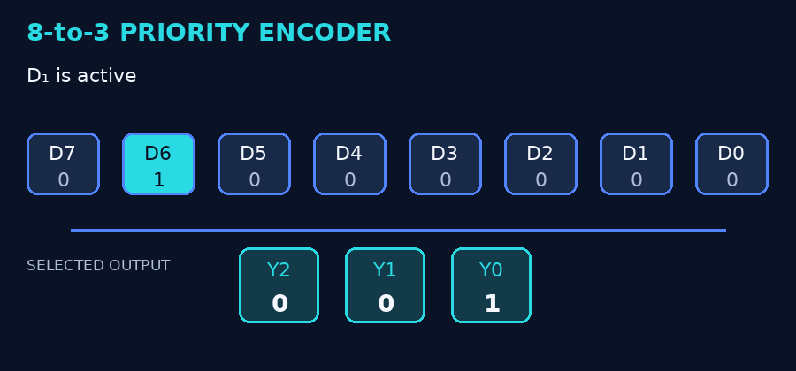
04 • SIMULATION RESULTS
Input-output combinations and truth table
EXAMPLE TEST CASES (D₇ HAS THE HIGHEST PRIORITY)
Inputs D₇…D₀ | Selected | Output | V
10000001 | D₇ | 111 | 1
01000100 | D₆ | 110 | 1
00100100 | D₅ | 101 | 1
00001010 | D₃ | 011 | 1
00000001 | D₀ | 000 | 1
00000000 | None | 000 | 0
ANIMATED EXAMPLE
When D₆ and D₃ are HIGH, D₆ wins.
Output = 110
V = 1 means at least one input is active. Capture your own Logisim tests for final submission.
05

Slide 6
05 • CONCLUSION AND APPLICATIONS
Outcome, uses, and possible improvements
CPU INTERRUPTS
BUS ARBITRATION
Select the most urgent processor request.
Choose among devices sharing a bus.
CONTROL SYSTEMS
DIGITAL SYSTEMS
Give precedence to critical signals.
Encode selected requests into binary.
Conclusion: 8 inputs are encoded into 3 bits representing the highest-priority active input.
Possible improvements: add a Valid output, test all priority cases, and extend to more inputs.
THANK YOU
06

