Slide 1

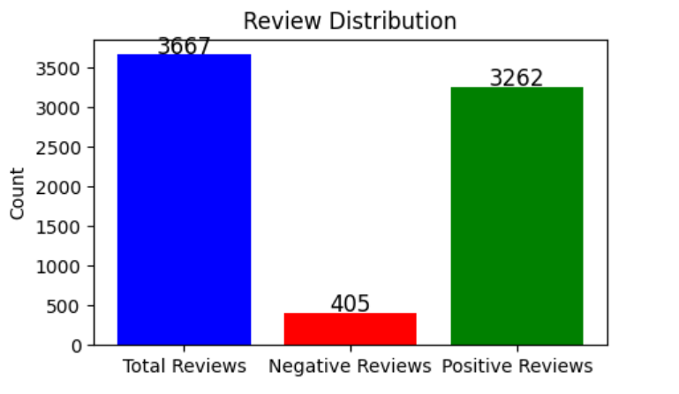
Analysed Reviews (405 Negative Reviews)
The most common concerns of those 405 Negative Reviews

