Slide 1

CN Mini Project : MQTT Broker

Slide 2
Problem Statement
Developing a MQTT Broker equivalent with the following functionalities,>
Support multiple subscribers and publishers>
Supports nested topics
Supports Authentication

Slide 3
About this Presentation
1
2
3
4
5
Introduction to MQTT
Key Features
MQTT Architecture
MQTT Message Flow
MQTT used Cases

Slide 4

Introduction to MQTT
MQTT (Message Queuing Telemetry Transport) is a lightweight messaging protocol designed for constrained devices and low-bandwidth, high-latency, or unreliable networks.
Plays a crucial role in the realm of computer networks, particularly in the Internet of Things (IoT), where it facilitates communication between device-to-device and device-to-server communication.

Slide 5
Key Features
Lightweight: Designed for efficient use of network bandwidth and system resources.
Asynchronous: Supports asynchronous communication, enabling decoupling of producers and consumers.
Reliable: Provides Quality of Service (QoS) levels to ensure message delivery.
Scalable: Scales well from small-scale deployments to large-scale IoT ecosystems

Slide 6
MQTT Architecture
Client-Server Architecture
Components
MQTT follows a client-server architecture, where clients connect to a central broker to exchange messages
Clients can act as publishers, subscribers, or both, depending on their role in the system
Broker
Clients
Topics

Slide 7
Socket Programming
Foundation for network communication.
Allows processes to communicate over a network.Involves creating sockets, binding them to specific addresses, and listening for connections.
Implementation in MQTT Broker:Utilize socket programming to establish communication between MQTT clients and the broker.
Implement socket functions for handling incoming connections, data transmission, and disconnection events

Slide 8
Secure Sockets Layer (SSL)
Secure Sockets Layer (SSL) : Protocols for securing communication over a network.Provide encryption, data integrity, and authentication.
Implementation in MQTT Broker:Integrate SSL support to encrypt data transmitted between clients and the broker.
Secure communication channels to prevent eavesdropping and data tampering

Slide 9
Protocol Details
MQTT Protocol Overview:
Publish-Subscribe messaging pattern.
Quality of Service (QoS) levels for message delivery assurance.
Topics for organizing messages.
Advanced Protocol Features:Extended to support nested topics.
Implementation of authentication mechanisms within the protocol

Slide 10
MQTT Communiction Model
Publish/Subscribe Model:
MQTT operates on a publish/subscribe messaging pattern, where publishers send messages to specific topics, and subscribers receive messages based on their topic subscriptions.
This decoupled model allows for flexible communication between devices without direct connections.

Slide 11
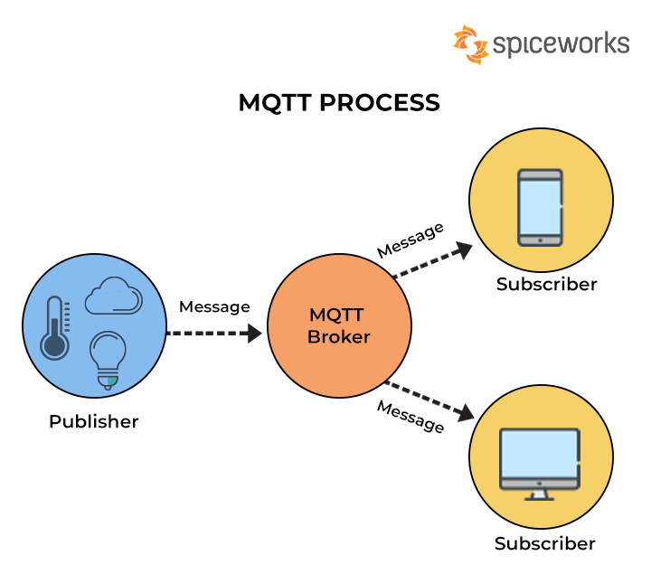
MQTT Message Flow Diagram

Slide 12
Components
Broker: The central hub that receives messages from publishers and routes them to subscribers based on topic subscriptions.
Clients: Devices or applications that connect to the broker to publish or subscribe to topics.
Topics: Logical channels through which messages are exchanged. Clients subscribe to specific topics to receive relevant messages.

Slide 13
MQTT used Cases
IOT applications
Smart Home Automation
Industrial Automation and Control
Environmental Monitoring
Healthcare

Slide 14
Thank You

