Slide 1
INTRODUCTION
S&P 500 is a market index that represents the performance of 500 companies and accurate representation of the US economy.
S&P 500 stock market return is the percentage change in the value of the S&P 500 index over a specific period.
The prediction of stock returns holds significant importance for market participants.
But it is a challenging task due to
Complexity
Dynamic nature
Uncertainty
Machine Learning (ML) models have gained popularity to predict S&P 500 market returns.

Slide 2
OBJECTIVES
The main objective is to compare ML models’ ability to forecast S&P 500 stock market returns based on the performance and evaluation metrics.
In this study, two ML models are compared namely,
Support Vector Machine (SVM) - can efficiently capture complex and non-linear relationships between input features and output feature.
Long Short Term Memory (LSTM) - to handle sequential data with time dependencies and can capture long-term dependencies and non-linear patterns.
To determine advantages of each model.
Notes:
To compare performance

Slide 3
METHODOLOGY
Data Collection
Data preprocessing
Model Selection
Model Training
Model Evaluation
-Historical data (OHLC), macroeconomic data and news data were collected.
From the beginning of 2018 to the beginning of 2023 with a daily frequency.
Preparing raw data to suit for training by handling any anomalies (missing values, categorical values, feature scaling and selection).
Dividing preprocessed data into training and test sets.
For SVM, support vector regression was used with a polynomial kernel.
For LSTM, sequence generation was done with hyperparameter tuning.
Training dataset was used to train the model with the best hyperparameters.
Predictions were done on separate test dataset and graphs were plotted.
Mean Square Error (MSE) and Mean Average Error (MAE) were calculated to evaluate the model’s performance.
Notes:
General methodology, datasets were preprocessed to suit for each ML model.

Slide 4
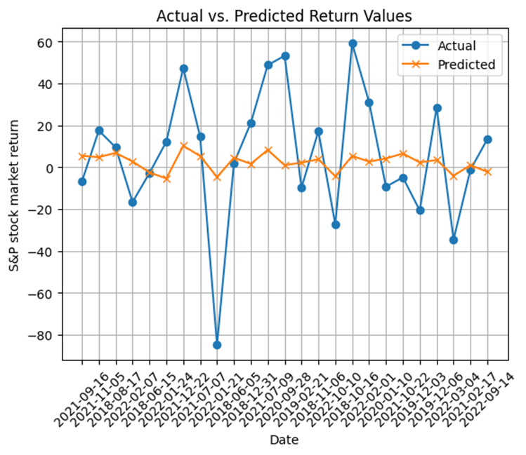
RESULTS
SVM model,
Mean Squared Error: 1790.62
Mean Absolute Error: 28.78
Can see a considerable difference between predicted and actual values.
In some days, have not identified the positive negatives aspects of return values.
Notes:
Accuracy is not that good, but can be improved by having more input features(which can affect return MA, news).
Therefore, model was improved considering those factors - next slide

Slide 5
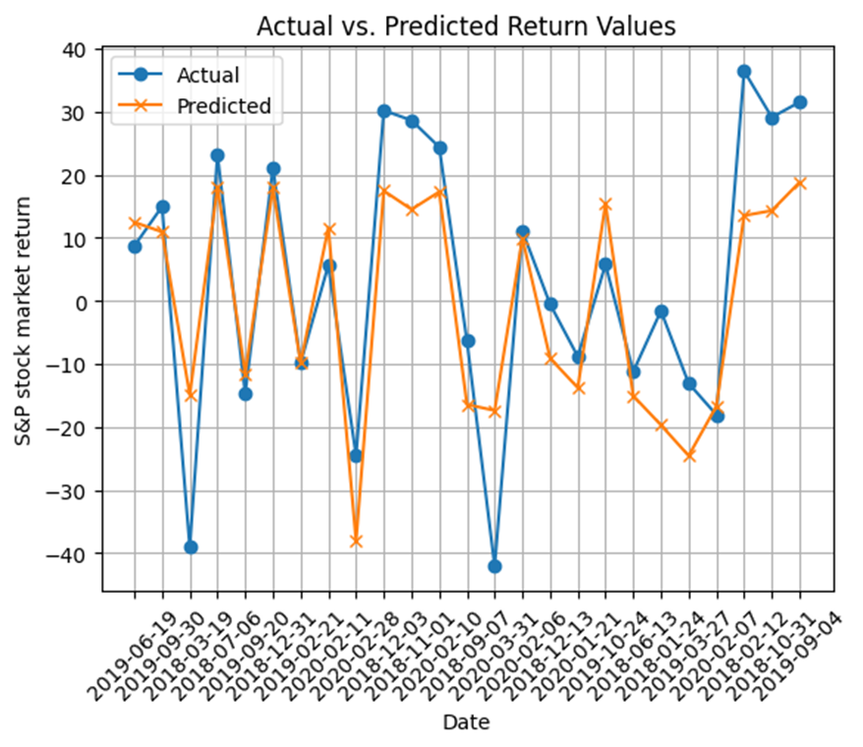
RESULTS Cont.
Improved SVM model,
Mean Squared Error: 415.98
Mean Absolute Error: 13.93
Performed well with low MAE and MSE values.
Small difference between predicted and actual values compared to previous model.
Have identified the positive negatives aspects of return values correctly.
Notes:
Showed the best performance out of 3

Slide 6
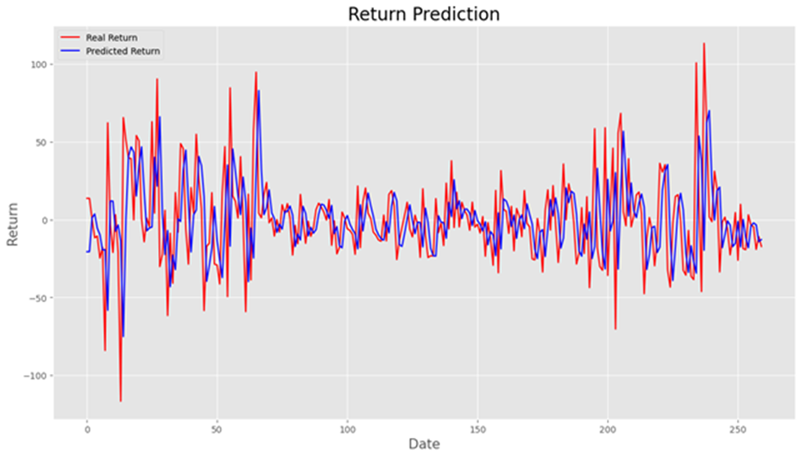
RESULTS Cont.
LSTM model,
Mean Squared Error: 1306.26
Mean Absolute Error: 25.87
Has performed well though univariate time series prediction is done based on the close prices of stocks.
Notes:
Good performance. According to research papers multivariate LSTM models have greater accuracy when compared with univariate LSTM model

Slide 7
CONCLUSIONS
Improved SVM is the best-performing model in terms of both metrics as it has the smallest overall errors in its predictions compared to the other models.
SVM model performance can be improved by considering external factors such as news events, and economic indicators.
The improved SVM model has exhibited superior predictive performance in identifying the positive and negative aspects of return values compared to the SVM model.
LSTM model has performed well even when considering the univariate time series (without considering additional features).

