Slide 1
Cloud Intrusion Detection Method Based on Stacked Contractive Auto-Encoder and Support Vector Machine
IEEE TRANSACTIONS ON CLOUD COMPUTING, VOL. 10, NO. 3, JULY-SEPTEMBER 2022
Wenjuan Wang , Xuehui Du , Dibin Shan, Ruoxi Qin, and Na Wang
PPT BY
GEETIKA T K
2021115035

Slide 2
OBJECTIVES
Enhance cloud security.
Develop an intrusion detection system.
Address data complexity.
Utilize deep learning.
Introduce the SCAE method.
Combine SCAE with SVM classification.
Optimize detection performance.
Validate the methodology.

Slide 3
INTRODUCTION
Cloud computing faces security threats, making intrusion detection vital.
Traditional methods struggle with complex network traffic.
Deep learning, especially SCAE, offers promise for better detection.
The study aims to use SCAE-SVM for automatic feature extraction.
The paper reviews challenges, proposes the model, and discusses results.

Slide 4
EXISTING SYSTEM
Studies have explored various deep learning methods for intrusion detection, using datasets like KDD Cup 99 and NSL-KDD.
Approaches include DNN, DBNþSVM, AE, STL, and NDAE combined with RF, applied to both datasets.
Private or public datasets like UNB ISCX IDS 2012 and CTU-13 have also been used, with methods like RNN-LSTM, SDAE, and DCAE.

Slide 5
PROPOSED SYSTEM
The proposed system introduces a novel SCAE-based method for intrusion detection, aiming to leverage deep learning techniques.
It combines SCAE with SVM for feature extraction and classification, capitalizing on the strengths of both deep and shallow learning.
A cloud intrusion detection system (CIDS) is designed, utilizing SDN for collecting virtual network traffic and implementing the SCAEþSVM model.
Evaluation on established datasets demonstrates the effectiveness of the proposed system, with improvements in detection performance compared to existing models.

Slide 6
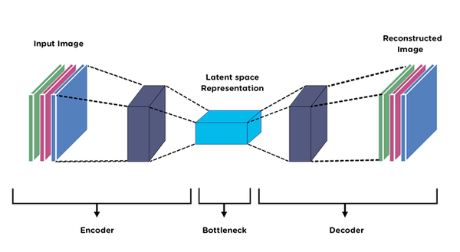
Autoencoder (AE)
Unsupervised feature dimensionality reduction technique.
Structure includes encoder and decoder, with input, hidden, and output layers.
Encoder reduces dimensionality, decoder reconstructs.

Slide 7
Training dataset D has n samples, each with a d-dimensional feature vector x and class label y.
Encoder function f maps input x to hidden representation h, decoder function g maps h back to reconstruction z.
Compression occurs when hidden layer neurons are fewer than input/output neurons (dh<dx), achieving dimensionality reduction.
Encoding and decoding processes defined mathematically.
Parameters include weight matrices w and w', bias values b and b'.

Slide 8
Goal is to minimize reconstruction error (JAE) between input x and output z by adjusting parameters.
Loss function L measures reconstruction error, typically mean squared error or cross-entropy loss.
Smaller reconstruction error indicates effective feature representation.
Problem: Output may become identical to input, hindering feature extraction.
Strategies like constraint representation or noise corruption address this issue.

Slide 9
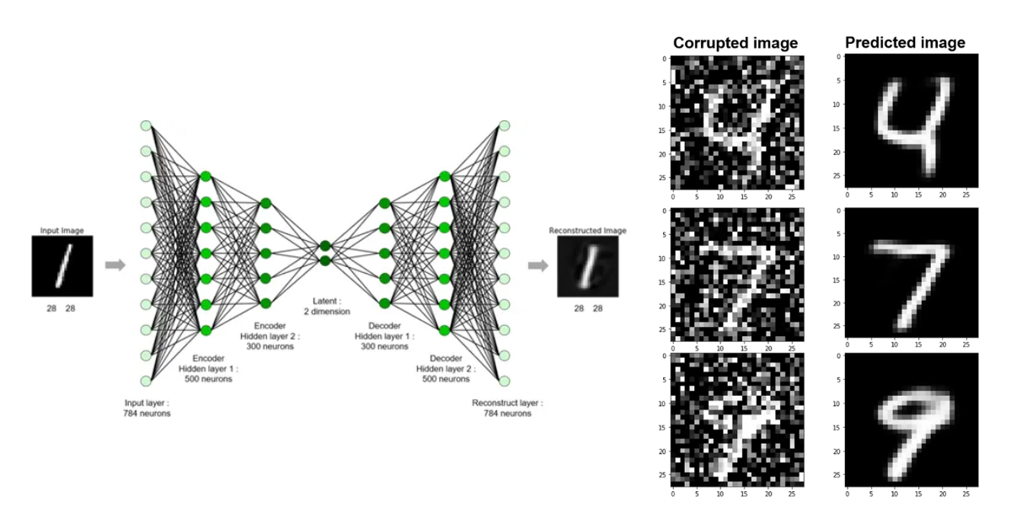
DENOISING AUTOENCODER (DAE)
A variant of the conventional autoencoder.
Aims to learn more effective and robust feature representations from corrupted input data x^.

Slide 10
First corrupts input x, then sends corrupted data x^ into the autoencoder for denoising, and finally reconstructs the clean version x.
Objective function JDAE is defined as the sum of reconstruction errors over corrupted input data.
Expectation is taken over corrupted versions x^ of samples x obtained from a corruption process q(x^|x).
Common corruption approaches include additive isotropic Gaussian noise (GS) and binary masking noise (M).

Slide 11
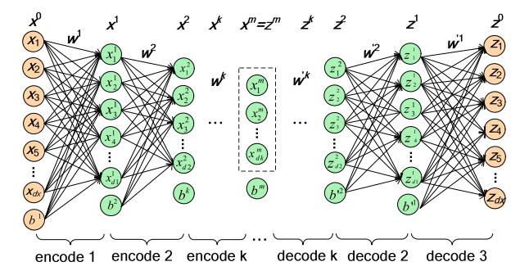
CONTRACTIVE AUTOENCODER (CAE):
Aims to learn robust feature representations.
Differs from DAE by adopting regularization for robust feature learning.
Objective function JCAE consists of the sum of reconstruction errors and a penalty term.

Slide 12
The penalty term is based on the Frobenius norm of the Jacobian matrix, representing the partial derivative of hidden features with respect to weights.
Activation functions like sigmoid are used for computing the penalty term.
The penalty term suppresses minor perturbations in input data, ensuring locally invariant feature learning.
Overall computational complexity is O(dx dh), where dx and dh are the dimensions of input and hidden representation respectively.

Slide 13
PROPOSED METHODOLOGY
Develop a Stacked Contractive Autoencoder (SCAE) for feature learning.
Train SCAE in three phases: pretraining, unrolling, and fine-tuning.
Implement Support Vector Machine (SVM) for multiclass anomaly detection, using the One-Versus-All (OVA) approach.

Slide 14
CLOUD INTRUSION DETECTION SYSTEM BASED ON SCAE AND SVM
Utilizing Software-Defined Networking (SDN) technology, the CIDS architecture comprises data, control, and application planes. The anomaly detection application within the application plane is pivotal. It preprocesses data, trains the SCAEþSVM model, and performs attack recognition.
Data collection from the Xen cloud platform is facilitated by an OpenFlow Virtual Switch (OVS) and a Network Controller (NC). OVS forwards virtual network flow, while NC is responsible for routing control and network flow collection.

Slide 15
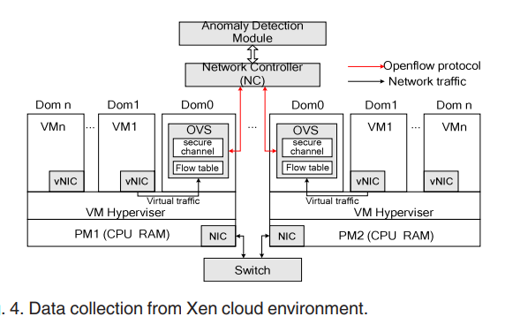
Data preprocessing involves transforming nominal features into numeric values and standardizing feature values using the Z-score method. This process ensures fair scaling and eliminates bias in favor of certain features.

Slide 16
The SCAEþSVM classifier is the core component. It extracts essential features from raw network traffic using SCAE, which is pretrained in an unsupervised manner and fine-tuned through supervised back-propagation. The SVM classifier, utilizing the One-Versus-All (OVA) approach, distinguishes between normal and abnormal data based on the extracted features.
During attack detection, the trained SCAEþSVM classifier is deployed to detect testing data or online traffic. Output from the classifier indicates whether data is normal or an attack (e.g., DOS, Probe, R2L, U2R). This enables the labeling of traffic accordingly, facilitating efficient network security management.

Slide 17

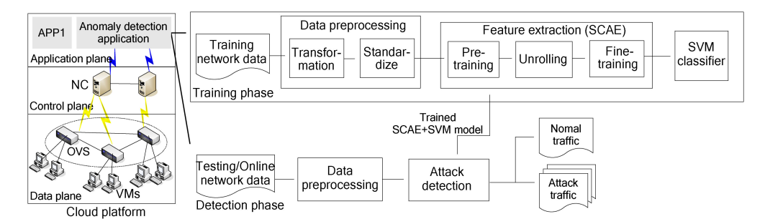

Slide 18
EXPERIMENTAL RESULTSAND ANALYSIS
Dataset: Two widely used intrusion detection evaluation datasets, namely KDD Cup 99 and NSL-KDD, were employed in the experiments. These datasets contain various types of attacks, such as DOS, Probe, R2L, and U2R.
Experimental Design: Two sets of experiments were conducted to evaluate the effectiveness of the proposed SCAEþSVM model. The first set focused on verifying the ability of SCAE to extract essential features and achieve dimensionality reduction. The second set aimed to assess the detection performance of the SCAEþSVM model in comparison to other state-of-the-art approaches.

Slide 19
EXPERIMENTAL RESULTS
The SCAEþSVM model demonstrated superior performance in terms of accuracy, precision, recall, and f-measure across various classification tasks, including 2-class, 5-class, and 13-class classification, on both NSL-KDD and KDD Cup 99 datasets.
The SCAEþSVM model outperformed standalone shallow SVM and achieved better or at least comparable results compared to other deep learning methods, such as SAEþSVM and SDAEþSVM.
The model showed stable and satisfactory detection performance across different numbers of attack categories, demonstrating its scalability and effectiveness in identifying different types of attacks.

Slide 20
Metrics and Analysis: Various metrics, including accuracy rate, precision rate, recall rate, f-measure, confusion matrix, and receiver operating characteristic (ROC) curve, were used to evaluate the detection performance. The SCAEþSVM model consistently achieved high scores in these metrics, indicating its robustness and reliability in intrusion detection.

Slide 21
CONCLUSION
The experimental results confirm that the SCAEþSVM model effectively combines the feature learning capabilities of SCAE with the classification power of SVM, leading to improved intrusion detection performance in cloud environments. The model's ability to accurately identify different types of attacks and its stability across various classification tasks highlight its potential for practical deployment in real-world scenarios.

Slide 22
REFERENCES
LINK: https://ieeexplore.ieee.org/document/9112664
TensorFlow Documentation: https://www.tensorflow.org/
Hinton, G. E., & Salakhutdinov, R. R. (2006). Reducing the dimensionality of data with neural networks. Science, 313(5786), 504-507.
Cortes, C., & Vapnik, V. (1995). Support-vector networks. Machine learning, 20(3), 273-297.

