Slide 1
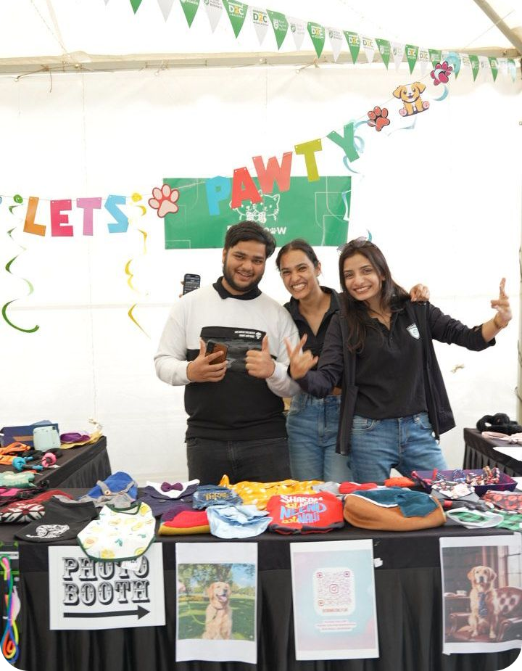

Building and Scaling a D2C Business
D2C SESSION
Lessons from our own stall at D2C Bazaar
Notes:
Welcome. A short D2C story from our own stall at D2C Bazaar, structured around the four parts on the next slide. About 25-30 minutes, questions welcome.

Slide 2

Session Overview
1
My D2C Journey
Experiences, challenges, learnings, advice for C3
2
Sales Channels & Growth
Where to sell, and how to scale profitably
3
Understanding Customers
Their needs, finding them, tailoring the pitch
4
Pricing & Profitability
Pricing that balances growth and profit
Notes:
Four parts, roughly 6-7 minutes each. Everything comes from what we saw and did at the stall.

Slide 3


What is D2C?
Direct-to-Consumer: the brand sells straight to the customer, with no middleman.
No middleman
Brand
Customer
Notes:
Keep to a minute. Ask the room for D2C brands they know.

Slide 4
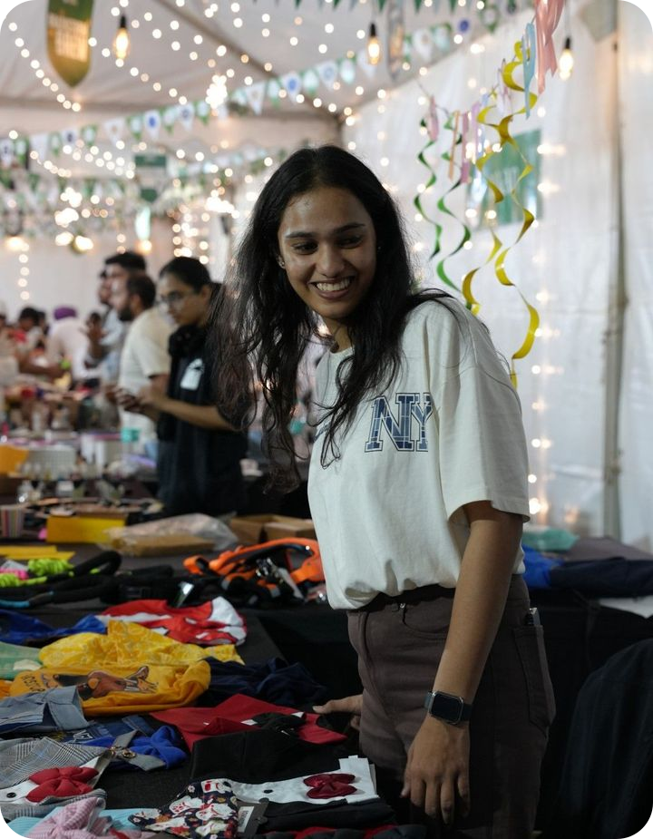
Our Stall at D2C Bazaar
1
MY D2C JOURNEY
Pet clothes, accessories and combos, sold face to face.
1
No brand, so we pushed
2
Customers are not consumers
3
Never leave value on the table
Notes:
Set the scene: the stall, the products, the crowd. Preview the three learnings that follow.

Slide 5
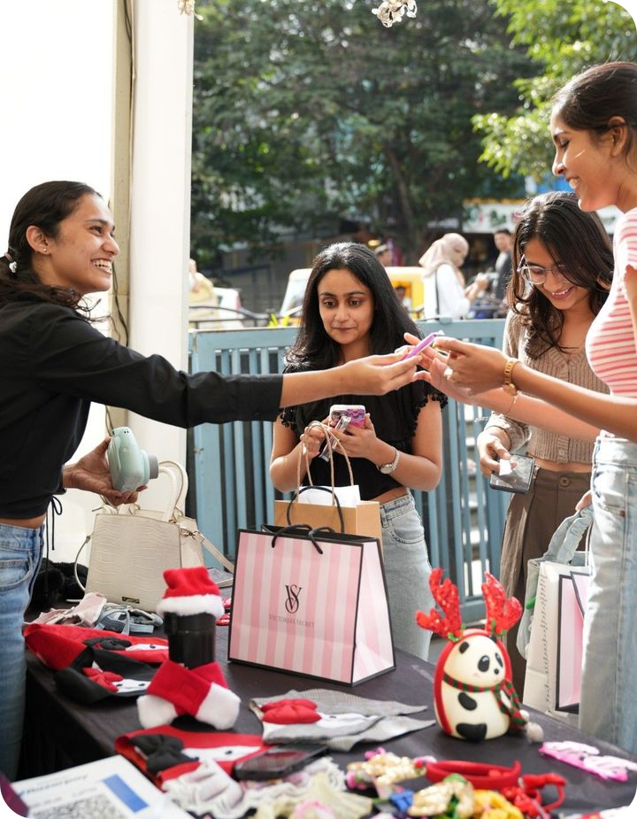
No brand to pull, so we had to push
1
MY D2C JOURNEY
Nobody came looking for us. We took the product to them.
Notes:
Nobody knew our name, so no one walked up looking for us. We had to put the product in people's hands.

Slide 6


Pull vs Push
PULL
PUSH
Customers come to you.
A known brand does the selling: ads, reviews, word of mouth.
You go to the customer.
You do the selling: in person, product in hand.
Without a brand, push was our only option.
Notes:
Pull scales, push takes effort, but it is how a new brand starts. Pushing also showed us what people actually react to.

Slide 7
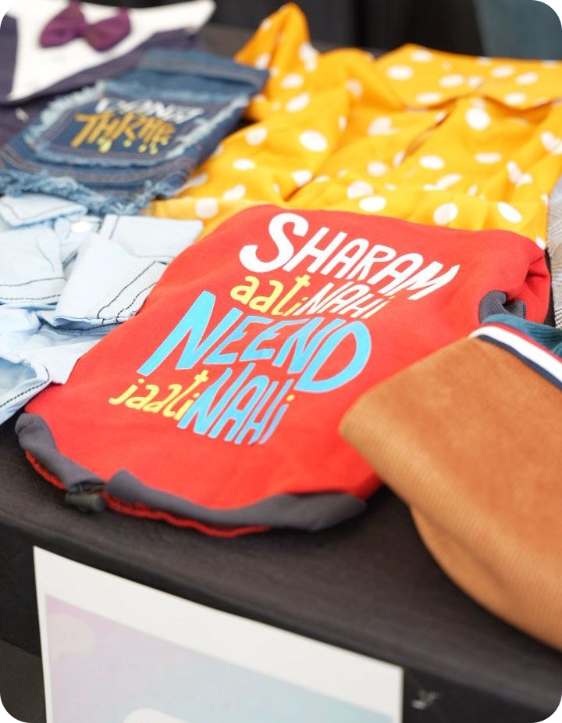

Sales Channels & Growth
2
SALES CHANNELS
Sell where customers are. Scale what pays.
Offline: our stall, face to face
Online: Instagram (QR on table)
Notes:
Our channel was the stall. The QR on the table points people to Instagram. Add your own channel numbers or examples here and talk about what to add next and what it costs.

Slide 8
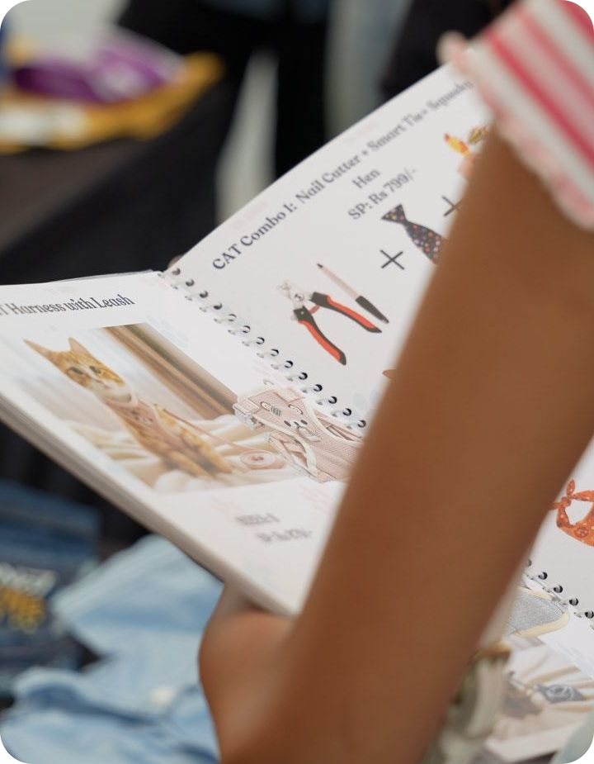
Our customers are not our consumers
3
CUSTOMERS
The one who pays is not the one who uses.
Notes:
Our products are for pets, but pets do not walk up to a stall or pay. Someone else decides.

Slide 9
Who Pays, Who Uses
OUR CUSTOMER
OUR CONSUMER
The pet parent
The pet
Pays and decides
Wears and uses
Win the parent. Delight the pet.
Notes:
Where else is the buyer different from the user? Kids' products, gifts, B2B tools. Speak to the buyer, still make something the user loves.

Slide 10
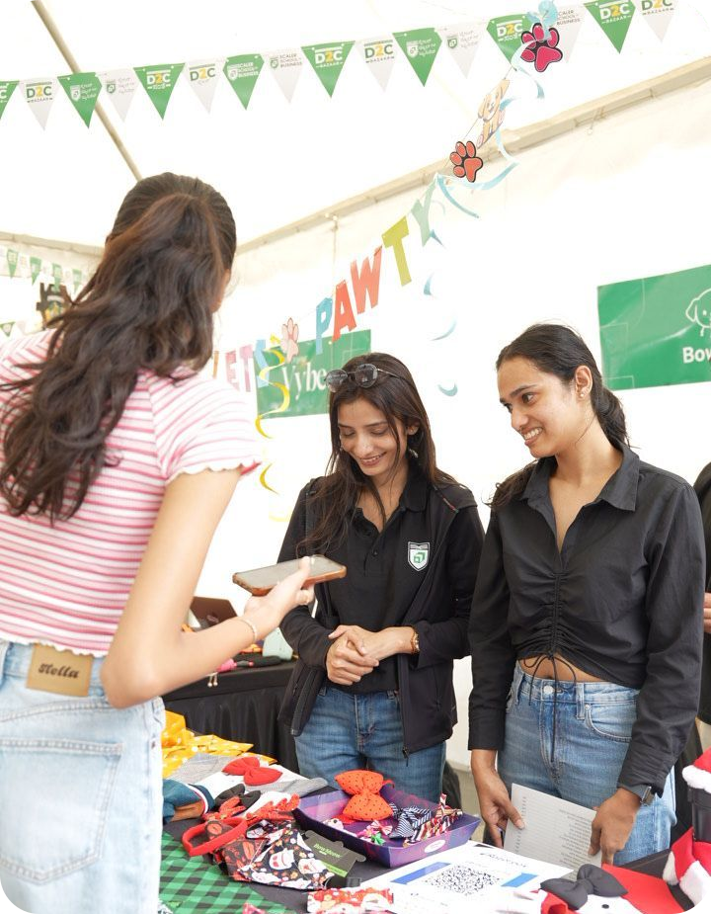
Smartly judge the customer
3
CUSTOMERS
Read them first, then tailor the pitch.
1
Look: who are they shopping for?
2
Ask: what does their pet need?
3
Tailor: the pitch, combo and price
Notes:
Every shopper at the stall was different: a browser, a gifter, a regular pet parent. Reading them quickly decided how we sold. Add a real example here.

Slide 11
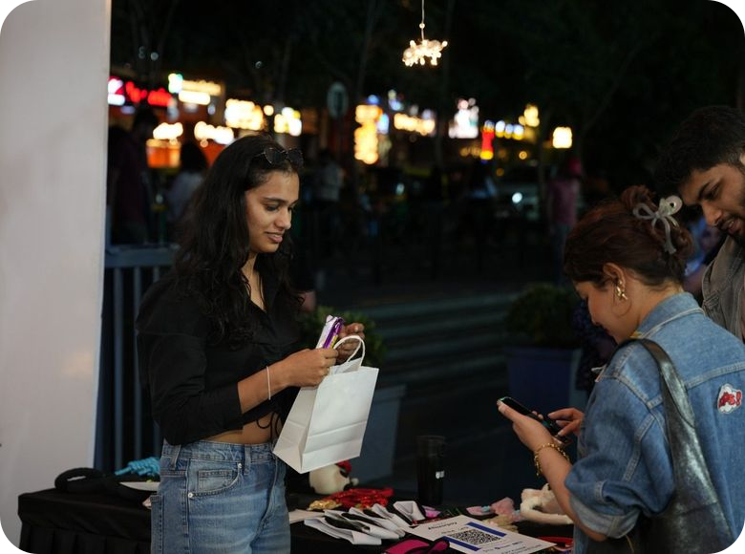
Value product, not volume product
4
PRICING & PROFIT
Fewer, better sales beat many cheap ones.
Paying at the stall
Notes:
Products people are happy to pay properly for, rather than chasing the biggest number of units.

Slide 12


Value vs Volume
VOLUME
VALUE
Low price, many units
Better product, fair price
Thin margin on every sale
Healthy margin on every sale
Needs big reach to work
Customers who come back
Sell products worth paying for.
Notes:
Give one concrete example from the stall where a better product or a combo beat a cheap one.

Slide 13
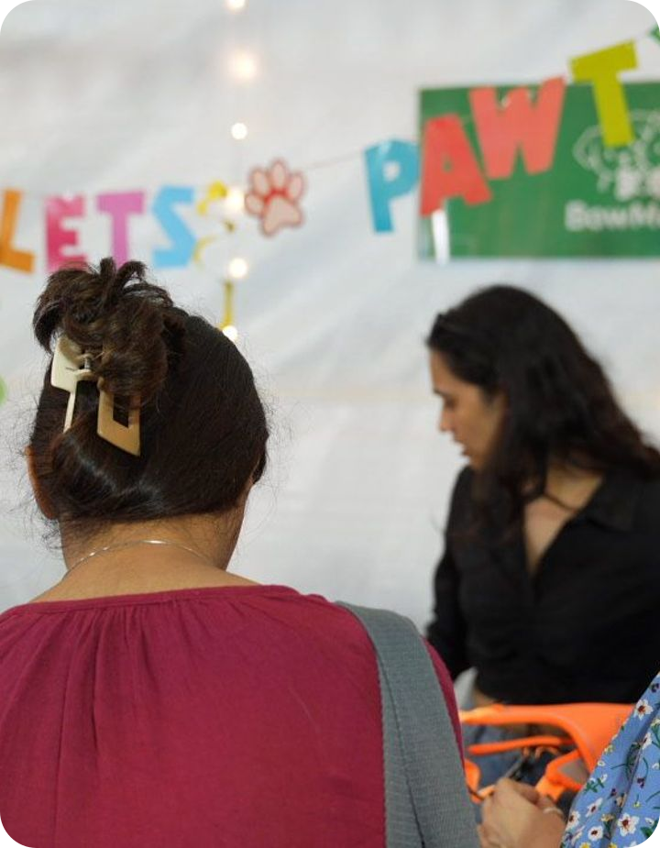
Never leave value on the table
4
PRICING & PROFIT
Judge the customer, then price to match.
1
Know what they will pay for
2
Offer the right option
3
Don't discount a ready buyer
Notes:
Every sale left money behind if we offered the same thing to everyone. Tie back to judging the customer and to combos in the catalogue.

Slide 14
Key Takeaways
1
No brand? Push the product
Go to the customer and earn the sale in person.
2
Know who pays and who uses
Speak to the buyer, design for the user.
3
Smartly judge the customer
Read them first, then tailor the pitch.
4
Value over volume
Never leave the value on the table.
Notes:
Recap in one sentence each, one per part of the session.

Slide 15
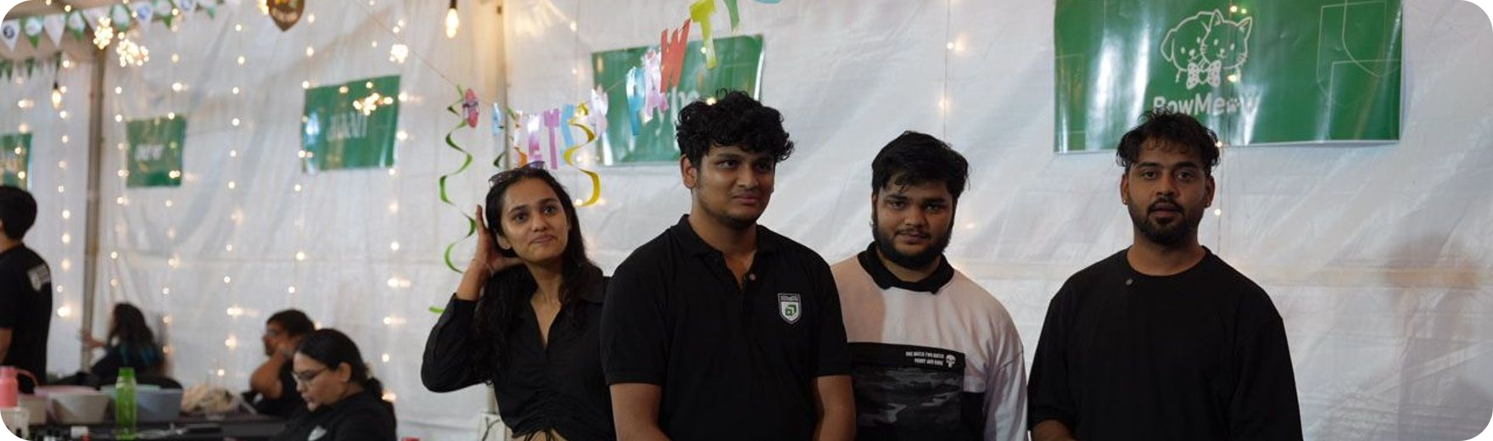
Thank You
Questions and discussion
Notes:
Open the floor. Prompts: what would you push if you had no brand yet? Who is your buyer versus your user?

