Slide 1
Contextually Mediated Semantic Similarity Graphs for Topic Segmentation
Geetu Ambwani & Tony Davis
StreamSage/Comcast

Slide 2
Outline of talk
Motivations
Relevance intervals
Graphs representing documents
  Application to segmentation
Experiments and Evaluation
  Comparison with other systems
Conclusions and future work

Slide 3
Topic segmentation
Topic segmentation defined: dividing a document into topically coherent segments
  Typically a partition (exhaustive, non-overlapping segments)
  But could vary (e.g., hierarchical, overlapping, “fuzzy”, etc.)
  Labeling the segments with good terms is a separate problem
Advantages of segmenting video (e.g., news broadcasts)
  Viewers can select only the portions of a program they want to watch
  They can browse in the order they want

Slide 4
Related Work on Segmentation
Previous work has used several approaches
  Discourse features
    Some signal a topic shift; others a continuation
    Highly domain-specific
  Similarity measures between adjacent blocks of text
    Typical document similarity measures used, as in TextTiling (Hearst, 1994) or Choi’s algorithm (Choi, 2000)
    Choi measures lexical similarity among neighboring sentences
    Posit boundaries at points where similarity is low
  Lexical chains: repeated occurrences of a term (or of closely related terms)
    Again, posit boundaries where cohesion is low (few lexical chains cross the boundary (e.g., Galley, et al., 2003)

Slide 5
Motivations behind our approach
Model both the influence of a term beyond the sentence it occurs in and semantic relatedness among terms
  The range of a term’s influence extends beyond the sentence it occurs in, but how far? (relevance intervals)
  Semantic relatedness among terms (contextually mediated graphs)
Apply this model to topic-based segmentation
Notes:
We incorporate these insights into a graph which we then try to segment into topically coherent sections.
Our approach is similar to last 2 approaches but what we want to do is explicitly model the range of a terms influence. We represent it as a graph. And then we look for subgraphs where discourse coherence is high.
Our hope is that modeling these phenemenon will provide a good way to segment text coz segment boundaries will occur where

Slide 6
Relevance Intervals

Slide 7

Relevance Intervals (RIs)
Each RI is a contiguous segment of audio/video deemed relevant to a term
Developed originally to improve audio/video search and retrieval
RI calculation relies on a pointwise mutual information (PMI) model of term co-occurrence (built from 7 years of New York Times text, 325M words)
Previously evaluated on radio news broadcasts, and currently deployed in Comcast video search
Anthony Davis, Phil Rennert, Robert Rubinoff, Tim Sibley, and Evelyne Tzoukermann. 2004. Retrieving what's relevant in audio and video: statistics and linguistics in combination. Proceedings of RIAO 2004, 860-873.
Notes:
RI is a way of modeling scope of a terms influence beyond the sentence it occurs in.
We use a corpus of nytimes – basically pmi values nxn matric of pmi values.
We use pointwise mutual info between a term and terms near it to determine whether additional sentences should be included in the
We build ri for a term based on pmi values between that term and other terms occuring in neighboring sentences. If the following sentnece has high pmi terms, then we extend that interval.

Slide 8
Relevance Intervals (RIs)
Each RI is a contiguous segment of audio/video deemed relevant to a term
  RIs are calculated for all content words (after lemmatization) and common multi-word expressions
  An RI for a term is built outwards, forward and backward from a sentence containing that term, based on:
    PMI values between pairs of terms across sentences; high PMI values suggest semantic similarity between terms
    Discourse markers which extend or end an RI
    Synonym-based query expansion, using information from WordNet
    Anaphor resolution – roughly based on Kennedy and Boguraev (1996)
    Nearby RIs for the same term are merged
    Large-scale vocabulary shifts (as determined by a modified version of Choi (2000) to indicate boundaries) *****
Notes:
There are various linguistic and statistical features that are used in calculating RIs – u can talk to me offline for more details.
In addition, we limit the expansion of relevance intervals by noting large scale vocab shifts in document using a modified version of chois algo.

Slide 9
Relevance Intervals: an Example
Index term: squatter
among the sentences containing this term are these two, near each other:
Paul Bew is professor of Irish politics at Queens University in Belfast.
In South Africa the government is struggling to contain a growing demand for land from its black citizens.
Authorities have vowed to crack down and arrest squatters illegally occupying land near Johannesburg.
In a most serious incident today more than 10,000 black South Africans have seized government and privately-owned property.
Hundreds were arrested earlier this week and the government hopes to move the rest out in the next two days.
NPR’s Kenneth Walker has a report.
Thousands of squatters in a suburb outside Johannesburg cheer loudly as their leaders deliver angry speeches against whites and landlessness in South Africa.
“Must give us a place…”
We build an RI for squatter around each of these sentences…
Notes:
Each of these occurencces is see for a ri. And we expand the ri according to terms in adjacent sentences.

Slide 10
Relevance Intervals: an Example
Index term: squatter
among the sentences containing this term are these two, near each other:
Paul Bew is professor of Irish politics at Queens University in Belfast.
[Stop RI Expansion]
In South Africa the government is struggling to contain a growing demand for land from its black citizens. [PMI-expand]
Authorities have vowed to crack down and arrest squatters illegally occupying land near Johannesburg.
In a most serious incident today more than 10,000 black South Africans have seized government and privately-owned property. [PMI-expand]
Hundreds were arrested earlier this week and the government hopes to move the rest out in the next two days.
NPR’s Kenneth Walker has a report.
Thousands of squatters in a suburb outside Johannesburg cheer loudly as their leaders deliver angry speeches against whites and landlessness in South Africa.
[Stop RI Expansion]
“Must give us a place…”
We build an RI for squatter around each of these sentences…
Notes:
Expansion stops when there arent enough related terms.

Slide 11
Relevance Intervals: an Example
Index term: squatter
among the sentences containing this term are these two, near each other:
Paul Bew is professor of Irish politics at Queens University in Belfast.
[Stop RI Expansion]
In South Africa the government is struggling to contain a growing demand for land from its black citizens. [PMI-expand]
Authorities have vowed to crack down and arrest squatters illegally occupying land near Johannesburg.
In a most serious incident today more than 10,000 black South Africans have seized government and privately-owned property. [PMI-expand]
Hundreds were arrested earlier this week and the government hopes to move the rest out in the next two days. [merge nearby intervals]
NPR’s Kenneth Walker has a report. [merge nearby intervals]
Thousands of squatters in a suburb outside Johannesburg cheer loudly as their leaders deliver angry speeches against whites and landlessness in South Africa.
[Stop RI Expansion]
“Must give us a place…”
The two intervals for squatter are merged, because they are so close
Notes:
Since the 2 intervals are close together, they are ultimately merged into one itnerval for squatter.

Slide 12
Documents → Graphs → Segmentation
Notes:
Once we have ris we can start constructing our graphs.

Slide 13
(S_1) Yesterday, I took my dog to the park.
(S_2) While there, I took him off the leash to get some exercise.
(S_3) After 2 minutes, Spot began chasing a squirrel.
______________________(Topic Shift)______________________
(S_4) Then, I needed to go grocery shopping.
(S_5) So I went later that day to the local store.
(S_6) Unfortunately, they were out of cashews.
Notes:
Heres a toy discourse to illustrate how the graphs are constructed.

Slide 14
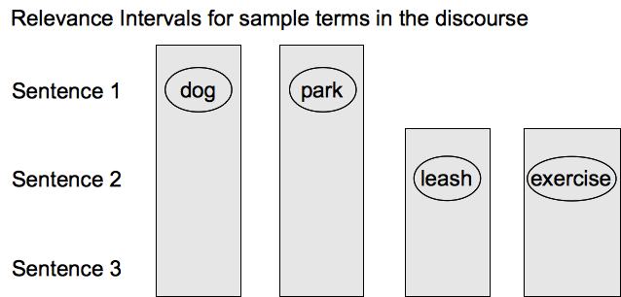
RIs → Nodes
Construct a graph in which each node represents a term and a sentence, iff the sentence is contained in an RI for that term
Notes:
We being by creating RIs for the contentful words. So for ex: RI for dog will go from sentence 1 -3 and so forth

Slide 15
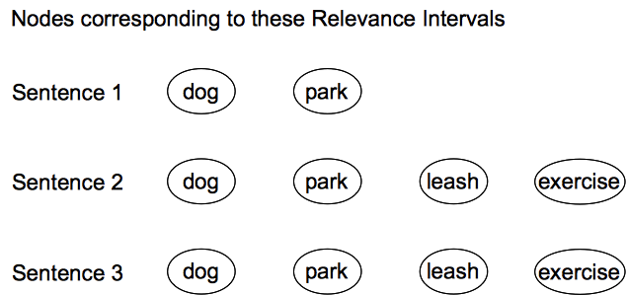
RIs → Nodes
Construct a graph in which each node represents a term and a sentence, iff the sentence is contained in an RI for that term
Notes:
Now we transform each ri into a set of nodes, one for each sentence that the ris covers. So u can see that theres a node for dog in sentence 1, 2 & 3.
Assume that the ri for dog which occurs in 1st sentence, extends from sentence 1 to sentence 3, then we create nodes for dog in each of these sentences.

Slide 16
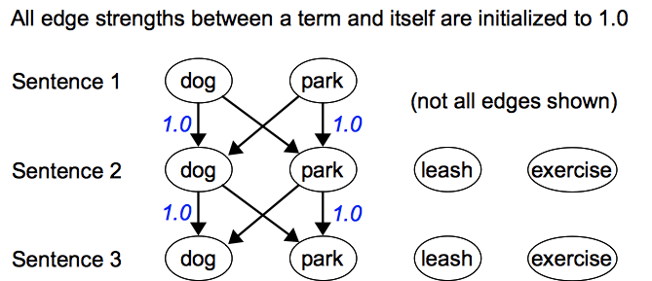
Connecting the Nodes …
Notes:
We start out with

Slide 17
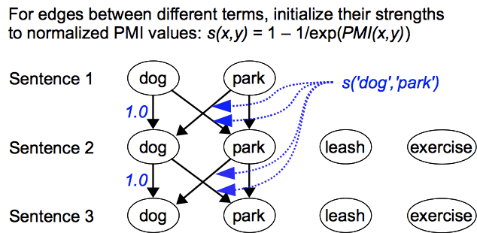
Calculating connection strengths for edges
Notes:
We start out with connection strength between 2 different terms, say dog and park as their normalized pmi value. (called s(x,y))

Slide 18
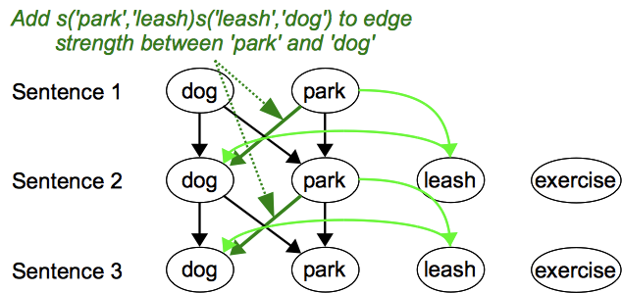
Calculating connection strengths for edges
Notes:
We want to amplify the connection strength between dog and park coz we have the word leash in context.

Slide 19
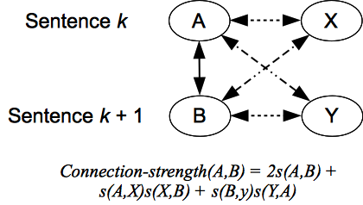

Connection strength formula
and in general, for terms a and b in sentences i and i + 1 respectively:
Notes:
So in general, we amplify the connection stength of a & b with the product of contexttual term x with a & x with b.
we use this formula. We add the products of strengths with a & b.
So formula generalizes to that.

Slide 20
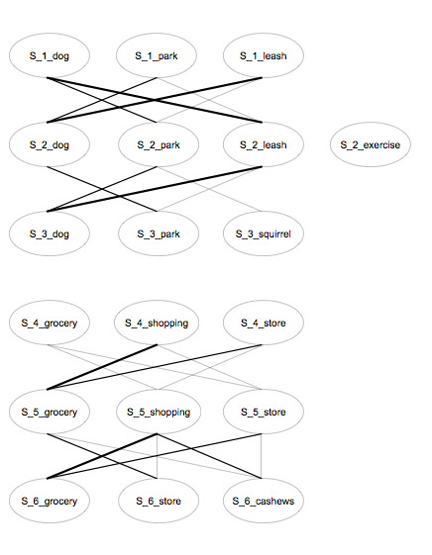
Filtering edges in the graph
We filter out edges with a connection strength below a set threshold (we’ve tried a couple and usually use 0.5)
Notes:
Result is a graph with edges connecting term nodes in one sentece with term nodes in the following sentences. But many of theosee edges have low connection strengths. So we filter out such edges.
so in our toy example u would end up with 2 subgraphs, one for the first 3 sentences and other for the last 3. each subgraph correspdong to a topically coherent segment.
So we can see these 2 regions fall out, once we filter out edges of weak connection strength.

Slide 21
Graph Representation of Document
Lets look at a real example. 1st 8 minutes of an episodes of Bizarre Foods.
Bizarre_Foods_With_Andrew_Zimmern-Japan.pdf
Notes:
This is a graph after filtering low weight edges out – u can see u end up with some very dense areas.
Make it clear that this is post filtering.

Slide 22
Segmentation from graphs
General idea: look for places in the graph where connections are sparse or weak
  Typically, this will be where relatively few Ris cross a boundary
  Edges with low connection strengths are unlikely to bear on topical coherence, so it’s best to remove them from the graph
  “Normalized novelty”: on the two sides of a potential boundary, the number of nodes labeled with the same terms, normalized by the total number of terms
Notes:
Graph edges getting sparse near topic boundaries.

Slide 23
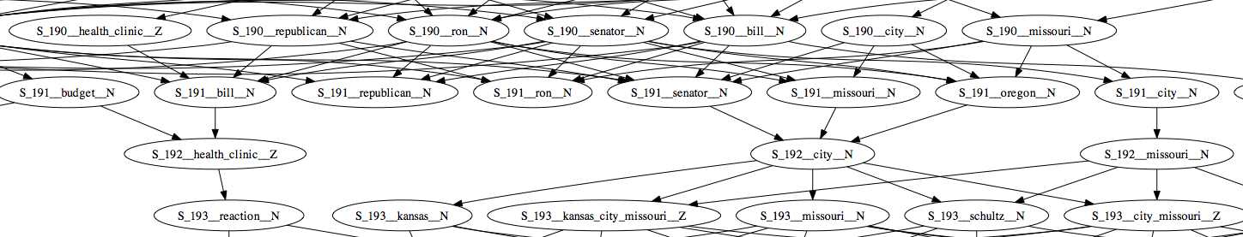
Graph representation of documents
Example snippet and graph from t.v. news broadcast
S_190 We’ve got to get this addressed and hold down health care costs.
S_191 Senator ron wyden, the optimist from oregon, we appreciate your time tonight.
S_192 Thank you.
S_193 Coming up, the final day of free health clinic in kansas city, missouri.
Notes:
U will notice that there are very few terms that occur on both sides of the potential boundary at sentence 192
Throw this out !!

Slide 24
Experiments and Evaluation

Slide 25
Evaluation metrics
How well does the hypothesized set of boundaries match the true (reference) set?
P_{k} (Beeferman, et al. 1997) and WindowDiff (Pevzner & Hearst, 2002)
  Both compare hypothesis to reference segmentation within a sliding window
  P_{k} is the proportion of windows in which hypothesis and reference disagree on the number of boundaries
  WindowDiff tallies the difference in the number of boundaries in each window
  Both commonly used instead of precision and recall, because they take approximate matching into account
  They have drawbacks of their own, however
Doug Beeferman, Adam Berger, and John Lafferty. 1997. Text Segmentation Using Exponential Models. Proceedings of EMNLP 2
Lev Pevzner and Marti A. Hearst. 2002. A critique and improvement of an evaluation metric for text segmentation. Computational Linguistics, 28:1
Notes:
We report precision and recall numbers but these are not ideal. Coz missing a boundary by one sentence is penalized same as missing a boundary by 10 sentences.
So we also report results with 2 metrics commonly employed in segmentation work – Pk & Wdiff.

Slide 26
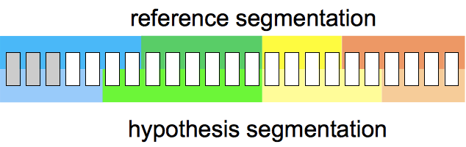
Evaluation metrics
P_{k} and WindowDiff: sliding window is half the average reference segment size

Slide 27
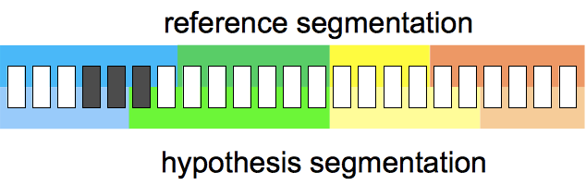
Evaluation metrics
One black mark against the hypothesis segmentation, where it differs from the reference (mistakes closer to reference boundaries appear in fewer windows, and are thus penalized less)
Notes:
Pk: At each step, look through the window and check if each of the two
segmentations say the ends of the window are in the same segment If
they disagree, it counts as an error
WindowDiff: everything is the same, except you ask how many boundaries
fall within the window

Slide 28
Systems compared
Choi | Implementation from MorphAdorner*
SN | Our system, using a single node for each term occurrence (no extension)
FE | Our system, using an extension of a fixed number of sentences for each term from the sentence it occurs in
SS | Our system, using Ris without “hard” boundaries determined by the modified Choi algorithm
SS+C | Our full segmentation system, incorporating “hard” boundaries determined by the modified Choi algorithm
* morphadorner.northwestern.edu/morphadorner/-textsegmenter
Notes:
Now that we have talked about the metrics, lets talk about the systems we have to compare.
We consider a system where we don’t model a terms influence at all. So no ris
Next we consider a system where a terms influence is represented by a fixed length extension. (10 sentences)
Last 2 versions use the RIs I described earlier.
These comparisons aim to demonstrate first, the usefulness of modeling a zone of influence for terms beyond the sentence they occur in, and second, the effectiveness of RIs in modeling that influence accurately.
Lastly, to establish how much we can gain from using Choi’s algorithm to determine termi-nation points for RIs, we also compared two ver-sions of our system: one in which RIs are calcu-lated without information from Choi’s algorithm and a second with these boundaries included.

Slide 29
Results on pseudodocuments
185 documents each containing 20 Concatenated New York Times articles
Number of boundaries not specified to systems
system | precision | recall | F | Pk | WindowDiff
Choi | 0.404 | 0.569 | 0.467 | 0.338 | 0.360
SN | 0.096 | 0.112 | 0.099 | 0.570 | 0.702
FE | 0.265 | 0.140 | 0.176 | 0.478 | 0.536
SS | 0.566 | 0.383 | 0.448 | 0.292 | 0.317
SS+C | 0.578 | 0.535 | 0.537 | 0.262 | 0.283

Slide 30
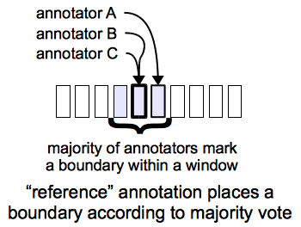
Results on TV shows
Data: Closed captions for 13 tv shows (News, talk shows, documentaries, lifestyle shows)
5 annotators manually marked up major and minor boundaries, using 1-5 rating scale
As expected, IAA is low, so we create a reference annotation

Slide 31
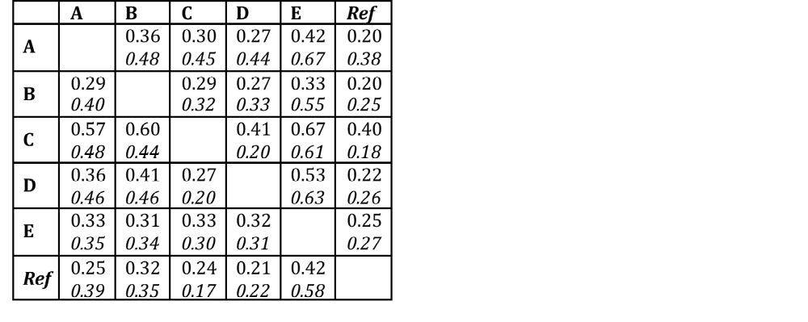
TV show closed-captions: inter-annotator agreement on segmentation
Pk values between pairs of annotators: all boundaries and major boundaries
Note that matrix is asymmetrical

Slide 32
TV show closed-captions: segmentation
Accuracy is low, which is unsurprising given the low IAA
system | precision | recall | F | Pk | WindowDiff
All topic boundaries
Choi | 0.197 | 0.186 | 0.184 | 0.476 | 0.507
SS+C | 0.315 | 0.208 | 0.240 | 0.421 | 0.462
Major topic boundaries only
Choi | 0.170 | 0.296 | 0.201 | 0.637 | 0.812
SS+C | 0.271 | 0.316 | 0.271 | 0.463 | 0.621
Notes:
Results we got are about .4 so we have some still ways to go to reach human annotator disagreement levels but seems promising.

Slide 33
Conclusions and future work

Slide 34
Conclusions and future work
Conclusions
Graphs constructed from RIs do seem to help segmentation
Semantic relatedness with reinforcement from neighboring terms
Works decently on “noisy” material, such as TV shows
Doesn’t require any training; however, there are lots of parameters to play with (and we have started exploring training to optimize them)
Future work
Several ways to segment a graph: try community detection or learn boundary detection through various graph features
Try to use graphs for more complex segmentation tasks, such as hierarchical segmentation; community structure in a graph might reflect hierarchical organization of discourse
Try to find the most “central” terms in a subgraph, to use as segment labels

Slide 35
We gratefully acknowledge…
Gene Chipman
Oliver Jojic
Akash Nagle
Robert Rubinoff
Hassan Sayyadi
Thank you! Questions?

Slide 36
The COW model

Slide 37
Two types of models
COW (Co-Occurring Words)
  Based on proximity of terms, using a sliding window
YAKS (Yet Another Knowledge Source)
  Based on grammatical relationships between terms

Slide 38
The COW Model
Large mutual information model of word co-occurrence
  MI(X,Y) = P(X,Y)/P(X)P(Y)
  Thus, COW values greater than 1 indicate correlation (tendency to co-occur); less than 1, anticorrelation
  Values are adjusted for centrality (salience)
  Two main COW models:
    New York Times, based on 325 million words (about 6 years) of text
    Wikipedia, more recent, roughly the same amount of text
    also have specialized COW models (for medicine, business, and others), as well as models for other languages

Slide 39
The COW (Co-Occurring Words) Model
The COW model is at the core of what we do
  Relevance interval construction
  Document segmentation and topic identification
  Word sense disambiguation (large-scale and unsupervised, based on clustering COWs of an ambiguous word)
  Ontology construction
    Determining semantic relatedness of terms
    Determining specificity of a term

Slide 40
The COW (Co-Occurring Words) Model
An example: top 10 COWs of railroad//N
  post//J 165.554
  shipper//N 123.568
  freight//N 121.375
  locomotive//N 119.602
  rail//N 73.7922
  railway//N 64.6594
  commuter//N 63.4978
  pickups//N 48.3637
  train//N 44.863
  burlington//N 41.4952

Slide 41
Multi-Word Units (MWUs)
Why do we care about MWUs? Because they act like single words in many cases, but also:
  MWUs are often powerful disambiguators of words within them (see, e.g., Yarowsky (1995), Pederson (2002) for wsd methods that exploit this):
    ‘fuel tank’, ‘fish tank’, ‘tank tread’
    ‘indoor pool’, ‘labor pool’, ‘pool table’
  Useful in query expansion
    ‘Dept. of Agriculture’ ←→ ‘Agriculture Dept.’
    ‘hookworm in dogs’ ←→ ‘canine hookworm’
  Provide many terms that can be added to ontologies
    ‘commuter railroad’, ‘peanut butter’

Slide 42
Multi-Word Units (MWUs) in our models
MWUs in our system
  We extract nominal MWUs, using a simple procedure based on POS-tagging:
  Example:
    ({N,J}) ({N,J}) N
    N Prep (‘the’) ({N,J}) N
    where Prep is ‘in’, ‘on’, ‘of’, ‘to’, ‘by’, ‘with’, ‘without’, ‘for’, or ‘against’
  For the most common 100,000 or so MWUs in our corpus, we calculate COW values, as we do for words

Slide 43
COWs of MWUs
An example: top ten COWs of ‘commuter railroad’
post//J 1234.47
pickups//N 315.005
rail//N 200.839
sanitation//N 186.99
weekday//N 135.609
transit//N 134.329
commuter//N 119.435
subway//N 86.6837
transportation//N 86.487
railway//N 86.2851

Slide 44
COWs of MWUs
Another example: top ten COWs of ‘underground railroad’
abolitionist//N 845.075
slave//N 401.732
gourd//N 266.538
runaway//J 226.163
douglass//N 170.459
slavery//N 157.654
harriet//N 131.803
quilt//N 109.241
quaker//N 94.6592
historic//N 86.0395

Slide 45
The YAKS model
Motivations
  COW values reflect simple co-occurrence or association, but no particular relationship beyond that
  For some purposes, it’s useful to measure the association between two terms in a particular syntactic relationship
Construction
  Parse a lot of text (the same 325 million words of New York Times used to build our NYT COW model); however, long sentences (>25 words) were discarded, as parsing them was slow and error-prone
  The parser’s output provides information about grammatical relations between words in a clause; to measure the association of a verb (say ‘drink’) and a noun as its object (say ‘beer’), we consider the set of all verb-object pairs, and calculate mutual information over that set
  Calculate MI for broader semantic classes of terms, e.g.: food, substance. Semantic classes were taken from Cambridge International Dictionary of English (CIDE); there are about 2000 of them, arranged in a shallow hierarchy

Slide 46
YAKS Examples
Some objects of ‘eat’
  OBJ head=eat
  arg1=hamburger 139.249
  arg1=pretzel 90.359
  arg1=:Food 18.156
  arg1=:Substance 7.89
  arg1=:Sound 0.324
  arg1=:Place 0.448

Slide 47
Ris: evaluation and testing
Evaluation of retrieval effectiveness in timed media raises further issues:
  Building a gold-standard is painstaking, and potentially more subjective
  It’s necessary to measure how closely the system’s Ris match the gold standard’s
  What’s a reasonable baseline?
We created a gold standard of about 2300 VDs with about 200 queries on about 50 documents (NPR, CNN, ABC, and business webcasts), and rated each RI in a VD on a scale of 1 (highly relevant) to 3 (marginally relevant).
Testing of the system was performed on speech recognizer output

Slide 48
Evaluating RIs and VDs
Measure amounts of extraneous and missed content
ideal RI missed
system RI
extraneous

Slide 49
Evaluating RIs and VDs
Comparison of percentages of median extraneous and missed content over all queries between system using COWs and system using only sentences with query terms present
relevance | most relevant |  | relevant |  | most relevant and relevant |  | marginally relevant
system | extra | miss | extra | miss | extra | miss | extra | miss
With COWs | 9.3 | 12.7 | 39.2 | 27.5 | 29.9 | 21.6 | 61.7 | 15.0
Without COWs | 0.0 | 57.7 | 0.3 | 64.7 | 0.0 | 63.4 | 18.8 | 60.2

Slide 50
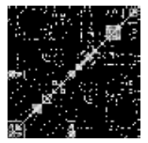
Topic segmentation – previous work
Choi’s algorithm (Choi, 2000)
  Construct a similarity matrix of all sentence pairs
  “Sharpen” the distinctions by replacing similarity values with their ranks in the local region
  Coherent regions appear as brighter
  square areas along the diagonal;
  segment boundaries lie at their
  corners
Freddy Y.Y. Choi. 2000. Advances in domain independent linear text segmentation. Proceedings of NAACL 2000, 109-117.

Slide 51
Results on pseudodocuments
86 documents out of the 186, for which C99 and SS+C both
find at least 20 boundaries; top 20 boundaries selected
system | prec = rec = F | Pk | WindowDiff
Choi | 0.530 | 0.222 | 0.231
SS+C | 0.643 | 0.192 | 0.201

