Slide 1
A Characterization of hard-to-cover csps*
Amey Bhangale
Rutgers University
joint work with
Prahladh Harsha and Girish Varma
TIFR TIFR

Slide 2
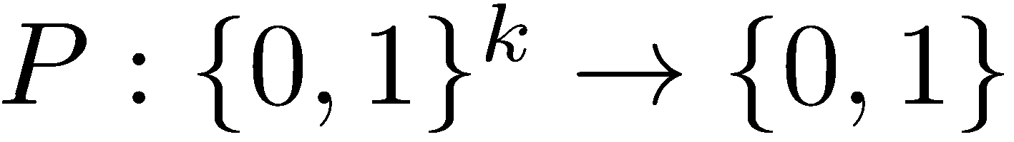
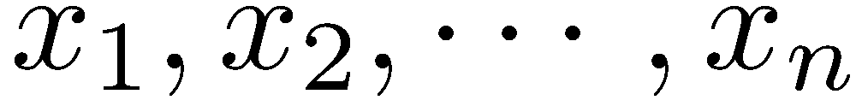
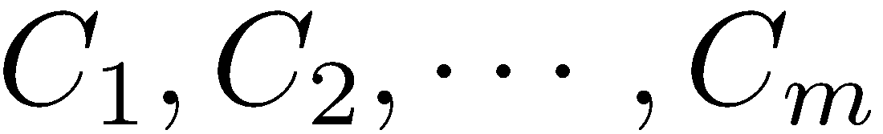
CSPs
A Predicate,
Set of variables
Set of constraints on literals.
Ex. 3-XOR,
Can ask for
Satisfiability: check if satisfiable or not
MAX/ MIN-CSP: an assignment that maximizes/minimizes the number of satisfied constraints –
CSPs with hard constraints: Same as above + additional constraints on the set of feasible assignments (max/min bisection)

Slide 3
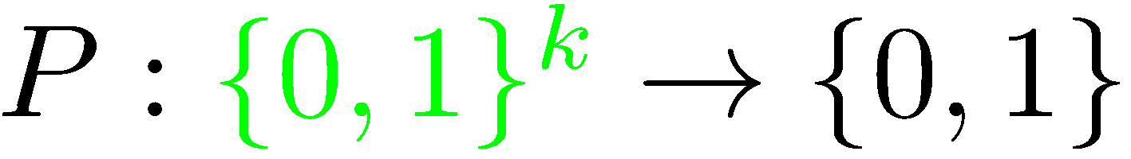
CSPs
A Predicate,
Set of variables
Set of constraints on literals.
Ex. 3-XOR,
Can ask for
Satisfiability: check if satisfiable or not
MAX/ MIN-CSP: an assignment that maximizes/minimizes the number of satisfied constraints –
CSPs with hard constraints: Same as above + additional constraints on the set of feasible assignments (max/min bisection)

Slide 4
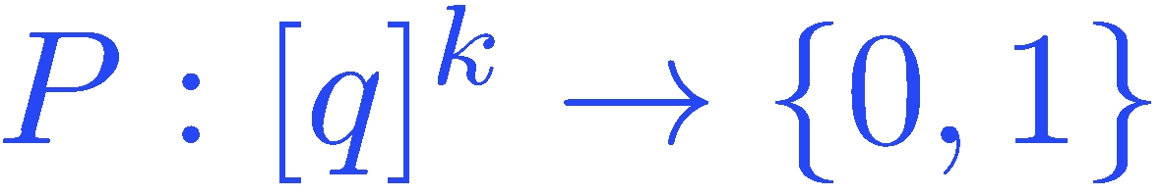
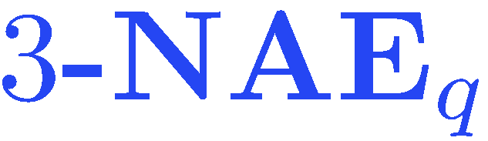
CSPs
A Predicate,
Set of variables
Set of constraints on literals.
Ex., (addition is mod q)
Can ask for
Satisfiability: check if satisfiable or not
MAX/ MIN-CSP: an assignment that maximizes/minimizes the number of satisfied constraints –
CSPs with hard constraints: Same as above + additional constraints on the set of feasible assignments (max/min bisection)
Notes:
----- Meeting Notes (6/13/15 18:26) -----
q, k - constants

Slide 5
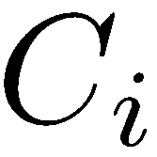


Covering CSP
Given a CSP, find minimum number of assignments such that for every constraint , there is at least one assignment that satisfies .
Ex.
A
B

Slide 6
Covering CSP
Given a CSP, find minimum number of assignments such that for every constraint , there is at least one assignment that satisfies .
Ex.
Satisfied by:
A
B
B
Covering number at most 2
A
B

Slide 7
Covering CSP
NP-hard to find the covering number.
Approximation of covering number

Slide 8
Covering CSP
NP-hard to find the covering number.
In fact, approximating better than 2 is NP-hard.
Approximation of covering number

Slide 9
Motivation
Natural optimization problem
Related to the chromatic number of hypergraph

Slide 10
Motivation
3-NAE_{q} instance :

Slide 11
Motivation
3-NAE_{q} instance :
Constrained hypergraph:

Slide 12
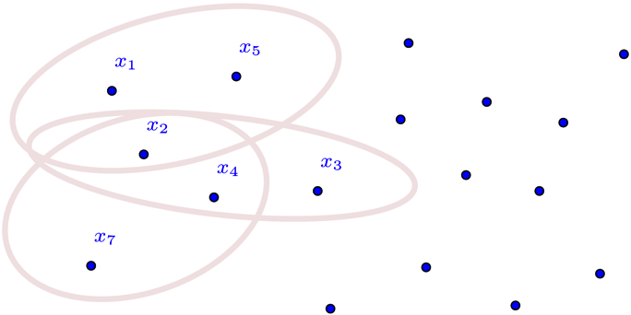
Motivation
3-NAE_{q} instance :
Constrained hypergraph:

Slide 13
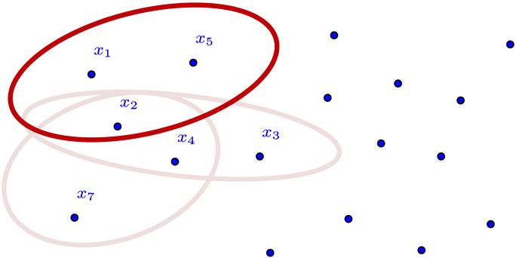
Motivation
3-NAE_{q} instance :
Constrained hypergraph:

Slide 14
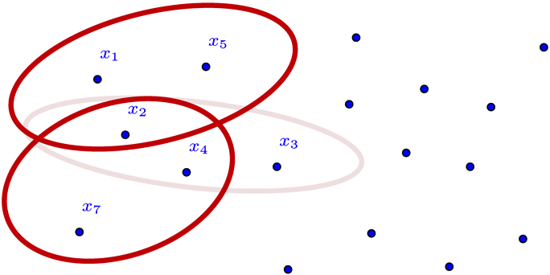
Motivation
3-NAE_{q} instance :
Constrained hypergraph:

Slide 15
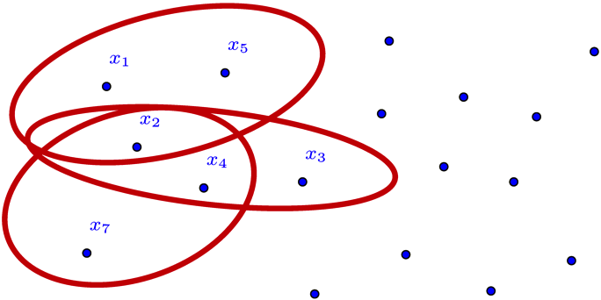
Motivation
3-NAE_{q} instance :
Constrained hypergraph:

Slide 16
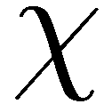
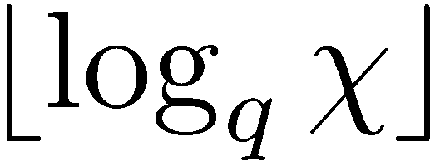
3-NAE_{q} instance :
Constrained hypergraph
Chromatic number
Covering number

Slide 17
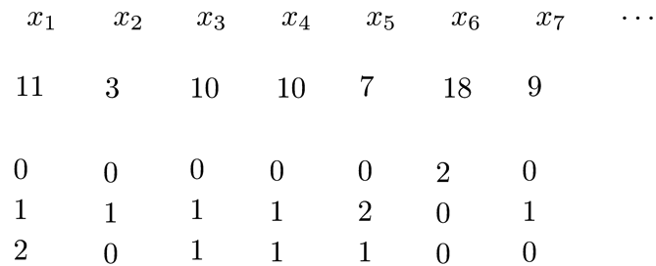
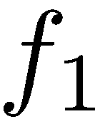
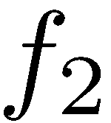
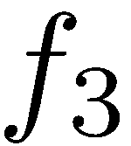
3-NAE_{q} instance :
Constrained hypergraph
Chromatic number
Covering number
Coloring
forms a cover

Slide 18
Classification

Slide 19
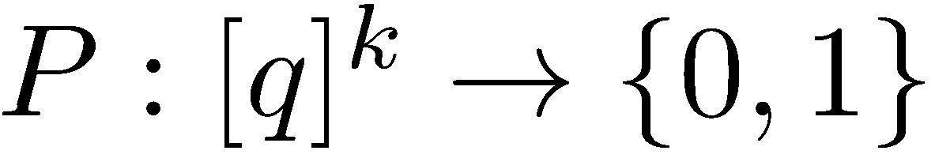
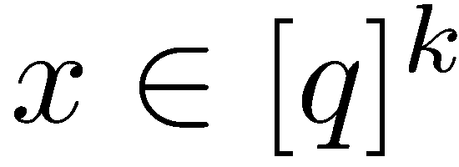
Covering CSP
Odd Predicate
is odd if for all , the following holds
Eg. 3-SAT, 3-XOR, Non eg. 3-NAE, 4-XOR

Slide 20
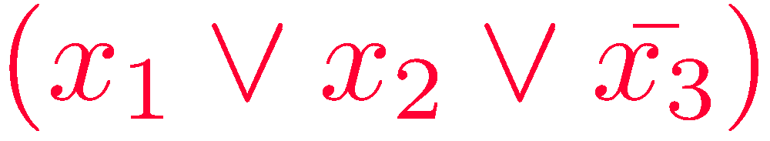
Covering CSP
Odd Predicate
is odd if for all , the following holds
Eg. 3-SAT, 3-XOR, Non eg. 3-NAE, 4-XOR

Slide 21
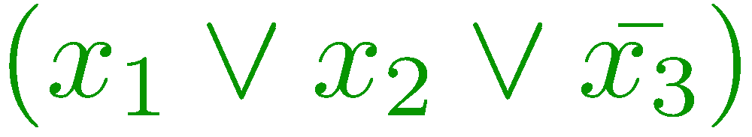
Covering CSP
Odd Predicate
is odd if for all , the following holds
Eg. 3-SAT, 3-XOR, Non eg. 3-NAE, 4-XOR

Slide 22
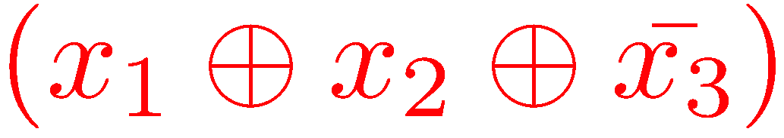
Covering CSP
Odd Predicate
is odd if for all , the following holds
Eg. 3-SAT, 3-XOR, Non eg. 3-NAE, 4-XOR

Slide 23
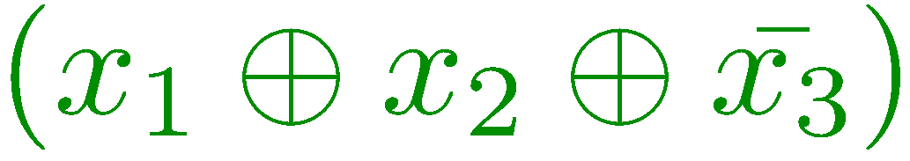
Covering CSP
Odd Predicate
is odd if for all , the following holds
Eg. 3-SAT, 3-XOR, Non eg. 3-NAE, 4-XOR

Slide 24
Covering CSP
Odd Predicate
is odd if for all , the following holds
Eg. 3-SAT, 3-XOR, Non eg. 3-NAE₃, 4-XOR

Slide 25
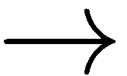
Covering CSP
Odd Predicate
Covering number at most q, always
When q=2
Distinguishing between 1 and 2 satisfiability.
Schaefer’s dichotomy theorem implies a characterization to distinguish between the two cases for Boolean CSPs
q approximation is trivial
Weather it is NP-hard or not

Slide 26
Covering CSP
Non-Odd Predicates
Covering number is unbounded, in general
At most O(log m)
Question : How well can we approximate the covering number?

Slide 27
Towards Characterization
Non-odd
- Status about inapproximability?
Odd
- trivial q-approximation.

Slide 28
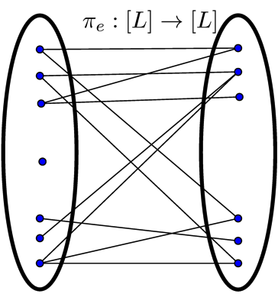
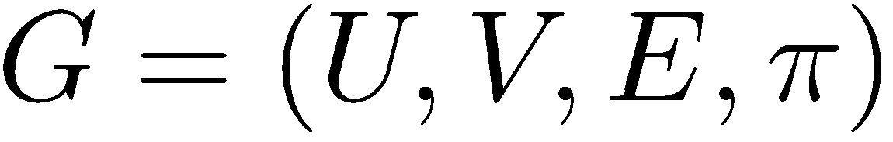
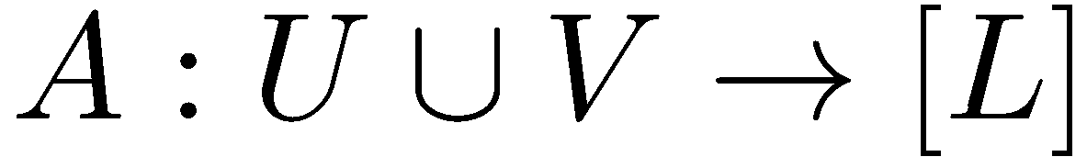
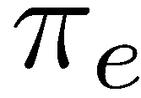
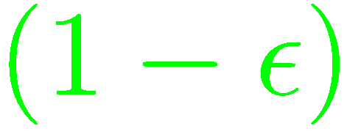

UGC
Unique Games
Find , that satisfies
many .
Conjecture [Khot02] : NP-Hard to decide between
Case 1: There is an assignment that satisfies at least fraction of constraints.
Case 2: No assignment satisfies more than fraction of constraints.

Slide 29
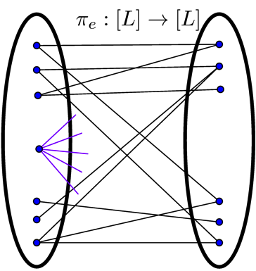
Covering UGC
Covering UGC [DK13]
c-covering of G
all of these
satisfied by some A_{i}
Conjecture : NP-Hard to decide between
Case 1: There exists a c-covering (c is an absolute constant)
Case 2: No assignment satisfies more than fraction of constraints.

Slide 30
Previous Results on Covering CSPs
Introduced in Guruswami et. al. [GHS02], its relation to hypergraph coloring.
Formally studied by Dinur-Kol [DK13] for general CSPs

Slide 31
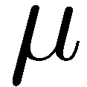
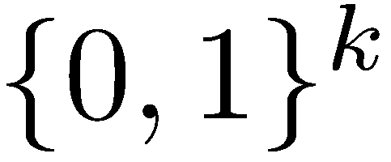
Previous Results on Covering CSPs
A distribution on is balanced and pairwise independent if the marginals on every pair of co-ordinates is uniform.

Slide 32
Previous Results on Covering CSPs
Non-odd
[DK13], when q=2
Odd
- trivial q-approximation.

Slide 33
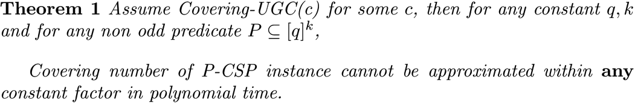
Our Results

Slide 34
Our Results
Non-odd
- Status about inapproximability?
- trivial q-approximation.
Odd

Slide 35
Our Results
Non-odd
- Covering-UG Hard to approximate within any constant
- trivial q-approximation.
Odd

Slide 36
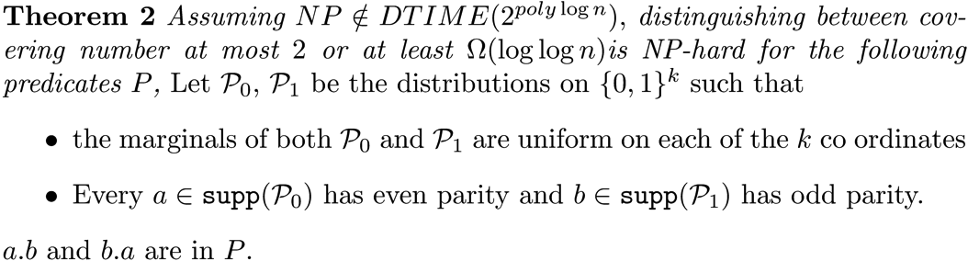
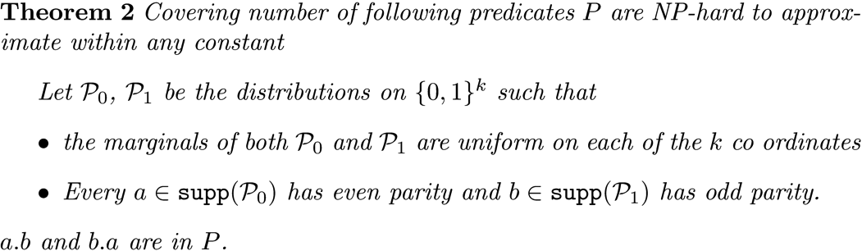
Our Results

Slide 37
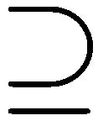
Our Results
Implies 4-LIN covering hardness of [DK13]
Take P₀ ~ all 2-bit parity 0 strings
P₁ ~ all 2-bit parity 1 strings
4-LIN = P₀ . P₁

Slide 38
Our Results
Implies 2k-LIN covering hardness
Take P₀ ~ all 2k-bit parity 0 strings
P₁ ~ all 2k-bit parity 1 strings
2k-LIN = P₀ . P₁

Slide 39
The state now
Non-odd
All non odd P are covering UG hard to approximate within any constant
NP-hard to approximate within any constant, q=2 case only
Odd
- trivial q-approximation.

Slide 40
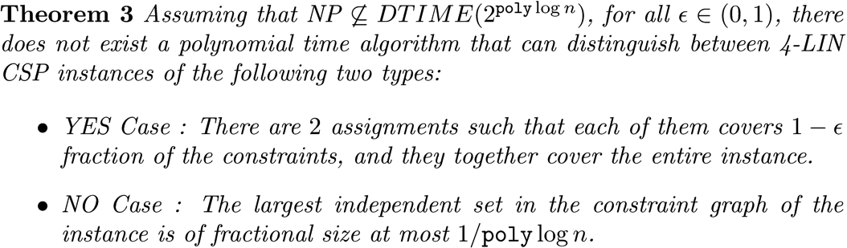
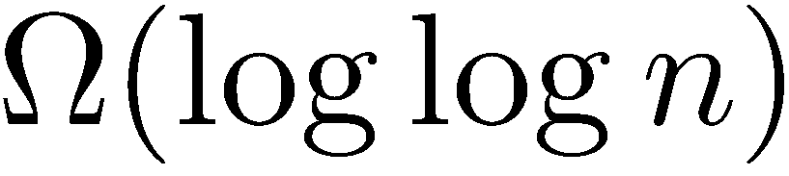
Our Results
Since 4-LIN is contained in 4-NAE
covering hardness

Slide 41
Proof Idea
Outline about usual UG hard reductions.
Start with a UG instance.
Ask provers to write down the labels over some alphabet q
Verifier queries this proof at some locations
Verifier does some check on the queried values
Accepts or Rejects based on the check
Heart of most of the analysis lies in the analysis of a dictatorship test.

Slide 42
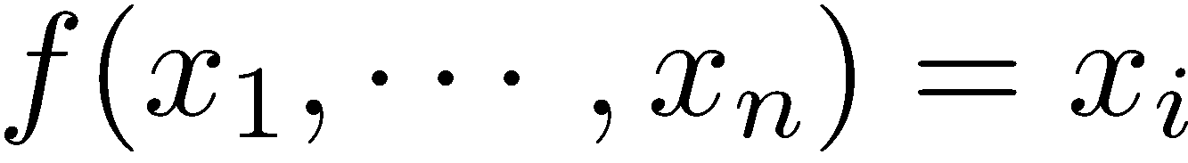
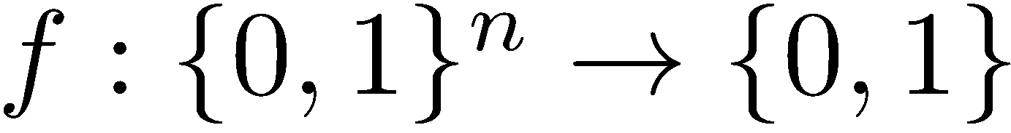
Dictatorship Test
Dictator is a function of the form
Given
Verifier queries f on some inputs
Based on the f’s value , accept or reject

Slide 43
Dictatorship Test
Completeness: Every dictator passes with high probability
Soundness: If a function is “far from dictator” then reject with high probability

Slide 44
Characterization
Suffices only for Predicates P such that :
P is non odd
Results for the remaining non odd predicates follow by simple reduction from the above CSPs.

Slide 45
Towards proof of Theorem 1
2 covering property makes it easier to apply this invariance principle.
IS analysis makes proof very easy to analyse

Slide 46
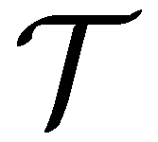
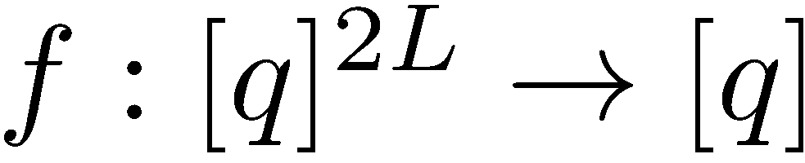
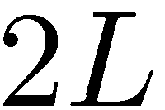
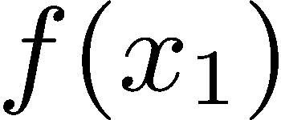
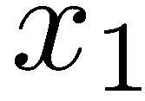

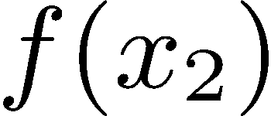
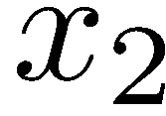
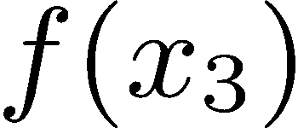
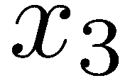

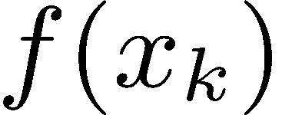

Proof of Theorem 1
Dictatorship test :
Given
P_{s}

Slide 47
Proof of Theorem 1
Completeness
If f is an i^{th} dictator, then consider two functions f₁ f₂ – one of them satisfies the check
f₁ = i^{th} dictator
f₂ = ( (i+L) mod (2L) ) dictator
Hence, covering number at most 2.

Slide 48




Proof of Theorem 1
Soundness overview
Proof: Suppose not,
Let be the indicator function of the largest independent set of size . Then,

Slide 49

Proof of Theorem 1

Slide 50

Proof of Theorem 1

Slide 51



Proof of Theorem 1

Slide 52

Invariance principle
Far from a dictator

Slide 53




Proof of Theorem 1
Are we done?
We had,
Invariance Principle implies,
for appropriate values of ``farness form a dictator’’ and

Slide 54

Open Problems
Characterization based on ?
1-covering (satisfiability) vs. c-covering
UGC/SSE Covering UGC ?

Slide 55
Thank You

Slide 56
Questions?

