Slide 1
Machine Learning Modelling for predicting the charges of health insurance of U.S.A citizen
Author:
Muhammad Azis Rizaldi
01/20/2024

Slide 2
Outline
Introduction
Metodology
Explanatory Data Analysist
Machine Learning Model
Results and Discussion

Slide 3

INTRODUCTION

Slide 4
Question
ACME Insurance Inc. offers affordable health insurance to thousands of customer all over the United States. As the lead data scientist at ACME, you're tasked with creating an automated system to estimate the annual medical expenditure for new customers, using information such as their age, sex, BMI, children, smoking habits and region of residence, and you must be able to explain why your system outputs a certain prediction.

Slide 5
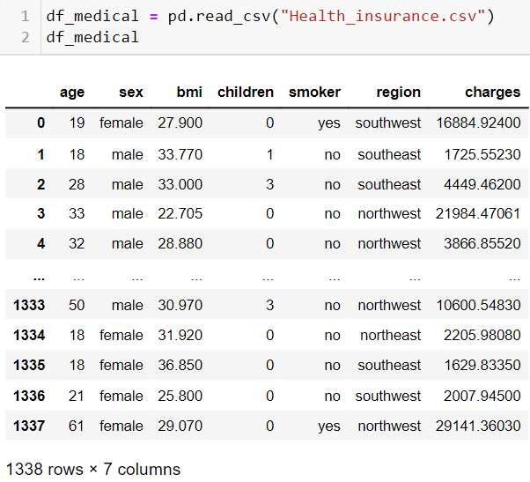
Description of Data
The data set contains 7 attributes such as age, sex, bmi, number of children, smoker (yes/no), region of domicile, and charge of health insurance for customers. In this data set, there are 1337 customers as U.S.A citizen.

Slide 6
METHODOLOGY

Slide 7
Data Wrangling
Data that we have may contains some outliers, missing/misleading value, inappropriate format. So, in the preliminary stage, we should overcome those challanges.
There are many ways to overcome those problems:
1. Check the data type and edit in appropriate format
2. Check the descriptive statistics, and
3. Consider fill or edit the missing/misleading values into zeros or mean, or just remove them.
Exploratory Data Analysist (EDA)
The data may contains thousands rows and variables. The most important thing is gaining the insights on the data. We can do exploratory data analysist and gain the correlation among variables by SQL or graph. This step is important to consider which variables must be entered in machine learning modelling
Machine Learning Modelling
Since we want to predict the annual medical charges, we choose the linear regression model. Before we start the modelling, we should determine which variables should exist in the model, and we make sure the data have been scaled or translated into numeric data type either by binary or one-hot encoding method.
We split the data into data training and data testing for seek the accuracy of model. We can inspect the quality of model by see the r2 score and its rmse.

Slide 8
DATA WRANGLING

Slide 9
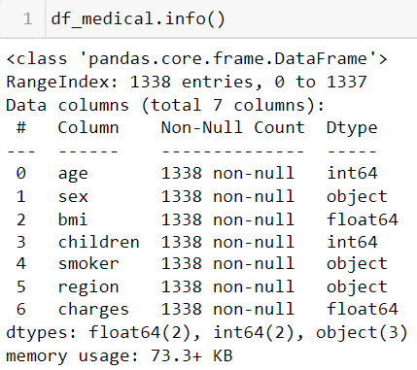
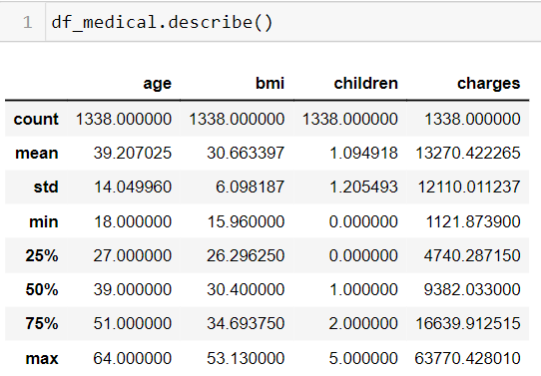
Data Wrangling
The first step to processing the data set is data cleansing or data wrangling.
We see the data have been in appropriate format, and there are no missing values (1338 of 1338 rows). So, we are free for doing the data cleansing.

Slide 10
EXPLORATORY DATA ANALYSIST (EDA)

Slide 11
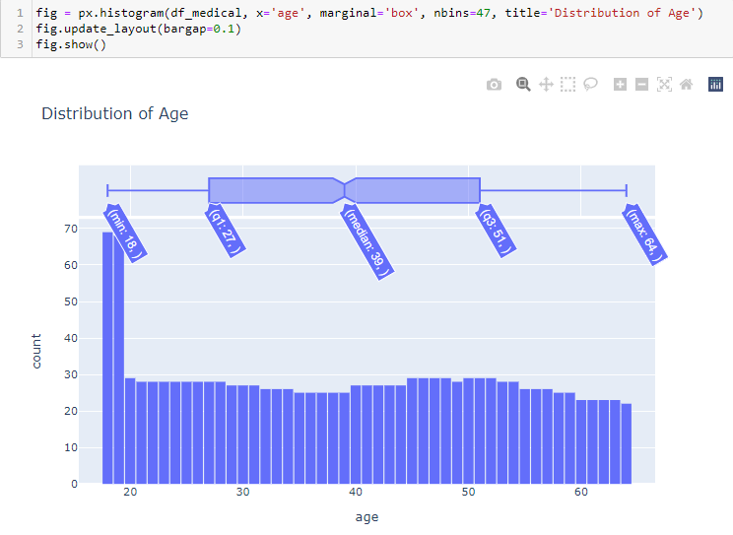
Exploratory Data Analysist
The distribution of age is normal distribution.
The number of customers are almost same for every age, except 18 and 19 years old as much twice as the other age.
The reason for this phenomena is the 18-19 years old customers are less prone to getting sick rather than the older one and thus company has to pay them less for their medical bills.

Slide 12
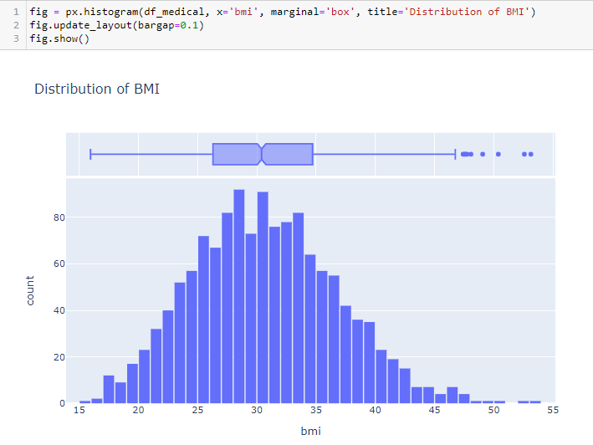
Exploratory Data Analysist
The distribution of BMI is gaussian distribution. The bmi for healthy person is in range 20-30. If the people who bmi under or above, they are considered more prone to health issues. Hence, they will pay the health insurance at higher price because thus company will more pay the medical bill.

Slide 13
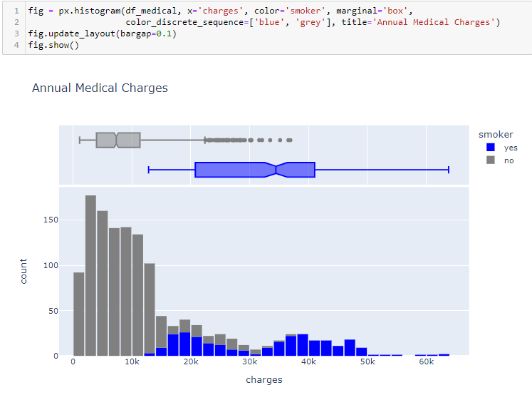
Exploratory Data Analysist
Most customers have annual medical charges under $14,000. Other customers have higher annual medical charges possibly due to accidents, major illness, and genetic diases.
There is a significant medical expenses between smokers and non-smokers. The smokers have the higher annual charges rather than the non-smokers.

Slide 14
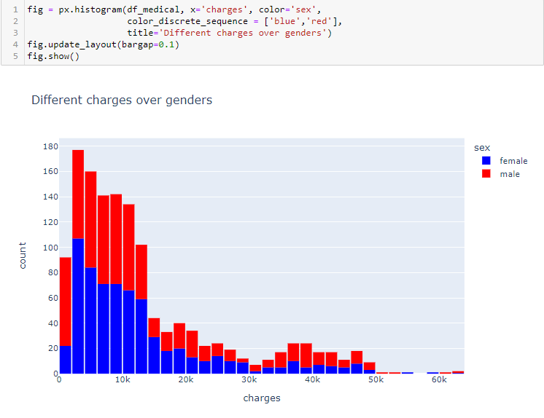
Exploratory Data Analysist
The number of male and female are equally same for wide range of annual medical charges, although men are dominant.
Males are substancially charged more because they are more likely to take risks and that keeps them in danger. Females are substancially also to be more prone to getting cancer rather than males.

Slide 15
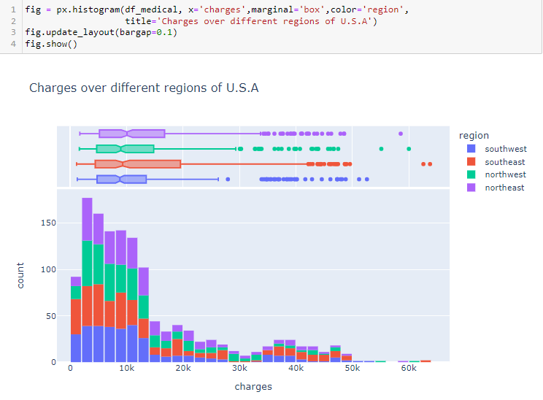
Exploratory Data Analysist
This distribution we see that southeaster part of U.S is leading in charges but majority of all customers from all parts of US are charged between 0-28k only.

Slide 16
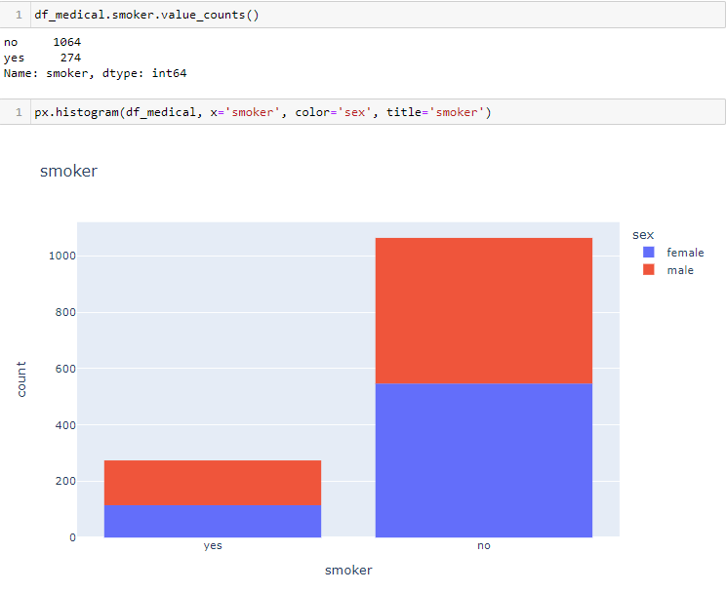
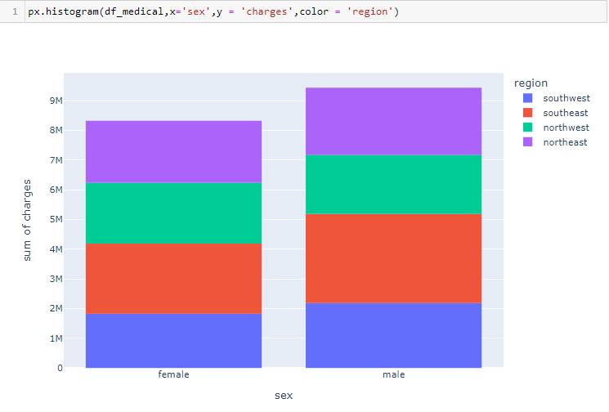
Exploratory Data Analysist
It appears that 20% of customers have reported that they smoke. We can also see that smoking appears a more common habit among males.
We see that in most regions except for northwest, the males are dominant smokers.

Slide 17
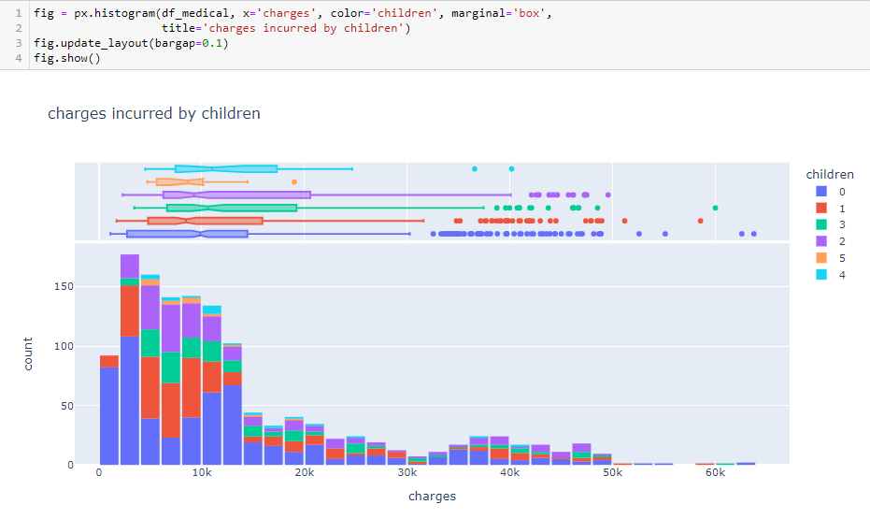
Exploratory Data Analysist
It seems that majority of our customers have 0 or 1 child and median charges vary between 8.5k to 10.6k dollars

Slide 18
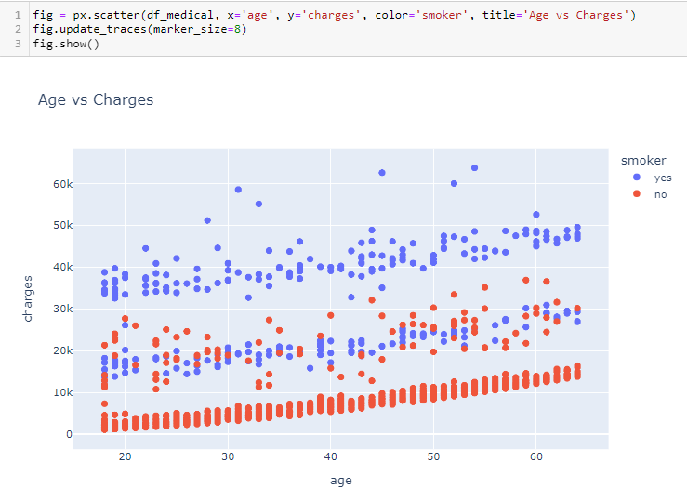
Exploratory Data Analysist
Increasing age absolutely increase the charges. There are three trend cluster
The healthy non-smokers, relatively low medical charges
The non-smokers with medical issues and smokers without major issues, intermediate medical charges
The smokers with major medical issues, relatively high medical charges

Slide 19
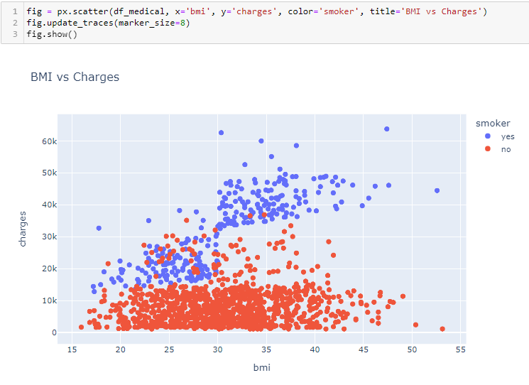
Exploratory Data Analysist
It appears that for non-smokers, an increase in BMI doesn't seem to be related to an increase in medical charges. However, medical charges seem to be significantly higher for smokers with a BMI greater than 30.

Slide 20
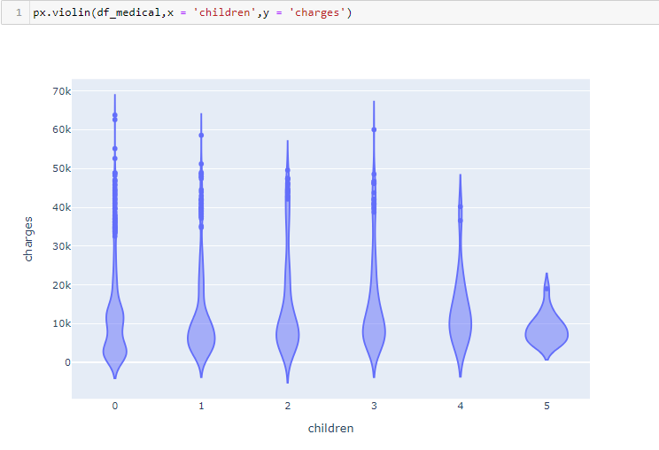
Exploratory Data Analysist
There doesn't seem to have a strong trend among this variables. The majority of customers having any number of children or no children altogether have charges in range of 0-20k dollars

Slide 21
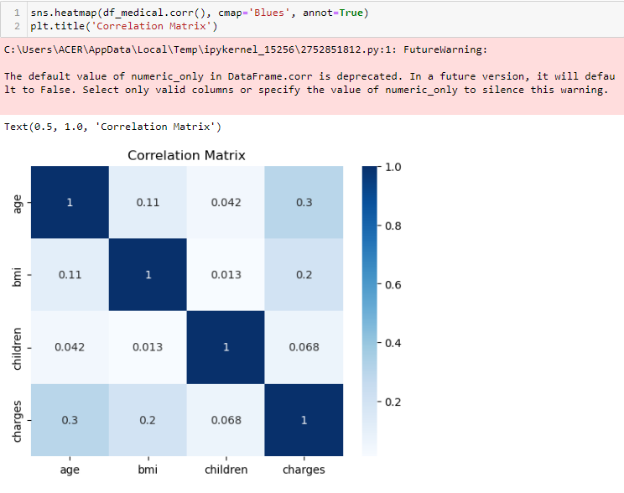

Correlation
Correlation helps us to determine the weight between two variables.
In this case, we will seek the variable which having high correlation relative to the ‘charges’ variable.
In numerical variables, there are age vs. charges, and bmi vs. charges which are the highest correlation.
In categorical variable, which is ‘smoker’ has the value of correlation 0.78.

Slide 22
MACHINE LEARNING MODELLING

Slide 23
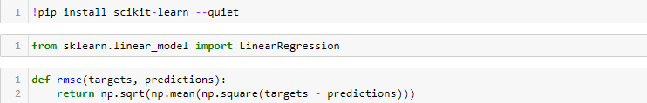
Machine Learning Modelling
Now, we can estimate the annual medical charges by making the linear regression model. Before we do that, the variables of data should be conditioning. If the variables are numerical we should and scale the variables, whereas if the variables are categorical we should translate the variables into numeric by binary or by one-hot encoding.
RMSE (root mean square error) is the parameter which counts the difference between predicted values by model and actual values. r2 (r-square) measures how the model can explain the variability in independent variables. So, the good model is describes as having higher R2 and lower rmse.

Slide 24
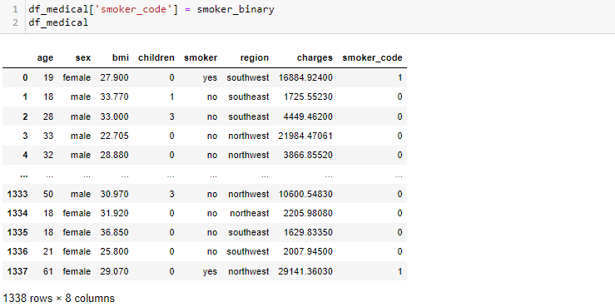
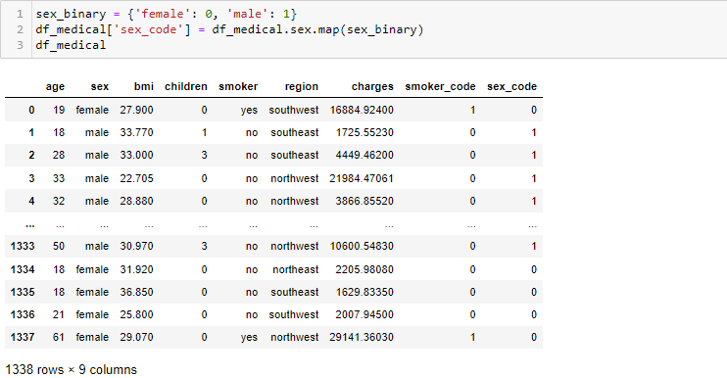
Machine Learning Modelling
We translate smokers into two, 1 for ‘yes’ and 0 for ‘no’ whereas sex translate into two, 1 for ‘male’ and 0 for ‘female’.

Slide 25
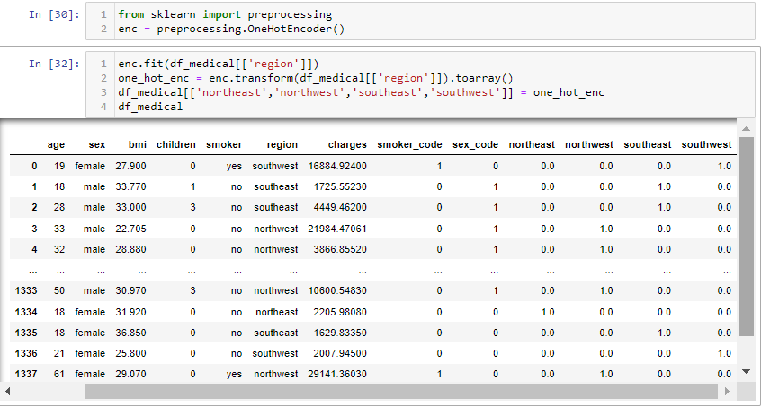
Machine Learning Modelling
Since the ‘region’ variable contains more than two values, we translate this variable into numeric by one-hot encoding.
Number 1 is defined as True, and number 0 is defined as False.

Slide 26
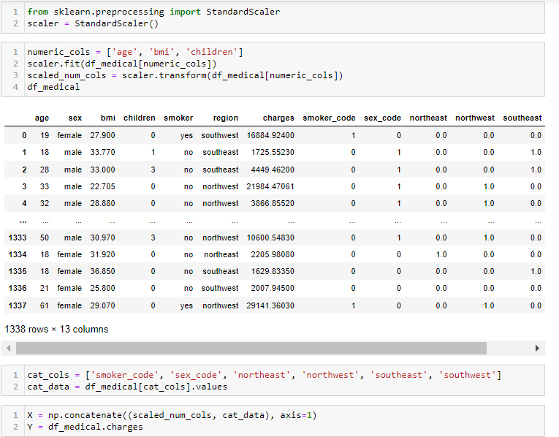
Machine Learning Modelling
After we translate the categorical variables into numeric, we can scale the numerical variables due to the wide range of value.
Now, we can concate the numerical and categorical variables (include age, bmi, children, smoker_code, sex_code, northeast, northwest, southeast, southwest) as inputs and charges as output

Slide 27
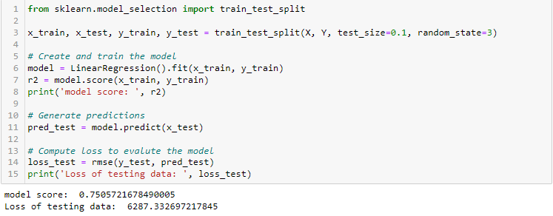
Machine Learning Modelling
Before we build the model, we split the data into training data (90%) and testing data (10%).
We do linear regression modelling to predict the annual medical charge. Unfortunately as we see, the model have score 0.75 and rmse of charges $6287 which is bad model.

Slide 28
Result and Discussion
After all procedure have been conducted, we found that:
The higher annual medical charge, fewer the customers.
The annual medical charge is getting higher along with the high health costs that need to be incurred by the company.
The high annual medical charge incurred by the Company are due to customers who smoke, excess or deficit of BMI (less than 22 or more than 30), and increasing age.
Customers who smoke are predominantly male.
There are strong correlation between charges and age, charges and bmi, charges and smoker. Machine learning modelling including all variables relative to the charges variable, has accuracy 0.75 and rmse $6287 which is low. So, other machine learning model may result the better accuracy for prediction, classification, or clustering.

