Slide 1
Tools and tricks to create study materials
Helpful steps and tools, especially for neurodivergent students, to use for studying difficult content

Slide 2
Study Guide Tools and Steps
Use digital resources; download transcripts from past lectures to create a study guide
Use AI tools to create a study guide from the transcript
Additional methods can use the study guide for learning styles that help with understanding and retaining information
Writing out notes from the study guide document
Listening to the notes with screen reading apps
Drawing notes from the audio and/or softcopy of the notes can help to create a custom visual learning guide

Slide 3
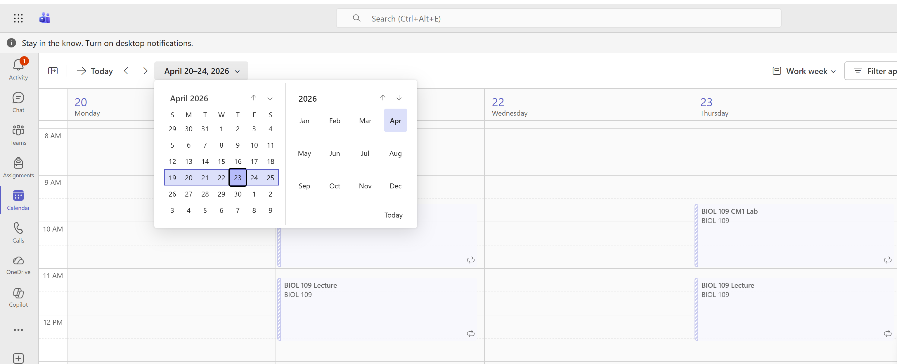
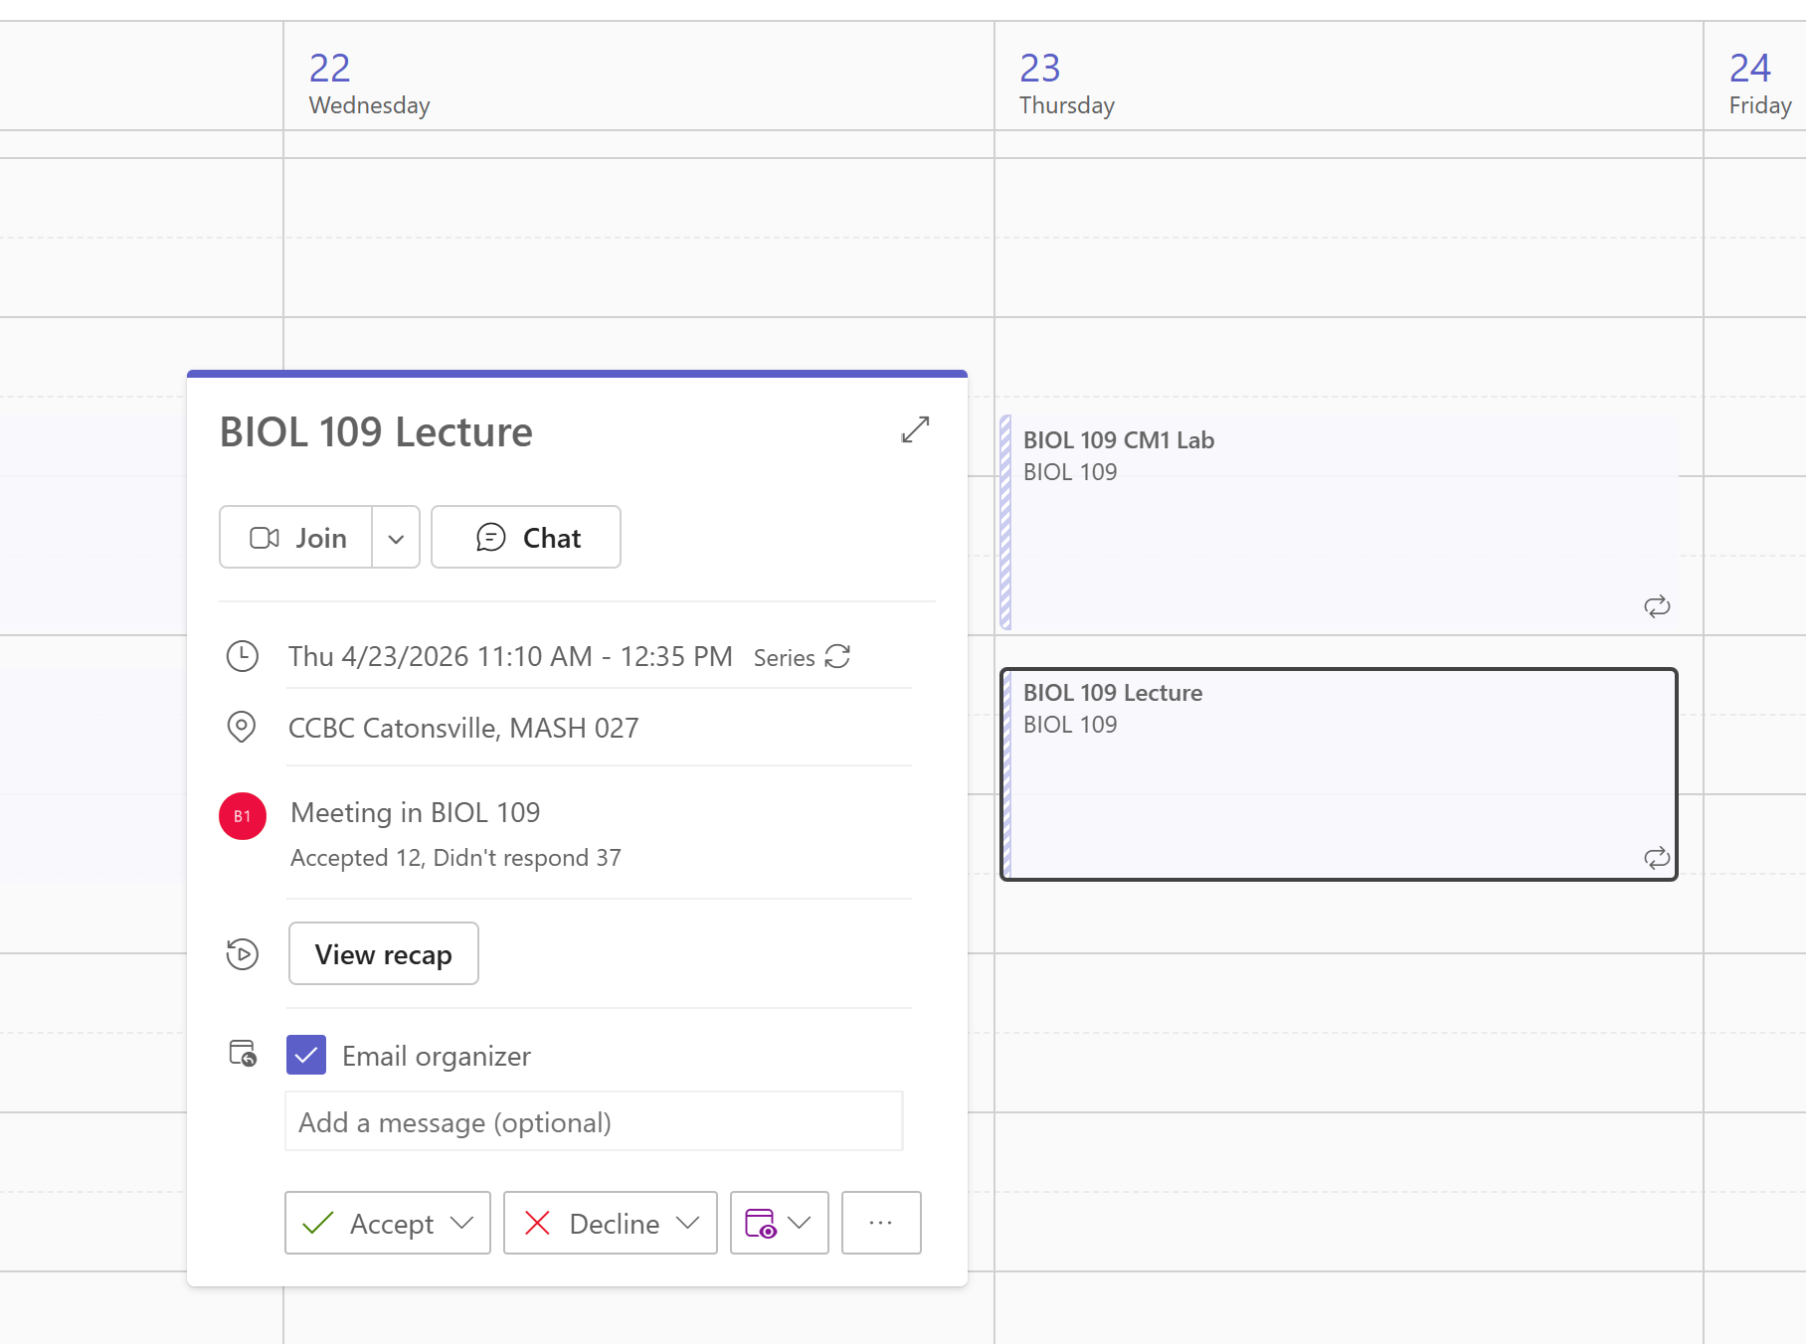
Using digital resources
Download the transcript from the recorded teams recap
Navigate to the date on Teams calendar and select the meeting block.
A window will pop up with details about the meeting. Click on the words “View recap”

Slide 4
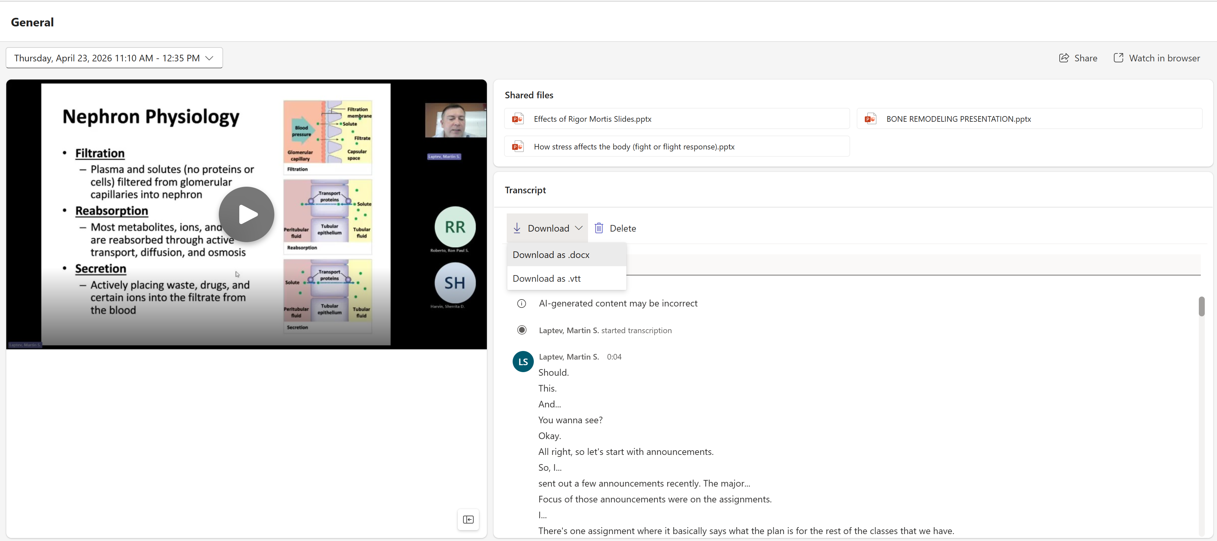
Downloading the transcript
The meeting recording will appear. Navigate to the right of the video image and click on the word Download.
In the dropdown menu, select Download as .docx file

Slide 5
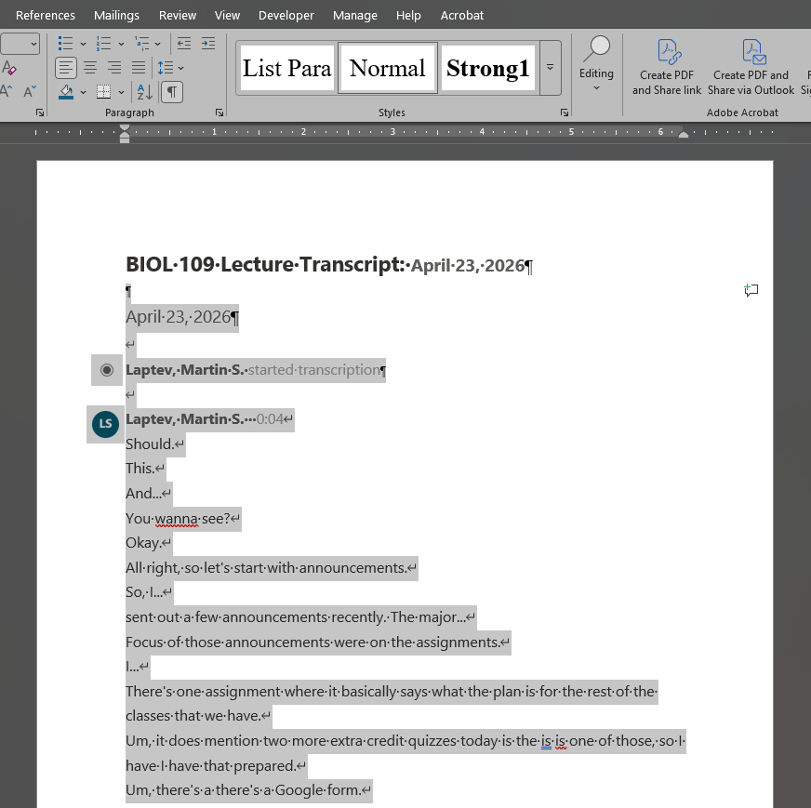
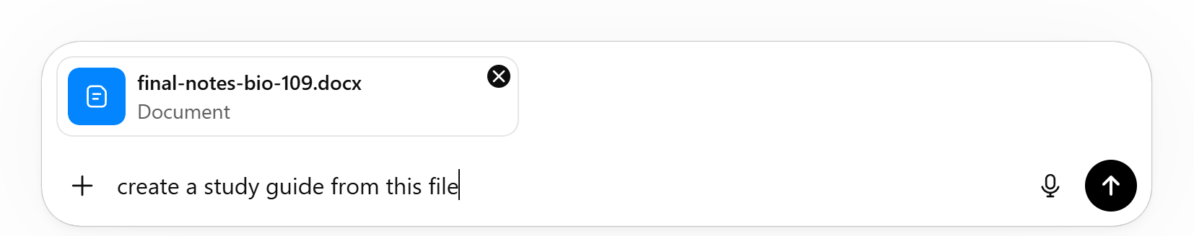
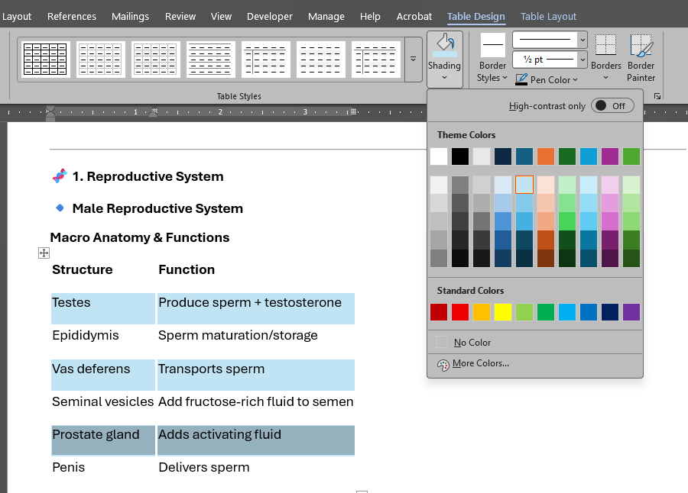
Processing the transcript file
1
2
Open the downloaded transcript .docx file and edit or delete any superfluous text
Run the file through an LLM with a prompt like “create a study guide from this file”
After copy and pasting the generated content into Word, edit the file to provide additional visual aids, such as adding color to alternating table rows to help break up multiple rows of text
3

Slide 6
Additional methods for learning styles
Listening to the notes with screen reading apps
Drawing notes from the audio and/or softcopy of the notes can help to create a custom visual learning guide
Writing out notes from the study guide document

