Slide 1
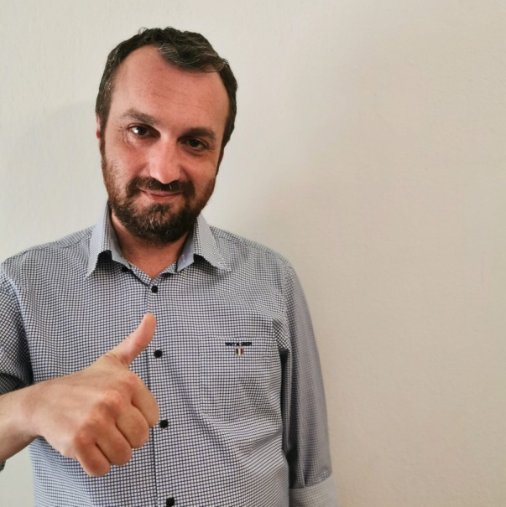
My name is George Ifantidis
About me :
I live in Thessaloniki
Studies :
Industrial informatics
Phd in Information systems

Slide 2
TOOLS USED IN PROJECT
Idelli J IDEA Community
SQL Server development
SQL Server management studio
Postman client
Git for windows
Putty key generator

Slide 3
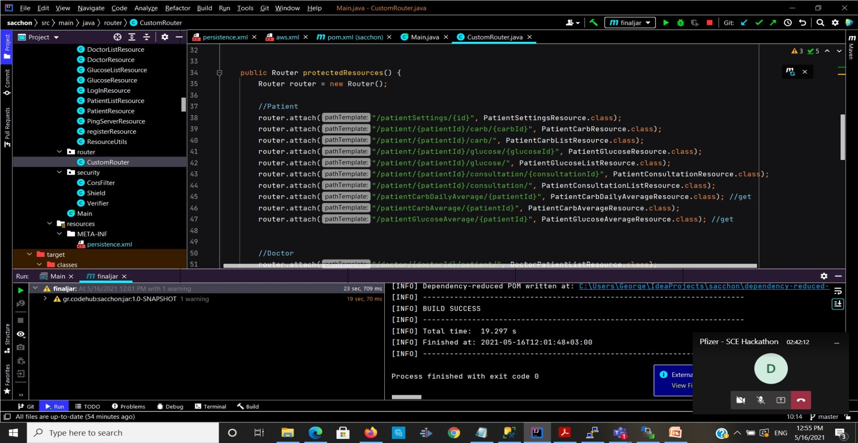
The first steps
Clone the project
Create a collection of request

Slide 4
Can we make the project better?
GDPR compliance
JWT authentication

Slide 5

Migration from in-premises to cloud.

Slide 6
Final Steps
Redesign the API
Develop tester classes for the system

Slide 7
The new knowledge
programming skills
Testing procedure
Cloud computing learning

Slide 8


THANKS

