Slide 1
If you have your PC and want to follow along, download slides:
https://github.com/msarvestani/CNI-JC
Notes:
i try to go to a summer workshop every year and, this year i ended up at a relatively new workshop that adrienne fairhall hosts along with some people from the allen institute. it was a great workshop all around, but the biggest takeaway for me was familiarity with the observatory dataset that the allen institute published this summer. it’s a ton of data, and they’ve worked pretty hard to make it accessible and transparent, so i just wanted to pass on my knowledge. because i think there’s a lot of potential for this group to put it to good use.
but let’s make this a conversation, i made the presentation pretty generic and short, so we have time to get into any details that you might be interested in. and you should interrupt me.
there are some links in the slides i’m going to use, so if you have your computer and want to follow along, go here:

Slide 2
Allen Brain Observatory Dataset
Madineh Sedigh-Sarvestani
CNI JC @ Upenn
Oct 2016
[Most slides are from Allen Institute’s Marina Garrett, or the Observatory website [observatory.brain-map.org/]

Slide 3



Observatory Team @ Allen
Saskia de Vries
Marina Garrett
Michael Buice
+ many others

Slide 4
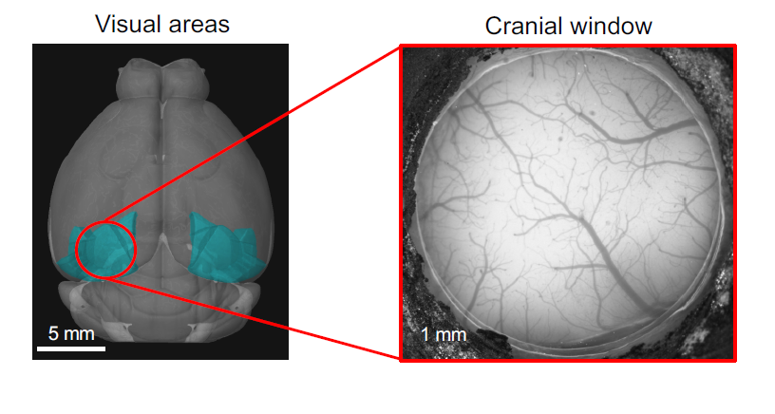
A ‘Window’ into the Brain
Mouse Brain
Notes:
All of observatory data is from about a 5 mm region around the visual cortex of the mouse. And they call it an observatory because you can get a glimpse of the mouse cortex universe, but really I think because the calcium flourescence images look like a starry sky.

Slide 5
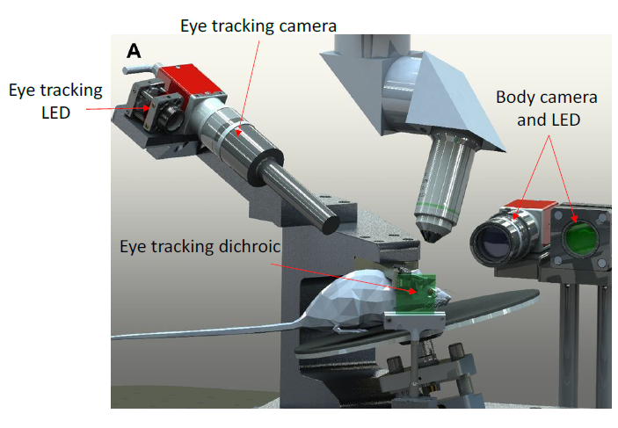
Notes:
So here’s the setup. There’s an awake mouse on a sort of running wheel, with the head fixed and the 2P objective over its cranial window. The monitor for the visual stim is sort of sticking out of the page Then there’s a video of the eye so you can do eye tracking and capture pupil diameter, and there’s a body camera so you can get general behavior if you’re interested in that sort of thing.

Slide 6
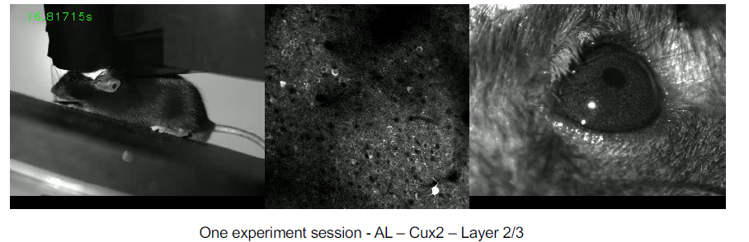
Awake, head-fixed mice, looking at visual stimuli.
2P calcium fluorescence responses of hundreds of neurons.
+ running speed
Eye video
Mouse behavior
Notes:
So the data this produces is the 2P calcium fluorescence movie, the running-speed, the eye-video, and the mouse behavior video

Slide 7
Genetic tools (Cre-lines x GCamp) are used to make specific cell types glow. Observatory dataset uses mice from 4 cre-lines (all exc). 7 more (exc/inh) planned for release.

Slide 8
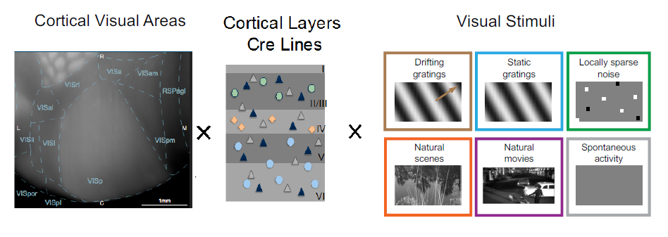
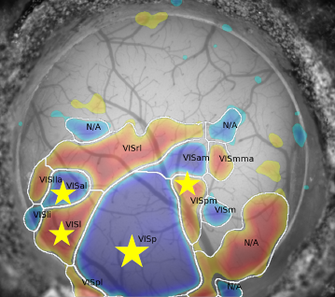
A Rich Dataset
4 Visual areas
4 cre-lines
Hypothesis-free
Notes:
But 0 hypotheses!!!!

Slide 9
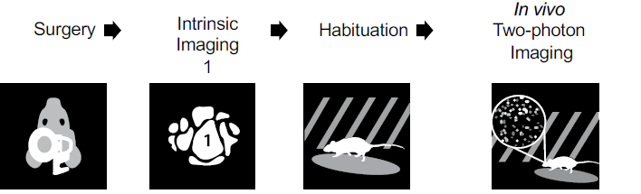
A Rich, Standardized, Dataset
Quality control throws out bad data

Slide 10
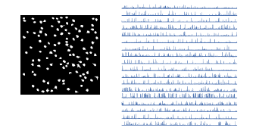
2P Data Generation
Motion correction
Segmentation (find cells)
Registration (match cells)
Fluorescence extraction
Background subtraction
Data pre-processing (temporal alignment, etc)
Compute df/f
Compute stimulus-specific response features
All raw (pre-processed) data also available.
Notes:
If you’ve done imaging, you know that this pipeline takes a fair amount of time to setup in your lab. And there is by no means consensus on what he best algorithms are to find the region of interest and how to subtract neuropil responses. But these are done for you here. And you have access to all levels of the data, from completely raw fluorescence traces without motion correction to each cell’s orientation selectivity index.

Slide 11
Pre-calculated Response Features
Stimuli, shown in three 1 hour sessions
Receptive field
Response reliability for each stimulus type
Orientation/direction selectivity
Preferred: tf, sf, orientation, natural image frame
Modulating by running

Slide 12
You can access some of the data (meta-data and extracted features) from the web. The rest (raw, post-processed, features) are accessible through a python package.

Slide 13
Accessing the Data (Web)
Web: observatory.brain-map.org

Slide 14
Accessing the Data (Python)
AllenSDK python package (toolbox) for downloading raw and processed data
Start with this example jupyter notebook

Slide 15
A Jupyter/Python notebook is just a web app that lets you interactively run python code, and look at the output. http://jupyter.org/

Slide 16
Accessing the Data (Python)
Run the notebook interactively (binder)

Slide 17
Data Format
Neurodata Without Borders (NWB).
HDF5 file
Includes stimulus data and metadata
Used for CRCNS ephys data sets:
https://crcns.org/
This paper has code snippets for reading;writing NWB data into matlab or python:

Slide 18
What to do with all this data? You could: 1) benchmark various motion correction/spike-extraction algorithms 2) Validate previous work on bigger dataset 3) Test new theories (running?) 4) Use it for teaching

Slide 19
Observatory Data Not Good for:
High temporal resolution (Calcium imaging)
Imaging frame rate is 30 Hz
Anything with precise spatial location
Eye movement (1/4 RF width) not controlled for until future release

Slide 20
Observatory Data Good for:
Response variability with: areas, cre-lines, layers, running, pupil diameter (extract)
Modeling signal and noise variability with brain state (Scholvinck 2015+)
Encoding with correlations (Pillow 2008+)
Also as a function of tuning similarity (sign-rule?)
Decoding with correlations
Does shuffling trials reduce performance?

Slide 21
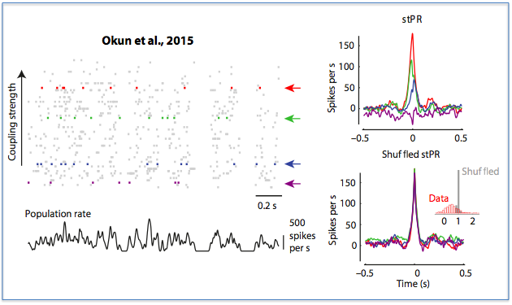
Population Coupling: an invariant neuronal property?
PC is peak of the spike-triggered population rate (stPR)
Okun et al. Figure 1
Pop coupling: correlation between each cell’s activity and total population activity.
Okun et al. Nature 521 (511-15), 2015
Notes:
Only use cells stable across all three sessions.
But define population as all cells in frame.

Slide 22
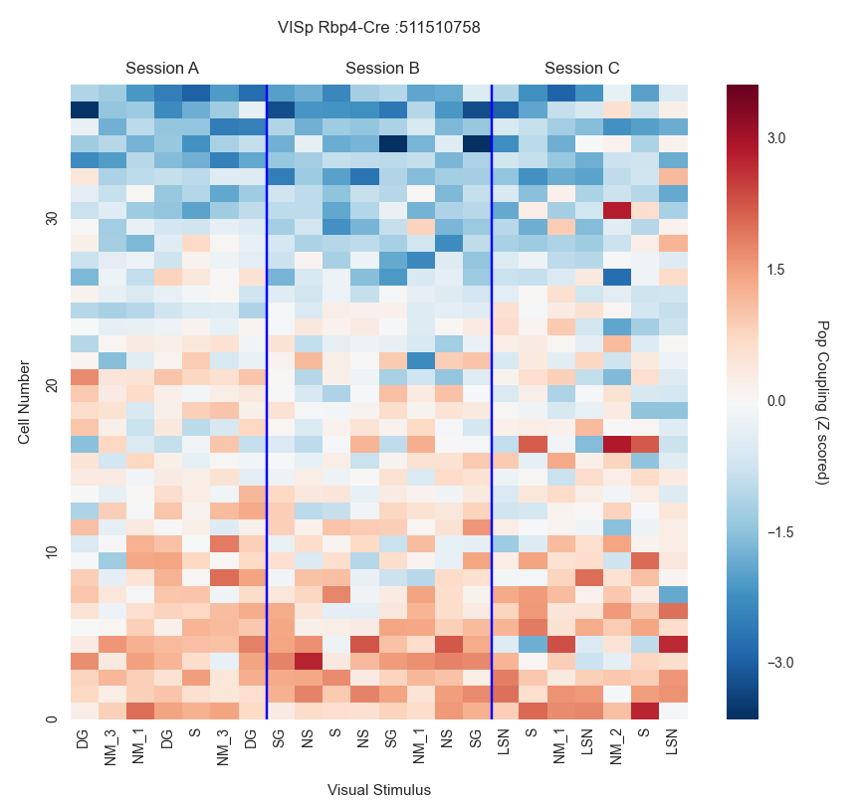
~Soloists
strong
PC low and invariant
Rows (cells) sorted by mean PC
PC high and invariant
~Choristers
weak
Notes:
Rows sorted by mean pc

Slide 23
Slides and Jupyter notebook: https://github.com/msarvestani/CNI-JC
Much More info on Observatory: http://observatory.brain-map.org/

Slide 24
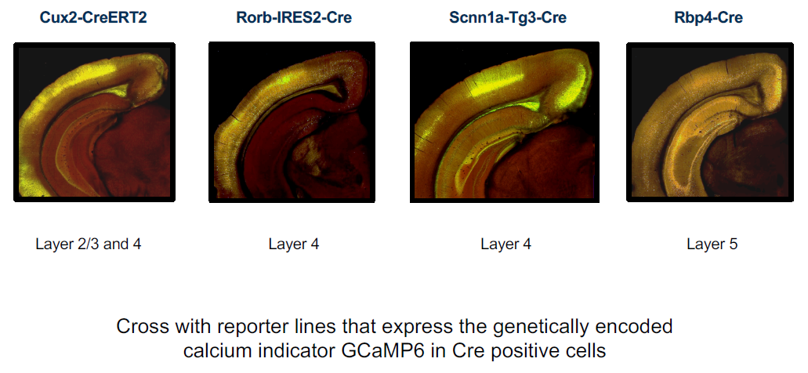
Cre-lines

Slide 25
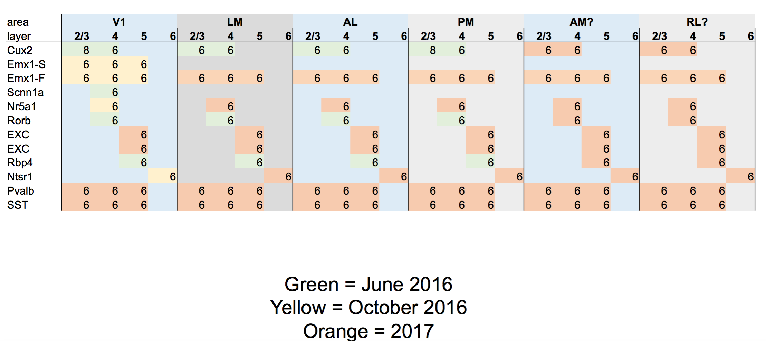
Upcoming Data Dumps

Slide 26
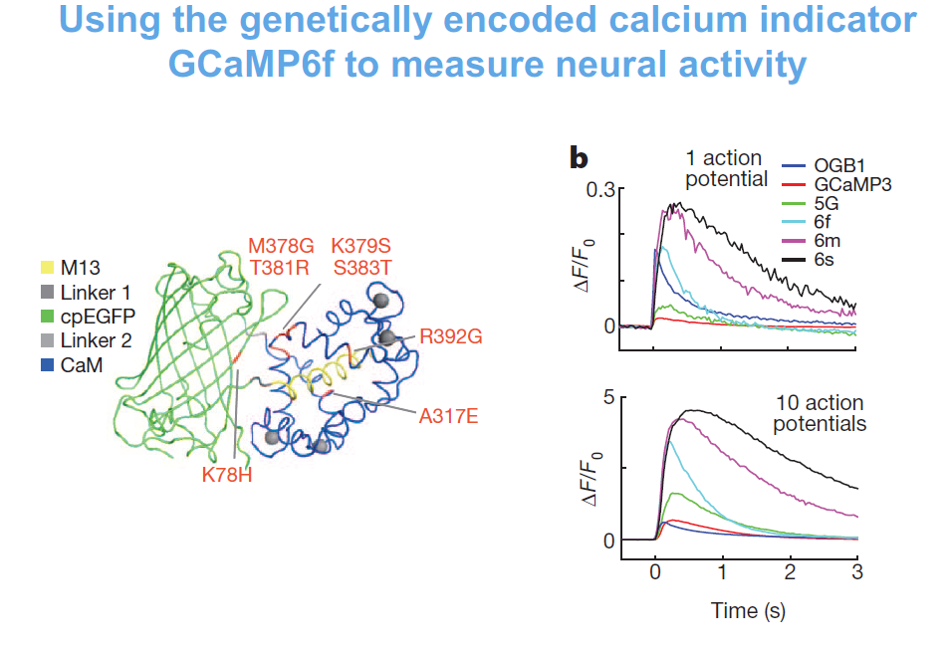
GCaMPf6f (Chen 2013)

