Slide 1


kubernetes
DotNetCore 3.0

Slide 2
Application Structure
K8.LongProcess.csproj
Import CronJob
K8.FrontEnd.csproj
FrontEnd – Web Api
Convert CronJob
http://k8-frontend-app.local/weatherforecast
api
http://k8-frontend-app.local/swagger
docs
http://k8-frontend-app.local/liveness
dotnet run -- -t Convert -d 10 -c 5
livenessProbe
http://k8-frontend-app.local/healthy
readinessProbe

Slide 3
Problem statement #1
It works on my machine!
Install OS dependencies breaks other apps.
Unable to upgrade the Application
Containers
App1
App2
Application
Container Engine/ Docker
Host OS /Linux
Hardware
OS

Slide 4
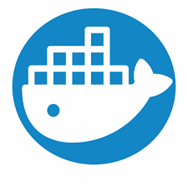

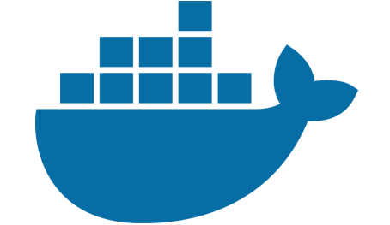


FROM mcr.microsoft.com/dotnet/core/sdk:3.0-alpine AS build
Dockerfile
Image Layers
Containers
docker build
docker run
docker-compose up –d –no-create
docker-compose up

Slide 5
Local Machine
Docker Host
Registry
docker daemon
Dockerfile
images
docker build
docker pull
Images
docker push
docker run
docker run
containers

Slide 6
Docker Images
Image: com.io/k8.demo.frontend:v1
src/K8.FrontEnd/Dockerfile
Image: com.io/k8.demo.base:v1
AspNetCore Web Api
Dockerfile.base
Image: com.io/k8.demo.cronjobs:v1
src/K8.LongProcess/Dockerfile
Supports:
ONBUILD commands
CUSTOM NUGET FEED
$PAT
$FEED
$MSI_ENDPOINT
$MSI_SECRET
CronJobs:
Import
Convert

Slide 7

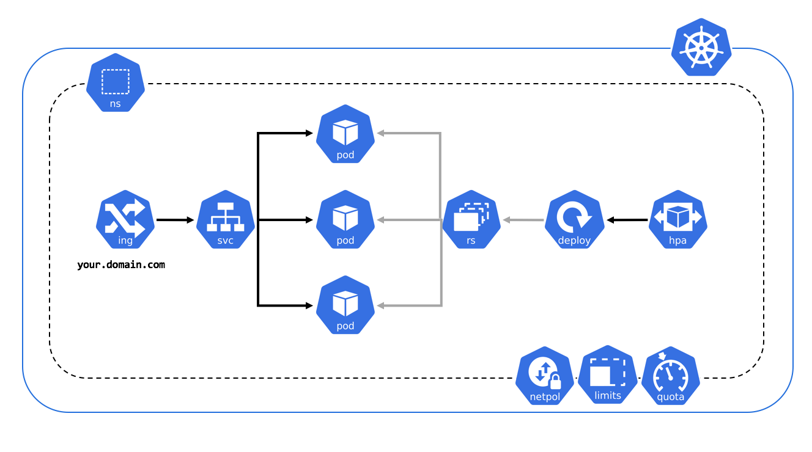


Slide 8


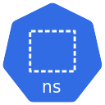


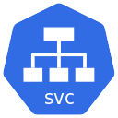
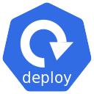



K8 and Azure
Azure Vault
Azure Storage
Azure Subscription
dev
ingress.yaml
frontend.service.yaml
frontend.yaml
cronjob-c.yaml
cronjob-i.yaml
frontent-wecp

Slide 9
Problem Statement #2
Storing securely Application Secrets
Application settings file
“database”
Azure Key Vault

Slide 10

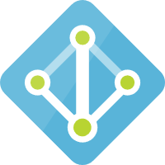

Managed Identity
Azure Key Vault
Pod Identity
Azure Storage
Azure Active Directory
Azure Container Registry (ACR)

