Slide 1

为.NET 开发人员准备的Dapr
张善友
代码 & PPT : https://github.com/geffzhang/TyeDaprDemo
Notes:
Dapr 是一个支持任何语言、运行框架、任何地方的分布式应用程序运行时，我将聚焦于dotnet 平台来介绍Dapr。

Slide 2
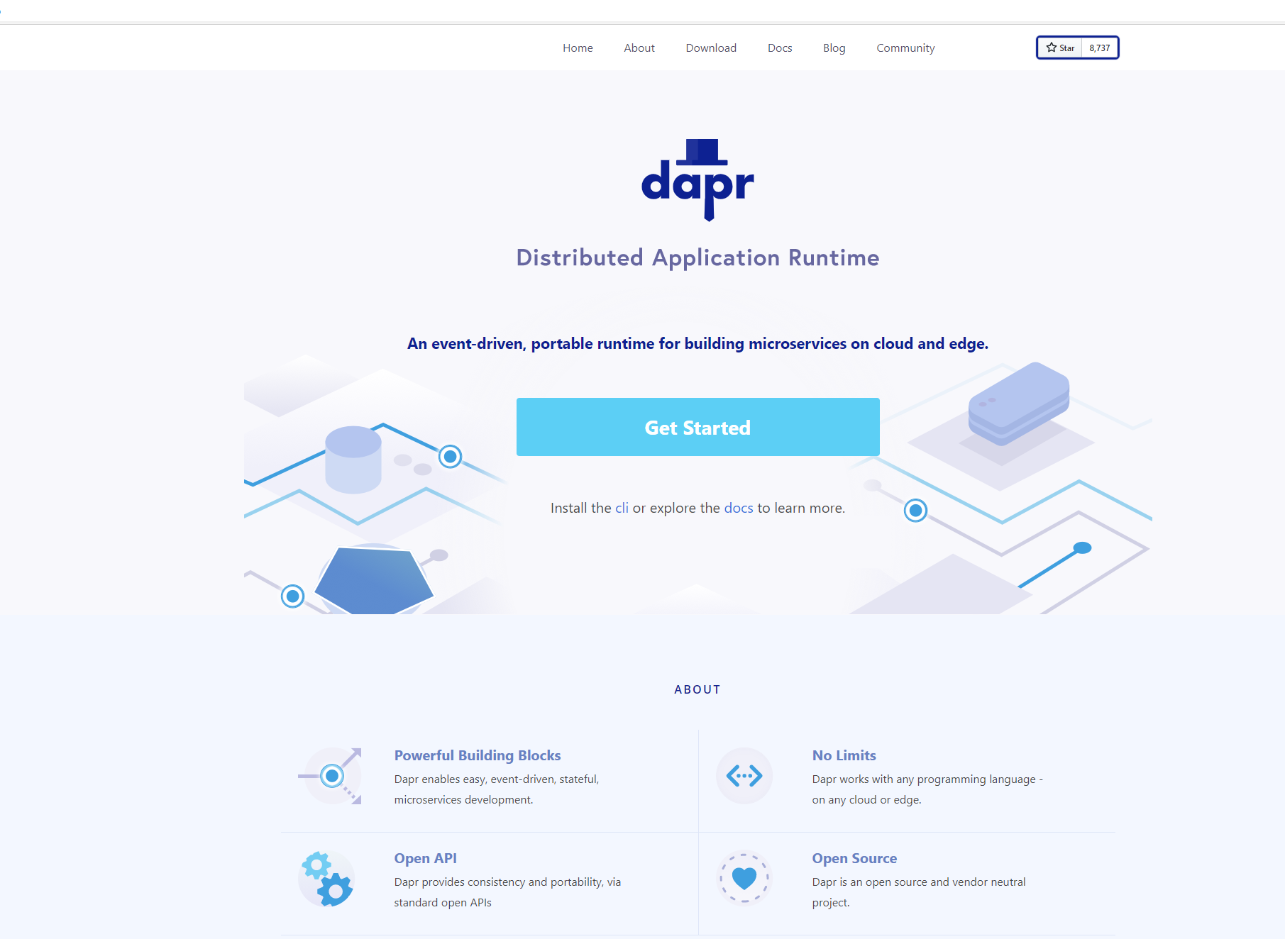
分布式应用程序运行时
Dapr 是一个可移植的、事件驱动的运行时，它使任何开发人员能够轻松构建出弹性的、无状态和有状态的应用程序，并可运行在云平台或边缘计算中，它同时也支持多种编程语言和开发框架
https://dapr.io

Slide 3
微服务为什么很难?
需要支持许多不同的集成点(cache, message queues, 3rd party APIs, secret stores)
与特定服务和 SDK 相结合，这会导致代码耦合。
有许多的方案来支持 tracing, configuration, 和 secret management

Slide 4
微服务构建块
HTTP API
gRPC API
Service-to-service invocation
State management
Publish and subscribe
Resource bindings and triggers
Actors
Observability
Secrets
Extensible

Slide 5

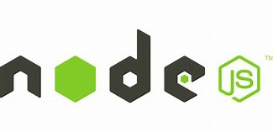



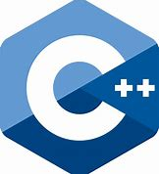

微服务构建块
用户服务代码通过http/gRPC 协议访问标准的APIs
http://localhost:3500/v1.0/invoke/cart/method/neworder
http://localhost:3500/v1.0/state/inventory/item67
运行时 为每一个服务通过 “边车 库”的形式动态的加载 运行
应用程序代码
微服务使用任何语言进行编写
任何语言或者框架……
HTTP API
gRPC API
Service-to-service invocation
State management
Publish and subscribe
Resource bindings and triggers
Actors
Observability
Secrets
Extensible

Slide 6
71 Dapr Components
27 I/O Bindings
18 State stores
11 Pub/Sub
13 General
7 Azure
5 AWS
Aerospike
Cassandra
Cloudstate
Couchbase
etcd
Hashicorp Consul
Hazelcast
Memcached
MongoDB
PostgreSQL
RethinkDB
Redis
Zookeeper
Azure CosmosDB
Azure SQL Server
Azure Table Storage
Azure Blob Storage
Google Cloud Firestore
Redis Streams
Apache Kafka
AWS SNS/SQS
Azure Events Hub
Azure Service Bus
GCP Pub/Sub
Hazelcast
MQTT
NATS streaming
Pulsar
RabbitMQ
APNs
Cron (Scheduler)
HTTP
InfluxDB
Kafka
Kubernetes Events
MQTT
PostgreSql
RabbitMQ
Redis
Twilio
Twitter
SendGrid
Azure Blob Storage
Azure EventHubs
Azure CosmosDB
Azure Service Bus Queues
Azure SignalR
Azure Storage Queues
Azure Event Grid
AWS DynamoDB
AWS S3
AWS SNS
AWS SQS
AWS Kinesis
1 AliCloud
Blob Storage
2 GCP
GCP Cloud Pub/Sub
GCP Storage Bucket
8 Secret stores
Azure Key Vault secret store
Azure Key Vault with Kubernetes MI
AWS Secrets Manager
GCP Secret Manager
HashiCorp Vault
Kubernetes Secrets
Local environment variables (for Development)
Local file (for Development)
4 HTTP Middleware
2 Name Resolution
OAuth2
Open Policy Agent (OPA)
Rate limit
Bearer
Kubernetes
Multicast DNS

Slide 7











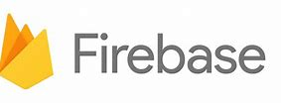



Observability
Sidecars 和
components
Capturing, querying
traces, logs and metrics
Prometheus
AppInsightts
Jaeger
Bindings
…others
Scanning for events
Input/output
EventHub
Kafka
AWS SQS
GCP pub/sub
Application
Secure communication with mTLS
Service
code A
Service
code B
Dapr API
Dapr API
Tracing, logs
and metrics
Tracing, logs
and metrics
Sidecar
Sidecar
Load and
save state
State stores
…others
AWS DynamoDB
CosmosDB
Publish & subscribe
Messaging
…others
Service Bus

Slide 8
Dapr 构建块
服务间调用
Post
http://localhost:3500/v1.0/invoke/nodeapp/method/neworder
{
“orderid":“123",
“data":“item1"
}
pythonapp
1
2
multicast DNS component
6
Post
http://10.0.0.2:8000/neworder
{
“orderid":“123",
“data":“item1"
}
3
5
nodeapp
3
4

Slide 9

Dapr 构建块
发布和订阅
Publish
Subscribe
“cart”
“shipping”
Post
http://10.0.0.5:8005/order
Post
http://localhost:3500/v1.0/publish/
"data":{
"user":"johndoe",
"item":"ZeroDay"
}
"topic":"order",
"data":{
"user":"johndoe",
"item":"ZeroDay"
},
Post
http://10.0.0.4:8004/order
“email”

Slide 10
Dapr 是如何运行的
Kubernetes
Standalone (self-hosted)
apiVersion: apps/v1
kind: Deployment
metadata:
name: my-app
labels:
app: my-app
spec:
selector:
matchLabels:
app: my-app
template:
metadata:
labels:
app: my-app
annotations:
dapr.io/enabled: "true"
dapr.io/app-id: "my-appr"
dapr.io/app-protocol: ”http"
dapr.io/app-port: ”8080”
…
dapr run --app-id my-app \
--app-protocol grpc \
--app-port 50105 \
--components-path ./config \
go run main.go
dapr run --app-id my-app \
--app-protocol http \
--app-port 3000 \
--components-path ./config \
dotnet run
dapr run --app-id my-app \
--app-protocol http \
--app-port 5678 \
--components-path ./config \
./my-exe
Notes:
So, how do you get that magical sidecar that does all these things?
Well, on k8s, that’s as simple as decorating your deployment with a few annotations (2 required, enabled, app-id, but there is more)
Dapr will inject a sidecar into your Pod, and your app has the same API you had on your laptop during the development
In a standalone mode (or self-hosted as it is sometimes called) you use the “dapr run” command with a few flags
Whether this is Java, C#, Go, Python or compiled executable

Slide 11
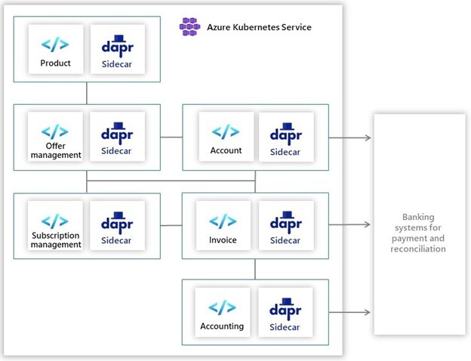
Dapr 的 .NET 案例
Ignition Group 打造的订单处理软件可以跟踪产品、管理订阅和处理来自各种来源的支付。订单处理涉及许多依赖，有一个采购跟踪机制，这个机制会调用客户订阅，触发会计和计费流程，并确定适当的支付渠道。Ignition Group 希望微服务能给其工作流逻辑带来好处——高可用性、弹性、可扩展性和性能。使用 Dapr 和 .NET Core，Ignition Group 构建了一个新的、可扩展性更好的、可维护的订单处理和支付系统，该系统目前已在生产中运行。
https://customers.microsoft.com/en-us/story/1335733425802443016-ignition-group-speeds-development-and-payment-processing-using-dapr-and-azure

Slide 12
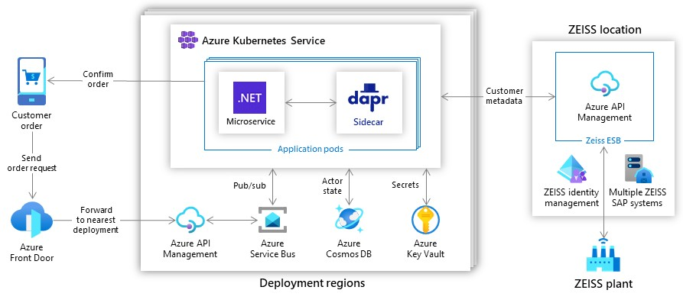
Dapr 的 .NET 案例
ZEISS 面临的挑战是维护和更新一个具有 20 年历史的带有硬编码业务规则的后端系统。原来的订单验证和路由解决方案是基于一个具有固定容量的单体架构，开发人员在不直接在系统中重新配置表格的情况下，无法轻松的更新、重新路由或跟踪订单。此外，业务部门无法直接控制其订单处理流程。由于存在大量的系统依赖，变更总是需要代价高昂而耗时的开发人员干预。为了解决这个问题，ZEISS 使用 Azure 和 Dapr 开发了一个新的应用程序，可以更快地完成客户订单，同时还加快了开发速度，并改善了公司的业务连续性
https://customers.microsoft.com/en-us/story/1336089737047375040-zeiss-accelerates-cloud-first-development-on-azure-and-streamlines-order-processing

Slide 13
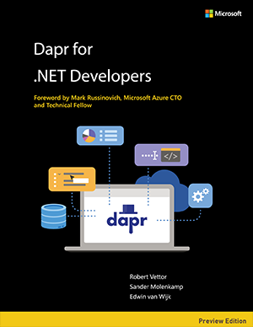
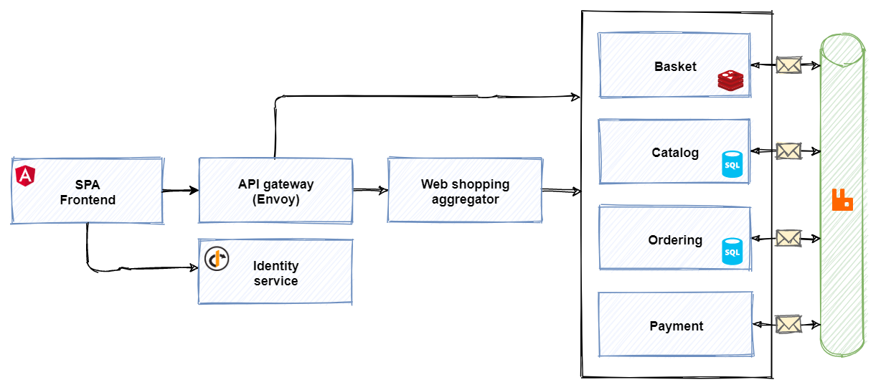
Dapr 的 .NET 资料
https://github.com/dotnet-architecture/eShopOnDapr
https://dotnet.microsoft.com/learn/aspnet/microservices-architecture#ebook-dapr-swimlane

Slide 14
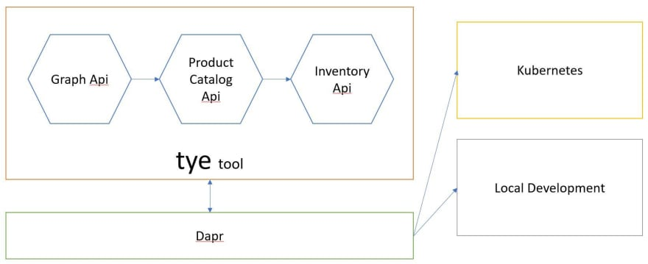
Dapr 的 好兄弟 Tye
使用 Tye 调试Dapr 应用程序
通过配置约定实现服务发现
了解.NET项目文件
本地日志、指标等仪表板
可以运行Docker依赖关系
可以将您的服务部署到 K8s
“热重载"

Slide 15
DEMO: Dapr state management and bindings
DEMO
Dapr for the .NET developer

