Slide 1
ASP.NET Core Introduction
Miroslav Popović
Technical Lead, Seavus Group
@miroslavpopovic
https://miroslavpopovic.com
Notes:
So what is .NET?

Slide 2
Benefits

Slide 3
ASP.NET Core Benefits
Multiplatform
Real open-source
Performance
Languages - C#, F#...
New configuration system
Easy to use with Docker

Slide 4
ASP.NET Core Benefits (cont.)
Side by side execution
Joined MVC and Web API
Excellent for REST APIs
Plays great with modern web tools
Blazor - full-stack C#
Part of the .NET future

Slide 5
Basics

Slide 6
Project files
.csproj SDK project file type
Lot simpler than in .NET Framework
Configure project properties and dependencies

Slide 7
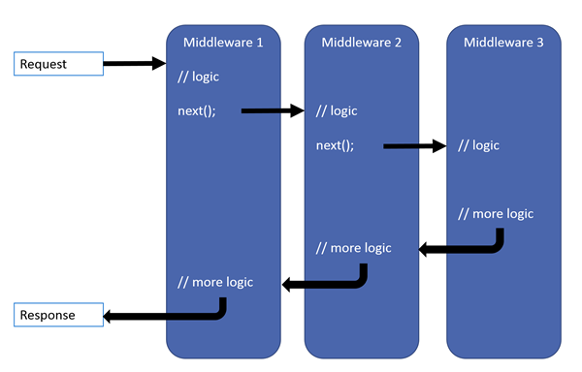
Middleware pipeline
Notes:
Image taken from the blog post by Thomas Levesque: https://thomaslevesque.com/2018/03/27/understanding-the-asp-net-core-middleware-pipeline/

Slide 8
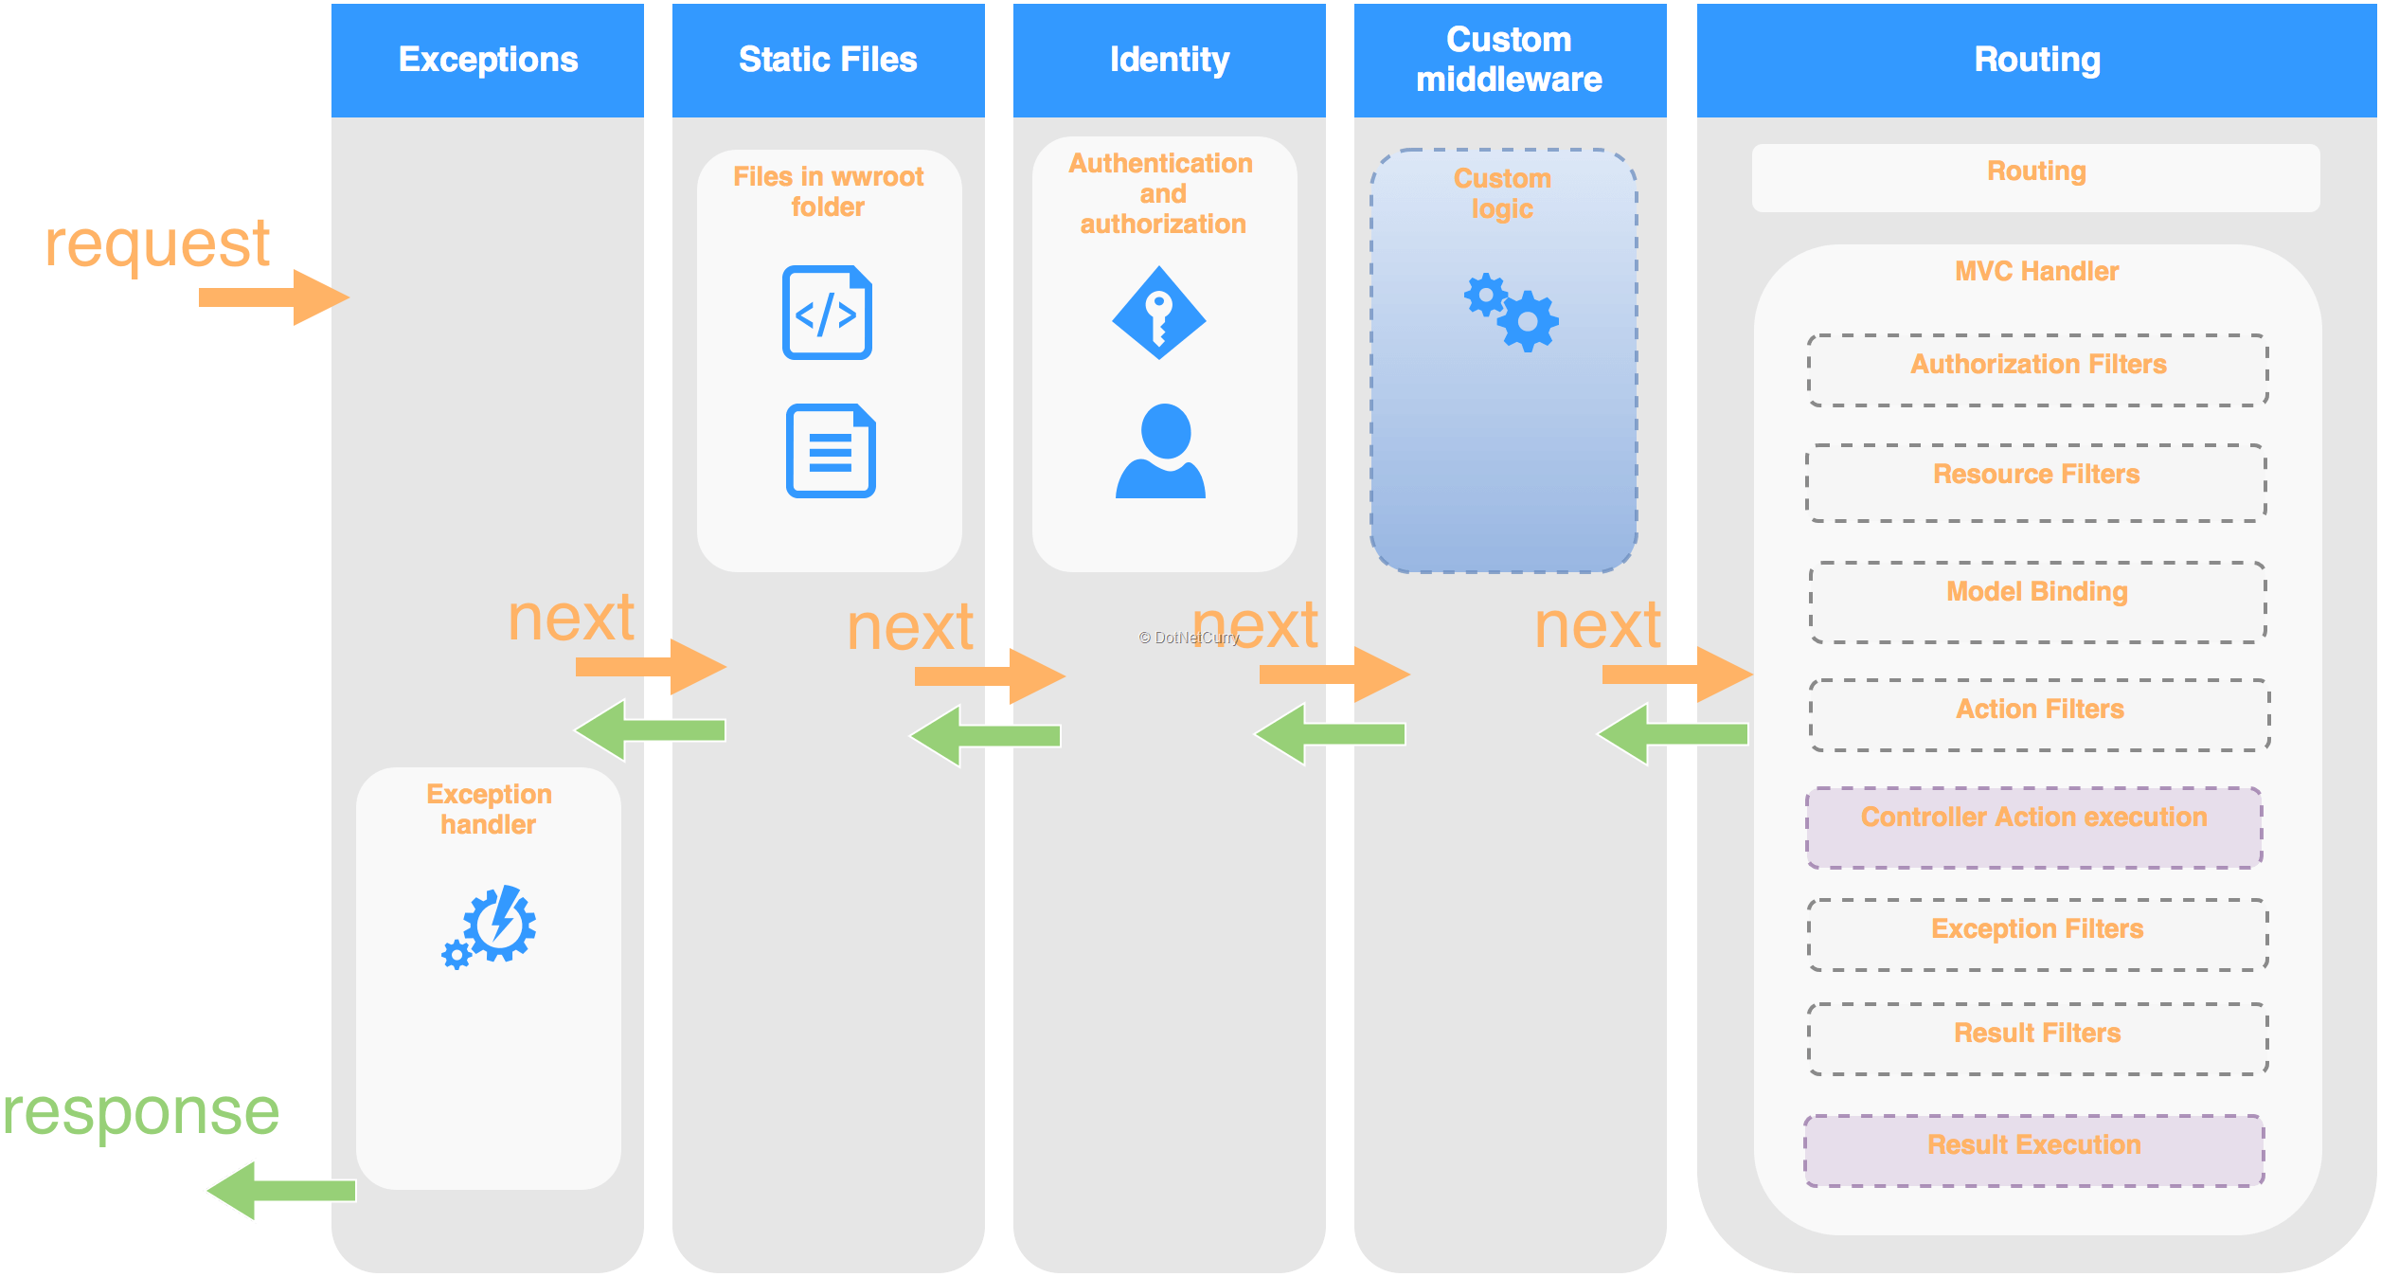
Middleware pipeline
Notes:
Image taken from the DotNetCurry article: https://www.dotnetcurry.com/aspnet/1329/aspnet-core-11-what-is-new

Slide 9
Dependency Injection
Inversion of Control (IoC) between classes and dependencies
Lifetime - transient, scoped, singleton
Services (dependencies) registered in Startup class

Slide 10
Startup class
ConfigureServices
Dependency Injection configuration
services.AddTransient()
services.AddScoped()
services.AddSingleton()
Adding predefined services
services.AddMvc()
services.AddAuthentication()
Configure
Defining middleware pipeline
app.UseRouting()
app.UseMvc()
app.UseEndpoints()

Slide 11
Configuration
Host.CreateDefaultBuilder()
IConfiguration
appsettings.json
appsettings.Development.json
appsettings.Production.json
User secrets
Environment variables
Command line arguments

Slide 12
Logging
ILogger, ILogger<T>
_logger.LogInformation()
_logger.LogDebug()
_logger.LogError()
Console logger
Debug logger

Slide 13
Routing
Mapping URLs to code
Conventions and attribute based
Works for any server type
app.UseRouting()
app.UseEndpoints(...)

Slide 14
Static files
wwwroot folder
app.UseStaticFiles()
app.UseDirectoryBrowser()
app.UseDefaultFiles()
app.UseFileServer()

Slide 15
MVC

Slide 16

MVC
Model View Controller

Slide 17
Controllers
Inherit Controller class (or not)
Have action methods
Endpoints with URLs
Triggered with HTTP verbs
GET, POST, PUT, DELETE…
Can have input parameters
processed with model binding
Can return
views or
raw data using content negotiation

Slide 18
Models & View Models
Models
Domain data
Can be loaded from DB
Can have validation
View Models
Or input models, or display models, or DTOs…
Subset of data designed according to the view needs
Subset of data that user will send in request (input model)
Input models should have validation

Slide 19
Razor
.cshtml files
Syntax for embedding server-side code into web pages
Razor markup + C# + HTML

Slide 20
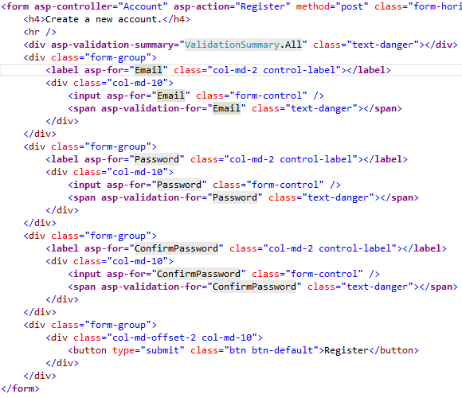
Tag Helpers
Enable server-side code to participate in creating and rendering of HTML elements
<label asp-for=“Product.Name”></label>
<label for=“Product_Name”></label>
Nicer syntax comparing to HTML helpers

Slide 21
Web Components
Doesn’t use model binding
Can have parameters and business logic
Has a C# class and a view
For reusable parts of the view:
Login panel
Shopping cart
Tag cloud
Dynamic menus
…
<wc:my-component parameter1=“value1”> </wc:my-component>

Slide 22
Web API

Slide 23
Similar to MVC
Same controllers
Same models
Similar View Models
No Views - raw data returned

Slide 24
Conventions
[ApiController] attribute
ActionResult<T>
API convention classes
API analyzers
Swagger / Open API specification

Slide 25
Clients
SPA clients (Aurelia, Angular, React, Vue…)
Mobile clients (Android, iOS…)
.NET Clients
HttpClient
HttpClientFactory
Swagger code generation
Notes:
Why it’s a good idea to use HttpClientFactory: https://docs.microsoft.com/en-us/dotnet/standard/microservices-architecture/implement-resilient-applications/use-httpclientfactory-to-implement-resilient-http-requests
NSwag: https://github.com/RicoSuter/Nswag

Slide 26
Data access & auth

Slide 27
Entity Framework Core
ORM - Object-Relational Mapper
Mapping models to db
LINQ for queries (or raw SQL)
Multiple databases supported
SQL Server, SQLite, InMemory
CosmosDB
PostgreSQL, MySQL, Maria
Oracle
…
DB versioning and migrations

Slide 28
Authentication & Authorization
Authentication middleware
Authorization middleware
[Authorize] filters
OAuth 2.0 & OpenID Connect

Slide 29
ASP.NET Core Identity
Local authentication
username and password
OpenID authentication
Google, Microsoft, Twitter, Facebook…
Federated authentication
Active Directory, Azure AD, Windows authentication…
Full solution
Views and logic for user registration and authentication
Scaffolding

Slide 30
Identity Server
Advanced scenarios
OAuth 2.0 and OpenID Connect server

Slide 31
Thanks! Questions?
@miroslavpopovic
https://miroslavpopovic.com

