Slide 1
Blazor Introduction
Miroslav Popović
Technical Lead, Seavus Group
@miroslavpopovic
https://miroslavpopovic.com
Notes:
So what is .NET?

Slide 2
What is Blazor?

Slide 3

Blazor framework
A new framework for building interactive web UI with .NET
Created by Steve Sanderson
Open source - part of ASP.NET Core
Uses C# instead of JavaScript
Full-stack C#
Components and hosting model
Client-side or server-side

Slide 4
Blazor Benefits
C# instead of JavaScript
Existing .NET ecosystem
Share logic between client and server
Development with Visual Studio 2019 and VS Code
Alternative to SPA frameworks like Aurelia, Angular, React, Vue…

Slide 5
Basics

Slide 6
Components
Element of UI - page, dialog, data entry form…
Define rendering logic
Handle user events
Can be nested and reduced
Can be shared as class libraries or NuGet packages
.razor files

Slide 7
Sample component - Dialog.razor
<div>
<h1>@Title</h1>
@ChildContent
<button @onclick="OnYes">Yes!</button>
</div>
@code {
[Parameter]
public string Title { get; set; }
[Parameter]
public RenderFragment ChildContent { get; set; }
private void OnYes()
{
Console.WriteLine("Write to the console in C#! 'Yes' button was selected.");
}
}

Slide 8
Sample component usage - Index.razor
@page "/"
<h1>Hello, world!</h1>
Welcome to your new app.
<Dialog Title="Blazor">
Do you want to <i>learn more</i> about Blazor?
</Dialog>

Slide 9
Blazor WebAssembly (client-side)
WebAssembly - wasm standard
Wide browser support
Based on work done by Mono team
How it works
C# code and Razor get compiled into .NET assemblies
The assemblies and .NET runtime downloaded to browser
Blazor WebAssembly bootstraps runtime and loads the assemblies for the app
JavaScript interop used for DOM manipulation and browser API calls

Slide 10
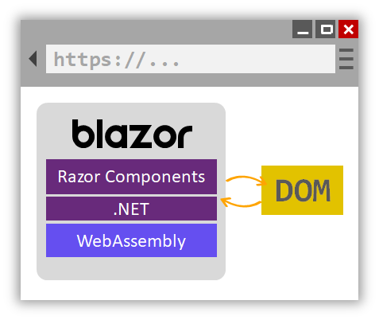
Blazor WebAssembly (client-side)

Slide 11
Blazor Server
Blazor components hosted on server
UI updates handled over SignalR connection
Event handling logic runs on server
JavaScript interop also done via SignalR connection

Slide 12
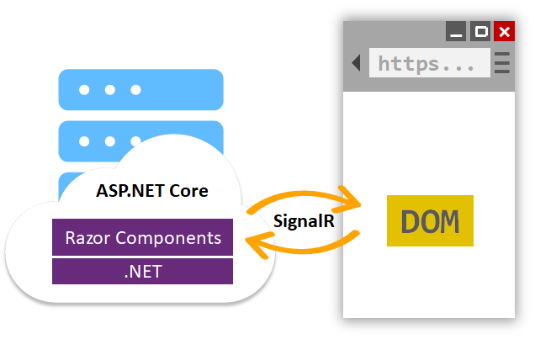
Blazor Server

Slide 13
Resources and future

Slide 14
Blazor resources
https://blazor.net/
https://dotnet.microsoft.com/apps/aspnet/web-apps/client
https://docs.microsoft.com/en-us/aspnet/core/blazor/?view=aspnetcore-3.0
https://github.com/AdrienTorris/awesome-blazor

Slide 15
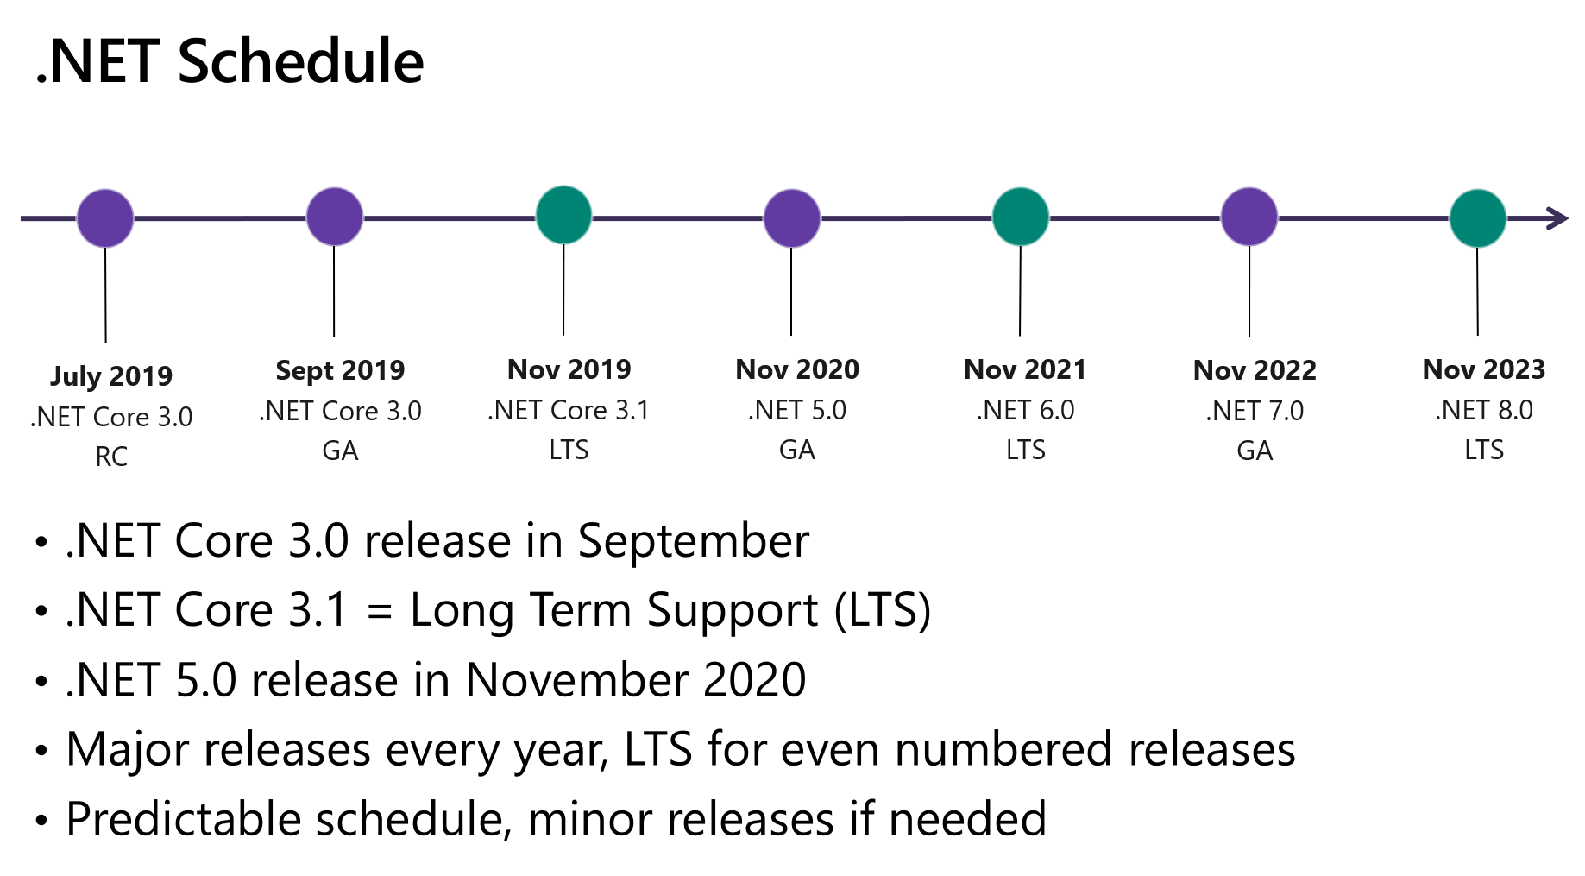
Future
Blazor Server - released as part of ASP.NET Core 3.0
Blazor WebAssembly - out-of-band release
First quarter of 2020.?
Blazor xxx (native)?

Slide 16
Thanks! Questions?
@miroslavpopovic
https://miroslavpopovic.com

