Slide 1
REST API Introduction
Miroslav Popović
Technical Lead, Seavus Group
@miroslavpopovic
https://miroslavpopovic.com
Notes:
So what is .NET?

Slide 2
Basics

Slide 3
REST(ful)
REST
architecture type that’s using the existing web infrastructure
RESTful
services that implement REST architecture
Web resources – identified with URL address
HTTP verbs
GET, POST, PUT, DELETE, PATCH…
JSON or XML
Strict and pragmatic approach

Slide 4
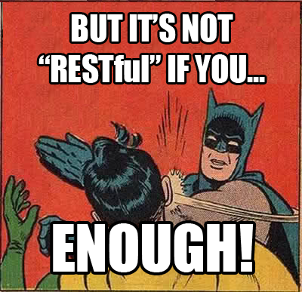

Slide 5
Additional ASP.NET Core Benefits for REST APIs
Endpoint routing - defining URLs
Support for HTTP verbs
Model binding
Content negotiation (JSON, XML, …)
Middleware / action filters
OAuth 2.0 support

Slide 6
Additional ASP.NET Core Benefits for REST APIs
Conventions
[ApiController]
ActionResult<T>
Convention definitions
Roslyn analyzers
Swagger support
SPA authentication with Identity Server

Slide 7
Production-ready APIs?

Slide 8
Best practices
IActionResult, ActionResult<T>
View Models
Model / input validation
Exception handling
Logging
Paging

Slide 9
Security
HTTPS
OAuth 2.0
JWT token based authentication
Identity Server 4.0
https://identityserver.io/
Third party
Auth0 - https://auth0.com/
Okta - https://developer.okta.com/
…

Slide 10
Testing
Unit testing
Integration testing
Manual testing
Tools (Postman, Fiddler, …)
Stress / load testing
https://loader.io/
https://artillery.io/
https://gatling.io/
http://websurge.west-wind.com/

Slide 11
Documentation
http://swagger.io/ -> https://www.openapis.org/
Swagger -> Open API Specification 3.0
API framework
Docs
Define an API
Automate API testing
Code generation
...
API Analyzers - Microsoft.AspNetCore.Mvc.Api.Analyzers
Swashbuckle or NSwag and Swagger UI

Slide 12

Rainbows and unicorns
Image source: https://www.percussion.com/blog/2015/March/unicorns-and-rainbows-wont-help-your-social-media-data-will

Slide 13
Usage limiting
Limit per token
With middleware or action filter
https://github.com/stefanprodan/AspNetCoreRateLimit
Limit per Client IP
Limit per Client ID header

Slide 14
Versioning
URL
/api/v2/games/
Query string
/api/games?api-version=2
Custom request header
api-version: 2
Accept header
Accept: application/json;v=2
Microsoft.AspNetCore.Mvc.Versioning
Supports all types, query string by default (?api-version=2)

Slide 15
Monitoring
Simple logging – errors, logs
Performance tracking
Usage tracking
Azure – Azure Monitor, Application Insights, Log Analytics …
ASP.NET Core Health Checks
https://github.com/Xabaril/AspNetCore.Diagnostics.HealthChecks/
Third-party monitoring services
https://newrelic.com/
https://stackify.com/
https://www.monitis.com/
https://www.runscope.com/
…

Slide 16


Slide 17


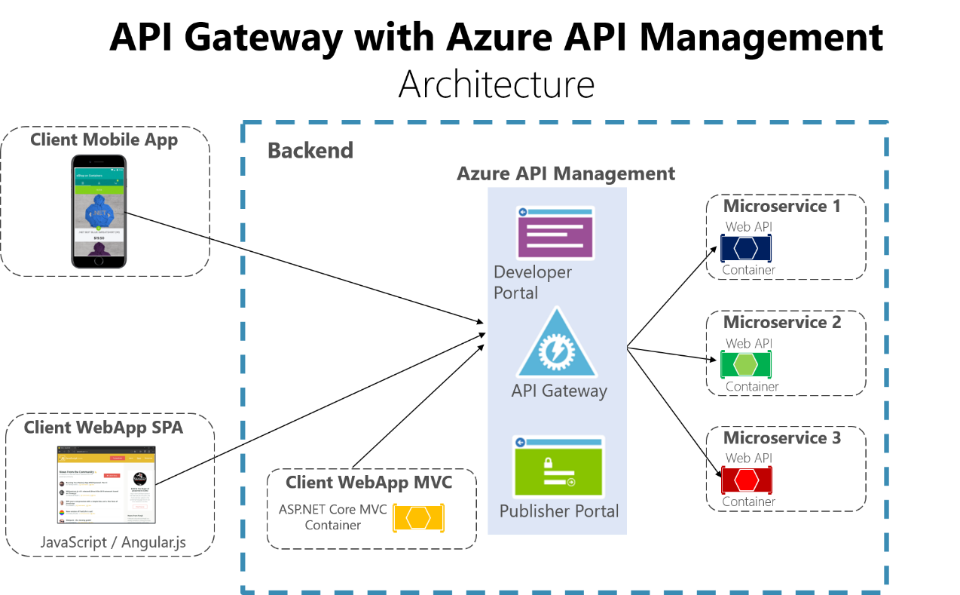
API Gateways
Features
Routing
Request Aggregation
Service Discovery with Consul & Eureka
Service Fabric
Kubernetes
WebSockets
Authentication
Authorisation
Rate Limiting
Caching
Retry policies / QoS
Load Balancing
Logging / Tracing / Correlation
Headers / Query String / Claims Transformation
Custom Middleware / Delegating Handlers
Configuration / Administration REST API
Platform / Cloud Agnostic

Slide 18
Closing up

Slide 19
Summary
Basics – REST, ASP.NET Core
Best practices
Security
Testing
Documentation
Limiting
Versioning
Monitoring
API Gateways

Slide 20
Further reading
https://github.com/microsoft/api-guidelines
Specifications
HATEOAS – Hypermedia as the Engine of Application State
https://ionwg.org/ - The ION Hypermedia Type
http://jsonapi.org/ - JSON API Specification
http://json-schema.org/ - JSON (Hyper-)Schema...
http://graphql.org/ - GraphQL
APIs
https://dev.twitter.com/rest/public - Twitter REST
https://developer.github.com/v3/ - GitHub REST / v4 GraphQL
https://stripe.com/docs/api - Stripe
https://www.twilio.com/docs/api/rest - Twilio

Slide 21
Thanks! Questions?
@miroslavpopovic
https://miroslavpopovic.com

