Slide 1




Avoiding Microservice Megadisasters
Jimmy Bogard
@jbogard
github.com/jbogard
jimmybogard.com

Slide 2
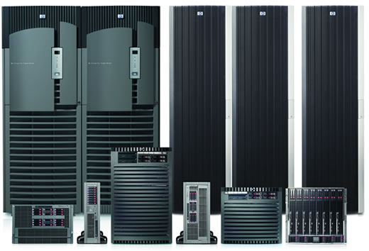
Dellenovacer Computers

Slide 3
Dellenovacer Computers
ERP

Slide 4
Dellenovacer Computers
Sales
ERP

Slide 5
Dellenovacer Computers
Sales
ERP
Catalog
Orders

Slide 6
Dellenovacer Computers
Sales
ERP
Catalog
Catalog
Orders
Returns
CRM
Shipping

Slide 7


Slide 8
Dellenovacer.com design
Catalog
Account
Orders
Search

Slide 9
Dellenovacer.com reality
Catalog
Account
Orders
Search

Slide 10
Dellenovacer.com reality
Catalog
Account
Orders
Search

Slide 11
Dellenovacer.com by the numbers
15 years in production
Worldwide orders
Billions of $ per year in revenue
Millions of orders per day
But no way forward

Slide 12
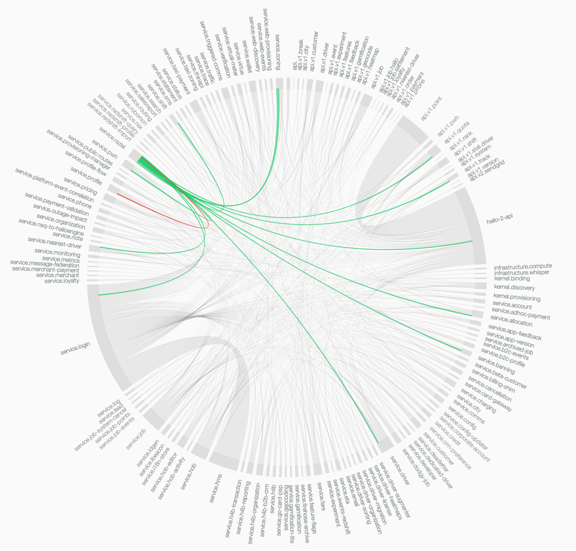
Netflix-oriented architecture

Slide 13
Core principles
No data duplication
Isolation and autonomy
Web APIs for everything
“Dellenovacer on Dellenovacer”

Slide 14
Pre-production go-live
18 months of effort
Hundreds of developers
Dellenovacer’s top hardware
… and nothing happened

Slide 15
API hell

Slide 16
Doing the math
Each API call SLA – 150ms, 99.9% uptime
200 * 150ms = 30sec
99.9% uptime * 200 calls = 0% availability
Doomed from the start

Slide 17
You own your SLA or your SLA owns you

Slide 18
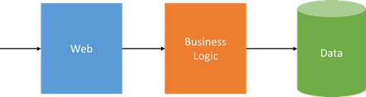
How Not to Do It (MS Style)
https://azure.microsoft.com/en-us/blog/microservices-an-application-revolution-powered-by-the-cloud/

Slide 19
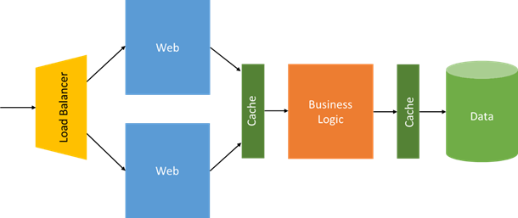
How Not to Do It (MS Style)
https://azure.microsoft.com/en-us/blog/microservices-an-application-revolution-powered-by-the-cloud/

Slide 20
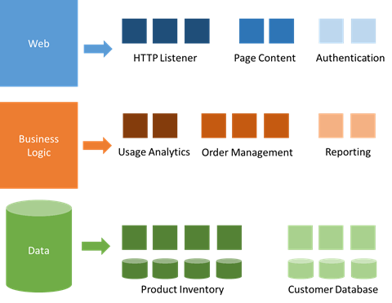
How Not to Do It (MS Style)
https://azure.microsoft.com/en-us/blog/microservices-an-application-revolution-powered-by-the-cloud/

Slide 21
Microservices != N-Tier + Docker

Slide 22
Traditional n-tier
UI Layer
Business Logic Layer
Data Access Layer
Database

Slide 23
DDD-style n-tier
UI Layer
Domain Objects
Repository
Database

Slide 24
Areas of Responsibility
Catalog
Config
Cart/Checkout
UI Layer
Domain Objects
Repository
Database

Slide 25
What is a Service? Software that is…
…owned, built and run by an organization
…is responsible for holding, processing and/or distributing particular kinds of information within the scope of a system
…can be built, deployed, and run independently, meeting defined operational objectives
…communicates with consumers and other services, presenting information using conventions and/or contract assurances
… protects itself against unwanted access, and its information against loss
…handles failure conditions such that failures cannot lead to information corruption

Slide 26
What is a Microservice?
Small and focused on doing one thing well
Autonomous
Town planning metaphor

Slide 27
What is a Bounded Context?
Delineates the applicability of a particular model
Logically unified model inside the context
Encapsulates internal operations
Defines explicit contracts for external communication
Cell metaphor

Slide 28
“Immutability changes everything” – Pat Helland

Slide 29

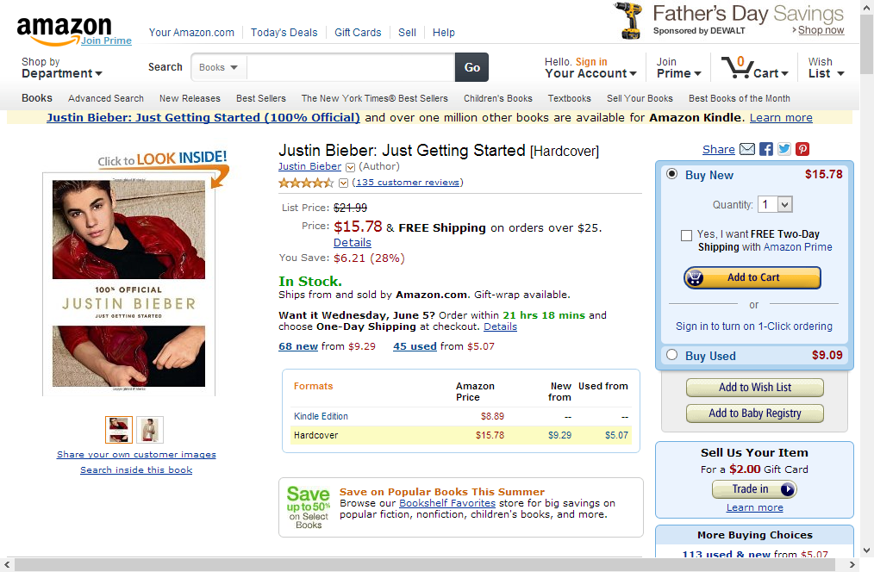

Grounding in reality

Slide 30
Original Dellenovacer.com Search
Catalog
Pricing
REST API
search. dellenovacer.com
x 1000
Localization
Content

Slide 31
Areas of Responsibility
Catalog
Config
Cart/Checkout
Search
UI Layer
Domain Objects
Repository
Database

Slide 32
Data ownership
Search owns the shape of the data
Search owns the SLA of response
Search owns the relevance
But none of the data!

Slide 33
Catalog
Complex configuration
Standard configs
Known quantity
1/day update
Search
SOAP
Catalog
DocDB

Slide 34
Pricing
Depends on config
Depends on region
Depends on catalog
Served with catalog
Sever connection
Search
Pricing

Slide 35
Localization
Rarely changes
Serves many internal clients
Existing integration method
Consume files 1/day
…
…
…
Search
Localization
DocDB

Slide 36
Content
Changes frequently
Important to react quickly
Triggers inside DB
Messaging to update
Search
Localization
DocDB
DB

Slide 37
Dellenovacer.com Search
Catalog
Pricing
search. dellenovacer.com
DocDB
Denormalizer
Localization
Content

Slide 38
Search
API

Slide 39
Search
API
Catalog
API

Slide 40
Search
API
Catalog
API
Cart/Checkout
API

Slide 41
Search
API
Catalog
API
Accounts
API
Cart/Checkout
API

Slide 42
What you measure will improve

Slide 43
Search
API
Catalog
API
Accounts
API
Cart/Checkout
API

Slide 44

Search
API
Catalog
API
Accounts
API
Cart/Checkout
API

Slide 45
What you reward and promote by will be optimized

Slide 46
Your microservice journey will go well beyond the technical

Slide 47
Avoiding Microservice Megadisasters
Jimmy Bogard
@jbogard
github.com/jbogard
jimmybogard.com
github.com/jbogard/presentations

