Slide 1




SOLID Architecture: Slices not Layers
Jimmy Bogard
@jbogard
github.com/jbogard
jimmybogard.com

Slide 2


Slide 3
Inmates and asylums
ASPX
4 screens
Basic workflow
Role-based security
20K LoC
2 solutions, 12 projects
Code-Behind
ServiceProxy
WCF Service Proxy
WCF Service
BAL
DAL
Stored Procedure

Slide 4
Traditional n-tier
UI Layer
Business Logic Layer
Data Access Layer
Database

Slide 5
DDD-style n-tier
UI Layer
Domain Objects
Repository
Database

Slide 6
Organizing by layer
Person.cs
PersonController.cs
PersonService.cs
PersonRepository.cs

Slide 7
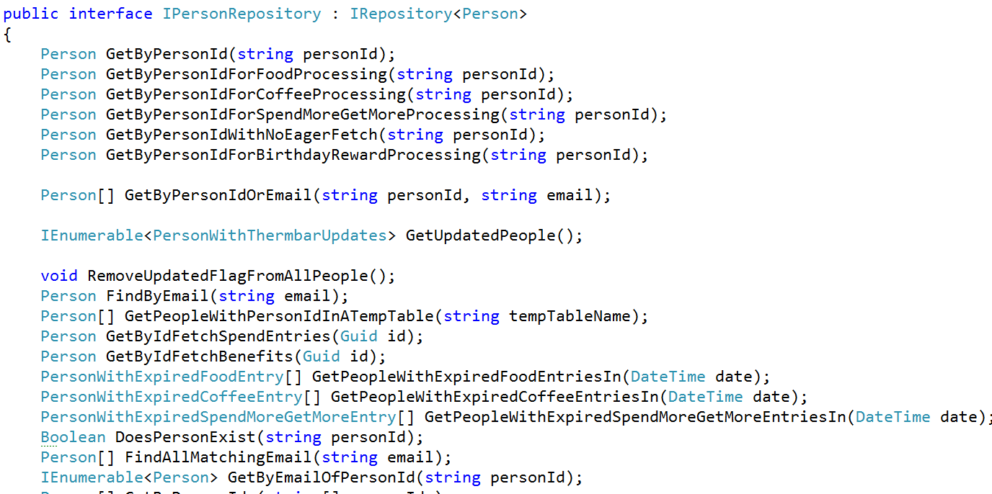
Inmates blew up the asylum

Slide 8
Web App Characteristics
Web App
Safe
Idempotent
Unsafe
Not idempotent
GET
Query
POST
Command

Slide 9
Axes of change
View Unapproved Invoices
Approve Invoice
Reject Invoice
UI Layer
Domain Objects
Repository
Database

Slide 10
CQRS: Two models where once there was one

Slide 11
CQRS to the Rescue
Queries
Commands

Slide 12
First step to sanity: Collapse layers

Slide 13
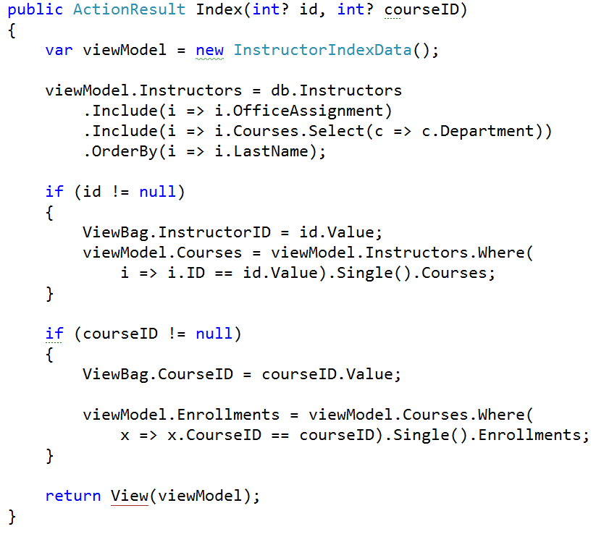
Queries

Slide 14
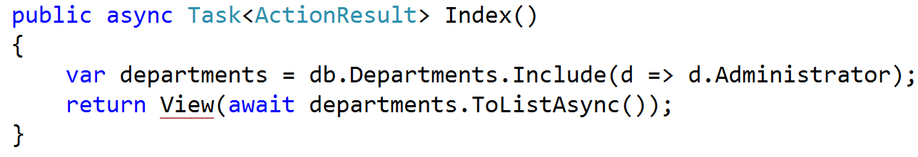
Queries

Slide 15
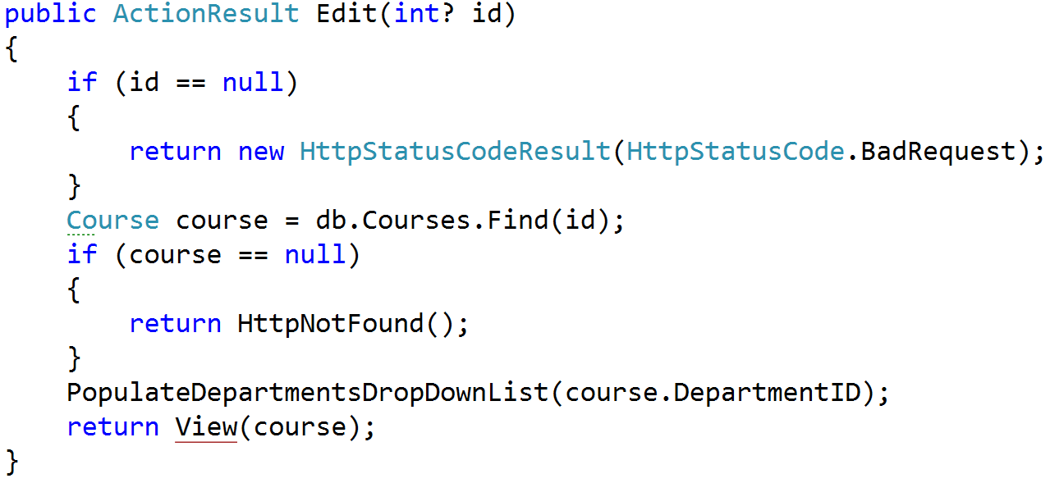
Queries

Slide 16
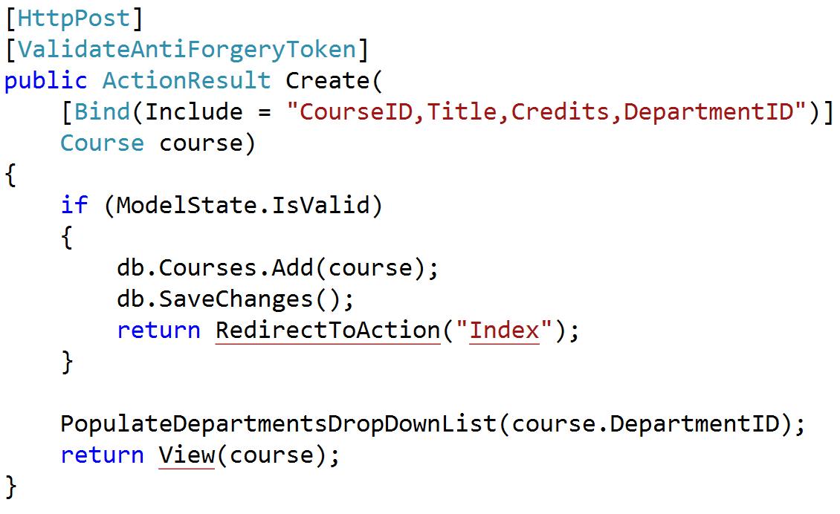
Commands

Slide 17
Creating queries

Slide 18
Modeling requests
Input
Request Handler
Output

Slide 19

Modeling requests with MediatR
Command
Command
Handler
Query
Query Handler

Slide 20
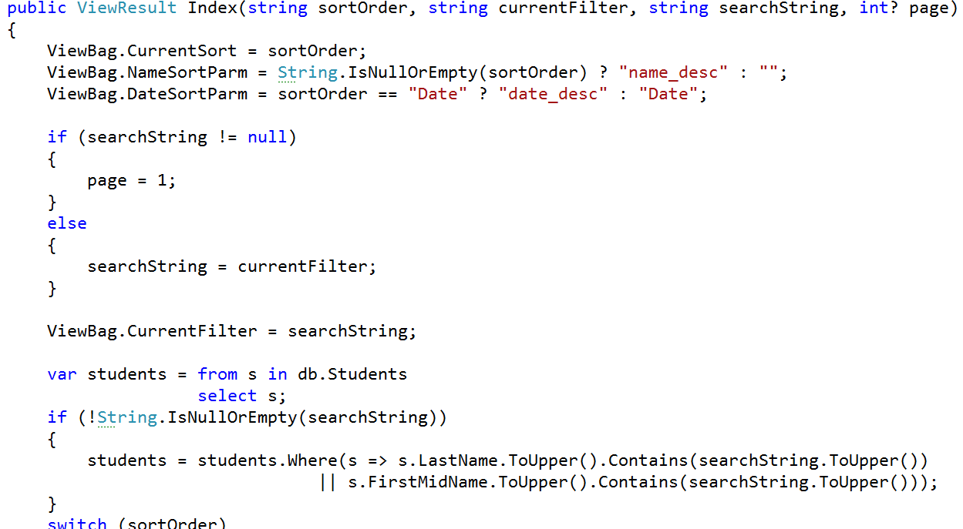
Modeling inputs

Slide 21
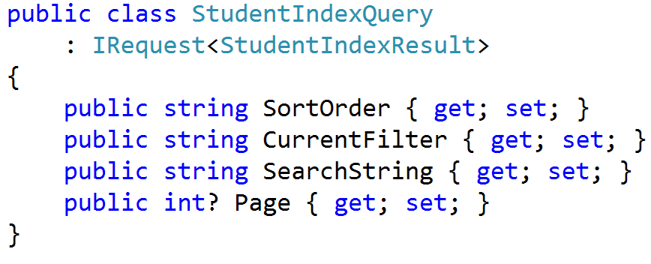
Query Requests

Slide 22
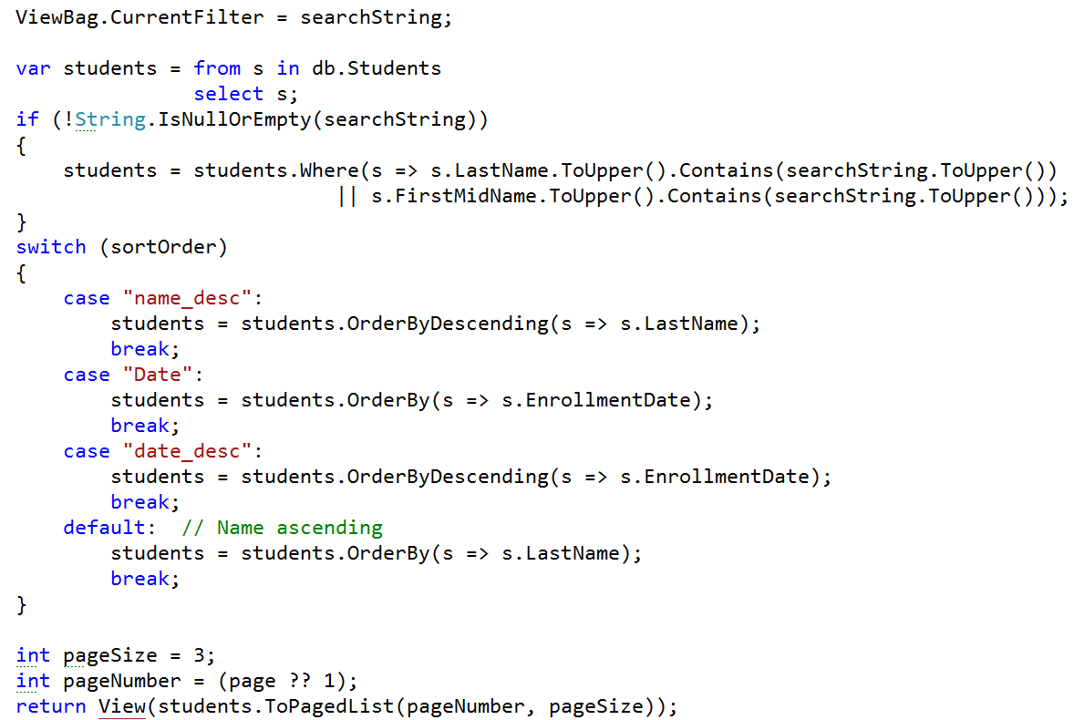
Modeling outputs

Slide 23
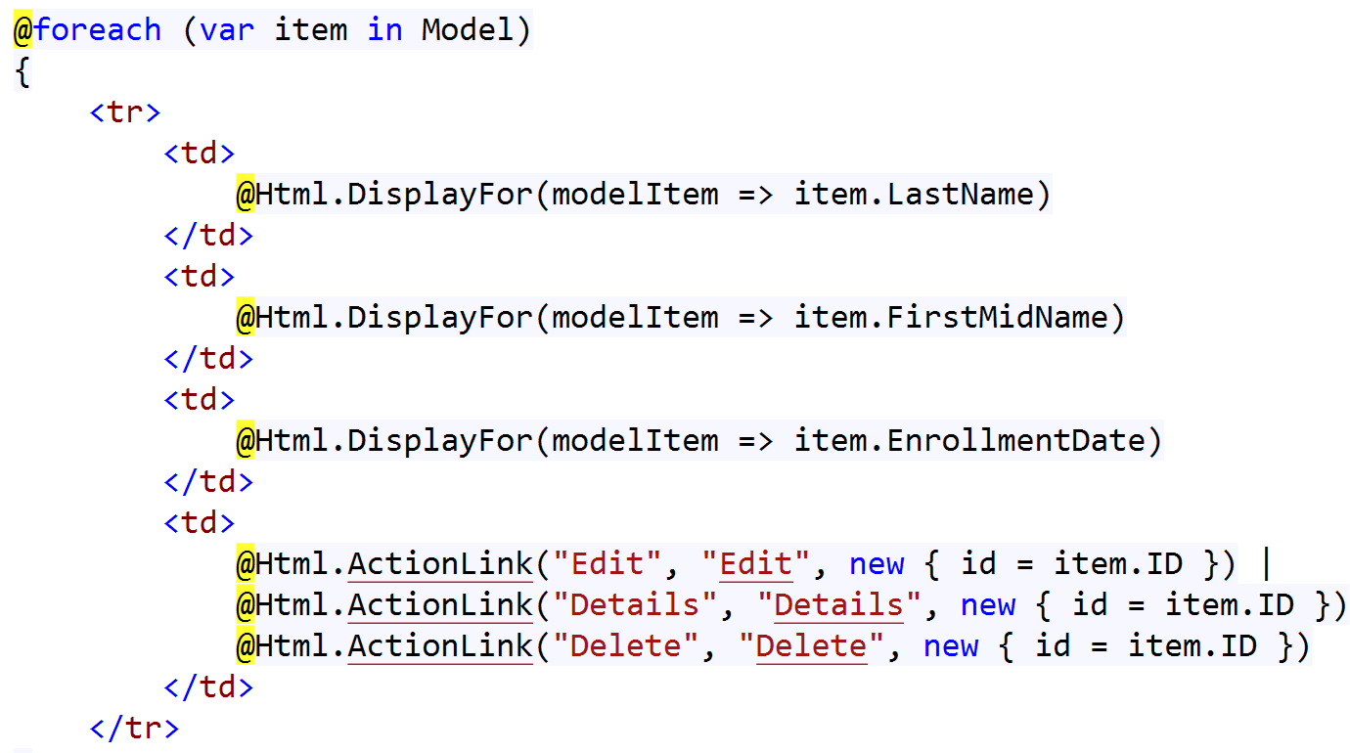
Modeling outputs

Slide 24
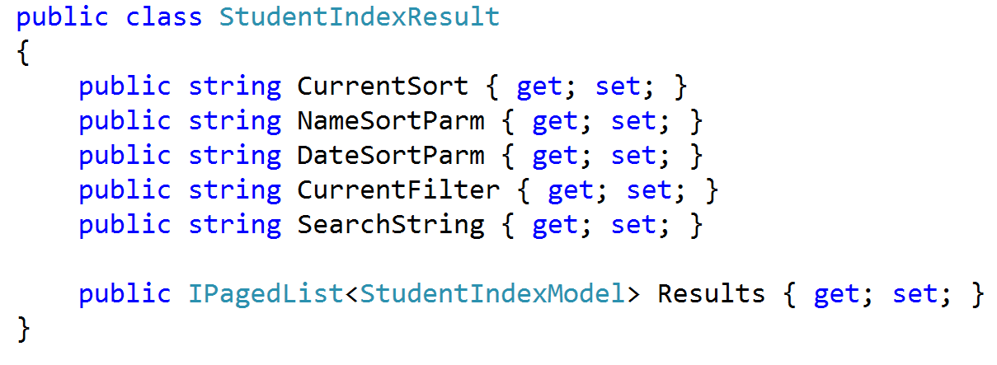
Query Response

Slide 25
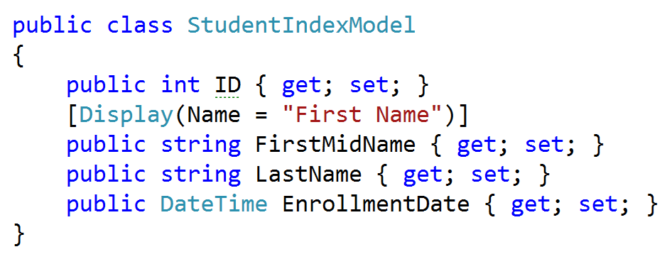
Query Model

Slide 26
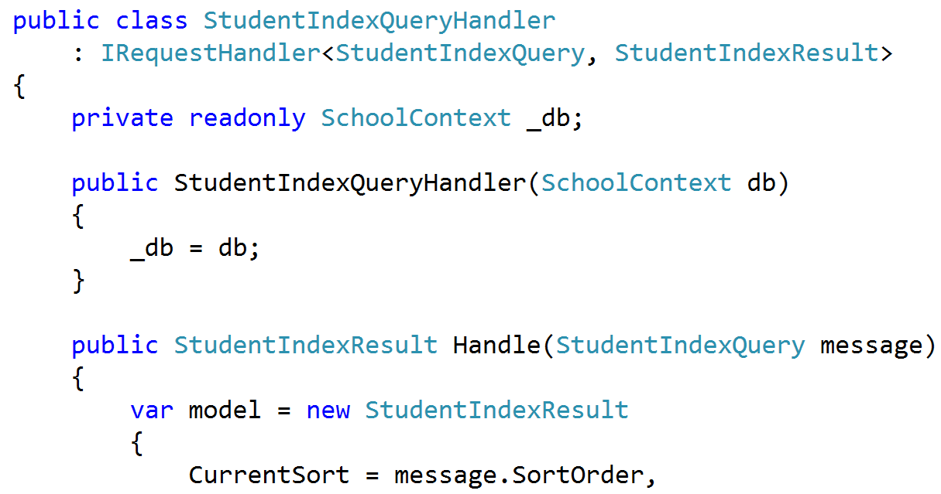
Handling Query Request

Slide 27
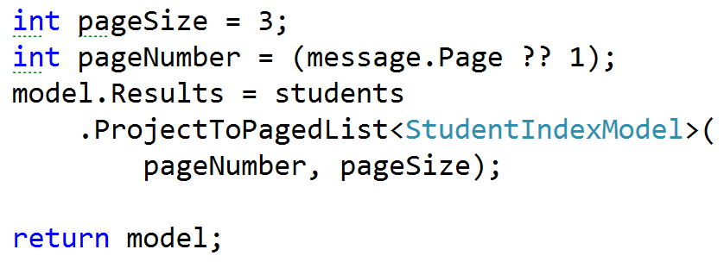
Returning Query Result

Slide 28
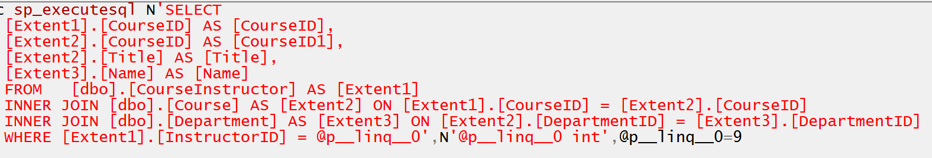
Projecting Query Result

Slide 29
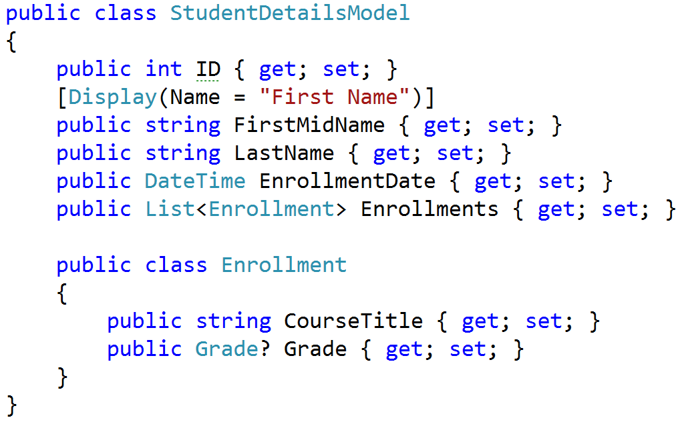
Complex query response

Slide 30
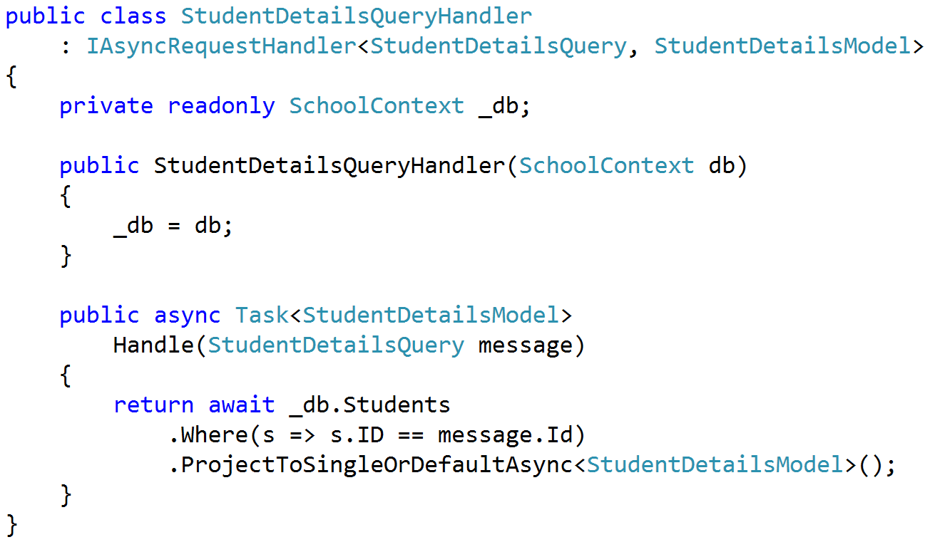
Projecting single model

Slide 31
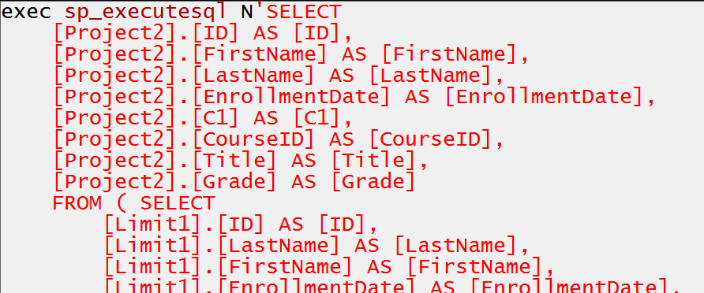
Single projected query

Slide 32
Creating commands

Slide 33
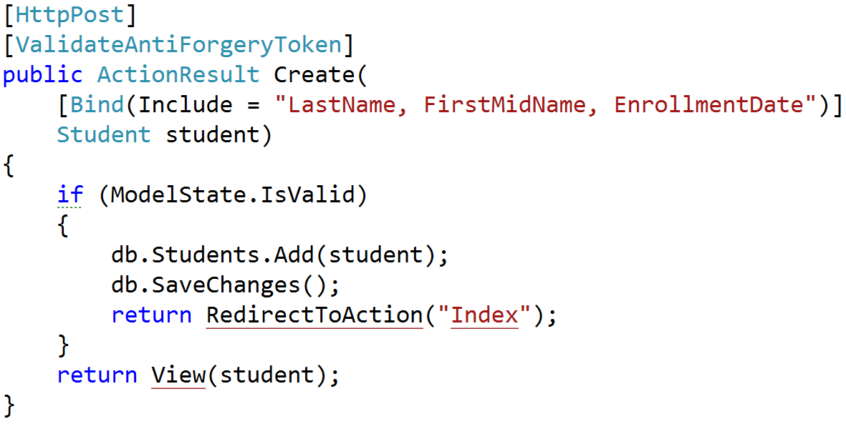
Command modeling

Slide 34
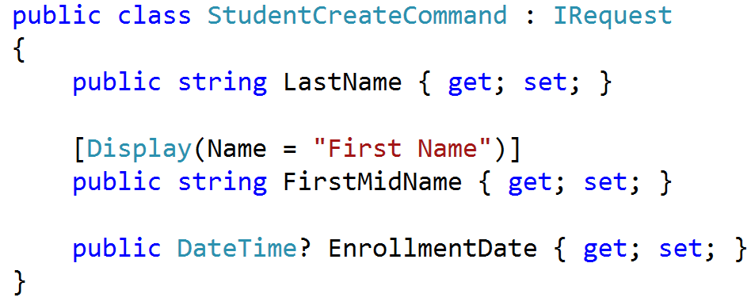
Command Request

Slide 35
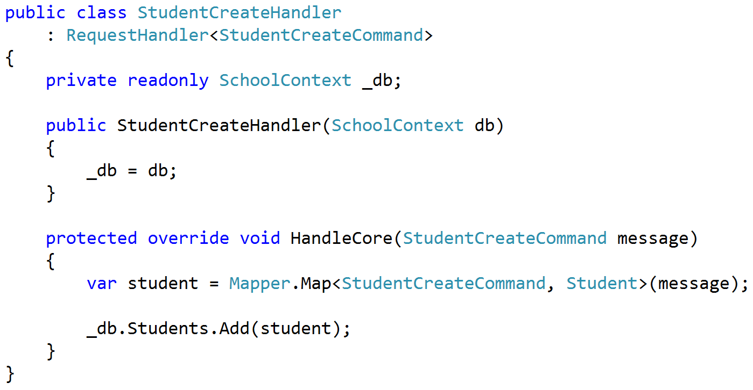
Command Handling

Slide 36
Cross-cutting concerns

Slide 37
Validation

Slide 38
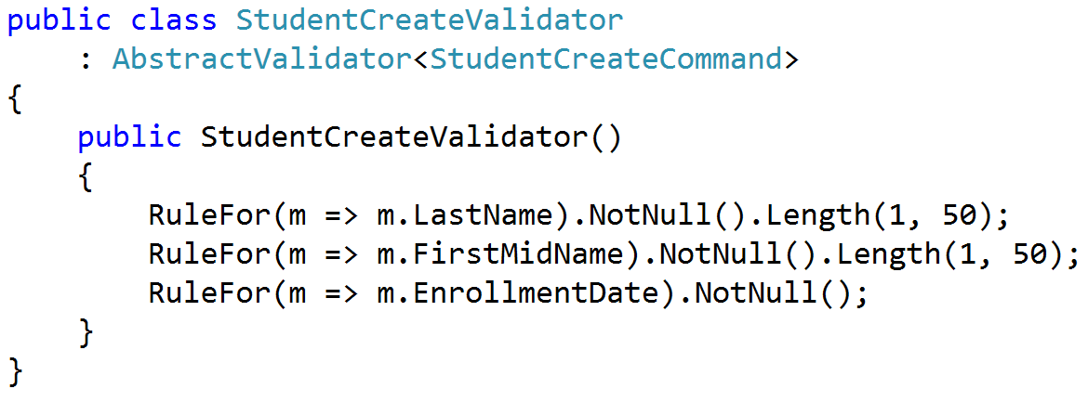
Validate requests, not entities

Slide 39
Normal validation flow
Browser
MVC
POST
Valid?
400 Bad Request
text/html
Do Work
302 Found
/student/index

Slide 40
Modified validation flow
Browser
MVC
AJAX POST
Valid?
400 Bad Request
text/javascript
Do Work
302 Found
/student/index

Slide 41
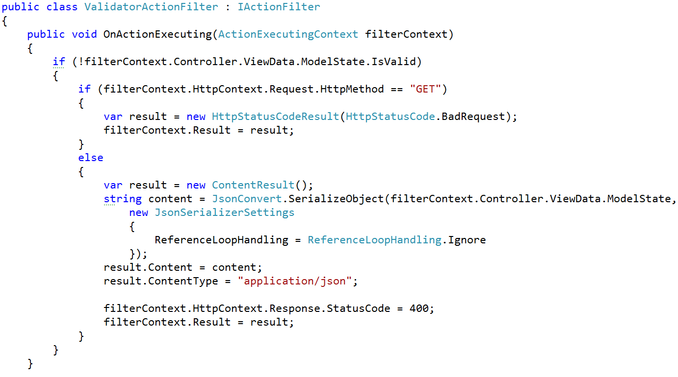
Cross-cutting validation

Slide 42
Organize by feature not layer

Slide 43
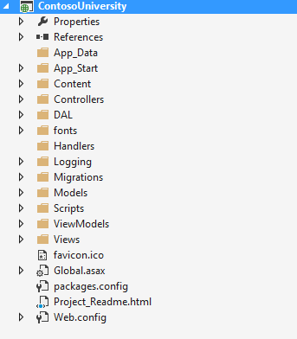
Areas of change

Slide 44
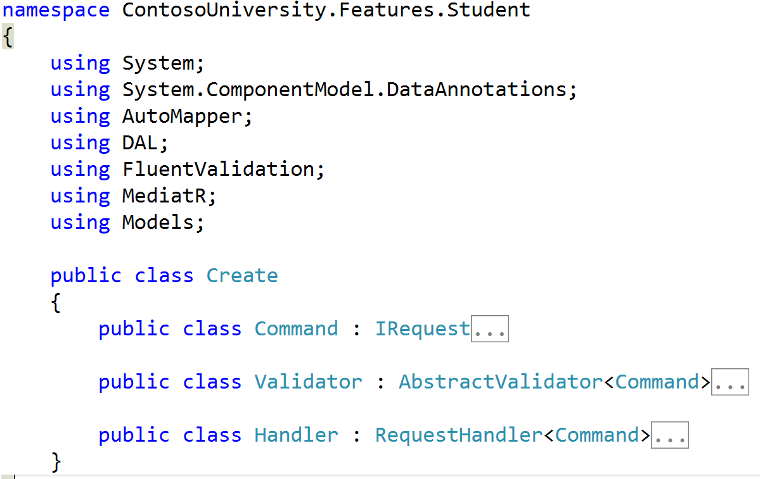
Collapsing Models

Slide 45
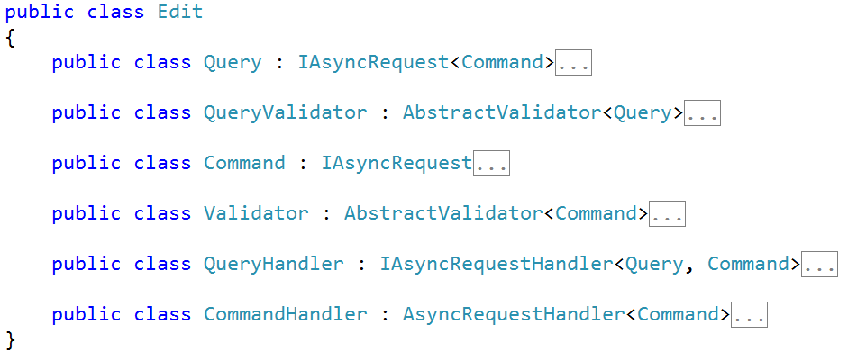
Collapsing Features

Slide 46
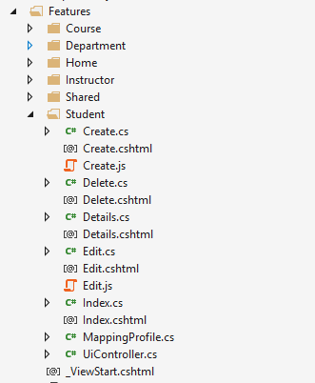
Full-stack organization

Slide 47
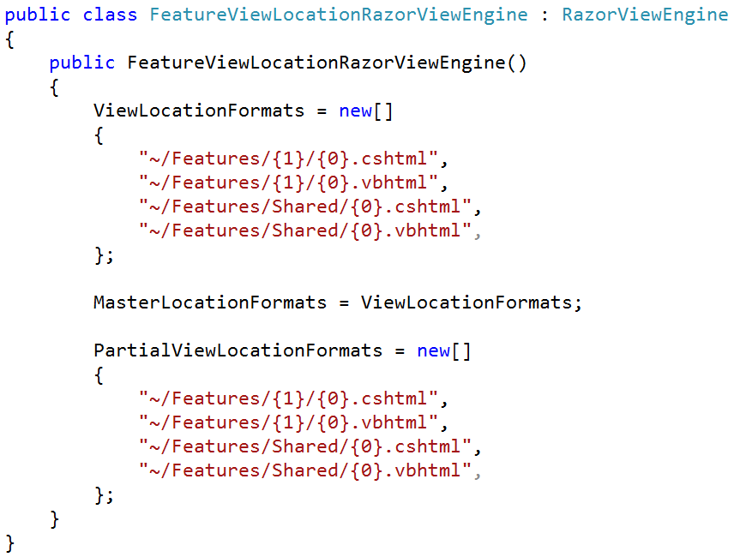
Redirecting MVC Views

Slide 48
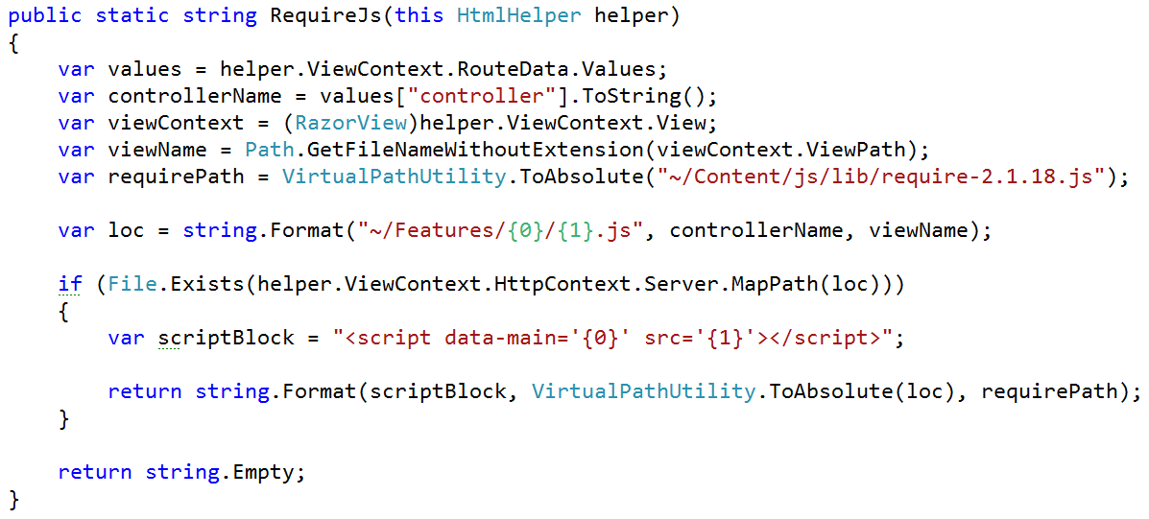
RequireJS module per slice

Slide 49
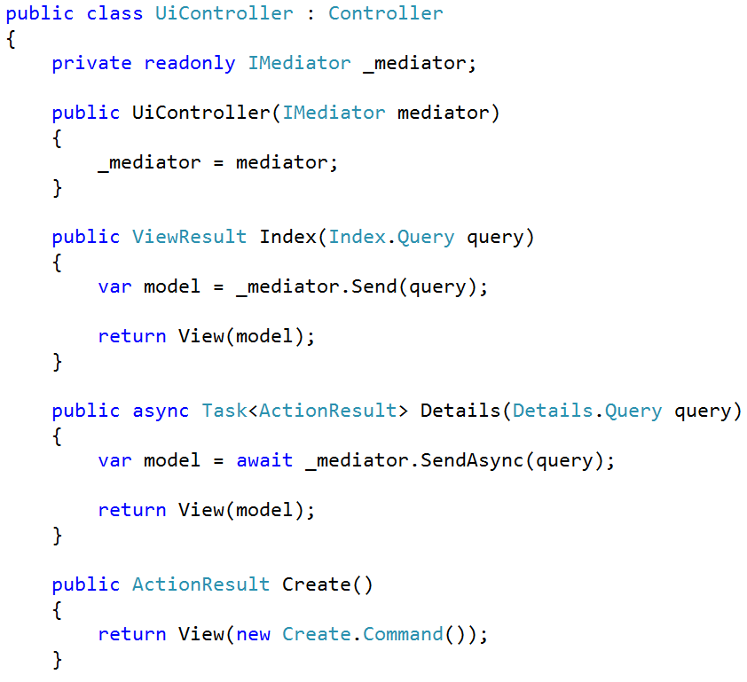
Our Controller

Slide 50
Architecture in slices
Validation
Domain Agnostic
Authentication
Authorization
Feature
Feature
Feature
Feature
Feature
Feature
Feature
Feature
Feature
Feature
Feature
Feature
Feature
Feature
Domain Specific
Persistence

Slide 51
SOLID Roundup
SRP – One class per feature/concept
OCP – Extend through cross-cutting concerns
LSP – Just don’t do inheritance
ISP – Separating queries from commands
DIP – Save for true external dependencies

Slide 52
SOLID Architecture: Slices not Layers
Jimmy Bogard
@jbogard
github.com/jbogard
jimmybogard.com
github.com/jbogard/presentations

