Slide 1

1- The connectome of a Drosophila: a beautiful tangled mess! But can we untangle it?
Drosophila raw connectome :
At first sight, structureless, almost like noise.

Slide 2
2- And what if we grouped neurons by their angular preference and then sorted them accordingly?
Still, no clear structure emerges
Angular preference ∈ [0°, 72°]
Angular preference ∈ [72°, 144°]
…
Angular preference ∈ [298°, 360°]

Slide 3
3- Well, and what if, in addition to all that, we also separate neurons by type?
A much more structured and interpretable pattern appears
Angular preference ∈ [0°, 72°]
∈ EPG (Ellipsoid body-Protocerebral bridge-Gall neurons)
Angular preference ∈ [72°, 144°]
∈ PEN Left (Protocerebral Bridge-Ellipsoid Body-Noduli)
…
Angular preference ∈ [298°, 360°]
∈ PEN Right

Slide 4
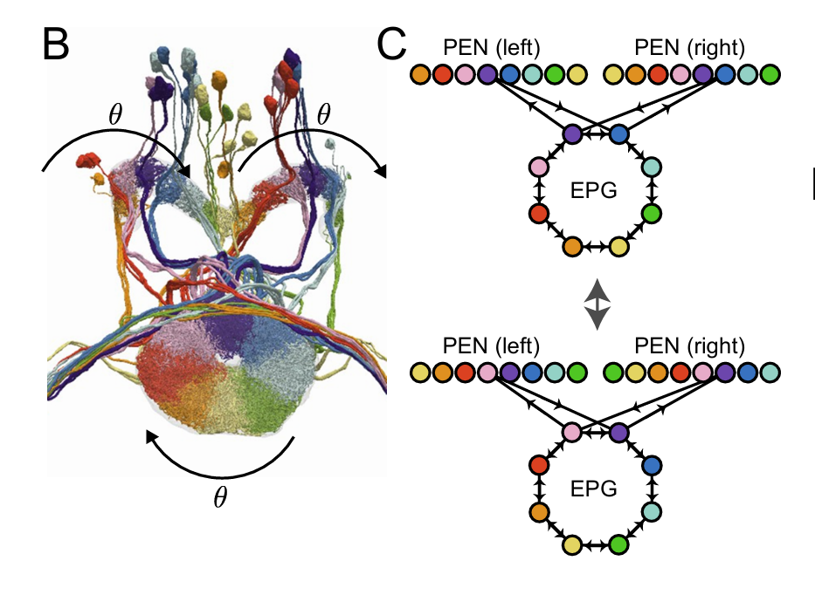
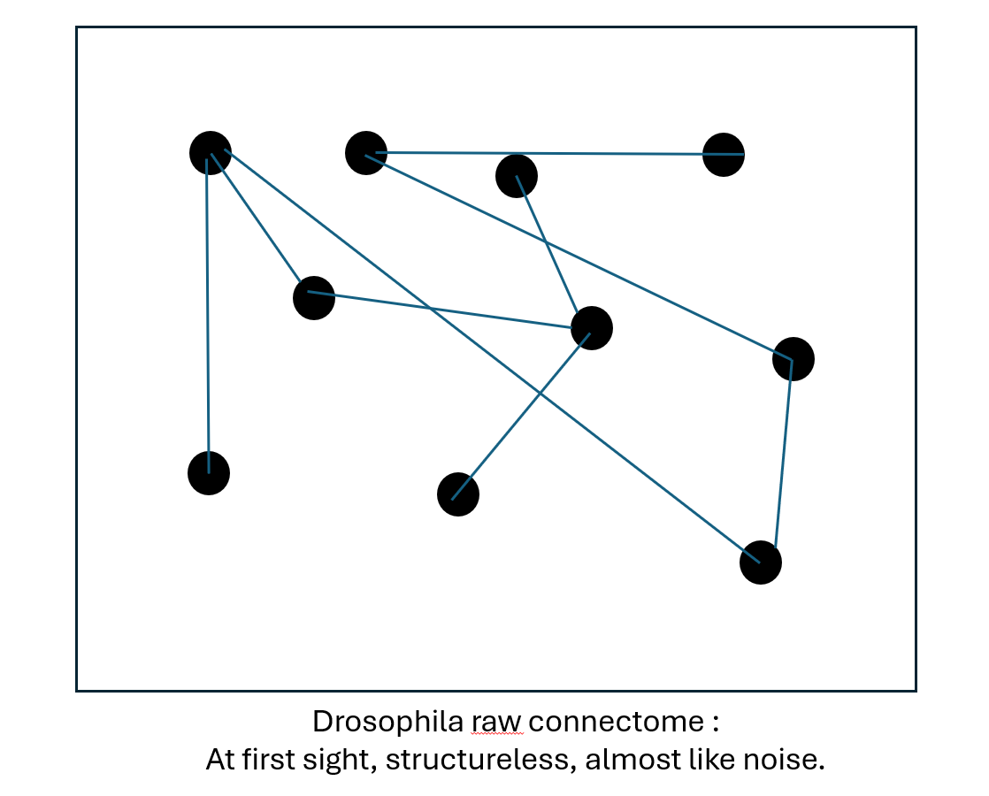
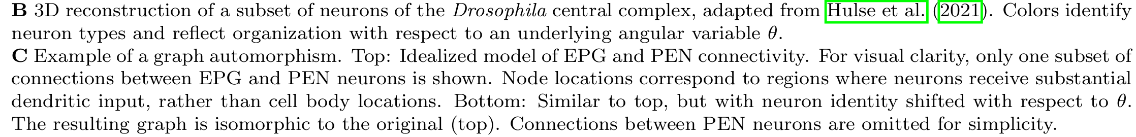
4- Emergence of structure
A circular organization for EPG–EPG connections, and a systematic offset for EPG–PEN connections.

Slide 5
5- The organization of the central complex compass system in a Drosophila.
This organization contributes to the understanding of how the Drosophila compass system works
A simple analogy for its functioning is that of an incremental sensor:
EPG neurons: act as a memory that stores head orientation in the form of a circular map (or disk)
Right and left PEN neurons: update this representation by incrementing or decrementing the stored orientation depending on the direction of head rotation
Drosophilia’s head
EPG
EPG

Slide 6
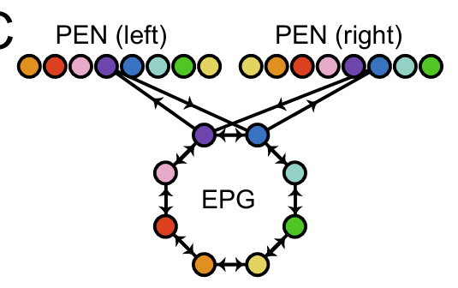
6 — Symmetry
We observe that this structure is invariant under a shift of the angle θ:
if all neurons are shifted according to their preferred orientation, the connectivity patterns remain unchanged.
Take the place of
…

Slide 7
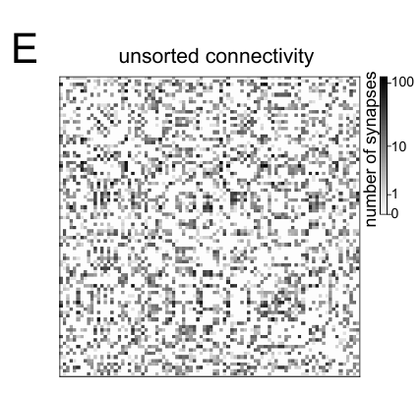
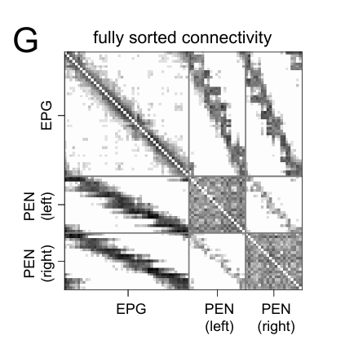
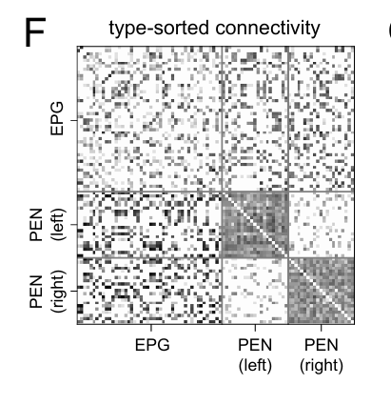
Slide 7 — Matrix representation
If we now look at the adjacency matrix: by organizing neurons first by type and then by increasing preferred orientation, we obtain…

Slide 8
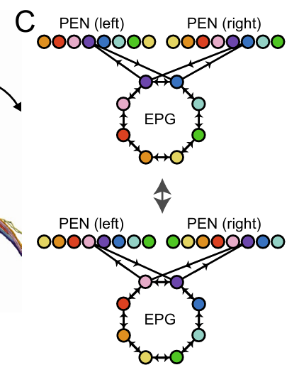
Slide 8 — circulant Matrix
A circular graph (i.e., invariant under shifts along a given variable) translates, at the matrix level, into an adjacency matrix that is invariant under permutation, specifically, it takes a (block-)circulant form.

Slide 9
Slide 9 — Interpretation and significance of identifying circulant matrices or symmetries in the connectome using latent variables.
Only by exploiting symmetries, we were able to identify the variable encoded in this part of the connectome, namely head orientation.
It is therefore crucial to identify the variables that allow symmetries to emerge in the connectome.
The intuition of using orientation preference came from biological studies, but how can we recover these latent variables and symmetries directly from the adjacency matrix alone?
According to which variable should we sort?

Slide 10
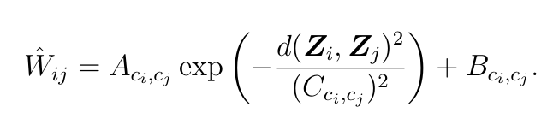
Slide 10 Awareness of neuron type
First, we need to remove the neuron type variable from the equation, as it can mask the latent variables that may reveal underlying symmetries.
The model may be inclined to use it as an all-purpose explanatory factor!
What can we do ?
Counterintuitively, cell-type parameters are explicitly included in the loss function as learnable components.

