Slide 1
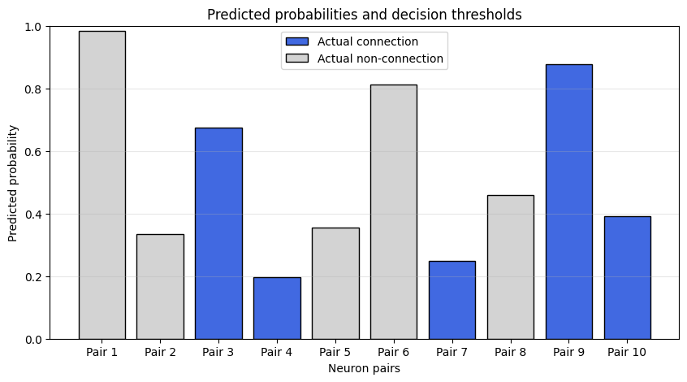
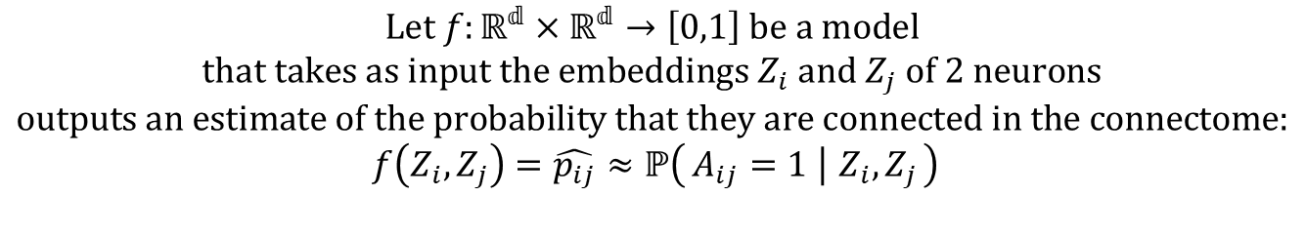
$$\text{Let }f:ℝ^{𝕕}×ℝ^{𝕕}→\left[0,1\right]\text{ be a model }$$
$$\text{that takes as input the embeddings }Z_{i}\text{ and }Z_{j}\text{ of 2 neurons }$$
$$\text{outputs an estimate of the probability that they are connected in the connectome: }$$
$$f\left(Z_{i},Z_{j}\right)=\hat{p_{ij}}≈ℙ\left(A_{ij}=1 ∣ Z_{i},Z_{j}\right)$$

Slide 2
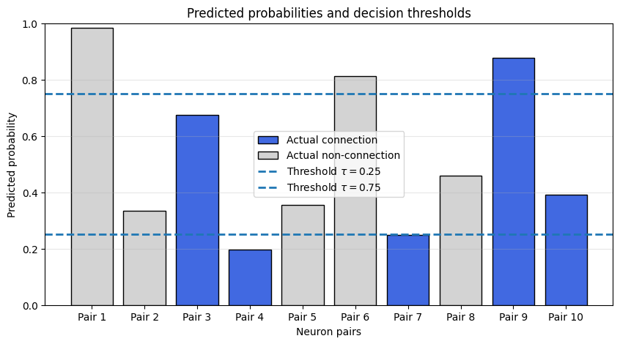
Decision treshold :
As the model outputs only a probability indicating whether two neurons are connected, a decision threshold must be defined to convert this probability into a binary prediction.

Slide 3
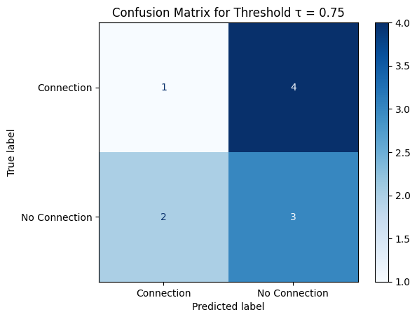

Confusion Matrix
 | Predicted Positive | Predicted Negative
Actual Positive | TP (True Positive) | FN (False Negative)
Actual Negative | FP (False Positive) | TN (True Negative)
$$τ=0,75$$

Slide 4
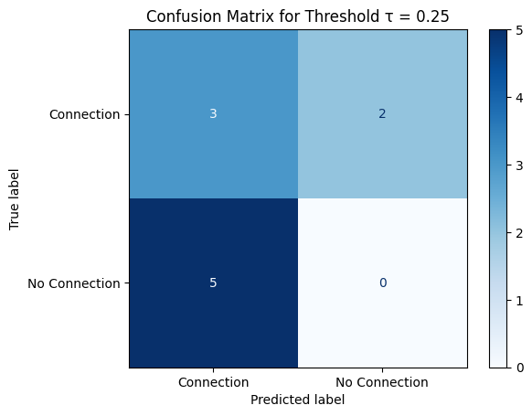

Confusion Matrix
 | Predicted Positive | Predicted Negative
Actual Positive | TP (True Positive) | FN (False Negative)
Actual Negative | FP (False Positive) | TN (True Negative)
$$τ=0,25$$

Slide 5
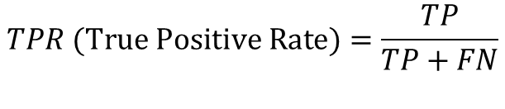
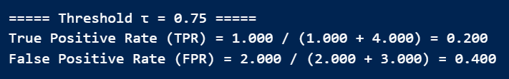
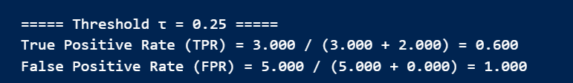
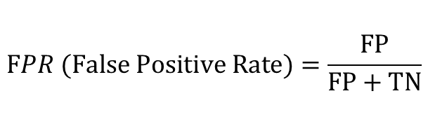
Confusion Matrix
 | Predicted Positive | Predicted Negative
Actual Positive | TP (True Positive) | FN (False Negative)
Actual Negative | FP (False Positive) | TN (True Negative)
$$TPR (True Positive Rate)=\frac{TP}{TP+FN}$$
Among all true connections in the connectome, what fraction is successfully detected by the model?
$$FPR (False Positive Rate)=\frac{FP}{FP+TN}$$
Among all neuron pairs that are not connected, what fraction is incorrectly predicted as connected by the model?

Slide 6
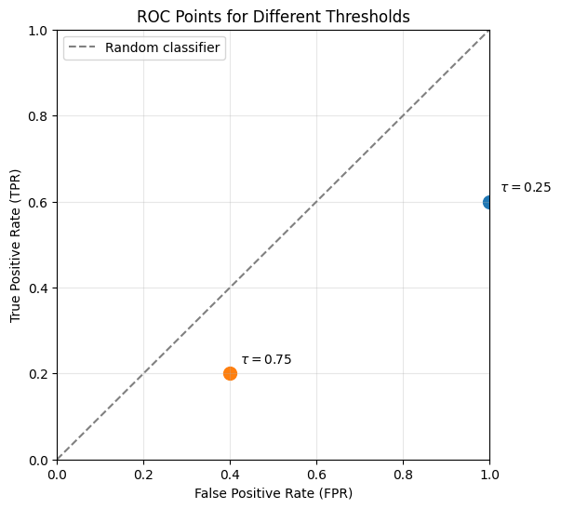
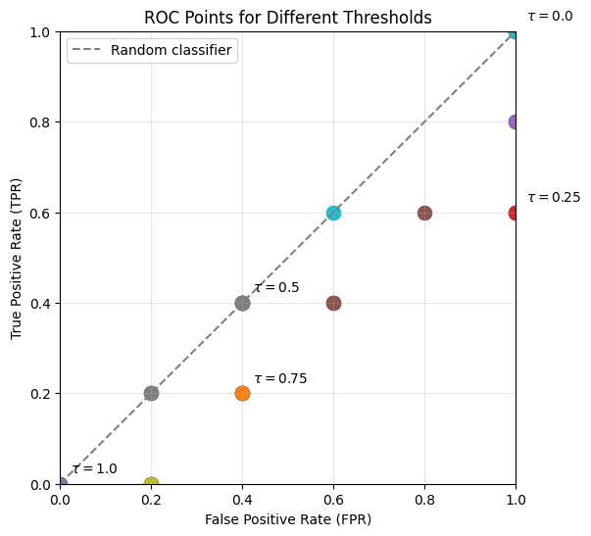
ROC (Receiver Operating Characteristic)

Slide 7

Intuition : Behind the Staircase Shape of the ROC Curve
The number of distinct points on the ROC curve cannot exceed the number of predicted probabilities.
$$𝒯=\left\{τ∈\left[0,1\right] ∣ ∃\left(i,j\right)\text{ such that }τ=\hat{p_{ij}}\right\}$$
$$\text{When }τ=0.0\text{, all neuron pairs are classified as connected}$$
Consequently, all actual connections are correctly identified, resulting in a TPR of 1. However, all actual non-connections are also incorrectly classified as connections, leading to a FPR of 1
$$\text{Then, nothing changes until }τ={\hat{p}}_{\text{p}\text{air 4}}$$
$\text{When }τ={\hat{p}}_{\text{pair 4}}$ , 2 cases:
If pair 4 is an actual connection : TPR will decrease from 1/(number of actual connection)
If pair 4 is an actual non-connection :
FPR will decrease from 1/(number of actual non-connection)

Slide 8
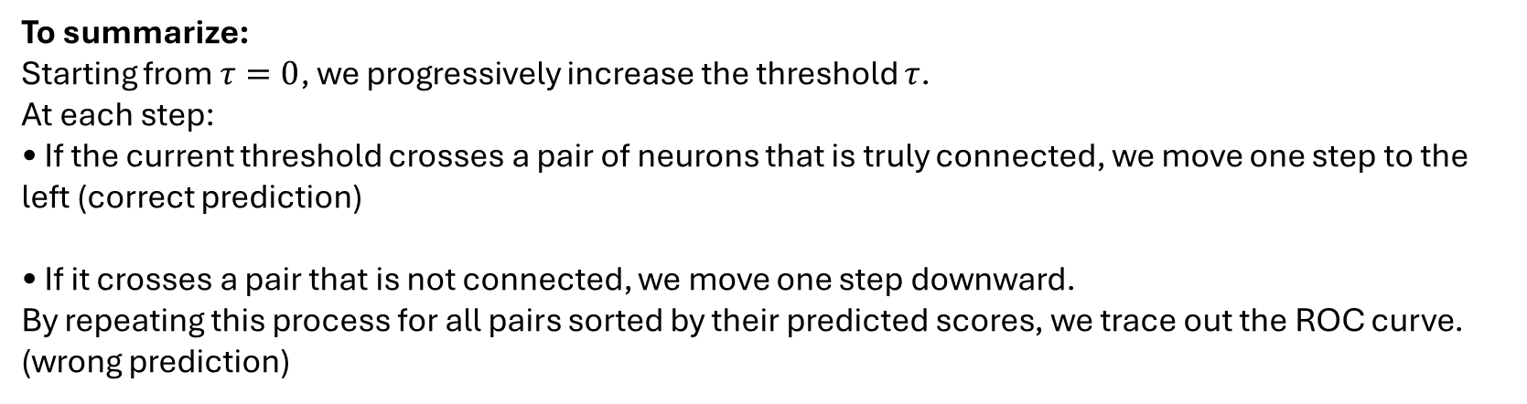
Intuition : Behind the Staircase Shape of the ROC Curve
To summarize:
Starting from $τ=0$, we progressively increase the threshold $τ$.
At each step:
• If the current threshold crosses a pair of neurons that is truly connected, we move one step to the left (correct prediction)
• If it crosses a pair that is not connected, we move one step downward.
By repeating this process for all pairs sorted by their predicted scores, we trace out the ROC curve.
(wrong prediction)

Slide 9
AUC : Area Under The Curve
How can we determine whether our model predicts connections accurately?
Based on the previous discussion, the better a model is, the closer its ROC curve lies to the upper-left corner of the plot.
Therefore, the area under the ROC curve (AUC-ROC) is used as a performance metric: the larger the area, the better the model.
A random classifier is equally likely to correctly or incorrectly classify a pair, making downward and leftward steps equally probable. As a result, its ROC curve follows the diagonal line $y=x$.
*Typical interpretations are as follows:
AUC = 0.5: performance equivalent to random guessing.
0.5 < AUC < 0.7: poor discrimination.
0.7 < AUC < 0.8: acceptable discrimination.
0.8 < leq AUC < 0.9: good discrimination.
0.9 < leq AUC < 1.0: excellent discrimination.
AUC = 1.0: perfect classification.
An AUC below 0.5 indicates that the model performs worse than random guessing, suggesting that its predictions are systematically inverted.

