Slide 1
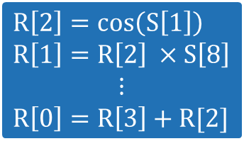
LGP Agent
MAPLE Agent
MATPG Agent
A₀
Registers R
T₀
State Inputs S
$$R\left[2\right]=\cos\left(S\left[1\right]\right)$$
$$R\left[1\right]=R\left[2\right] ×S\left[8\right]$$
$$⋮$$
$$R\left[0\right]=R\left[3\right]+R[2]$$
A₁
T₁
0
5
1
3
0
2
4
Output R[0]
A₂
A₃
T₀
Team vertex
Program (LGP)
0
5
Action class
2
3
4
0
3
A₀
Action vertex
3

Slide 2

LGP Agent
MAPLE Agent
MATPG Agent
A₀
Registers R
T₀
State Inputs S
$$R\left[2\right]=\cos\left(S\left[1\right]\right)$$
$$R\left[1\right]=R\left[2\right] ×S\left[8\right]$$
$$⋮$$
$$R\left[0\right]=R\left[3\right]+R[2]$$
A₁
T₁
0
5
1
3
0
2
4
Output R[0]
A₂
A₃
T₀
Team vertex
Program (LGP)
0
5
Action class
2
3
4
0
3
A₀
Action vertex
3

