Slide 1
personal income and expenditure IN New York
Gege Li
Xiaojia He

Slide 2
contents
1. Motivation
2. Income: Race and occupation difference,
Salary range percentage ,
County difference
3. Expenditure: Trend in recent years,
Expenditure proportion in three main variables
4. Challenges
5. Conclusion

Slide 3
motivation
As the financial center of the world, the personal consumption and income in New York is higher than most cities.
We want to sum up some information on the living standard in New York.

Slide 4
income

Slide 5
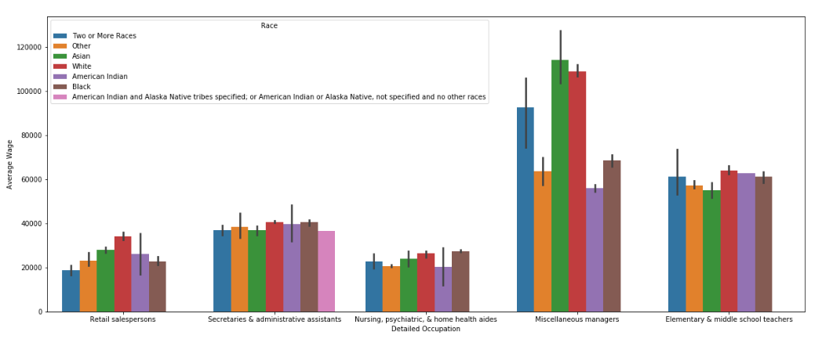
income difference: race and jobs

Slide 6
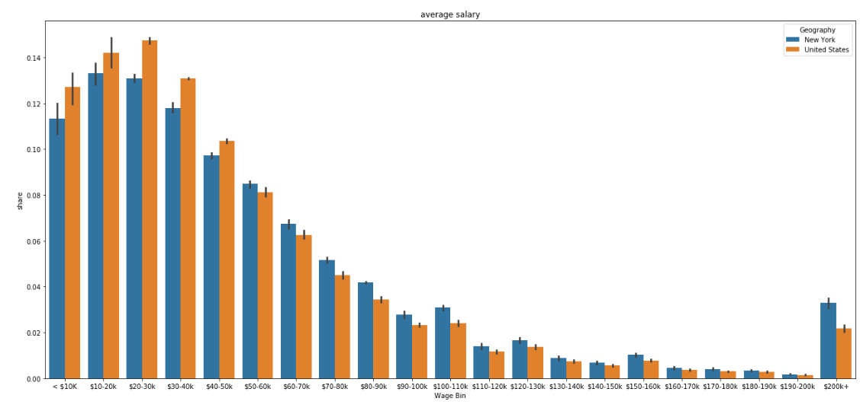
Income difference: Salary range

Slide 7
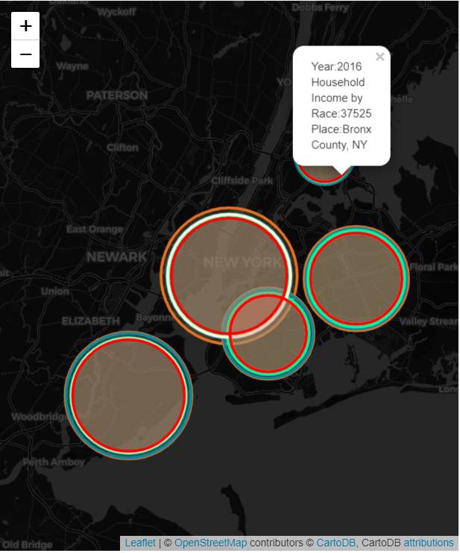
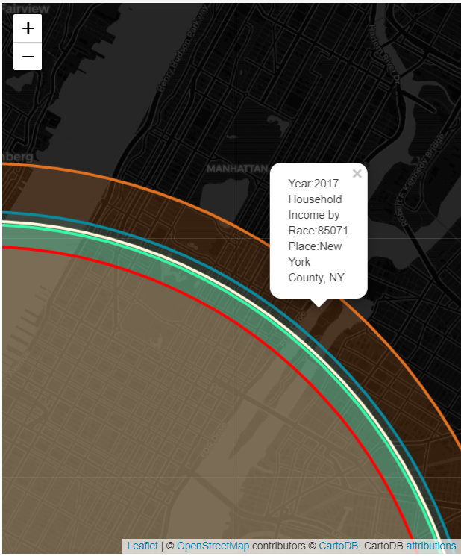
income difference:
county

Slide 8
expenditure

Slide 9
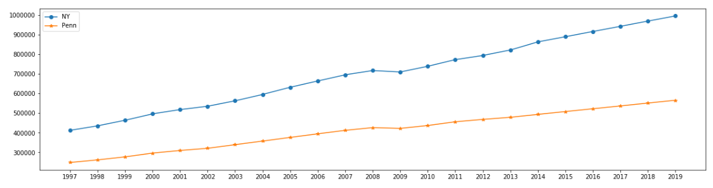
Expense trend in recent years
Notes:
The last measured personal consumption expenditure for New York was $863,447 in 2014. New York experienced an average growth rate of 6.43% from our first statistic recorded in 1997. If past trends continue, we forecast the personal consumption expenditure to be $996,102 by 2019.

Slide 10
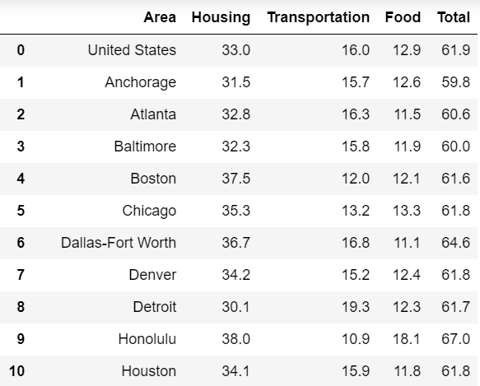
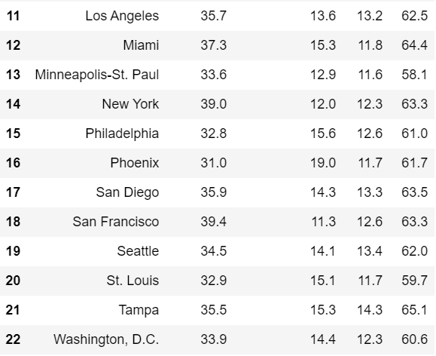
Proportion of housing, transportation and food

Slide 11
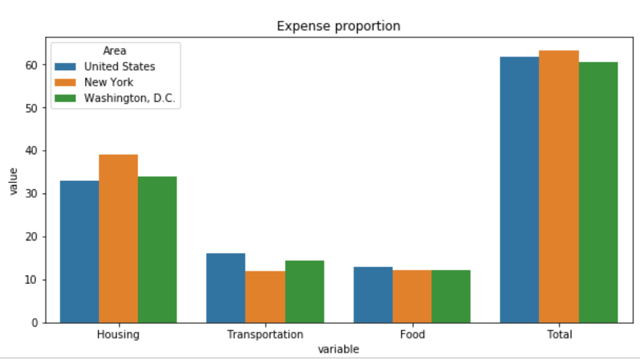
proportion and comparison

Slide 12
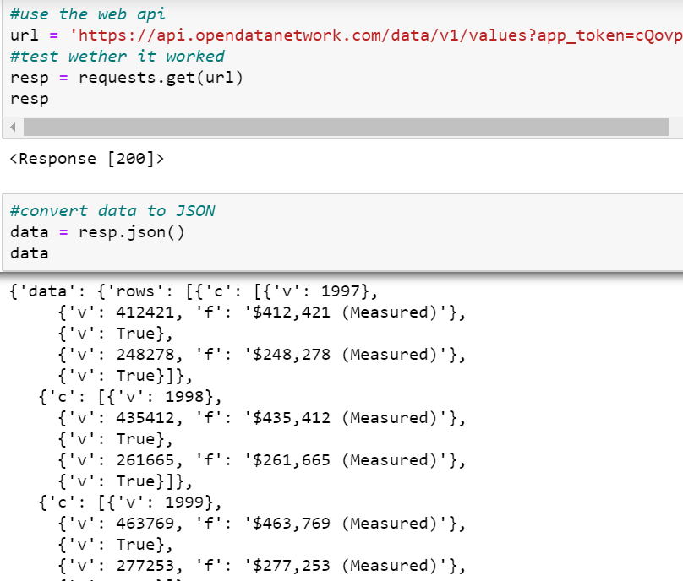
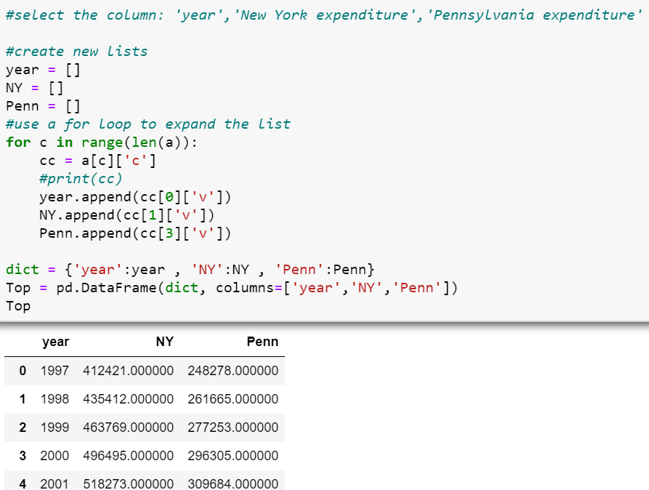
Challenges

Slide 13
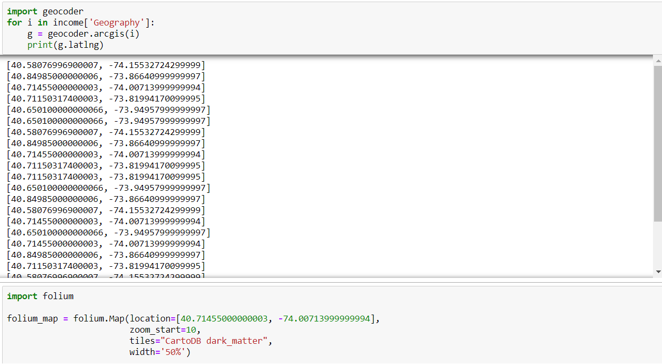
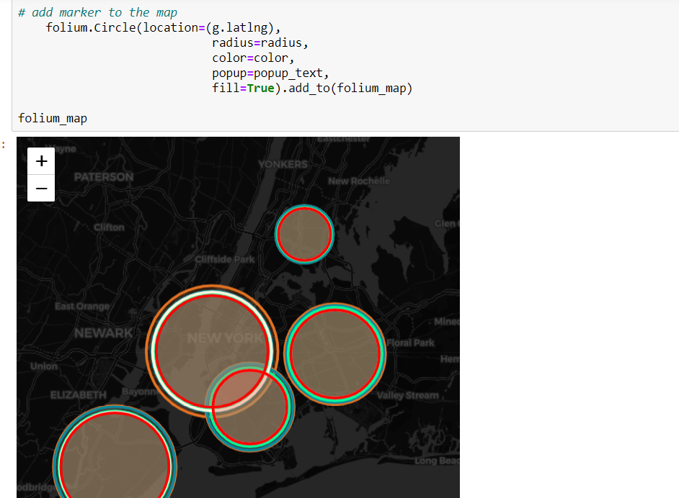
Challenges

Slide 14
Conclusions
The income increased every year, and the gap of income in different races is huge.
Among different jobs, wages are different obviously. Miscellaneous managers earn more than 3 times than Nursing; But for Nursing and retail salespeople, they earn almost the same in New York.
The total proportion of our necessary consumption is only 62% which means people also spend much money to enjoy their life and hobbies.

Slide 15

THANK YOU

