Slide 1
Project 5
Group 2
Member：JiaJie Zhu, Getong Liu, Jiahui Wu

Slide 2
Outline
Introduction
Data Exploration
Data Preparation
Methodology
Performance Metrics
Discussion
References

Slide 3
Introduction
READMISSION
when a patient who is discharged from the hospital, gets re-admitted again within a certain period of time.
Hospital readmission rates for certain conditions are now considered an indicator of hospital quality, and also affect the cost of care adversely.
HOSPITAL READMISSIONS REDUCTION PROGRAM
In 2011, American hospitals spent over $41 billion on diabetic patients who got readmitted within 30 days of discharge.
OUR GOAL
Be able to determine the factors that lead to higher readmission in such patients
Be able to predict which patients will get readmitted
Help hospitals save millions of dollars while improving quality of care.

Slide 4
Data Exploration
In this project, we used a dataset from UCI repository containing de-identified diabetes patient encounter data for 130 US hospitals between 1999–2008.
This dataset includes:
101,766 observations
50 attributes including patient characteristics, conditions, tests and 23 medications. These attributes contains:
13 numeric attributes
37 categorical (free-text) attributes
Missing data:
weight 98569
payer_code 40256
medical_specialty 49949
race 2273
diag_1 21
diag_2 358
diag_3 1423
gender 3

Slide 5
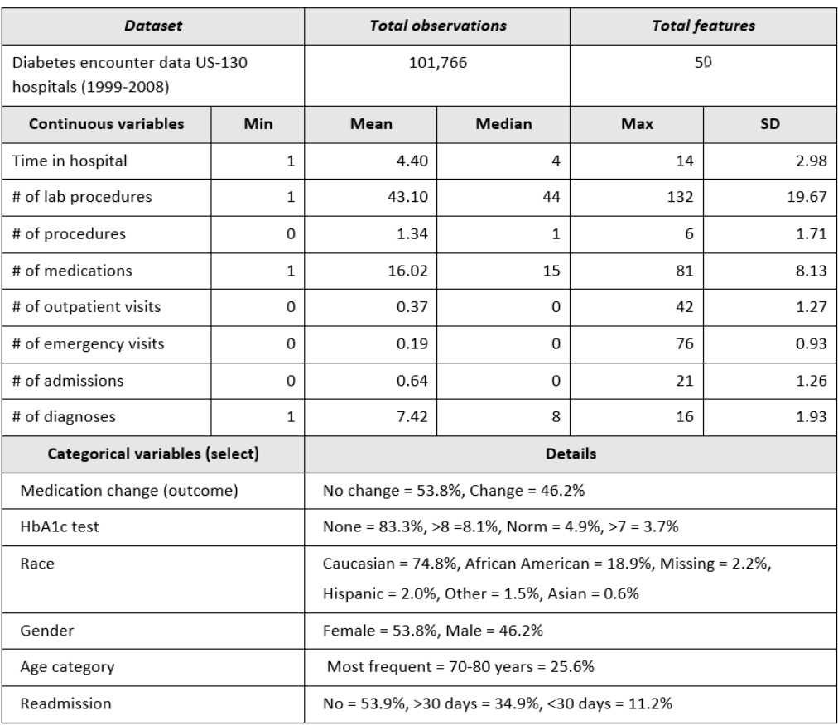
Data Exploration

Slide 6
Dealing with missing values
Based on our research and the background paper, we have found that
Weight attribute with 97% missing value was considered to be too sparse and thus was not included in further analysis.
Payer code attribute with over 50% missing values was not considered relevant to the outcome, and thus was removed as well.
Medical specialty attribute has over 50% missing data.
Therefore, these three attributes were dropped.
References:
“Impact of HbA1c Measurement on Hospital Readmission Rates: Analysis of 70,000 Clinical Database Patient Records,” BioMed Research International, vol. 2014, Article ID 781670, 11 pages, 2014.
https://medium.com/berkeleyischool/how-to-use-machine-learning-to-predict-hospital-readmissions-part-2-616a0c920ab1

Slide 7
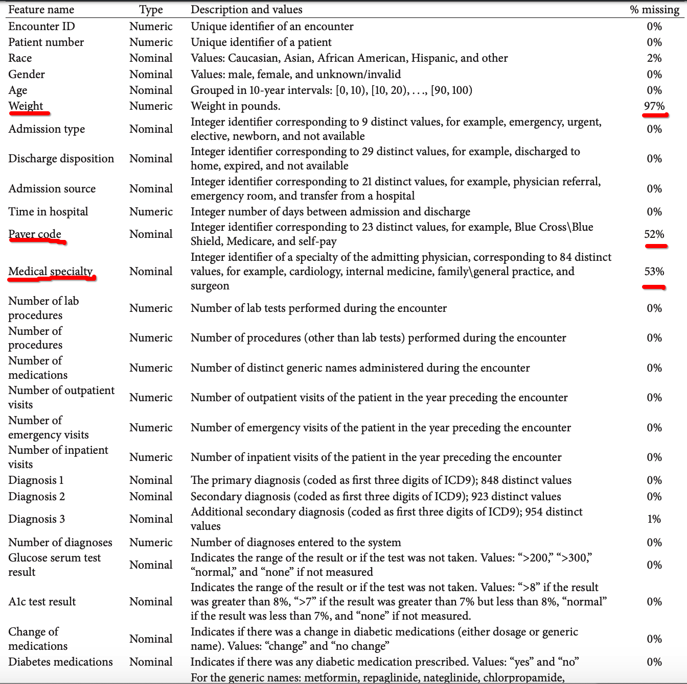

Slide 8
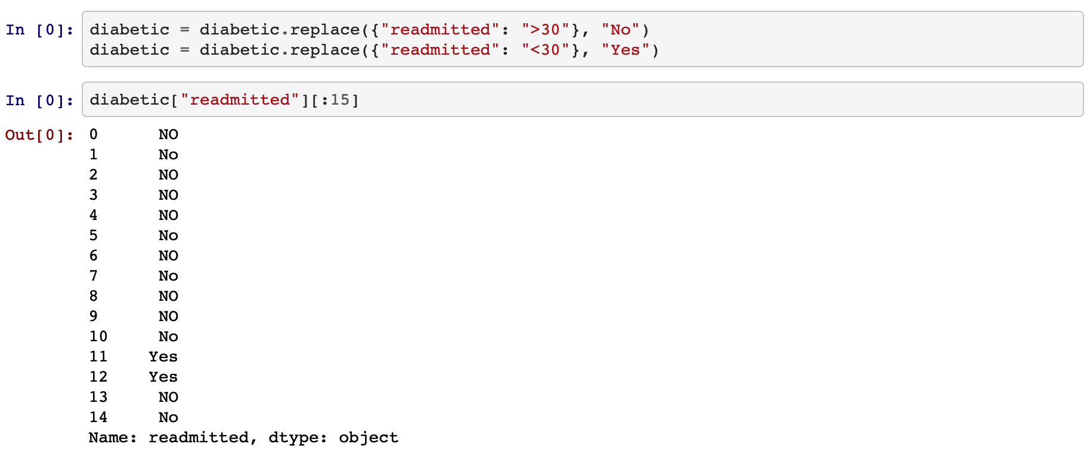
Since we are primarily interested in factors that lead to early readmission, we defined the readmission attribute (outcome) as having two values: “readmitted,” if the patient was readmitted within 30 days of discharge or “otherwise,” which covers both readmission after 30 days and no readmission at all.

Slide 9
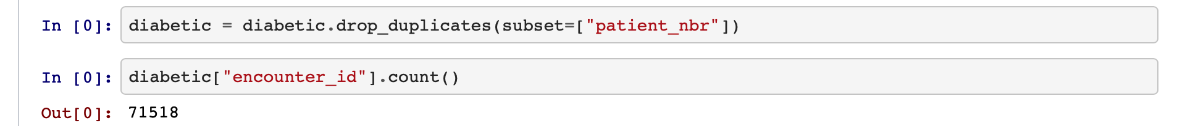
We thus used only one encounter per patient; in particular, we considered only the first encounter for each patient as the primary admission and determined whether or not they were readmitted within 30 days.
Now we have 71518 distinctive patients records without same patients that have multiple visit records.

Slide 10
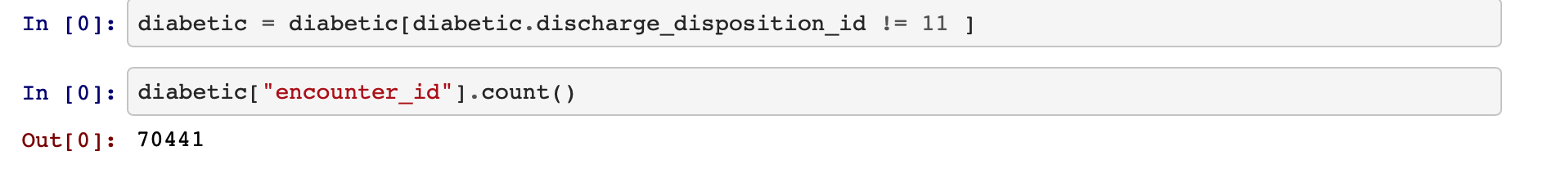
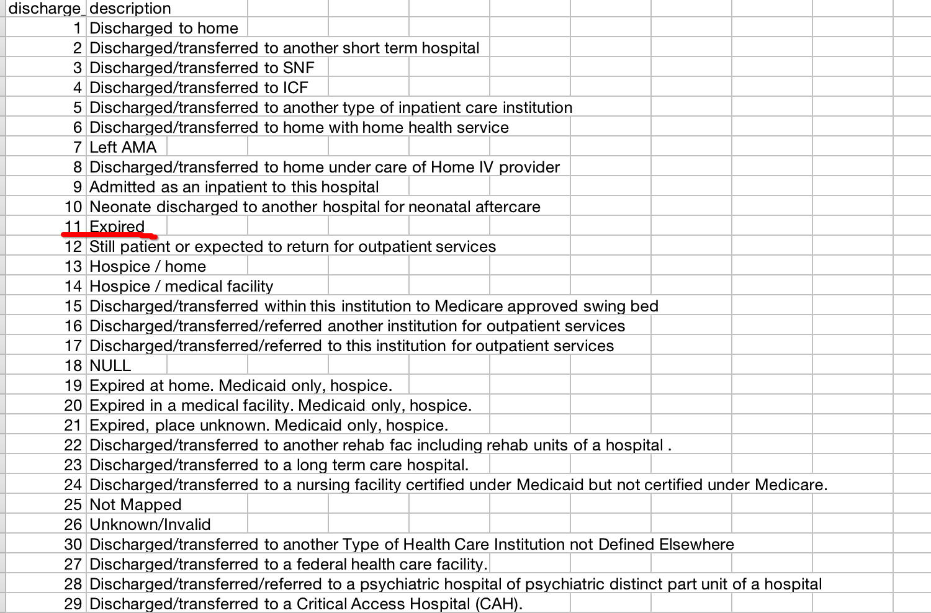
Then we drop rows that indicates the patient was deceased (ID = 11) which will not be readmitted.
IDs_mapping.csv

Slide 11
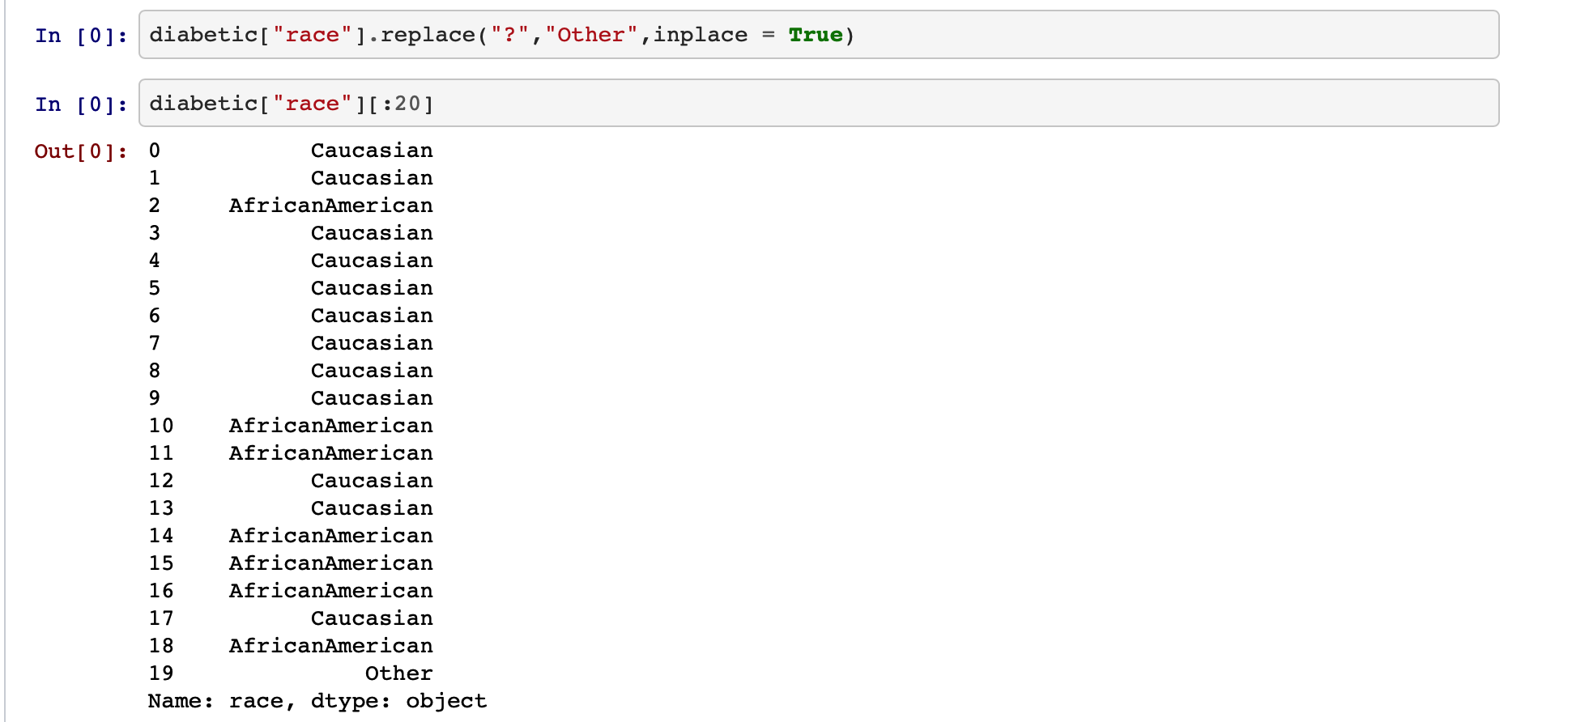
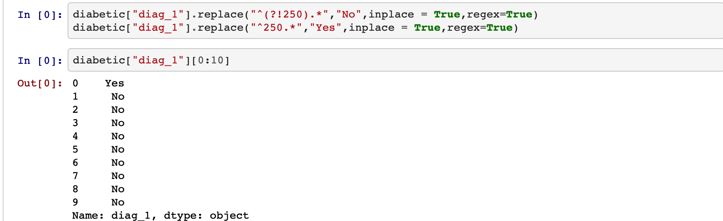
Also we'll need to make a decision on other columns which has small amount of missing data, including "diag_1" <0.1%, "diag_2" 0.3%, "diag_3" 1.3%.
Since this project is only targeting the diabetes here which has value as 250.xx. All values other than this tag will be tagged as 'No' while all diagnosed as diabetes will be tagged as 'Yes'.
.
Next, from the background paper of table 1, we can know there are 2% missing data at Race feature. So we filled with "Other".

Slide 12
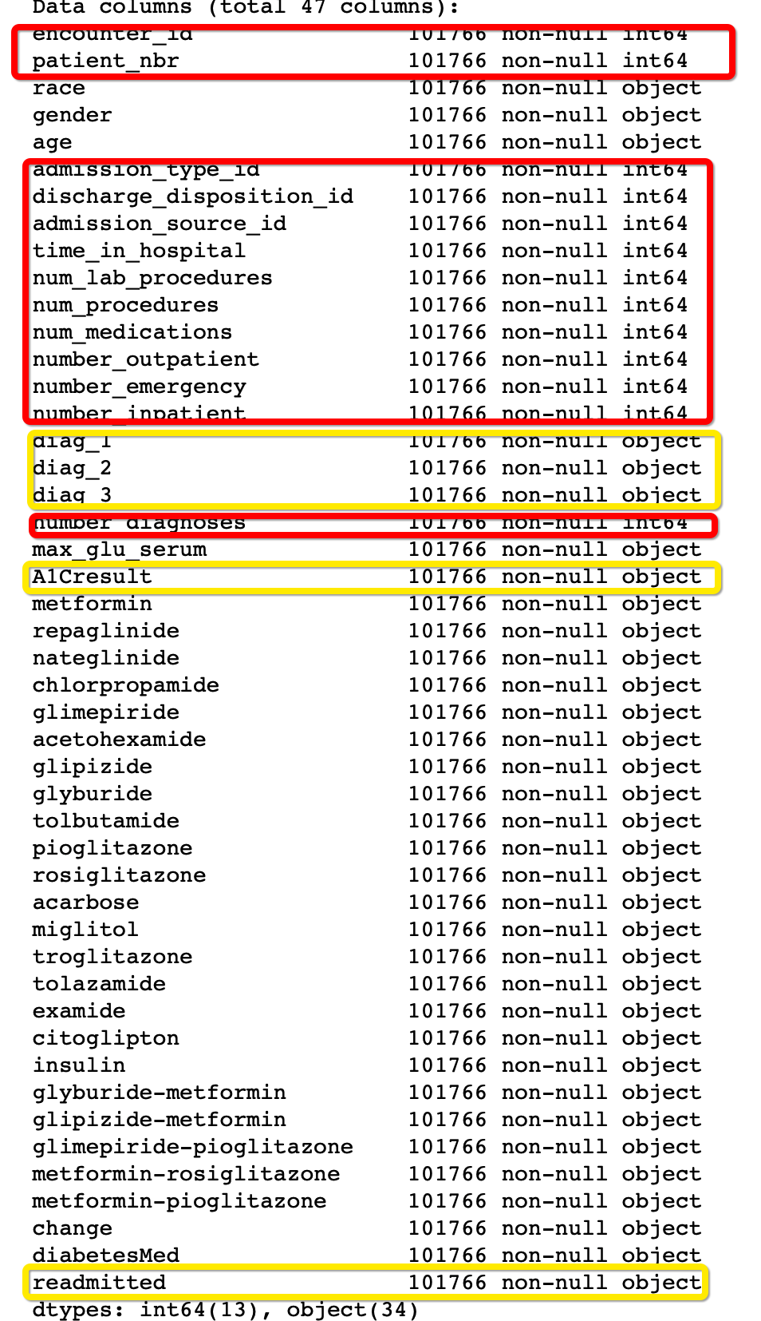
Numerical Features
The easiest type of features to use is numerical features. (Red)
These features do not need any modification.

Slide 13
Categorical Features
In order to perform machine learning algorithms, we need to transform categorical features into numeric values. OneHotEncoder() is useful and convenient method to do so. However, there are two downsides of this method.
The data was transformed to NumPy array, therefore lost its headers.
The categorical values were transform to vector arrays, and the length of this vector array depends on the the number of distinct categorical values.
In practice, after splitting the training set and the testing set, the number of attributes of training set is different from the number of attributes of the testing set due to the disperse distribution of the values.

Slide 14
Therefore, the categorical attributes were treated in 2 different ways.
23 features for 23 drugs (or combos) which indicate for each of these, whether a change in that medication was made or not during the current hospital stay of patient were dropped due to low correlations with readmitted and diagnoses for diabetes.
11 features were transformed into numerical values manually, including:
Diag_1, Diag_2, Diag_3 (Label)
Readmitted (Label)
Race
Age
Gender
Change
DiabetesMed
Max_glu_serum
A1Cresult

Slide 15
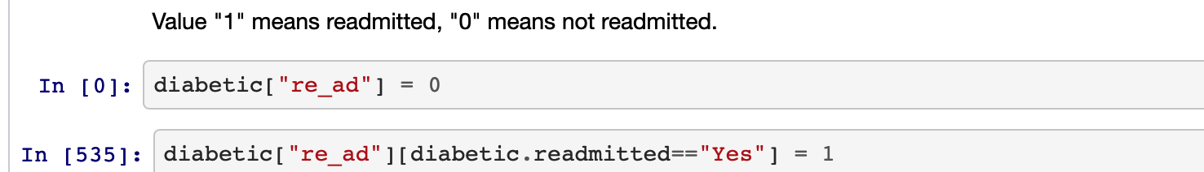
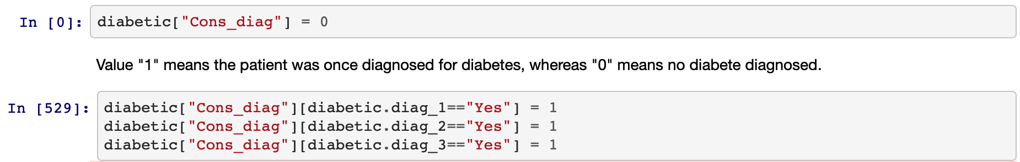
<1>diag_1/diag_2/diag_3 were consolidated into one attribute “Cons_diag”.
Since there are three diagnoses in the columns, here we unite these three columns into 1 when diagnosis of diabetes exist in one of the three. And convert it to be number. Value "1" means the patient was once diagnosed for diabetes, whereas "0" means no diabete diagnosed.
<2>readmitted

Slide 16
<3>A1Cresult.
After read about the background paper we know that the HbA1c is potentially highly related to the diagnoses for diabetes, here A1Cresult is transformed into numeric values.

Slide 17
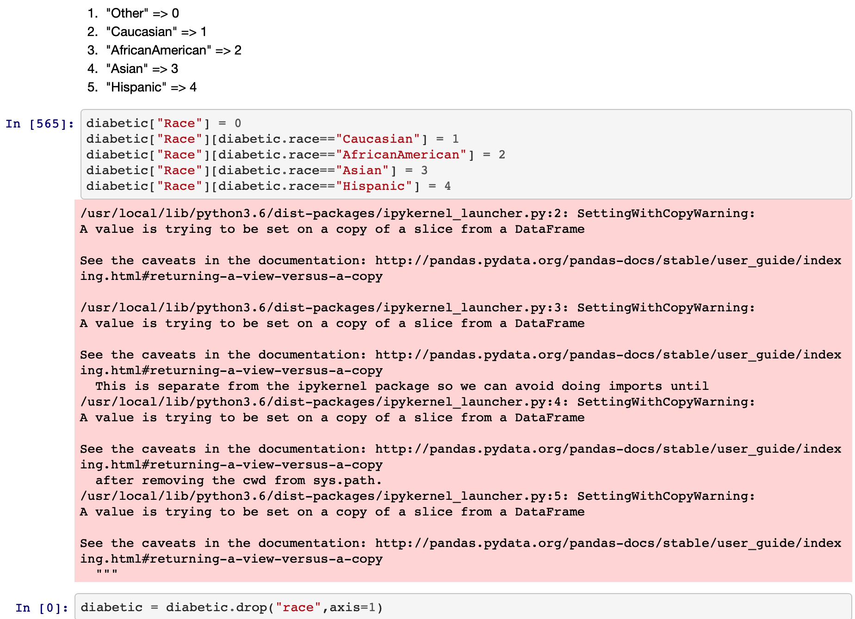
We manually transformed columns "race", "age", "max_glu_serum", "gender","change", "diabetesMed" into numeric data.

Slide 18
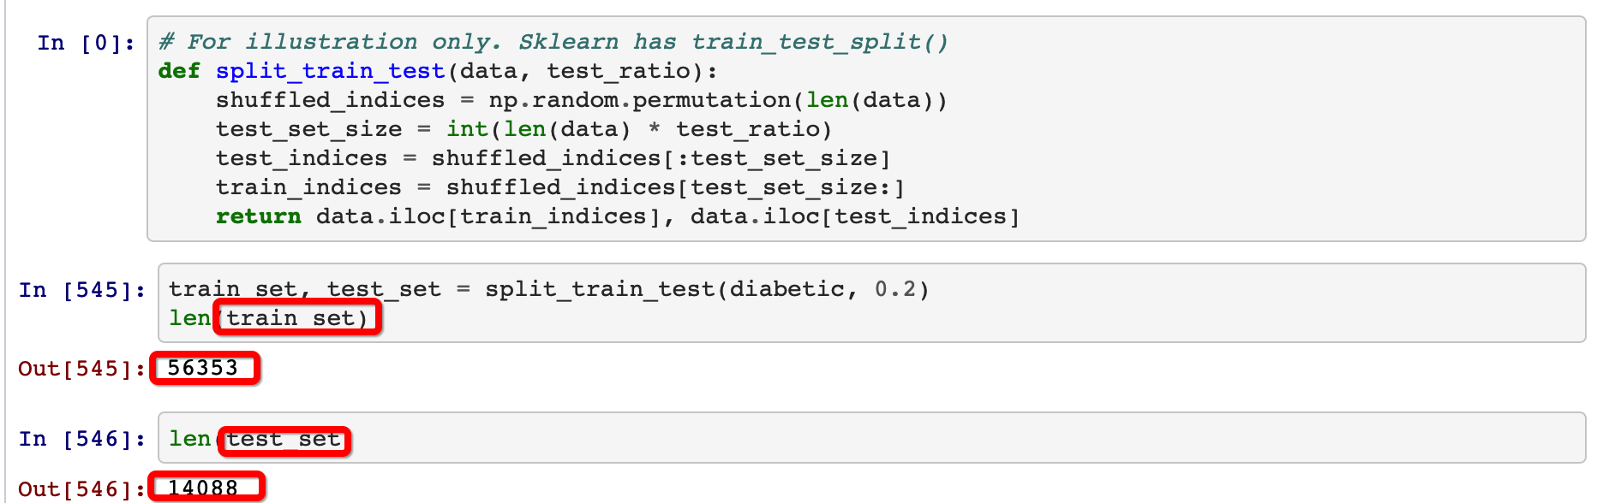
Data Preparation
Now, we can split the data into training and testing set

Slide 19
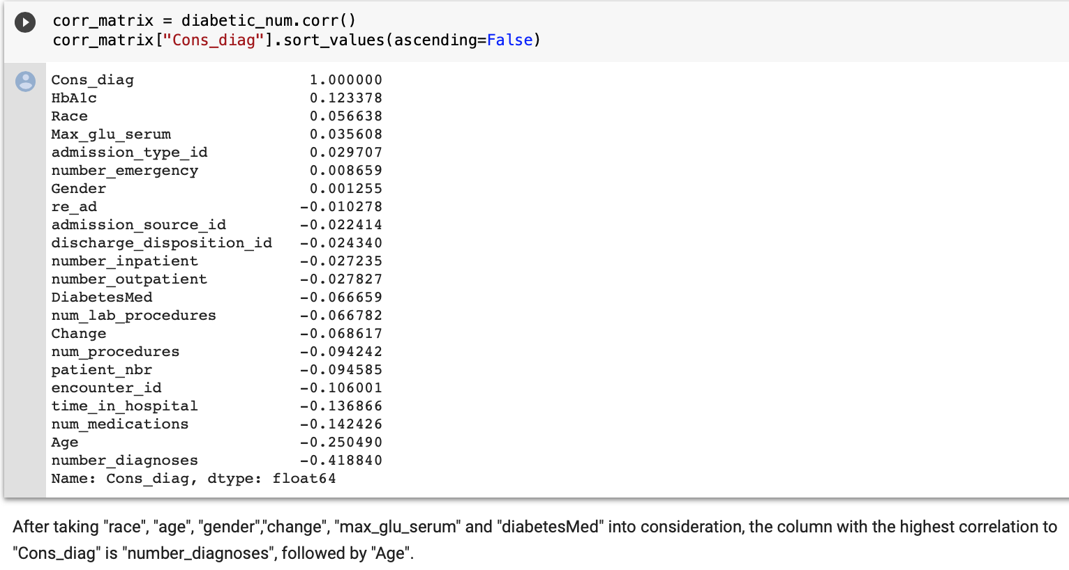
In order to find out which features have most influence on diagnosis of diabetes, we can use corr_matrix to get it.

Slide 20
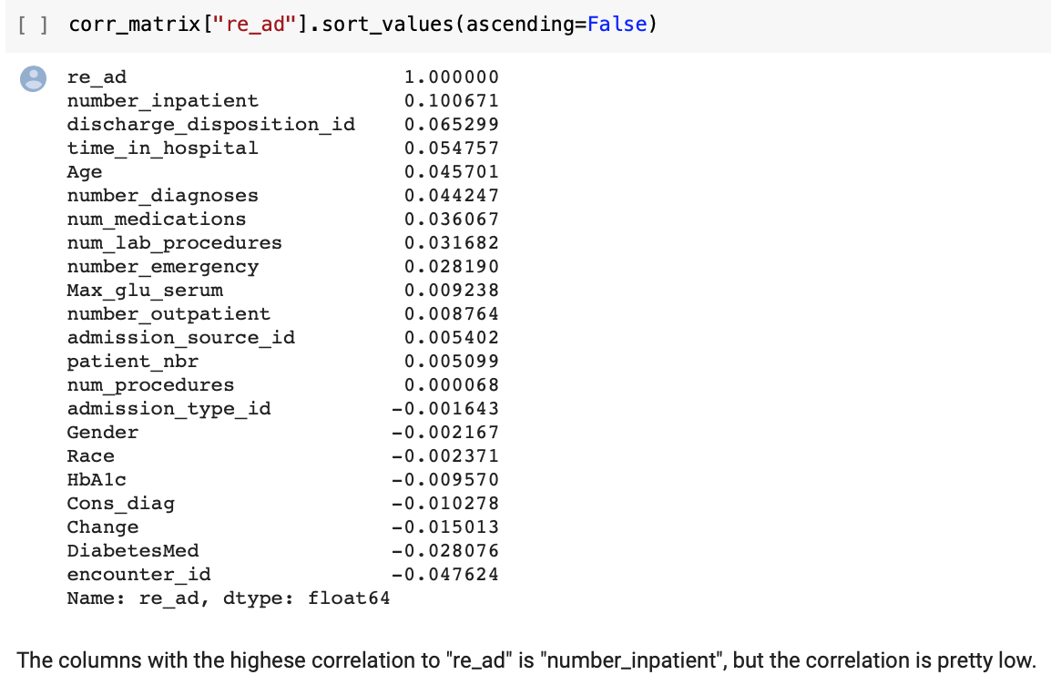
Now let’s find out which features have most influence on patients with diabetes or being readmitted.

Slide 21
Methodology
Random Forest
Linear SVM
SGD
NonLinear SVM(polynomial)

Slide 22
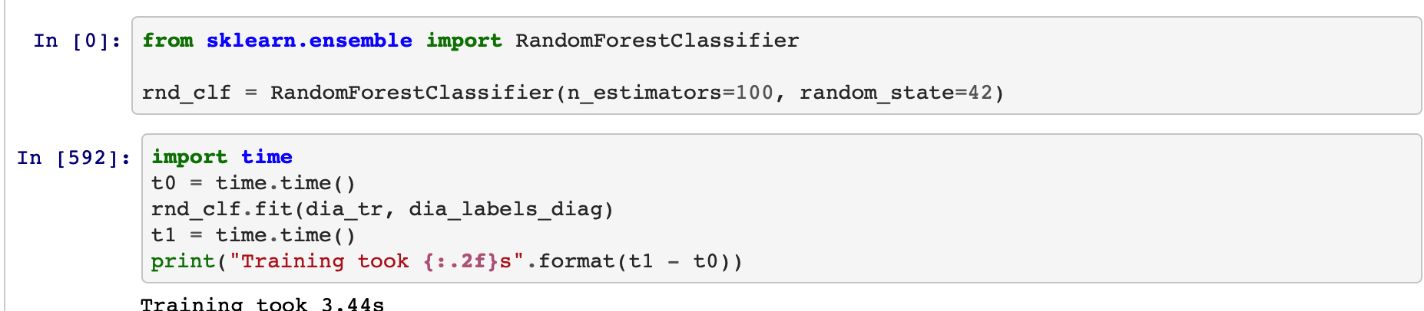
Random Forest
The Random Forest Classifier is an ensemble tree-based learning algorithm. It is a set of decision trees from randomly selected subset of training set.One disadvantage of decision trees is that they tend overfit very easily by memorizing the training data.
To fit random forests, we can use the following code.

Slide 23
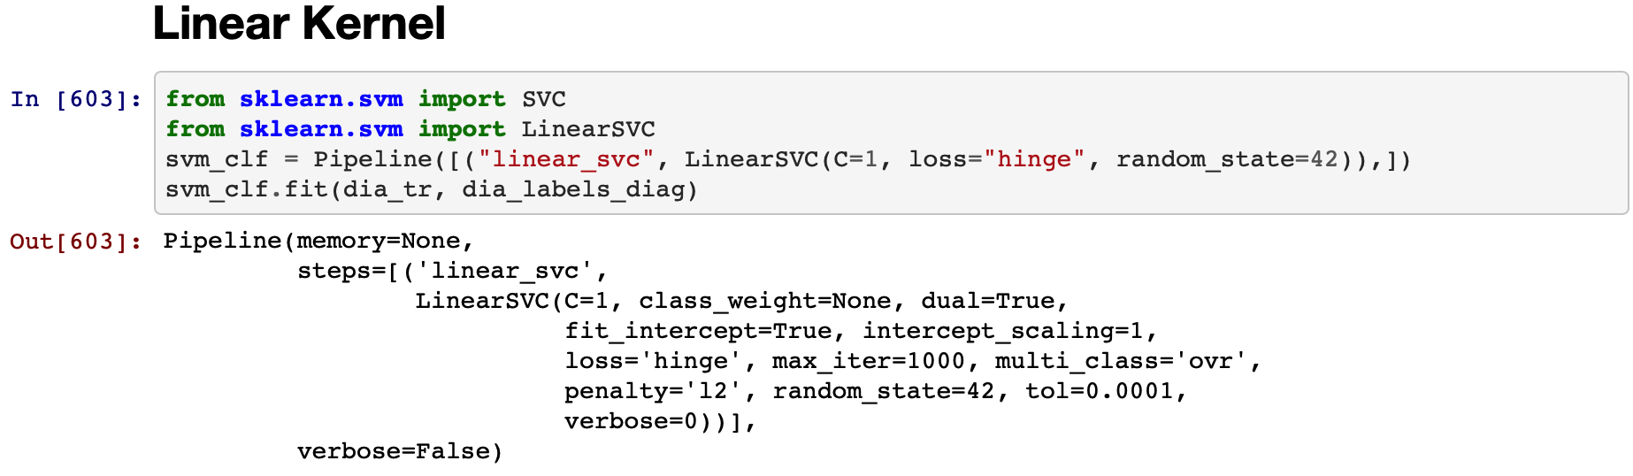
Linear SVM
In machine learning, support-vector machines are supervised learning models with associated learning algorithms that analyze data used for classification and regression analysis.
To fit SVM, we can use the following code.

Slide 24
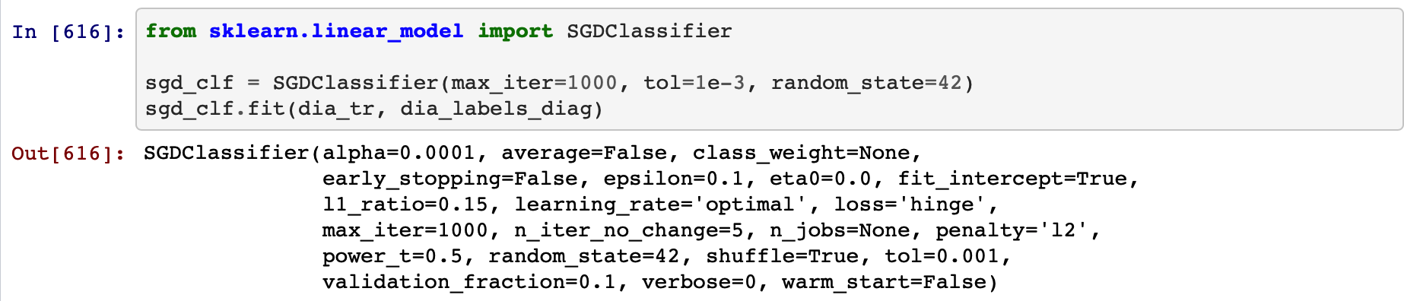
SGD
Stochastic gradient descent is a methods use gradient descent to optimize the coefficients of a linear function. All data samples are used at each iteration whereas in stochastic gradient descent only a small batch of samples is used.
We can fit stochastic gradient descent using the following code from scikit-learn.

Slide 25
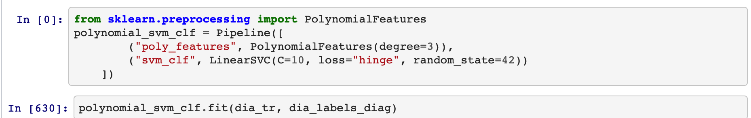
NonLinear SVM(polynomial)
Polynomial Regression is a form of linear regression in which the relationship between the independent variable x and dependent variable y is modeled as an nth degree polynomial.
To fit Polynomial Regression, we can use the following code.

Slide 26
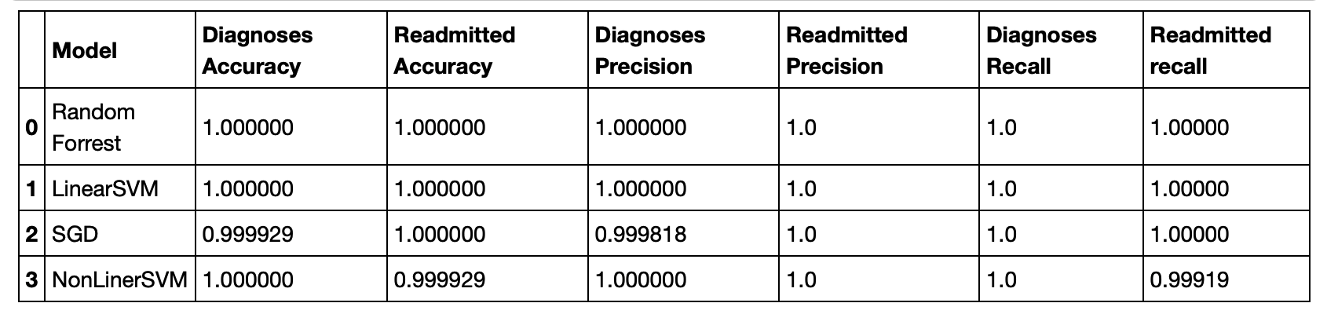
Performance Comparison

Slide 27
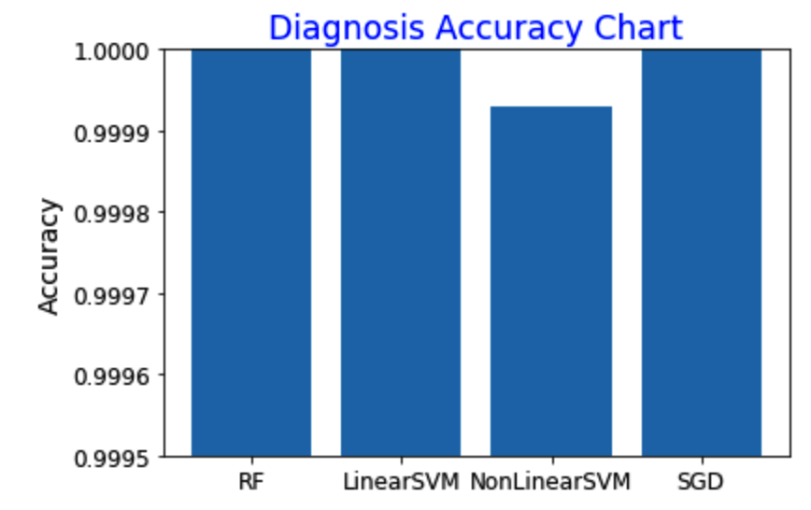
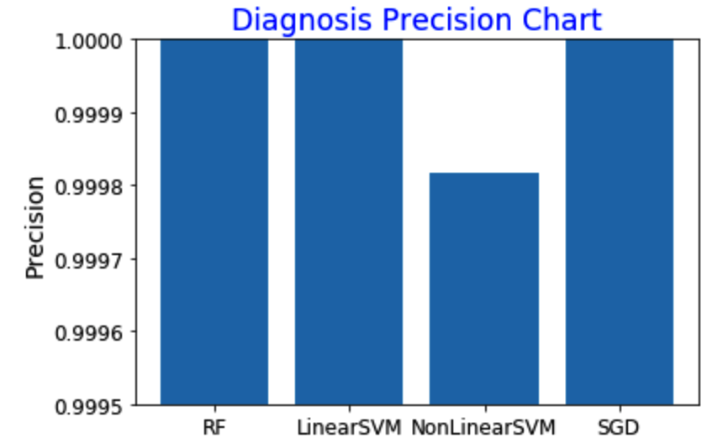
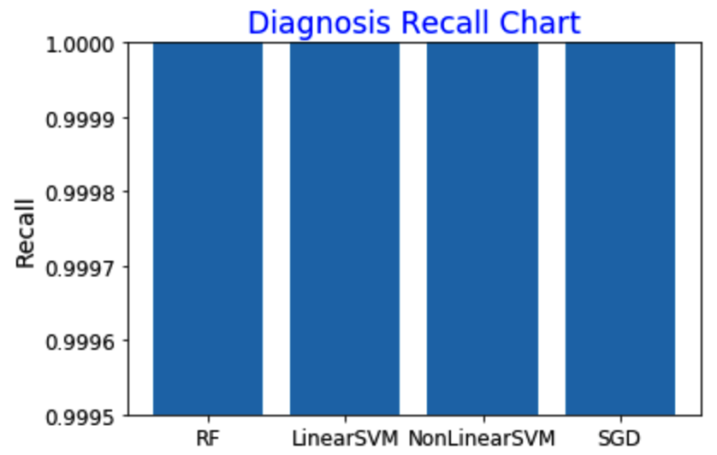
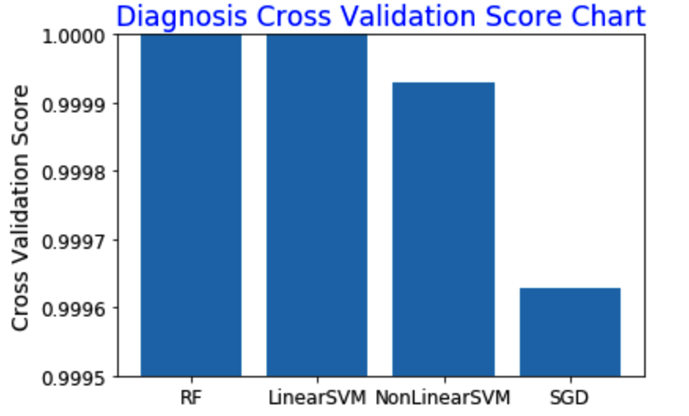
Performance Comparison

Slide 28
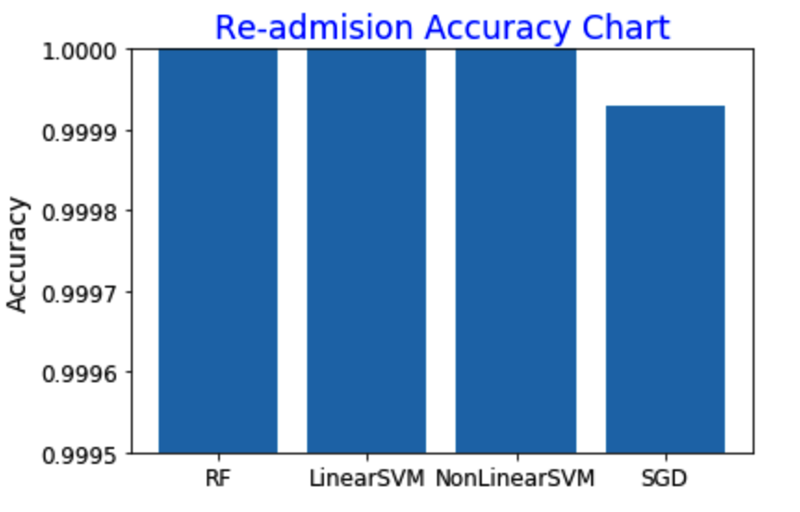
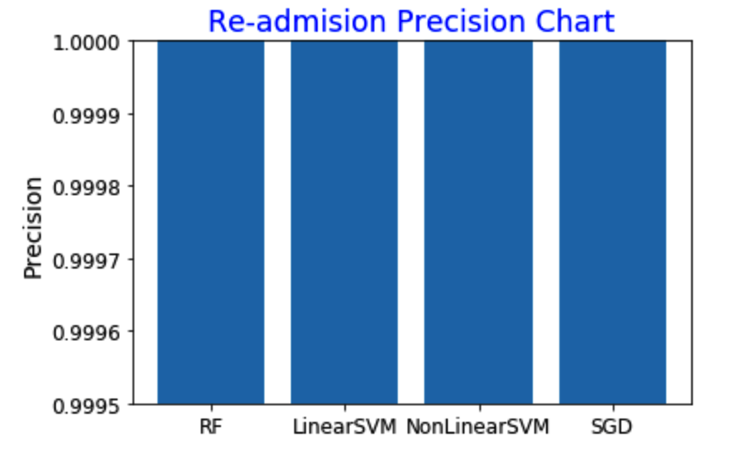
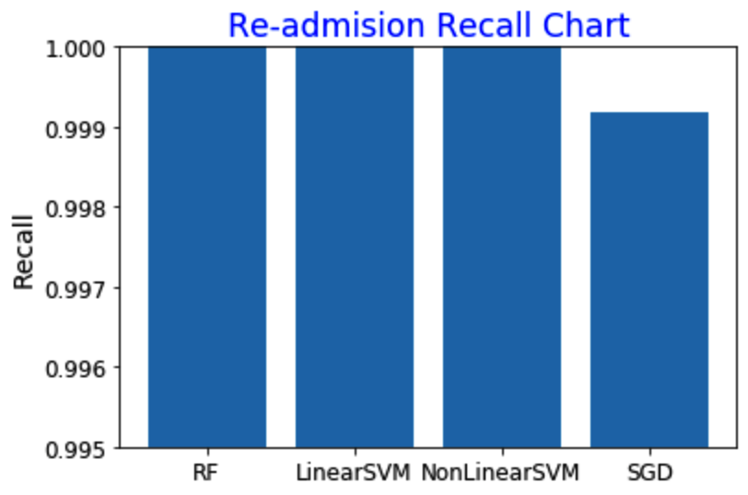
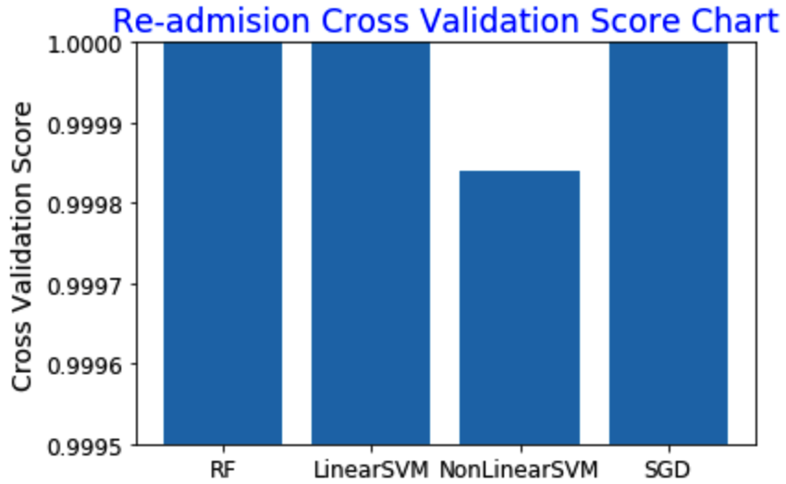
Performance Comparison

Slide 29
Discussion
Instead of using OneHotEncode() method, some categorical attributes were transformed into numeric values manually which introduce a new created variance that is the distance between each categorical value which does not exist in the origin dataset.
Similar to other 3 research papers, the differences and the range of these manly created value distance is arbitrary and there is no consensus could be reached in any way. In addition, these distance created by each researcher regarding on their own understanding of the data will be inevitably diluted by the scaling.

Slide 30
Discussion
Difference from all 3 research paper we have references from, we consolidate the diagnoses of diabetes with all three diagnoses trails, instead of just the primary diagnoses.
In authors’ understanding, no matter in which trail of diagnoses, a patient is valid for either one of these diagnoses is confirmed, therefore the consolidated data will present the whole population much more accurately.
In this practice, 23 attributes of drugs (or combos) were dropped due to low correlations with labels from previous research.
From the high prediction rate (99.9%) in this practice, it is confirmed that these ways of data cleaning and preparation is reasonable and effective compare to other researchers’ comparatively low accuracy (from 60% - 90%).

Slide 31
References
“Impact of HbA1c Measurement on Hospital Readmission Rates: Analysis of 70,000 Clinical Database Patient Records,” BioMed Research International, vol. 2014, Article ID 781670, 11 pages, 2014.
https://medium.com/berkeleyischool/how-to-use-machine-learning-to-predict-hospital-readmissions-part-2-616a0c920ab1
https://towardsdatascience.com/predicting-hospital-readmission-for-patients-with-diabetes-using-scikit-learn-a2e359b15f0?gi=ee36db827308

Slide 32
Thank you!

