Slide 1

Pixel Brightness Transformation
Computer Engineering Department
Faculty of Engineering
Cairo University
Image Processing & Computer Vision - CMP(N)446
Image Processing & Computer Vision

Slide 2
Quiz Time

Slide 3
Lab
Pixel Brightness Transformation

Slide 4
Required
You are required to implement functions that apply the following transformations to images:
Negative Transformation
Contrast Enhancement (Linear Transform)
Gamma Correction
Histogram Equalization

Slide 5
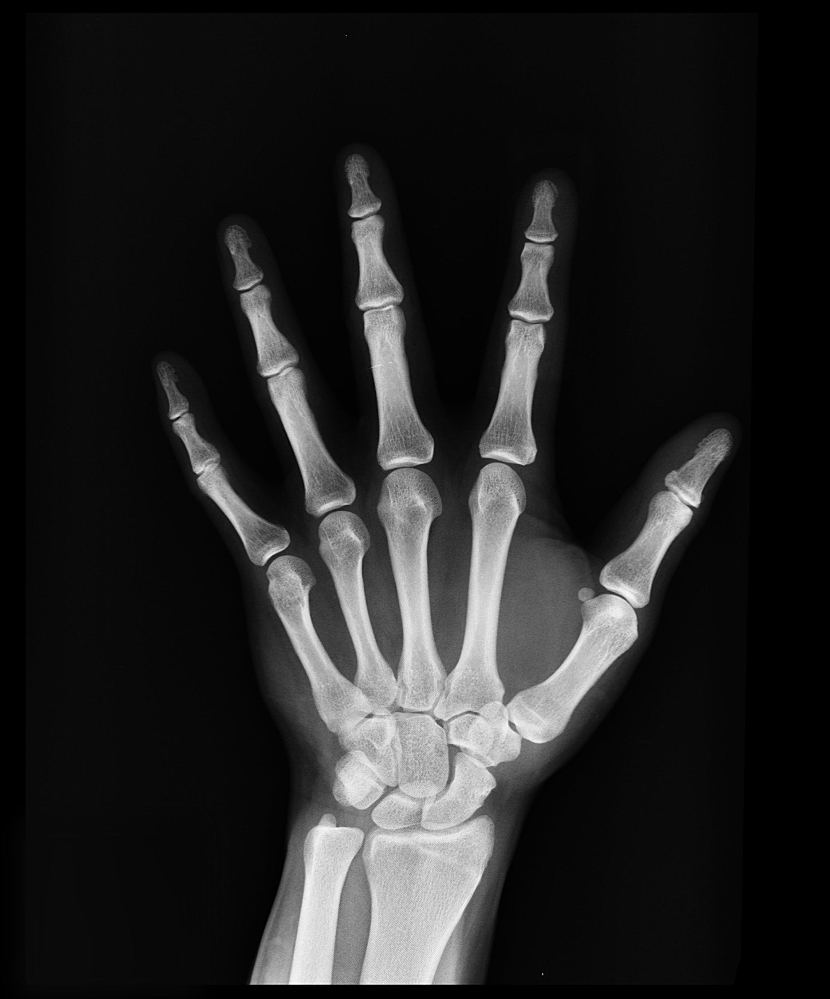
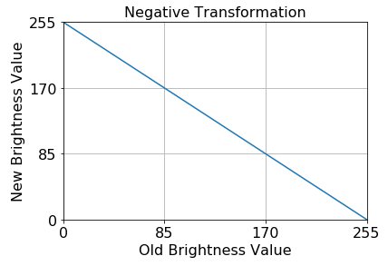
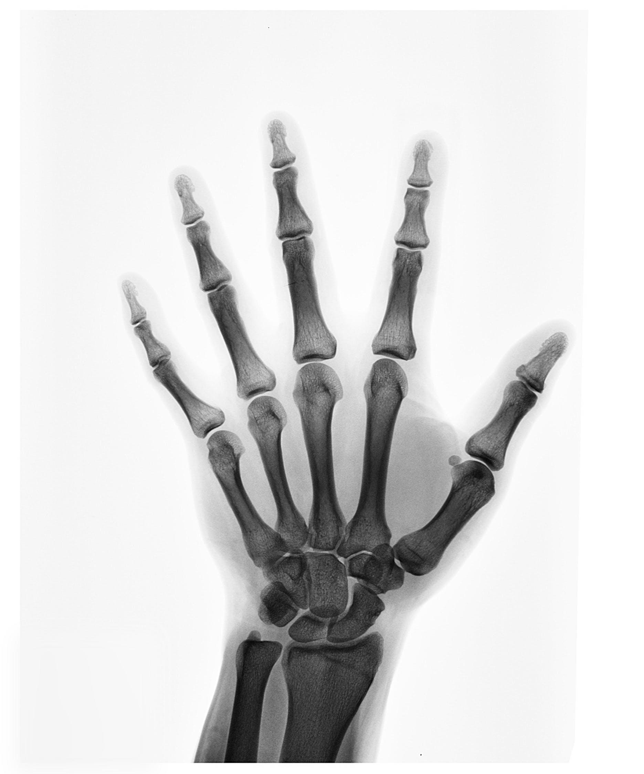
Part 1: Negative Transformation
Purpose: Enhances viewing white regions embedded in dark regions
Transform

Slide 6
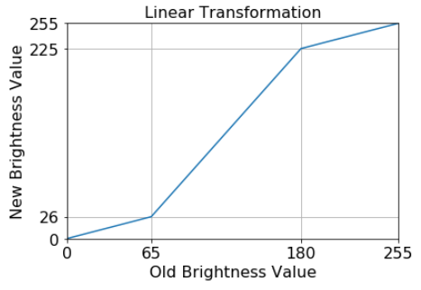

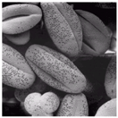
Part 2: Contrast Enhancement (Linear Transform)
Transform

Slide 7
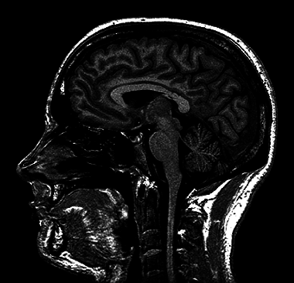
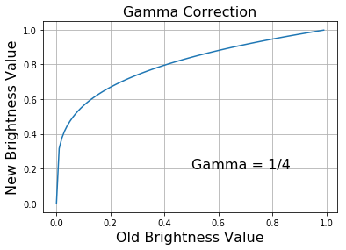
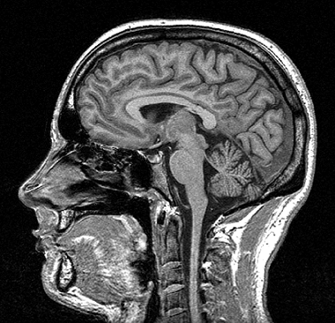
Part 3: Gamma Correction
Transform

Slide 8

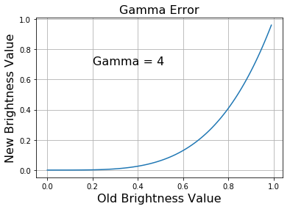
Part 3: Gamma Correction
Transform

Slide 9
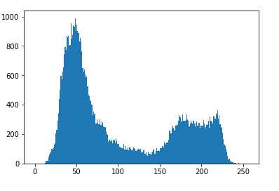
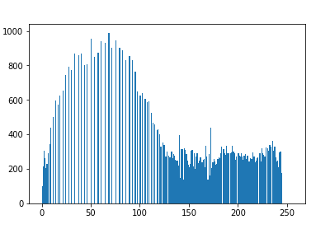
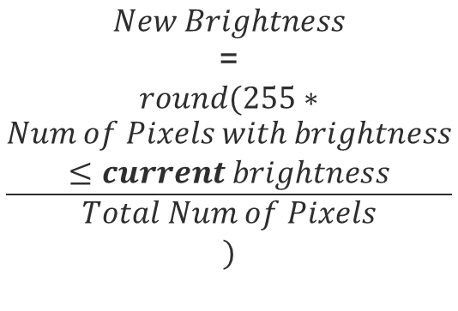
Part 4: Histogram Equalization
$$New Brightness$$
=
$$round(255∗$$
$$\frac{\begin{aligned}Num of Pixels with brightness \\ ≤current brightness\end{aligned}}{\begin{aligned}Total Num of Pixels \\ )\end{aligned}}$$
Transform

