Slide 1
Coordinate Frames and Time Systems

Slide 2
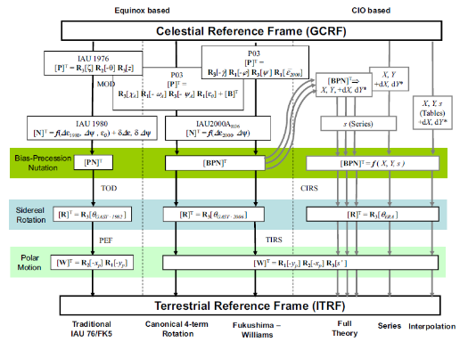
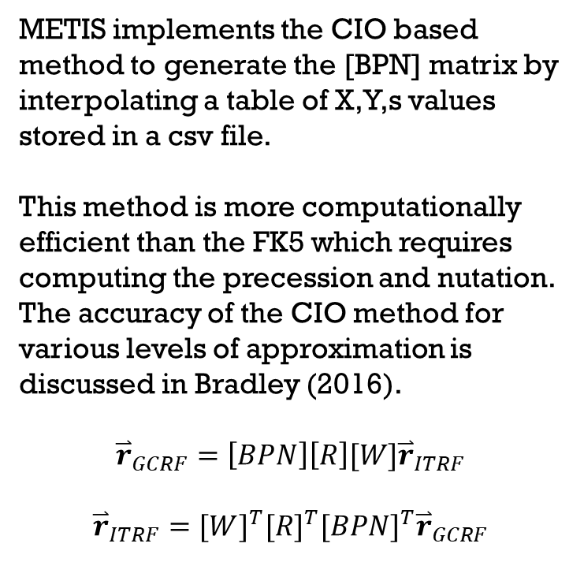
GCRF/ITRF Transformations
METIS implements the CIO based method to generate the [BPN] matrix by interpolating a table of X,Y,s values stored in a csv file.
This method is more computationally efficient than the FK5 which requires computing the precession and nutation. The accuracy of the CIO method for various levels of approximation is discussed in Bradley (2016).
$${\overset{⃑}{r}}_{GCRF}=\left[BPN\right]\left[R\right][W]{\overset{⃑}{r}}_{ITRF}$$
$${\overset{⃑}{r}}_{ITRF}={[W]}^{T}{[R]}^{T}{[BPN]}^{T}{\overset{⃑}{r}}_{GCRF}$$
GMAT
Image Credit: Vallado, 4th ed.

Slide 3
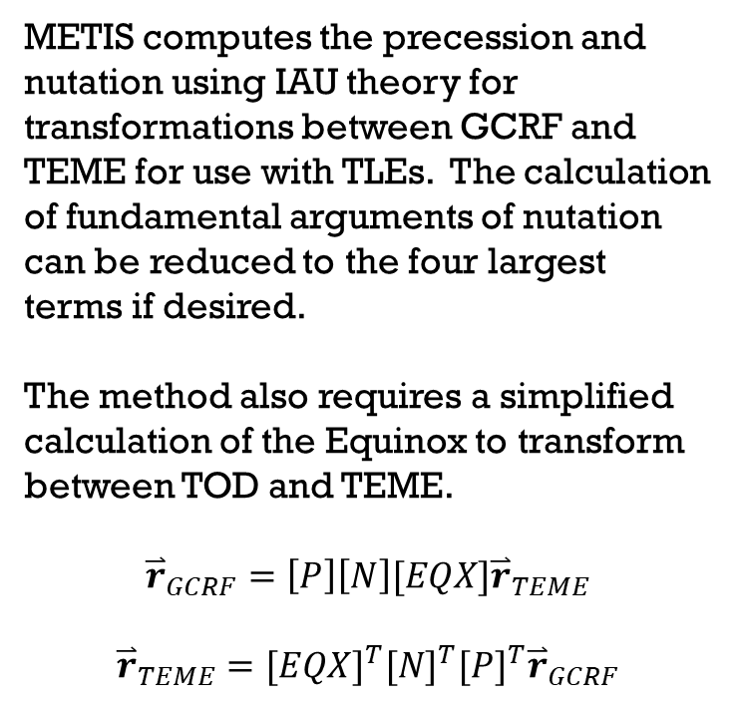
GCRF/TEME Transformations
METIS computes the precession and nutation using IAU theory for transformations between GCRF and TEME for use with TLEs. The calculation of fundamental arguments of nutation can be reduced to the four largest terms if desired.
The method also requires a simplified calculation of the Equinox to transform between TOD and TEME.
$${\overset{⃑}{r}}_{GCRF}=\left[P\right]\left[N\right][EQX]{\overset{⃑}{r}}_{TEME}$$
$${\overset{⃑}{r}}_{TEME}={[EQX]}^{T}{[N]}^{T}{[P]}^{T}{\overset{⃑}{r}}_{GCRF}$$
GMAT
Image Credit: Vallado, 4th ed.

Slide 4
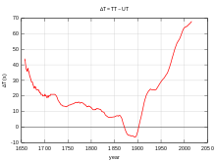
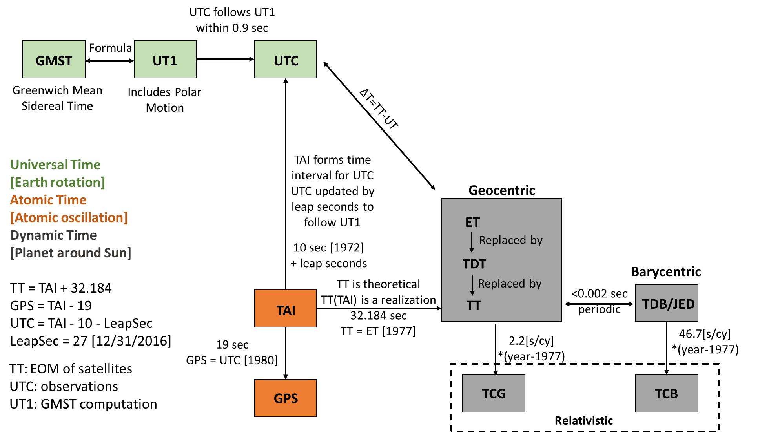
Time systems

Slide 5
Time systems
Calculation of precession and nutation terms, as well as sun/moon positions applies formulae based on dynamic time. METIS uses Terrestrial Time (TT) for these calculations.
Meeus “Astronomical Algorithms” Ch 10 states the difference between TT and TDB is less than 0.0017 sec and therefore either time system can be applied interchangeably for most calculations.
McCarthy (1996) provides equations using TT.

Slide 6
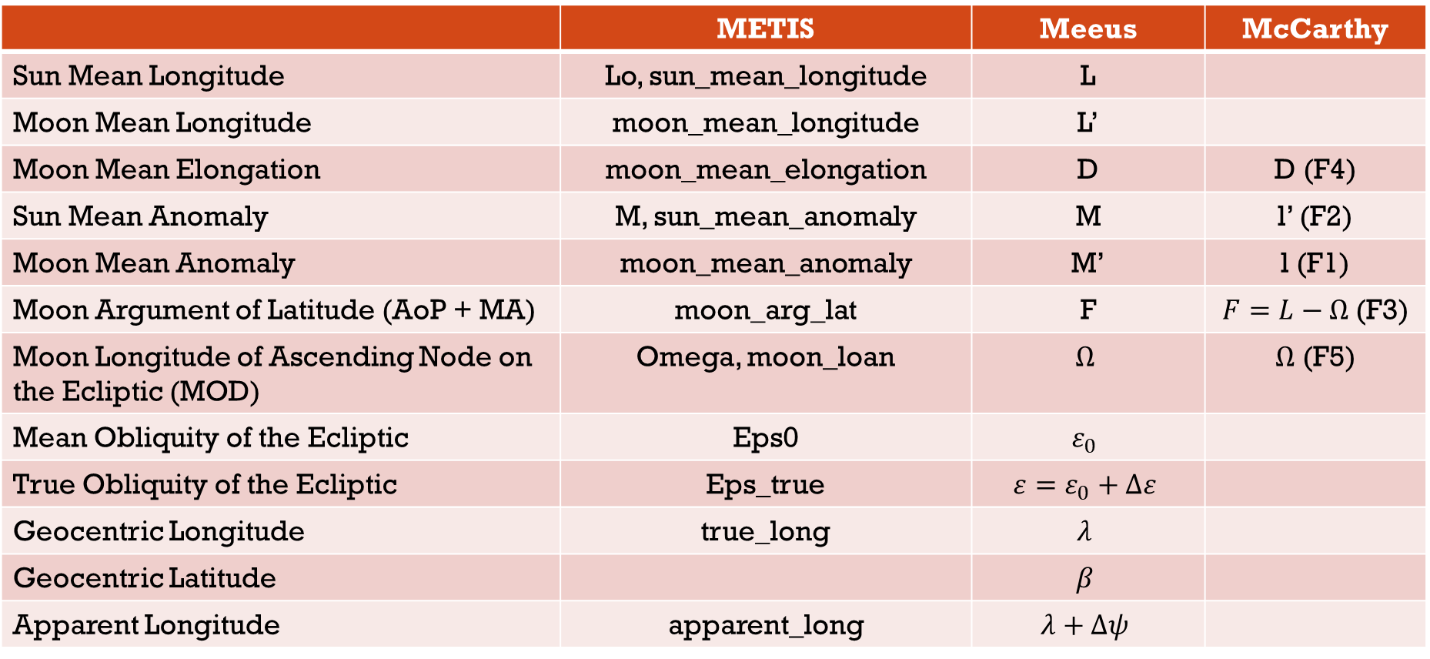
notation
Different sources apply different notation for Nutation Arguments, summarized in the table.
 | METIS | Meeus | McCarthy
Sun Mean Longitude | Lo, sun_mean_longitude | L
Moon Mean Longitude | moon_mean_longitude | L’
Moon Mean Elongation | moon_mean_elongation | D | D (F4)
Sun Mean Anomaly | M, sun_mean_anomaly | M | l’ (F2)
Moon Mean Anomaly | moon_mean_anomaly | M’ | l (F1)
Moon Argument of Latitude (AoP + MA) | moon_arg_lat | F | $F=L−Ω$ (F3)
Moon Longitude of Ascending Node on the Ecliptic (MOD) | Omega, moon_loan | $$Ω$$ | $Ω$ (F5)
Mean Obliquity of the Ecliptic | Eps0 | $$ε_{0}$$
True Obliquity of the Ecliptic | Eps_true | $$ε=ε_{0}+Δε$$
Geocentric Longitude | true_long | $$λ$$
Geocentric Latitude |  | $$β$$
Apparent Longitude | apparent_long | $$λ+Δψ$$

